Slide 1


GitHub: Guide
Techies Training Center
10th July 2018

Slide 2

https://github.com/

Slide 3
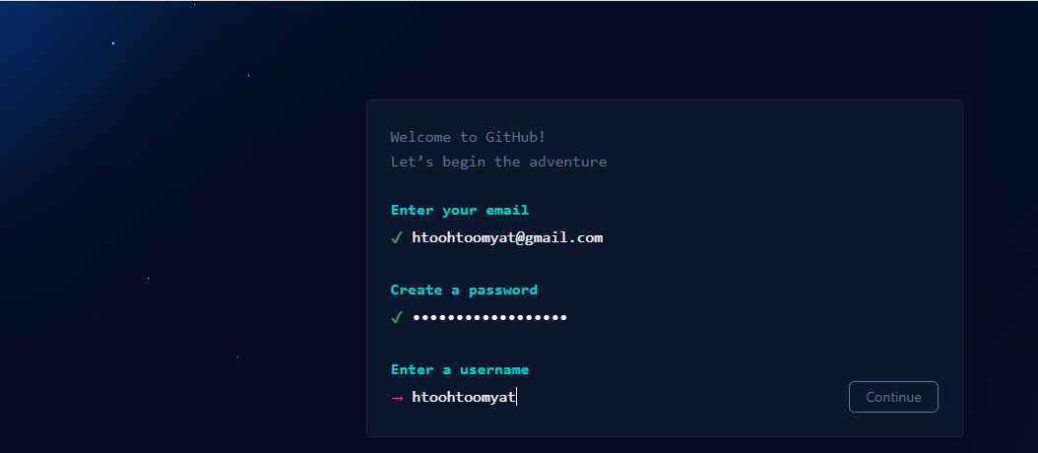
Create account

Slide 4
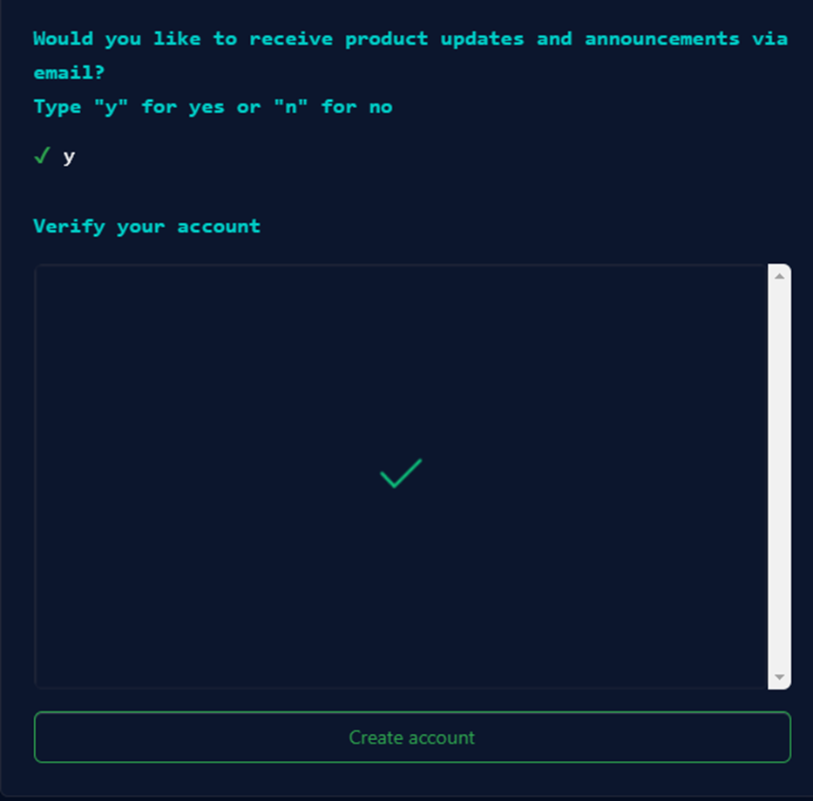

Slide 5
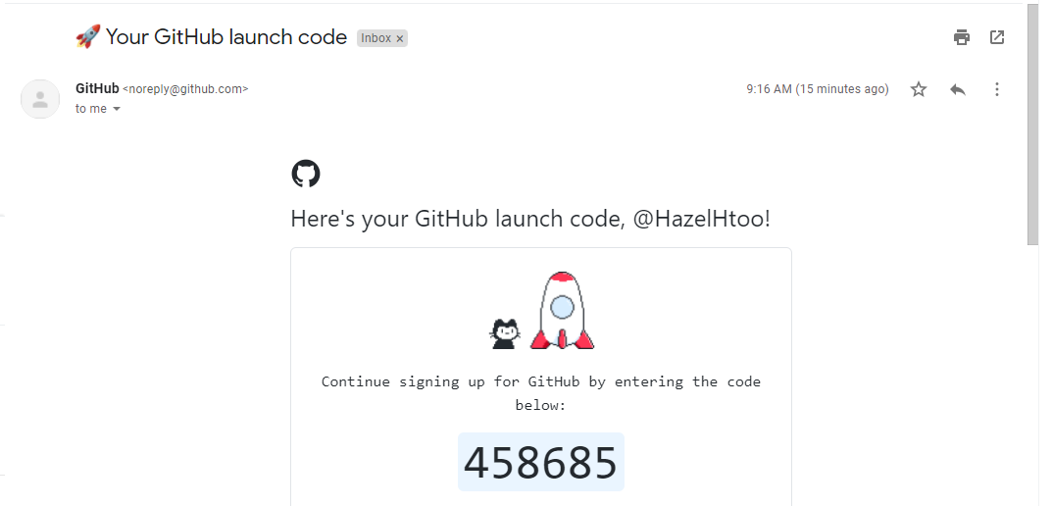
Get code at your email

Slide 6
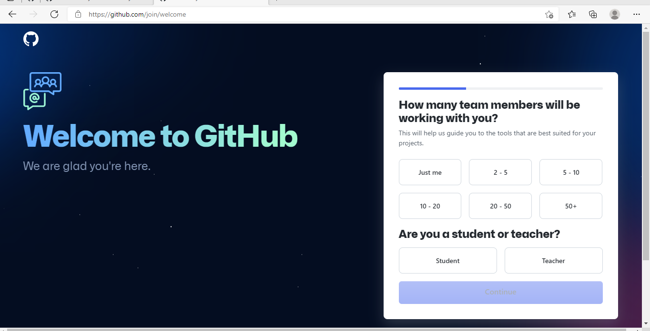
# Click Continue

Slide 7


# Click Continue

Slide 8
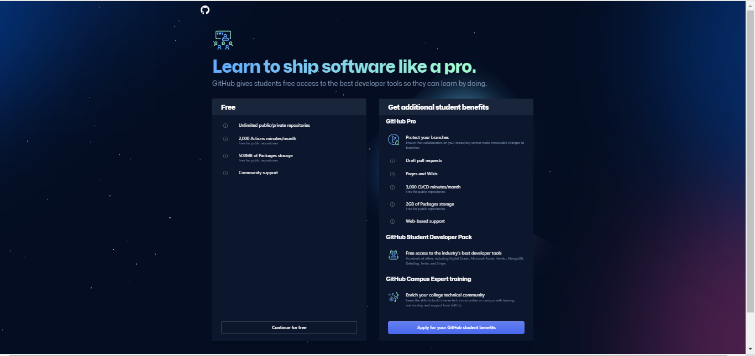

Slide 9
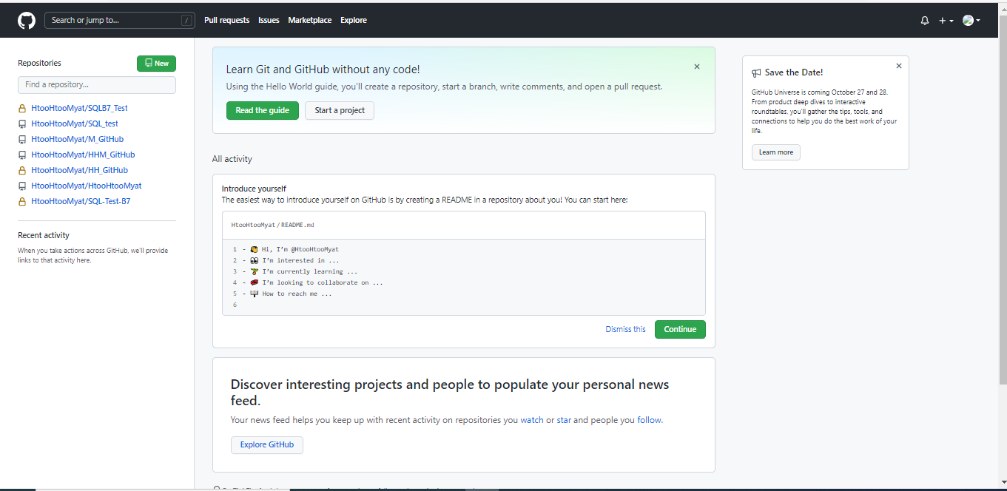
# Click New

Slide 10
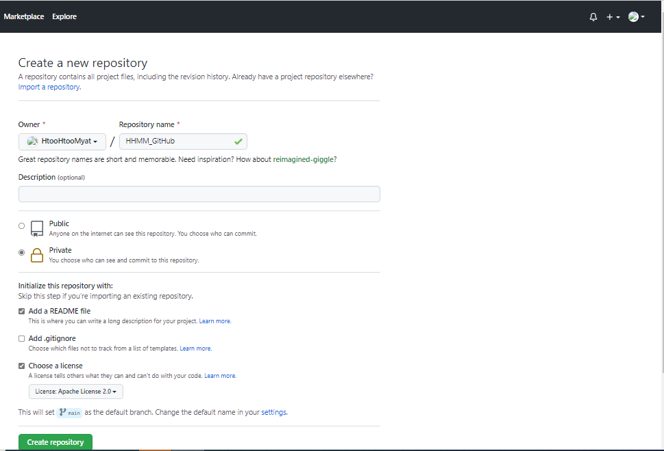
Create: New Repository
SQL_B7Test

Slide 11
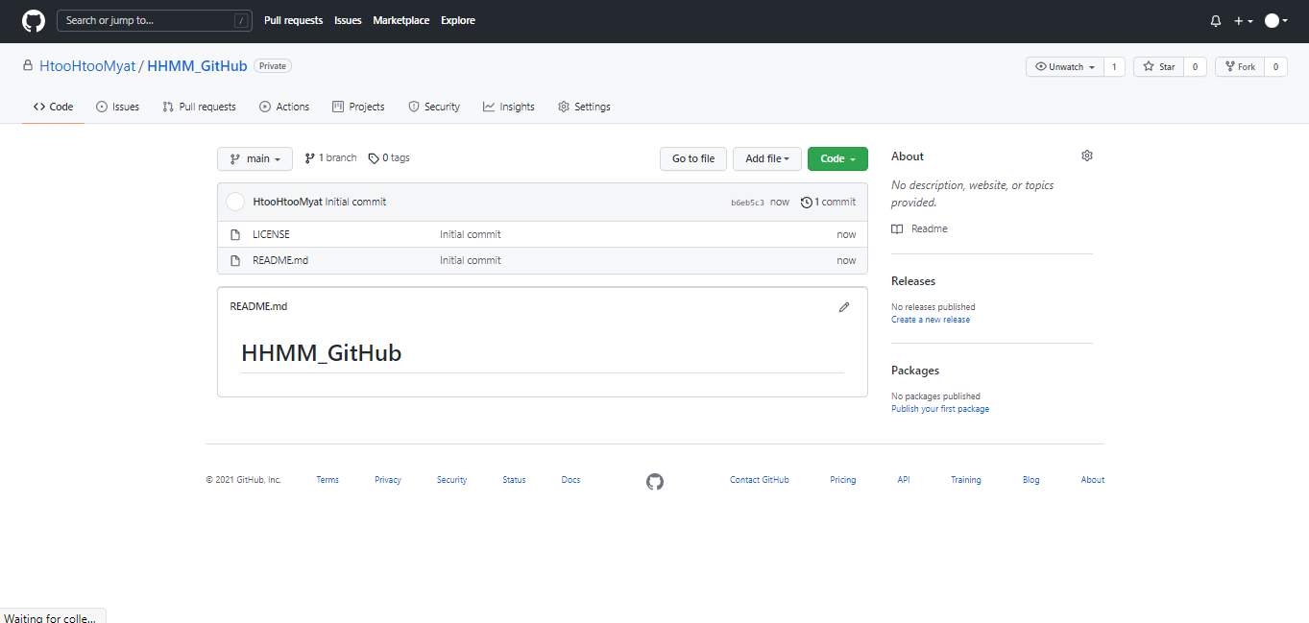

Open Oracle Sql Developer
Go to Code and click code and copy https:

Slide 12
Open Oracle Sql Developer

Slide 13

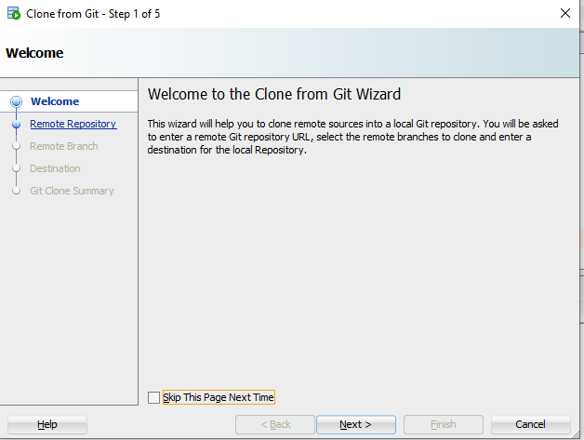
Click Team and choose Git and Clone
Click Next

Slide 14
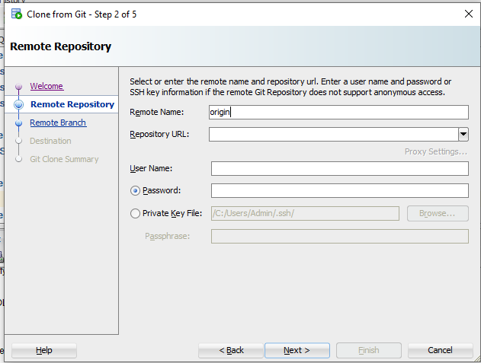

Slide 15
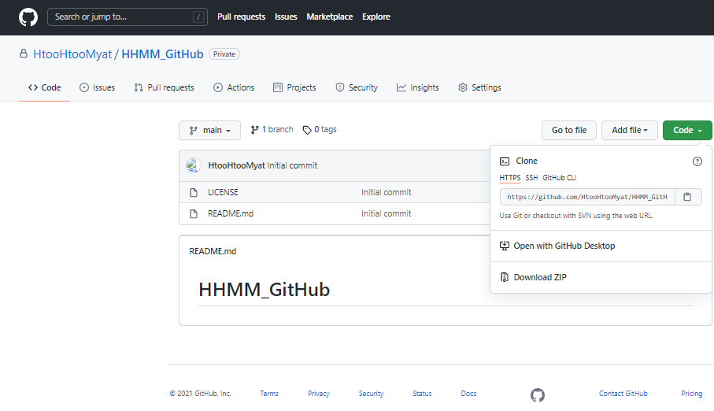
Go to GitHub and Copy : HTTPS link

Slide 16
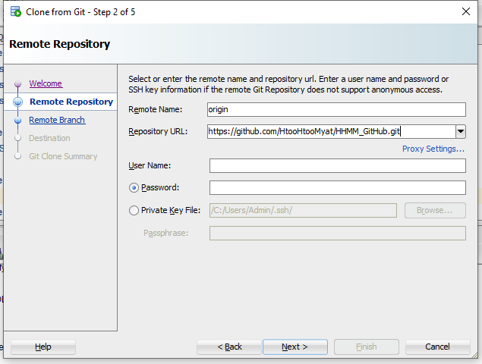
Paste: Repository URL:
Fill: User Name

Slide 17
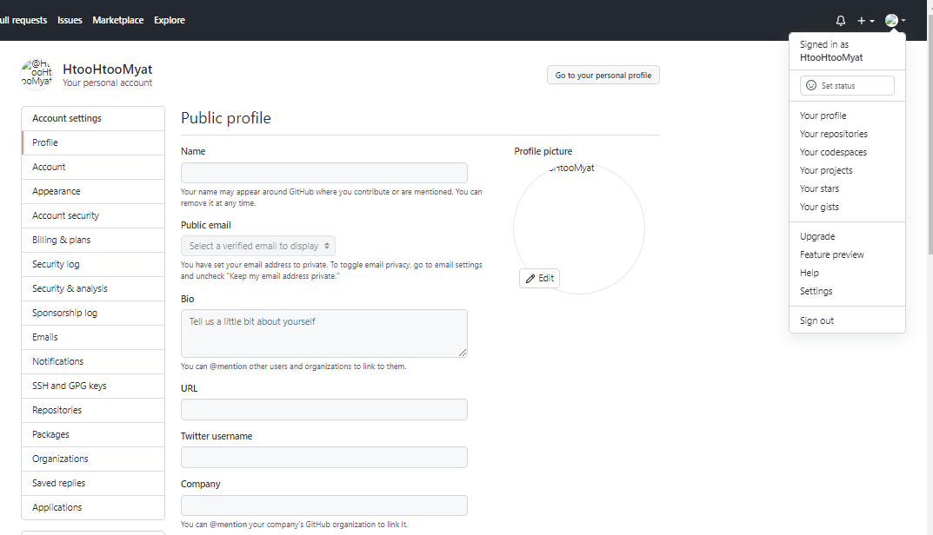
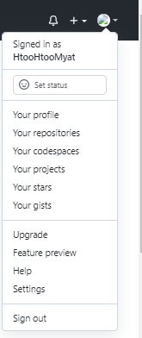
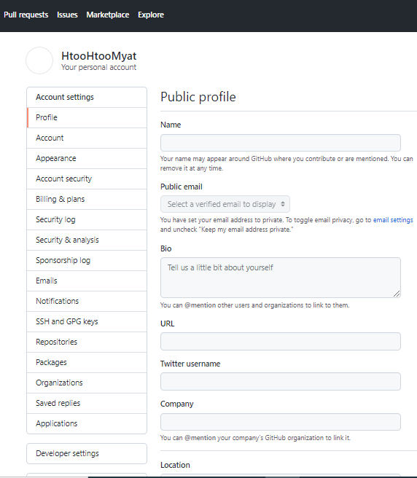
GubHub: Setting Choose: Developer Setting

Slide 18
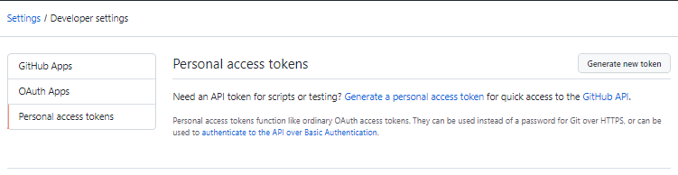
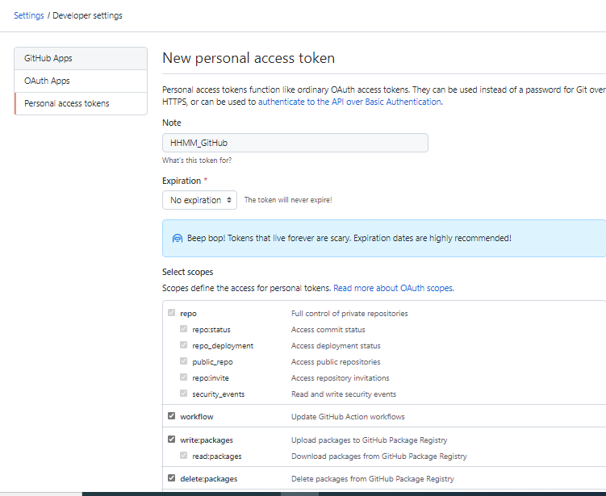
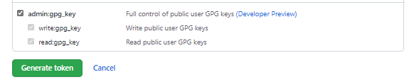
Choose: Personal access tokens and click Generate new token
Note: Name
Expiration:
Choose No Expiration
Select scopes: click mark in all
box
Choose: Generate token

Slide 19
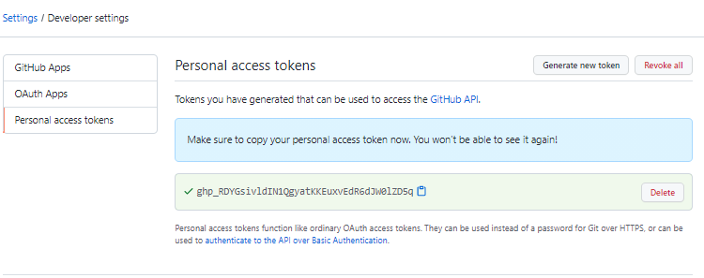
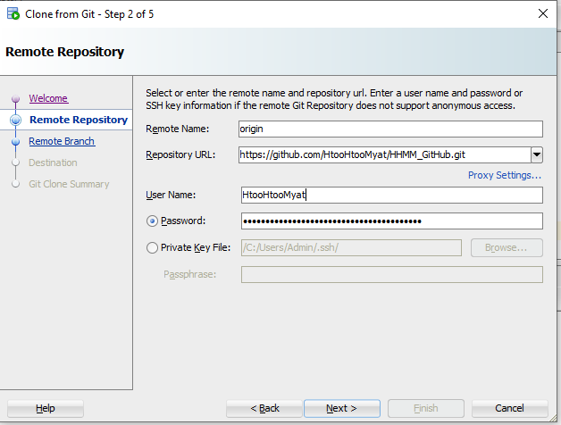
Click: Copy
Go to Oracle SQL Developer
To Paste the word that Copying from GitHub
Click: Next

Slide 20
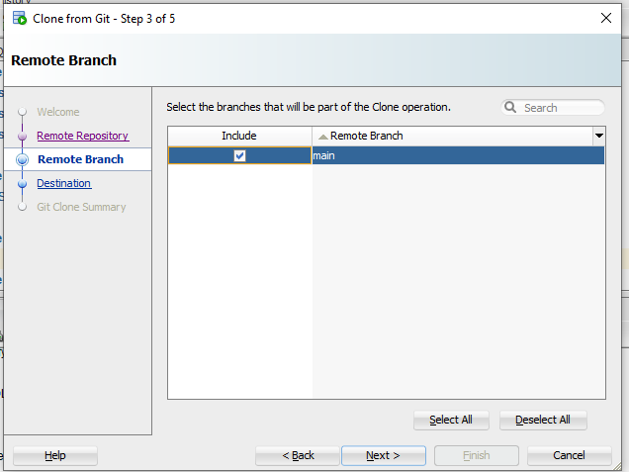
Click: Next

Slide 21
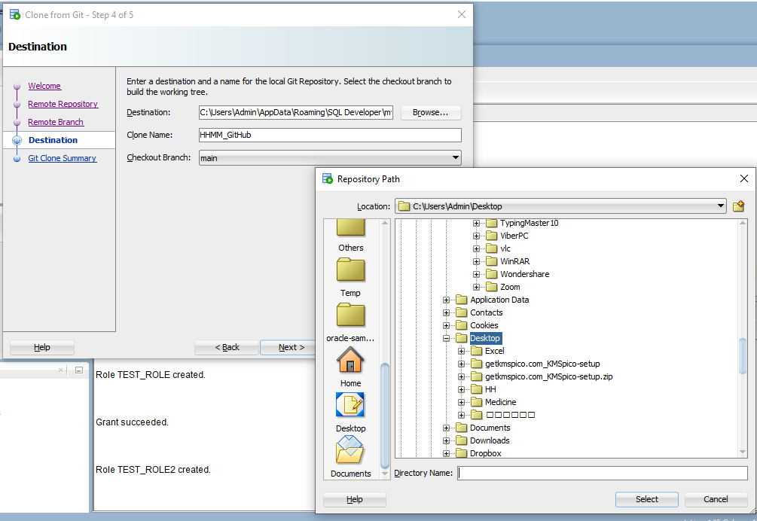
Click on Browse and Create the Path

Slide 22
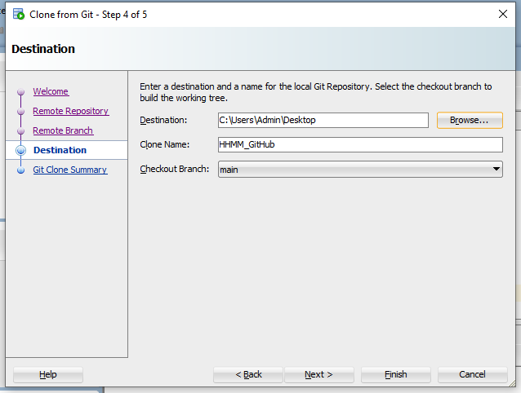
Click on Next

Slide 23
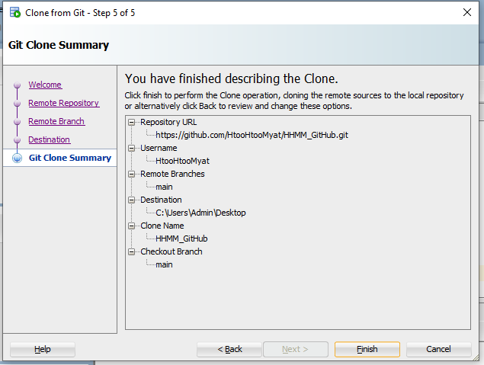
Click on finish

Slide 24
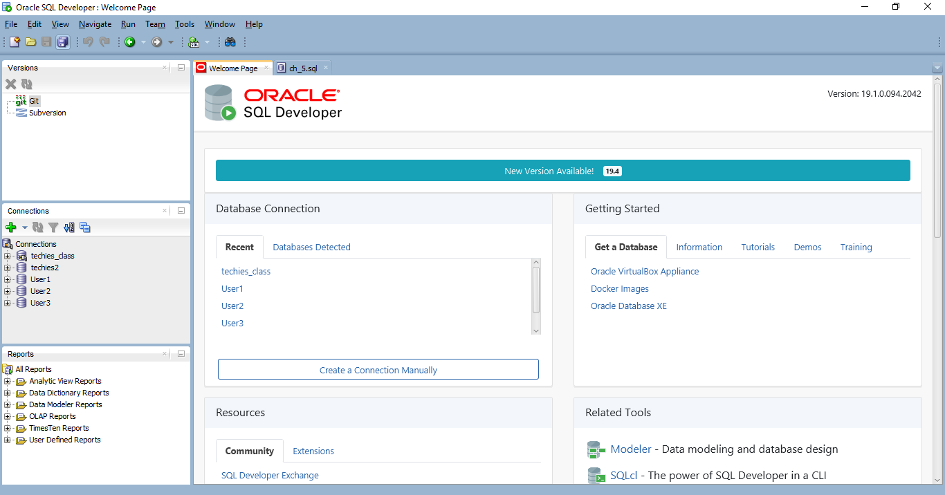

Slide 25
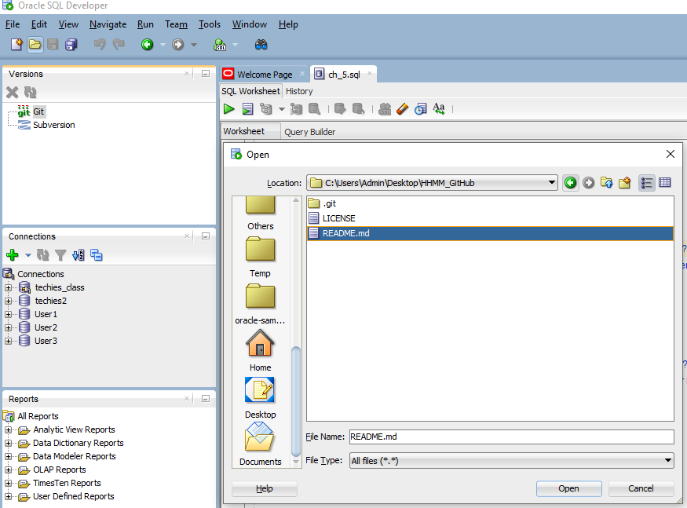
Click: Open/ Choose the folder on desktop that you create
Open Readme.md

Slide 26
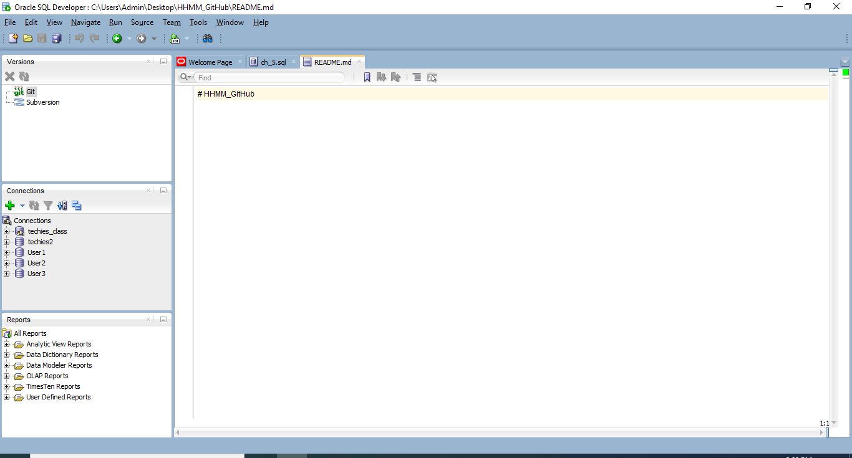
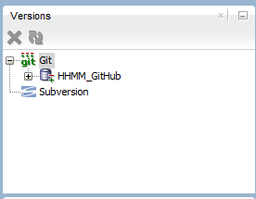
Right click on it and then show or change the Git + sign

Slide 27
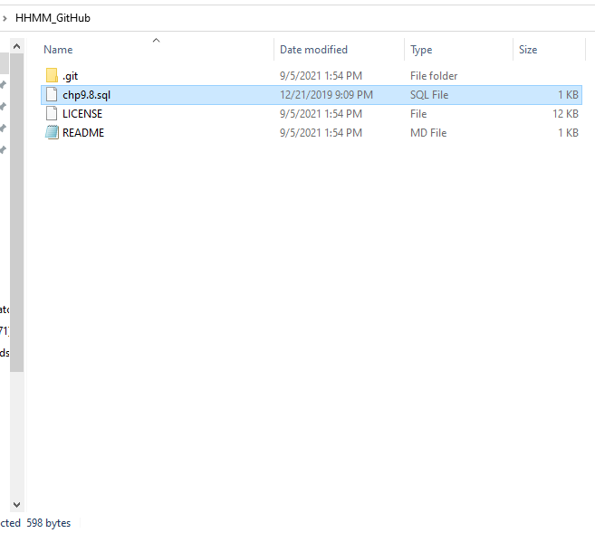
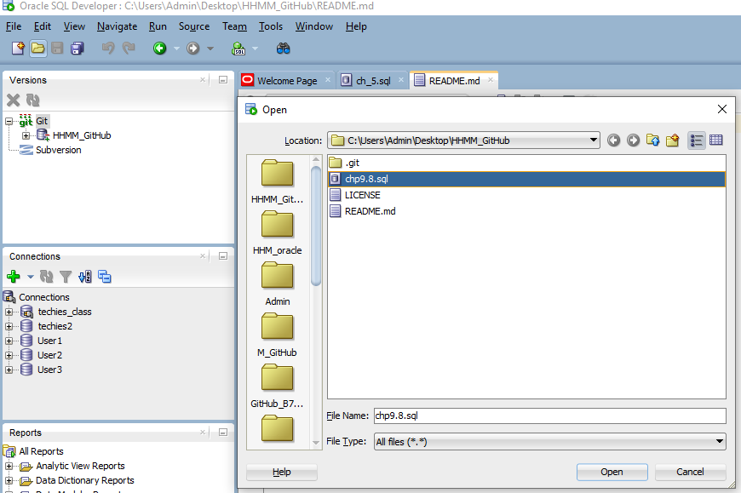
Add One .Sql
In your created folder
And open with
Oracle SQL Developer

Slide 28
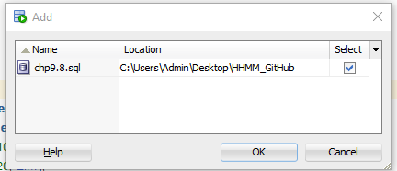
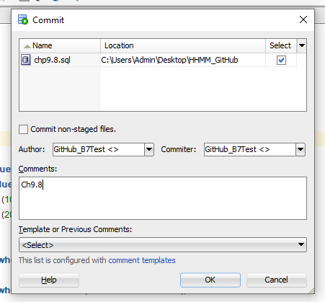
Right Click
Choose: Versioning +Add
Click on Ok
Choose: Versioning Commit
Fill Name: Author
Fill Name: Commiter
Fill Comments: Ch9.8
Click on Ok

Slide 29
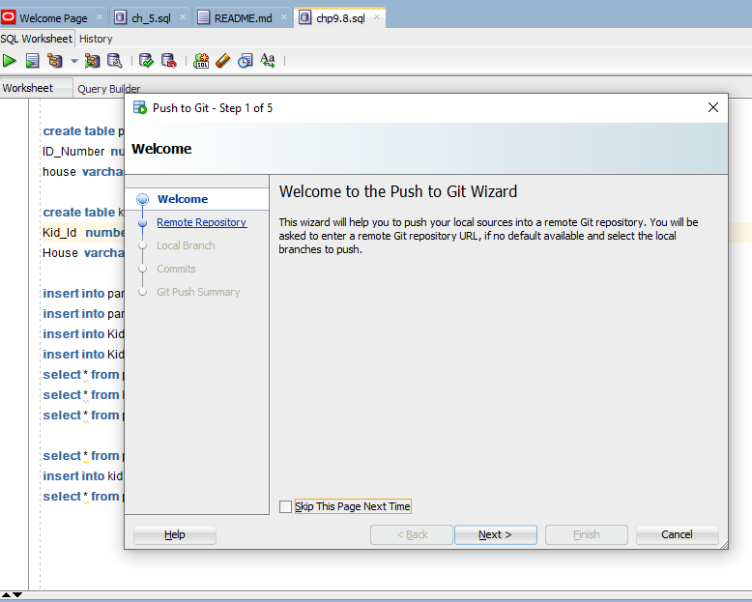
Right Click: Choose Versioning Push

Slide 30
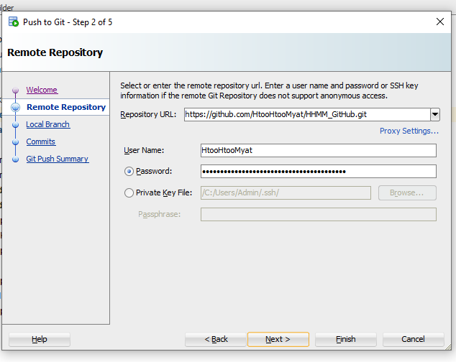
Click on Next

Slide 31
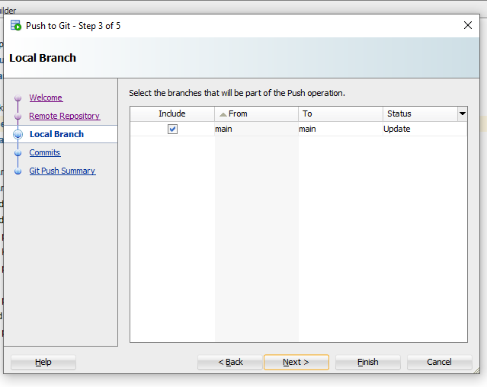
Click on Next

Slide 32
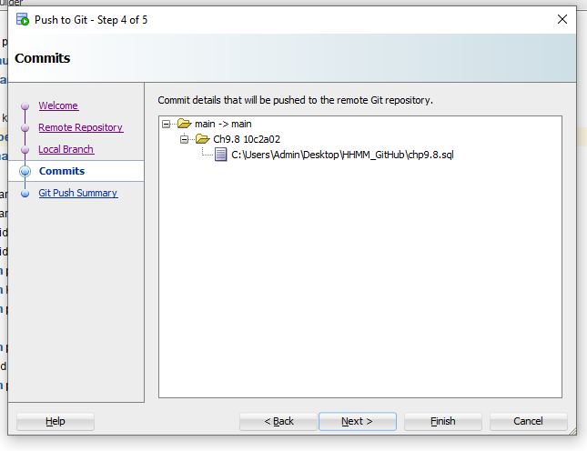
Click on Next

Slide 33
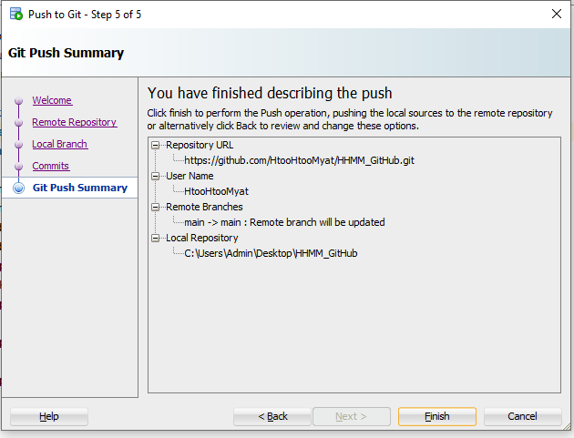
Click on Finish

Slide 34
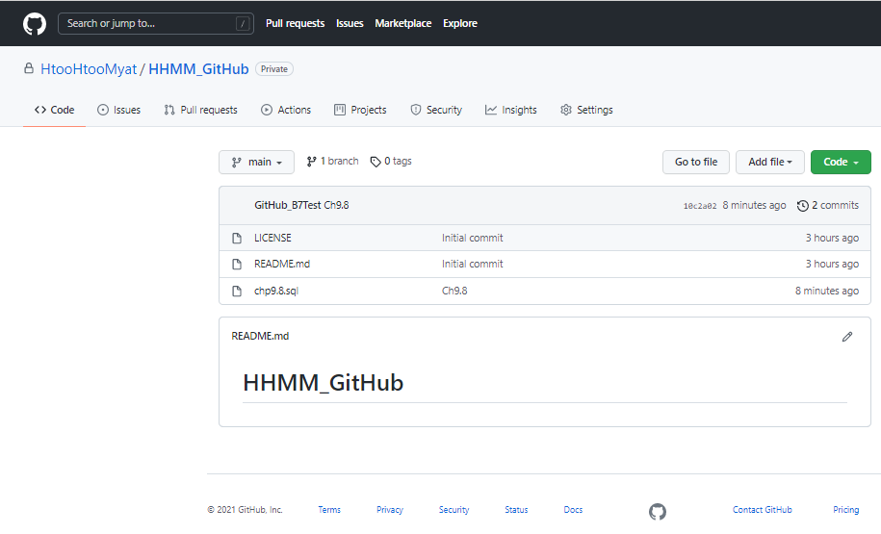
GitHub:HHMM_GitHub

Slide 35
Thank You! Techies Training Centre

