Slide 1

PRESENTATION ON HEALTHCARE MANAGEMENT SYSTEM
PRESENTED BY :- GUIDED BY :-
MANASI DAS MS. GITANJALI DIGAL
SARMISTHA NAYAK
SUNIL DALAI
CHANDAN KUMAR MOHANTY
ANKIT KUMAR BEHERA

Slide 2
CONTENTS
PROBLEM STATEMENT
DATASET OVERVIEW
TOOLS AND TECHNOLOGIES USED
MACHINE LEARNING MODEL
WORKFLOW
EXCEL DASHBOARD
TABLEAU VISUALIZATION DASHBOARD
FUTURE SCOPE
CONCLUSION

Slide 3
PROBLEM STATEMENT
In many hospitals and healthcare facilities, there is a lack of centralized, data-driven tools to monitor and manage key operational metrics. Healthcare administrators often rely on manually maintained records, which makes it difficult to gain real-time insights into patient flow, appointment scheduling, treatment outcomes, billing efficiency, and doctor performance. This leads to inefficiencies, delays in decision-making, and compromised patient care.
SOLUTIONS
To address these challenges, our project aims to build a Healthcare Management Dashboard that consolidates data from multiple sources (e.g., patients, doctors, treatments, appointments, and billing) into an interactive, visual platform. This dashboard empowers stakeholders to make informed decisions, track KPIs, and optimize hospital operations effectively.

Slide 4
DATASET OVERVIEW
Appointment.csv :- This dataset records patient appointments with doctors.It includes appointment dates, status, and related patients/doctors IDs.
Billing.csv:-Contains financial transactions linked to appointments.Tracks payment amounts, methods (e.g., Cash, Card), and payment status (Paid, Pending).
Treatments.csv :-Provides details of treatments given during appointments. Includes treatment type, description, cost, and treatment date.
Doctors.csv :- Lists doctor profiles including specialization and experience. Helps analyze doctor availability, performance, and branch-wise distribution.
Patients.csv:-Contains demographic and insurance details of patients. Useful for analyzing gender, age groups, and insurance provider distribution.

Slide 5
Tools and technologies used
Tableau – For data visualization and interactive dashboard creation.
Python – For building and integrating the machine learning model.
Pandas & NumPy – For data preprocessing and manipulation.
Scikit-learn – For training and evaluating ML models.
MS Excel / CSV – Data storage and input source.

Slide 6
ML MODEL OF HEALTHCARE MANAGEMENT
OBJECTIVE :-
The objective of this is to analyze the Health Management System dataset and build a predictive model to estimate treatment costs based on various features such as treatment type and specialization.
STEPS FOR BUILDING MODEL :-
1. Data Preparation
2. Data Analysis
3. Data Preprocessing
4. Model Building and Training
5. Predictions and Evaluation

Slide 7
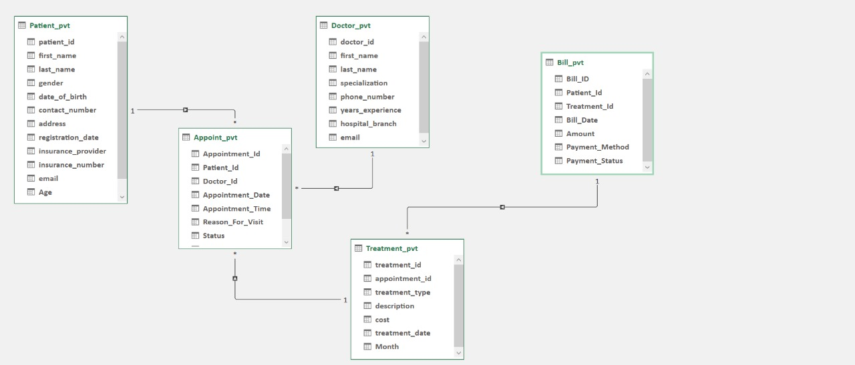
WORKFLOW

Slide 8
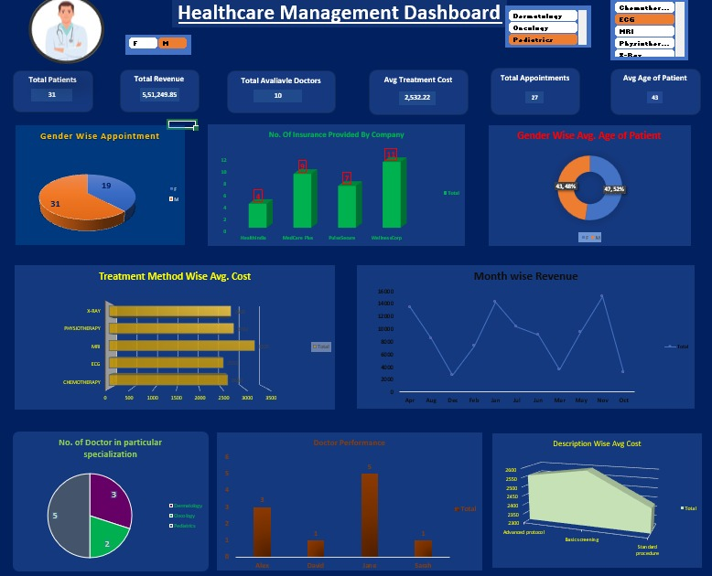
EXCEL DASHBOARD

Slide 9
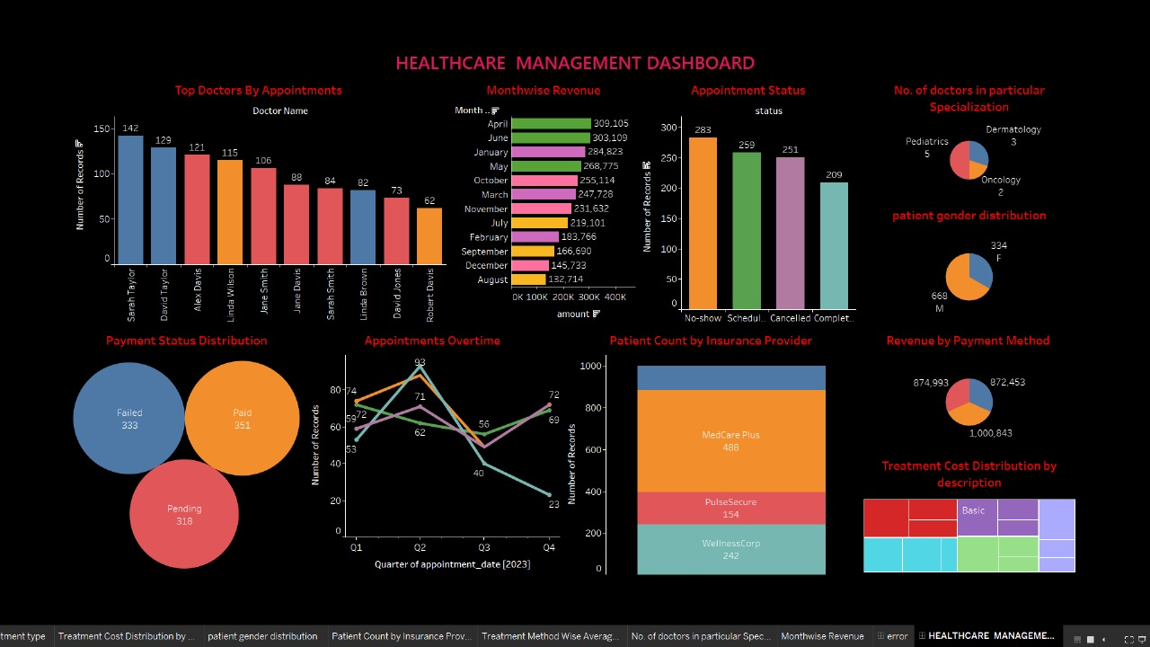
TABLEAU DASHBOARD

Slide 10
FUTURE SCOPE
Predict Patients No-Shows : Machine Learning can help forecast which patients are likely to miss appointments. This improves scheduling efficiency and reduces wasted time slots.
Real-Time Data Integration : Connecting the dashboard with live hospital databases allows dynamic updates. It enables doctors and admins to make timely, data-driven decisions.
Advanced Health Predictions : ML models can be trained to predict disease risks or treatment success rate. This supports preventive care and personalized treatment planning.
Multi-Branch Hospital Support : The system can be scaled to track data from multiple hospital branches. It provides centralized monitoring and comparison across locations.

Slide 11
CONCLUSION
To overcome the inefficiencies in healthcare data management, our project introduces a comprehensive Healthcare Management Dashboard using Tableau, integrated with a machine learning model. The solution unifies data from multiple sources—patients, doctors, treatments, appointments, and billing—into a centralized, interactive platform. It enables stakeholders to monitor key performance indicators (KPIs), gain real-time insights, and predict treatment costs, ultimately improving decision-making, optimizing hospital operations, and enhancing the overall quality of patient care.

Slide 12
THANK
YOU

