Slide 1

JackNDeals.com
By Tech Ingress Pvt. Ltd

Slide 2





Ecommerce in Nepal
Service Concentration
Vendor Availability
Service Availability
Delivery Experiences
Technical Backbone
Payment Gateways

Slide 3
Monopoly Scenario
Quality
Delivery Time
Customer Response
Pricing

Slide 4
SOLUTION

Slide 5
JackNDeals Concept
Diverse Market Strategy
Instant Delivery
Vendor Certification
Product Verification
Diverse Vendors

Slide 6

Diversification Concept

Slide 7
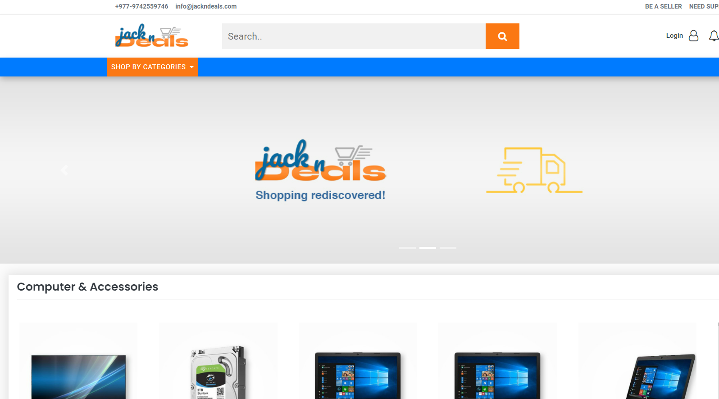
JackNDeals
Introduction
Features
Searchability
Pricing
Payment Gateways
Additional
Instant Delivery
Discount & Offers
Delivery Mechanisms & Pricing

Slide 8
User Benefits
Instant Delivery : Get instant deliverable items delivered within 1-2 hrs., depending upon traffic and availability, which currently many of the ecommerce aren’t doing.
Cheaper & Convenient Delivery Pricing : Delivery pricing are customizable and hence optimum pricing can be set. Hence delivery prices are cheaper if multiple items are ordered from same vendor at once.
Verified Products & Vendor Certification : Products are categorized and searched even on the basis of vendor verification, hence user can purchase from verified vendors and our delivery mechanism has integrated product verification before delivery.
On Time Delivery : JackNDeals is currently focusing on on-time delivery of product based on product availability and distance between vendor and customers.

Slide 9
Technologies Planning
Applications
Web Application
Mobile Apps
Android App
iOS App
Others (as required)
Payment Gateways
Connect IPS
International Card Gateways
Esewa
Fonepay Automated QR
Khalti
Social Media Integrations for Searchability
Recommendation System
Office ERP For Supply Chain Management & Automation
Market Integration System APIs

Slide 10
Market Opportunities
COVID Situation Market
Shopping with Click
Emerging Youth Shoppers
Busy Corporate Shoppers
Shopping for Families from Abroad
Emerging Small Town Shoppers

Slide 11

Launch Plan

Slide 12
Timeline
Beta Launch
Final Launch
Beta Testing
App Launch
45 Days
1 Month
As Beta Testing Ends
1 Month
As Testing Completes
App Testing

