Slide 1
Networking – Lessons from the Outreach component of the SNA Update
November 24, 2021

Slide 2
Networking: collaboration and user consultation
Better regional and global coordination between countries and agencies
Δ + Effectiveness of regional consultations
Δ - Redundancies and overlaps.
When feasible, regional forums should be organized jointly with regional commissions and agencies to foster regional ownership
Sharing good practices adopted by NSOs and IOs in maintaining regular consultations with users: public and private sectors, academia, the media, and NGOs

Slide 3
Networking: Infrastructure
Use of existing regional platforms is recommended for outreach and communication with countries
Regional Commissions and Regional Agencies facilitate
Closer interaction with countries
Multi-topical relationship
Better knowledge of challenges, plans, and opportunities
Global coordination of outreach facilitates/enables inter-regional collaboration and economies of scale

Slide 4
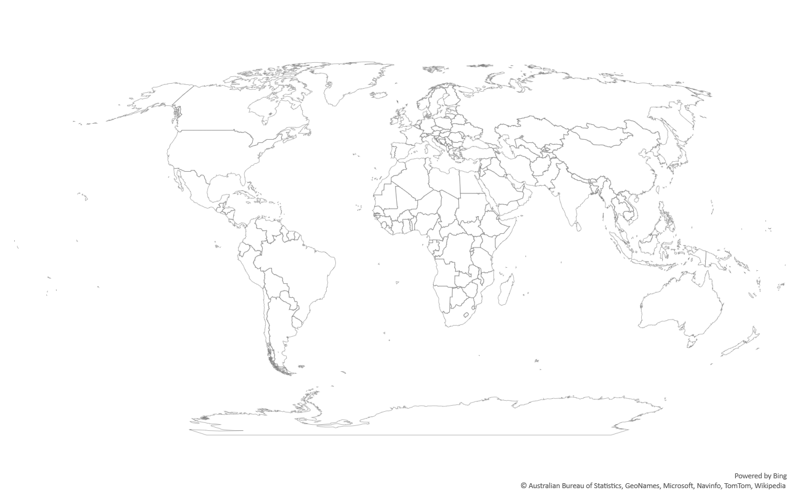
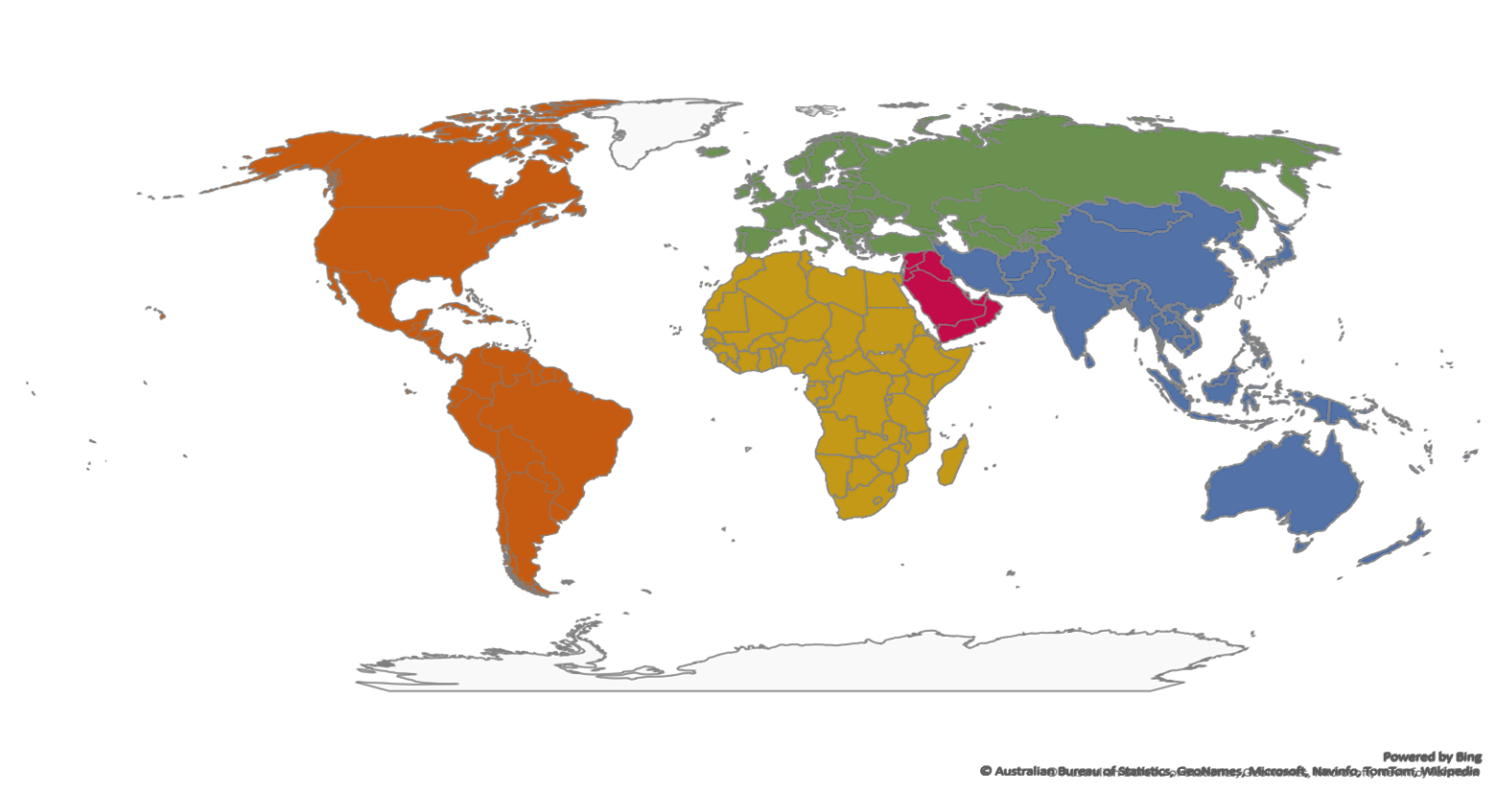
Networking: collaboration and user consultation
UNECE
ECLAC
ESCAP
UNECE
ESCWA

Slide 5
Outreach activities – SNA
Four thematic webinars are taking place during Oct/Nov 2021
Topics included:
Completion of the inception webinars in all the regions during May – July 2021
Broadcast
ECLAC
ESCWA – Joint with IMF
ECA
ESCAP
Region | # Participants | # Countries
ECLAC | ~140 | 38
ECA | ~150 | 49
ECE | 373 | 67
ESCAP | ~100 | 29
ESCWA | ~85 | 16
TOTAL* |  | 169/185**
* no duplicates, ** represented
Consultation
Informal Economy
Wellbeing and Sustainability
Digitalization
Islamic Finance
Delivery

Slide 6
Networking through outreach and user consultation – lessons learned from regional forums
Quarterly regional meetings with focused agenda
Synergies (combine global and regional strengths, use of existing networks and statistical infrastructure)
Team work (Regional teams of 3 => a Global team of 15)
Leverage existing regional experts
Agenda meets country needs – prioritization is demand driven
Language remains important
Coordinated global and regional programs on early implementation of standards (with focus on data collection and access, compilation methods, and training and capacity building through experimental estimates)

Slide 7
Thank you!

