Slide 1
Implement Ray Tracing With Physically Based Rendering

Slide 2
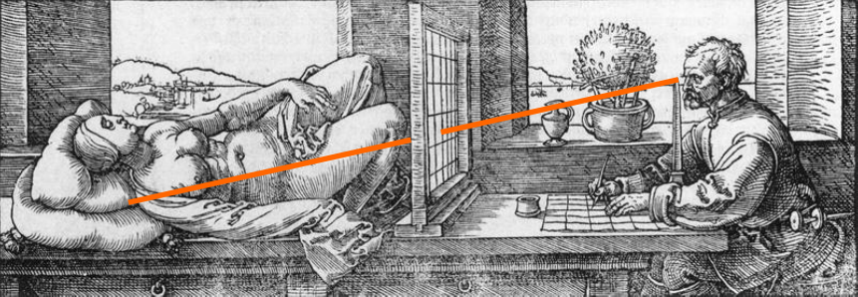
Ray Casting
Woodcut by Albrecht Dürer, 16th century

Slide 3
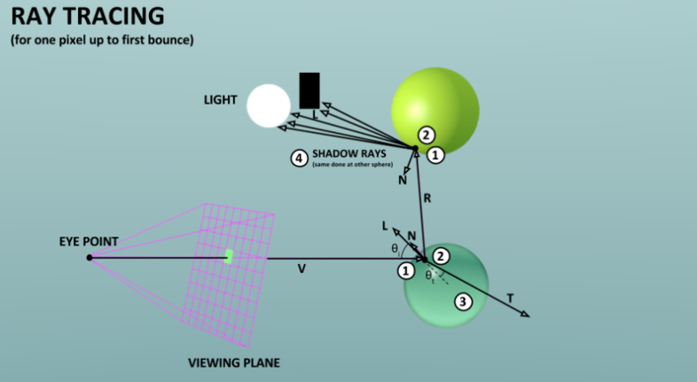
Ray Tracing Flow

Slide 4
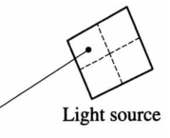
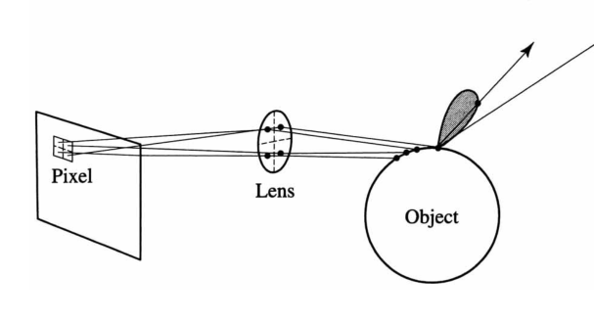
Distributed Ray Tracing
Area lights and soft shadows
Blurred reflections and refractions
Anti-aliasing
Depth of field
Motion blur

Slide 5
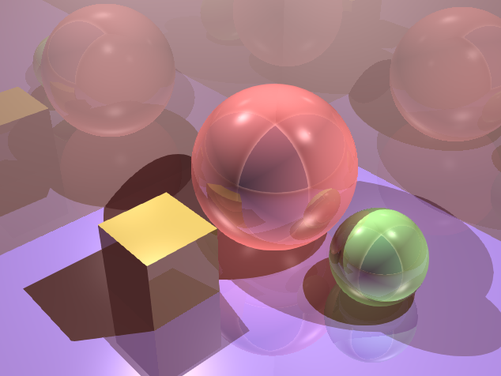
Distributed Ray Tracing
Anti-aliasing

Slide 6
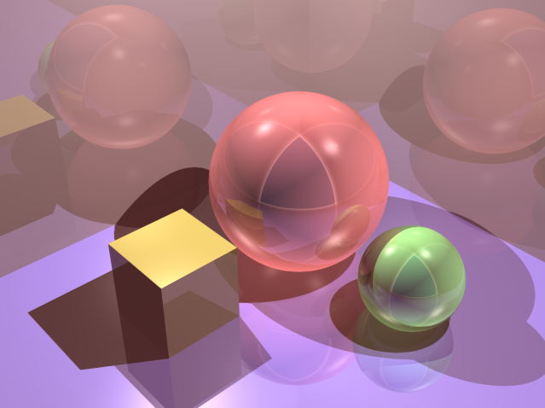
Distributed Ray Tracing
Anti-aliasing

Slide 7

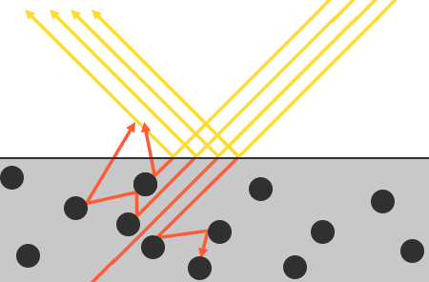
Physically Based Rendering
Mircofacet Model
Energy Conservation

Slide 8
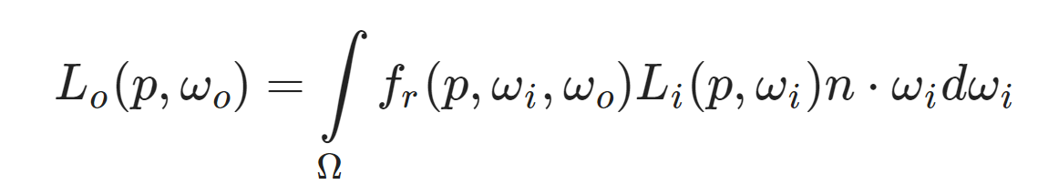
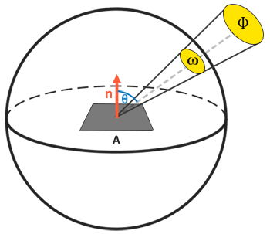
Physically Based Rendering
Render Equation
Bidirectional Reflective Distribution Function

Slide 9
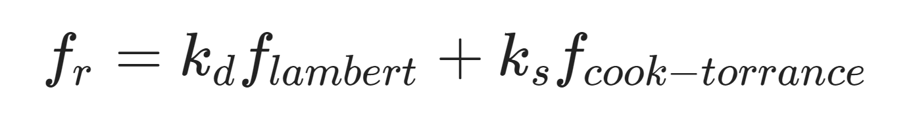
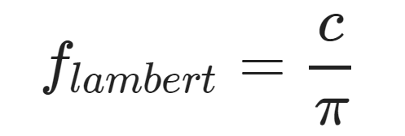
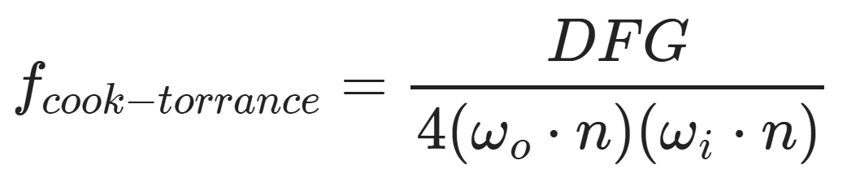
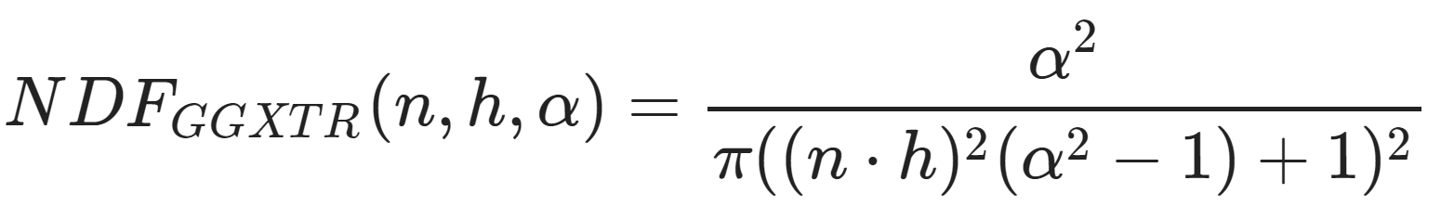
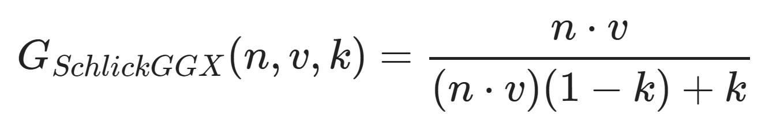
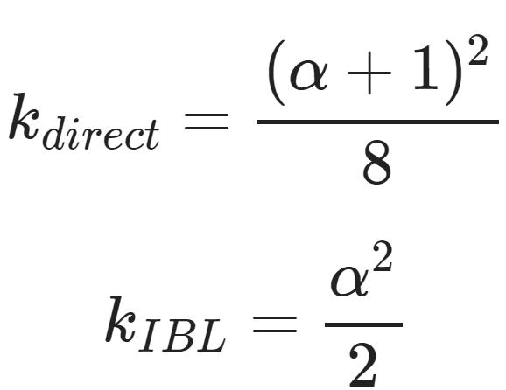
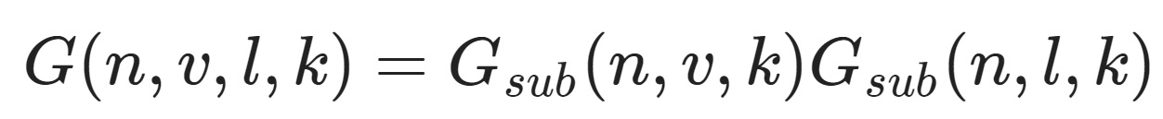
Physically Based Rendering
Cook-Torrance BRDF
Diffuse Part
Specular Part
Normal Distribution Function
Geometry Function
Fresnel Equation

Slide 10
Thanks

