Slide 1
Confidence Estimation Using Unlabeled Data
Chen Li, Xiaoling Hu, Chao Chen
Stony Brook University
Notes:
Hi, I’m Chen Li from Stony Brook University. I’m going to introduce our paper Confidence Estimation Using Unlabeled Data.

Slide 2

Confidence (uncertainty) estimation
Plane
Prediction
Neural network classifier
0.6
Confidence
Notes:
Besides accuracy, the confidence, measuring how certain a model is of its prediction, is also critical in real world applications such as autonomous driving and computer-aided diagnosis. Despite the strong prediction power of deep networks, their overconfidence is a very common issue. The output of a standard model, e.g., the maximum softmax output, does not correctly reflect the model confidence. There are many methods proposed for dealing with the overconfidence issue of deep models.

Slide 3
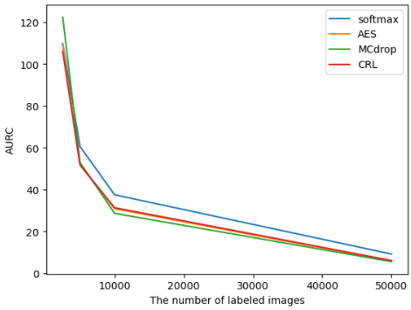
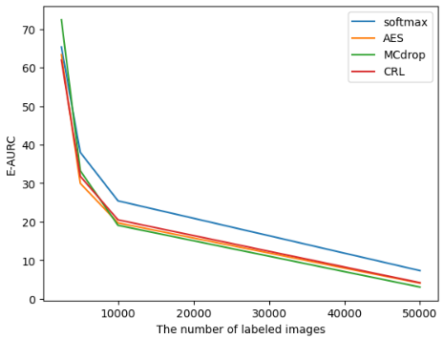
Problem
The existing confidence estimation methods rely heavily on the labeled samples. The lack of annotations leads to bad performance.
Can we utilize unlabeled sample to mitigate this problem?
We propose consistency ranking loss for estimating confidence under semi-supervised setting. (limited labeled samples and a large amount of unlabeled data)
Notes:
The existing confidence estimation methods rely heavily on the labeled samples. The lack of annotations leads to bad performance. As shown in the plots from CIFAR10, the y-axis here represent AURC and E-AURC, which are commonly used evaluation metrics for confidence estimation. Lower values mean better confidence estimation. We can see as the number of labeled images in training set decrease from 50000 to 2500, the confidence estimation performance deteriorates significantly. We try to alleviate this problem by utilizing unlabeled samples. Here we propose consistency ranking loss for estimating confidence under semi-supervised setting.

Slide 4
Motivation
High confidence
Decision boundary
High confidence
Low confidence
During training, decision boundary keeps vibrating
Notes:
We use training consistency as a surrogate for confidence estimation. The motivation is that during the training process, the decision boundary keeps vibrating until fully converged, the samples closer to decision boundary are more sensitive to boundary vibration and the predictions on these samples change more frequently. It is reasonable to believe that these samples which are closer to decision boundary should have lower confidence.

Slide 5
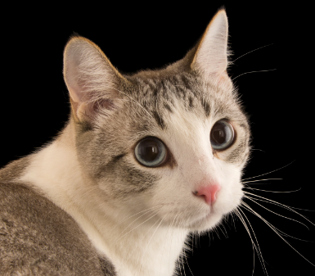
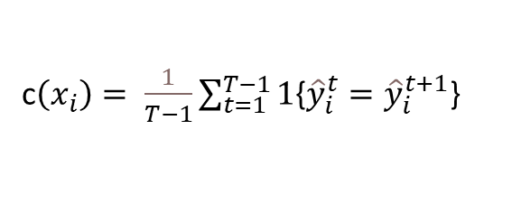
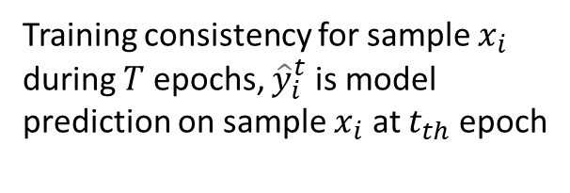
Training consistency
Training curve
Training consistency for sample $x_{i}$ during $T$ epochs, ${\hat{y}}_{i}^{t}$ is model prediction on sample $x_{i}$ at $t_{th}$ epoch
Consistency event
c$\left(x_{i}\right)= \frac{1}{T−1}\sum_{t=1}^{T−1}{1}${${\hat{y}}_{i}^{t}={\hat{y}}_{i}^{t+1}$}
Higher training consistency indicates higher model confidence
Prediction
Dog
Cat
Cat
Cat
Epoch
50
51
70
71
Training Consistency = # Consistency event / # epochs
Notes:
Motivated by the intuition above, we use training consistency to capture the confidence information contained in prediction changing in training process. For a sample, if the model prediction is the same in two consecutive epoch, then we say there is a consistency event. Training consistency is the proportion of consistency events during the whole training process. Higher training consistency leads to higher model confidence.

Slide 6
Training consistency
No ground truth needed!!!
Training curve
Training consistency for sample $x_{i}$ during $T$ epochs, ${\hat{y}}_{i}^{t}$ is model prediction on sample $x_{i}$ at $t_{th}$ epoch
Consistency event
c$\left(x_{i}\right)= \frac{1}{T−1}\sum_{t=1}^{T−1}{1}${${\hat{y}}_{i}^{t}={\hat{y}}_{i}^{t+1}$}
Higher training consistency indicates higher model confidence
Prediction
Dog
Cat
Cat
Cat
Epoch
50
51
70
71
Training Consistency = # Consistency event / # epochs
Notes:
One beneficial of training consistency is that there is no ground truth needed for estimating confidence. This makes sure training consistency can be used on unlabeled samples.

Slide 7
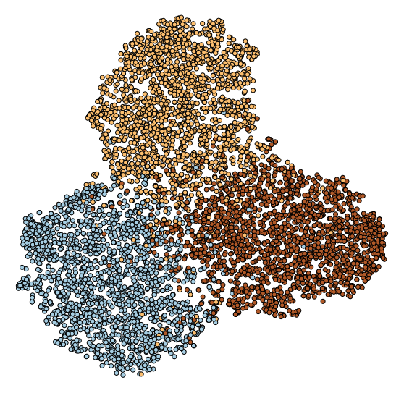
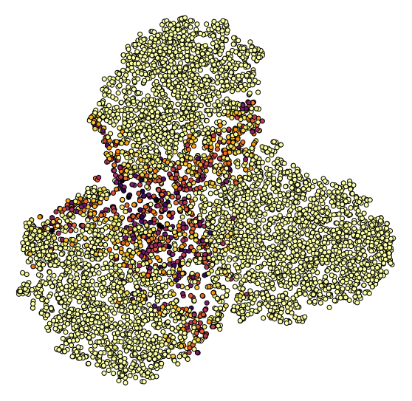
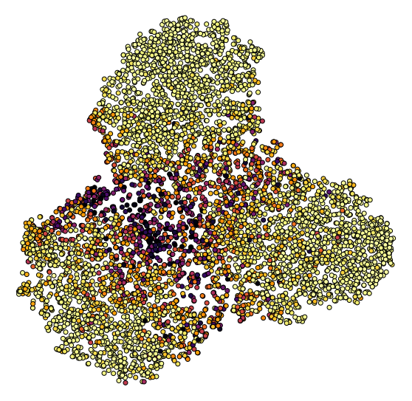
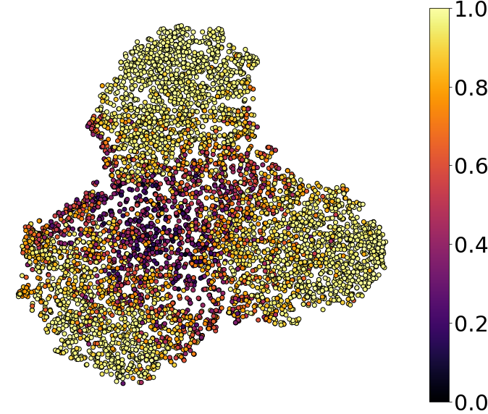
Quality verification
10000 labeled samples of CIFAR10 training (20%)
Training deep classifier
(a) Label
(b) Softmax
6000 unlabeled samples penultimate fully connected (FC) layer representation
t-SNE visualization
(c) Correctness
(d) Consistency
Notes:
To see the validity of training consistency, we use T-sne to show the distribution of confidence estimation on 2-d space. All results above are from CIFAR-10 dataset. (a) is the label distribution. (b) is the distribution of maximum softmax output. It is apparent that maximum softmax output tends to be overconfident. (c) is the correctness, which use the frequency of making correct prediction during training process to estimate model confidence. Correctness is a reliable confidence estimation for labeled samples but unavailable for unlabeled samples. (d) is our training consistency. The distribution similarity between training consistency and correctness can reflect the validity of our method. As expected, The training consistency is high within each class, but slowly transits to low towards the decision boundary.

Slide 8
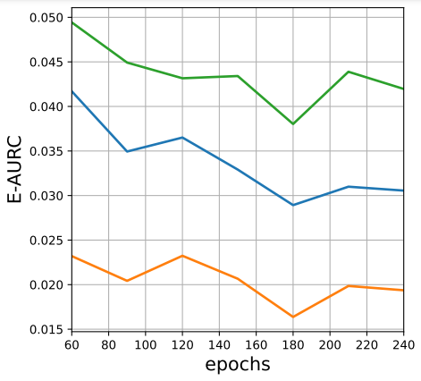
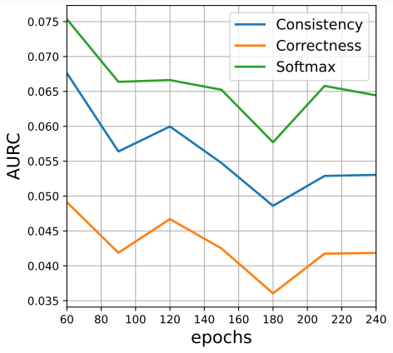
Quantitative verification
Performance of consistency as a confidence estimator. We evaluate the performance of softmax output, consistency and correctness in terms of popular metrics, AURC and E-AURC. We train a model with only 20% of CIFAR10 labeled data and evaluate on the remaining unlabeled data.
Notes:
Here we use AURC and E-AURC to evaluate the quality of training consistency as a confidence estimation on CIFAR10. As shown in plots, training consistency mitigate the overconfidence issue in a good manner and achieve better performance than maximum softmax across multiple epochs. Correctness is excellent as confidence estimator, but the need of annotation restricts its application in unlabeled samples.

Slide 9
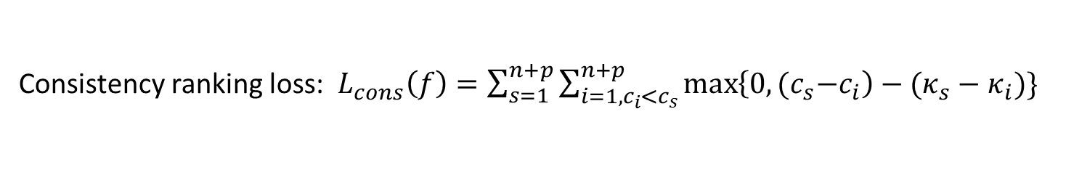
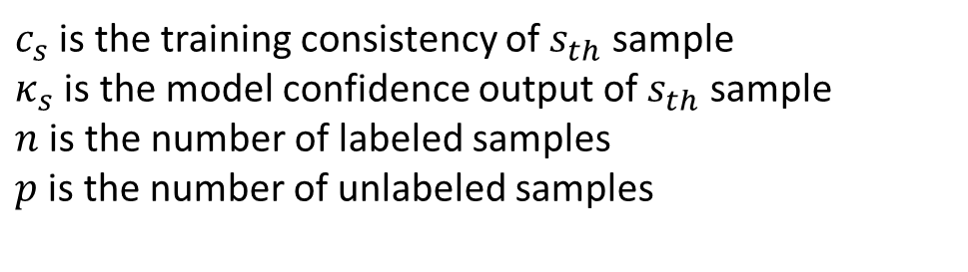
Consistency ranking loss
Consistency ranking loss: $L_{cons}\left(f\right)=\sum_{s=1}^{n+p}{\sum_{i=1, c_{i}<c_{s}}^{n+p}{\max\left\{0,{(c}_{s}−c_{i}\right)−(κ_{s}−κ_{i})\}}}$
$c_{s}$ is the training consistency of $s_{th}$ sample
$κ_{s}$ is the model confidence output of $s_{th}$ sample
$n$ is the number of labeled samples
$p$ is the number of unlabeled samples
Notes:
We have established that training consistency is a good approximation of the confidence. However, training consistency is only available for training data. At the inference stage, we do not have such measure for test data. To this end, we use a Consistency Ranking Loss during training to enforce the model’s maximum softmax output approximates the consistency well. The hope is at the inference stage, the maximum softmax output will well approximate the consistency, and thus the confidence. This consistency ranking loss enforces the rank of model confidence output to be consistent with training consistency.

Slide 10
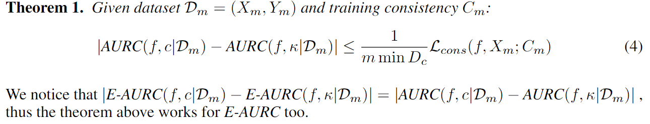
Consistency ranking loss
Consistency ranking loss: $L_{cons}\left(f\right)=\sum_{s=1}^{n+p}{\sum_{i=1, c_{i}<c_{s}}^{n+p}{\max\left\{0,{(c}_{s}−c_{i}\right)−(κ_{s}−κ_{i})\}}}$
$c_{s}$ is the training consistency of $s_{th}$ sample
$κ_{s}$ is the model confidence output of $s_{th}$ sample
$n$ is the number of labeled samples
$p$ is the number of unlabeled samples
Consistency ranking loss punishing
Notes:
Besides, we provide theoretical analysis of the proposed consistency ranking loss. Our main theorem (Thm. 1) states that the loss upper bounds the difference between the confidence estimation performance of κ and the consistency c, in terms of the popular metrics AURC and E-AURC. In other words, as we minimize the loss, κ will have a similar performance as the consistency c in terms of confidence estimation.

Slide 11
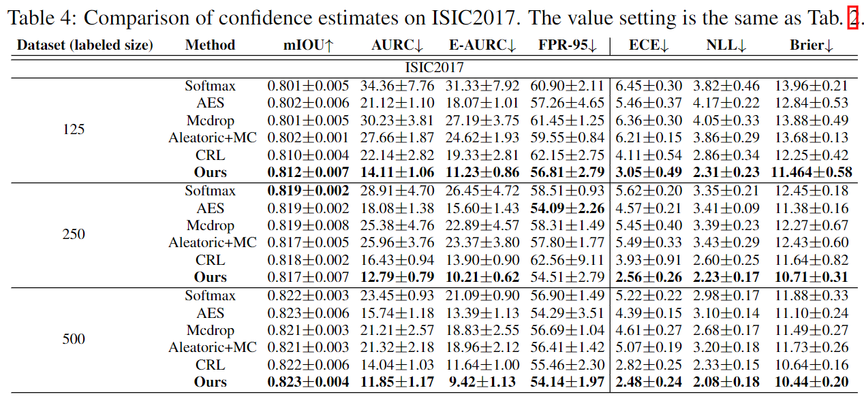
Experiment result
Notes:
In experiment part, we evaluate our method on image classification dataset CIFAR10/100, medical image segmentation data ISIC 2017 using multiple evaluation metrics with different proportion of labeled training data. we implement active learning on CIFAR10/100 to show that the highly uncertain samples picked up by our method will promote the learning process in a better manner. More details please refer to our paper.

Slide 12
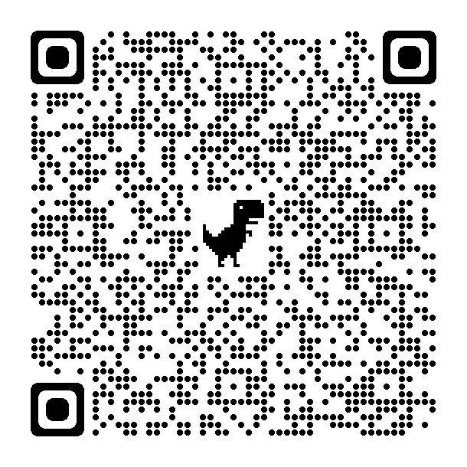
Thank you for your attention!
Q&A
Notes:
Thank you very much for your attention. All the related materials, including the papers, codes, slides can be found on my personal website, and here is the QR code for my website.

