Slide 1
Mediation Analysis via Mendelian Randomization: Searching for Causality in Observational Studies
General background reading: Mendelian Randomization, Methods for Using Genetic Variants in Causal Estimation by S. Burgess and S. G. Thompson (2015).

Slide 2
Outline
Observational and Experimental Studies
Randomized Clinical Trials and Instrumental Variables (IVs).
Mendelian Randomization
  Estimating Causal Effects using Mendelian Randomization.
  Potential Problems
Mediation Analysis more generally
Conclusions
Extra: A published example for illustration.

Slide 3
Observational versus Experimental Studies
Experimental studies are designed to understand causes and effects and make causal inferences by directly manipulating the amount of an exposure and which groups receive it.
Observational studies also seek to understand cause and effects. However, unlike experiments, the researcher is not able to control how subjects are assigned to groups or what treatments they receive.
Causality is harder to determine in observational studies due to residual confounding and the possibility of reverse causality.
Mediation analysis is designed to help determine the pathway of cause to effect.

Slide 4
Some Correlations
Individuals on Medicaid have worse health outcomes than individuals without health insurance in the US.
Individuals with Parkinson disease are less likely to be smokers than controls.
Stork populations and human birth rates are correlated in Europe.

Slide 5
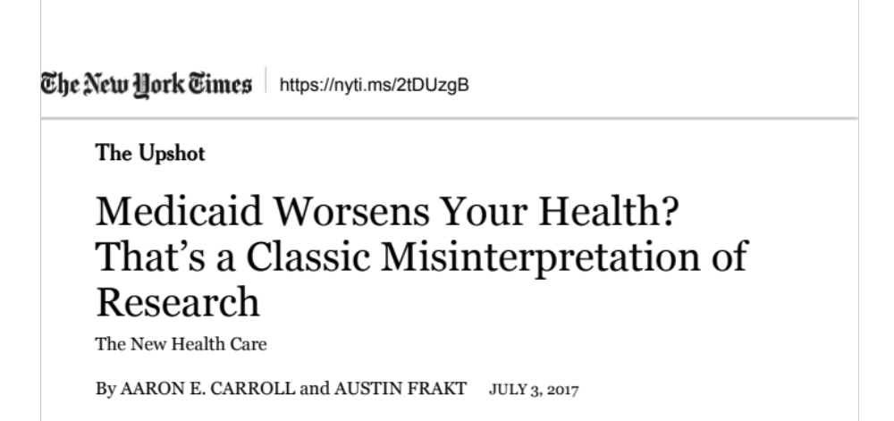
Inferring Causality from these Studies?
Smoking is protective of Parkinson’s disease (so smoke if you are at risk)?
AND …

Slide 6
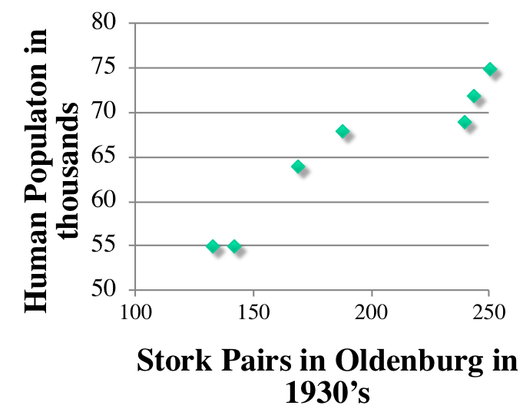
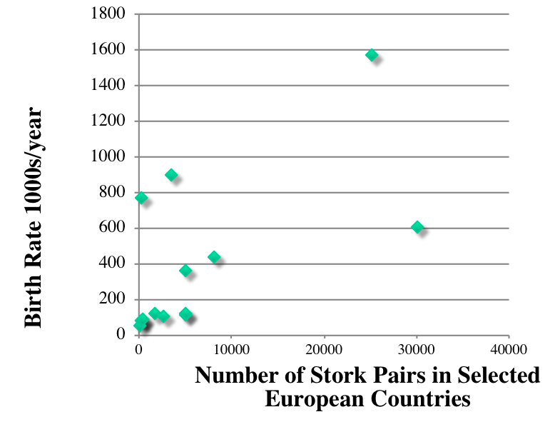
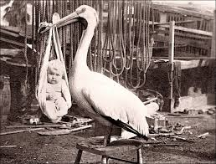

Reducing the Number of Storks will reduce Human Overpopulation

Slide 7
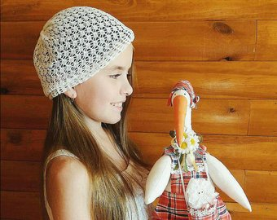
Correlation does not imply Causation
Alternative?
Reverse Causality: The outcome is actually the predictor. That is:
Y X not X Y
For our examples, possible reverse causality:
  People can sign up for Medicaid retroactively, so becoming ill can lead to Medicaid enrollment.
  Individuals with (subclinical) Parkinson’s may stop smoking because it makes them feel worse.
  Babies bring Storks?

Slide 8


Correlation does not imply Causation Continued
Confounding: A third variable (or set of variables) U influences both Y and X
  Medicaid enrollees are of lower socioeconomic status than even the uninsured and so less opportunity for good health practices.
  Unknown/unmeasured confounder in the case of Parkinson Disease and Smoking
  Amount of rural/agricultural area, storks and babies.
U
X
Y

Slide 9
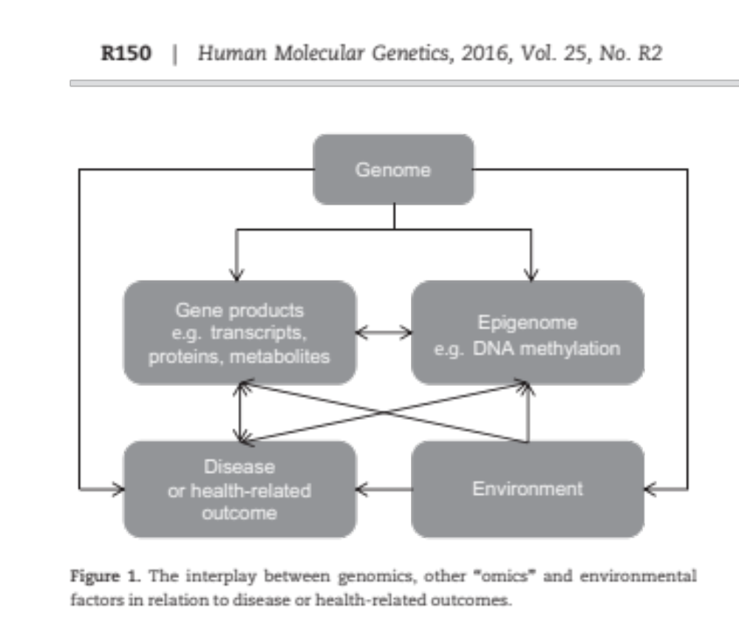
Which Genomic Correlations are Causal?
R.C. Richmond, G. Hemani, K. Tilling, G. Davey Smith, C.L. Relton

Slide 10
Medical Research has Relied on Randomized Clinical Trials to Demonstrate Causality
How do RCT work?
  Randomly assign individuals to treatment groups, then prospectively determine if groups differ in their outcomes.
  Determine the average effect of being assigned to the treatment group versus control group as an estimate of the causal effect in of treatment in the population.
Drug group
Change in exposure
Measure outcome
Group assignment?
Placebo group
No change in exposure
Measure outcome

Slide 11
Why do Randomized Clinical Trials allow Causal Inference?
In well designed randomized clinical trials:
  Assignment affects treatment but is not directly influencing outcome.
  Random assignment insures that the two groups the same in terms of levels of other risk factors (confounders) and thus exchangeable.

Slide 12
Problems with Randomized Clinical Trials
Not always practical. As examples:
  May need to follow up subjects for a long period of time.
  If the outcome is onset of a rare disease then very few at risk will ever have the outcome
Not always generalizable to the population
  Subjects tend to be healthier, more motivated, more compliant than the general population.
  Intent to treat is not the same as the “as treated” effect.

Slide 13
Instrumental Variable Analysis is an Example of Mediation Analysis
  Find a variable that is correlated with the exposure but does not influence the outcome (except indirectly through the exposure level).
  This variable should not be associated with any confounders of the exposure-outcome association.
  In effect, find a “natural experiment” where some variable has randomized individuals to exposure groups that are exchangeable except for exposure level.
  Differs from classical RCT in that we want to determine the causal effect of exposure on outcome using the association of the IV with exposure and the association of IV with outcome.
Value 1
Exposure level 1
Outcome 1
Instrumental variable value?
Value 2
Exposure level 2
Outcome 2

Slide 14
Mendelian Randomization
  Choose a genetic locus as the IV such that:
    It is correlated with the exposure but does not influence the outcome (except indirectly through the exposure level).
    It is not associated with any confounders of the exposure outcome association.
  The division of the population into subgroups by variant is independent of competing risk factors and so these groups are exchangeable.
  Use the association of variant with exposure and the association of variant with outcome to estimate the causal effect of exposure on outcome.
Variant 1
Exposure level low
Outcome Measures
Genetic
Locus
Variant 2
Exposure level high
Outcome Measures

Slide 15
The Mendelian Randomization Model represented as a Directed Acyclic Graph (DAG)
G denotes the locus (or loci)
X the exposure
U (possibly unmeasured) confounder(s)
Y the outcome
Acyclic because there are no feed back loops.
U
G
X
Y

Slide 16
Estimating Causal Effects with MR
Additional assumptions
  SUTVA (stable unit treatment value assumption). Outcome is not affected by how treatment was assigned and an individual’s outcome depends only on his/her risk factors and treatment (not anyone else’s).
  Monotonicity: the value of the IV should effect at least one person’s exposure. All those affected are affected in the same direction.
A number of analysis methods exist. (see e.g. V. Didelez et al. (2010) Stat. Sci. 25:22-40 or S. Burgess and S. Thompson (2015) chapter 4 for reviews)

Slide 17
Examples of MR Analysis Methods:
The form of the estimates depends on whether the outcome is continuous or dichotomous, the exposure is continuous or dichotomous, the IV is polychotomous or dichotomous, and the statistical approach.
Generalized linear model based:
  Ratio of coefficients (Wald type statistics)
  Two stage methods
  Likelihood and Bayesian Methods
Semi-parametric Methods.
U
G
X
Y

Slide 18
Estimates from Ratios
When the outcome and exposure are continuous, then the average causal effect can be estimated as
β = Cov(Y,G)/Cov(X,G).
  When Y is dichotomous and exposure is continuous, then the causal odds ratio (COR) is approximated as
  log(COR)= log(OR_{Y|G})/β_{X|G} => COR = OR_{Y|G}^{1/βX|G}
These Wald like estimates let us use summary statistics, however they require large sample sizes to be accurate estimates and are subject to bias.
Standard errors and confidence intervals are approximate.

Slide 19
Two Stage Regression
U
G
X
Y
Regress X on G then regress Y on E(X).
If outcome, Y, is continuous then regression is linear if not use generalized linear models.
With a single IV and continuous Y get same estimate as the ratio method but model extends so that multiple IVs (multivariate regression) can be used simultaneously.

Slide 20
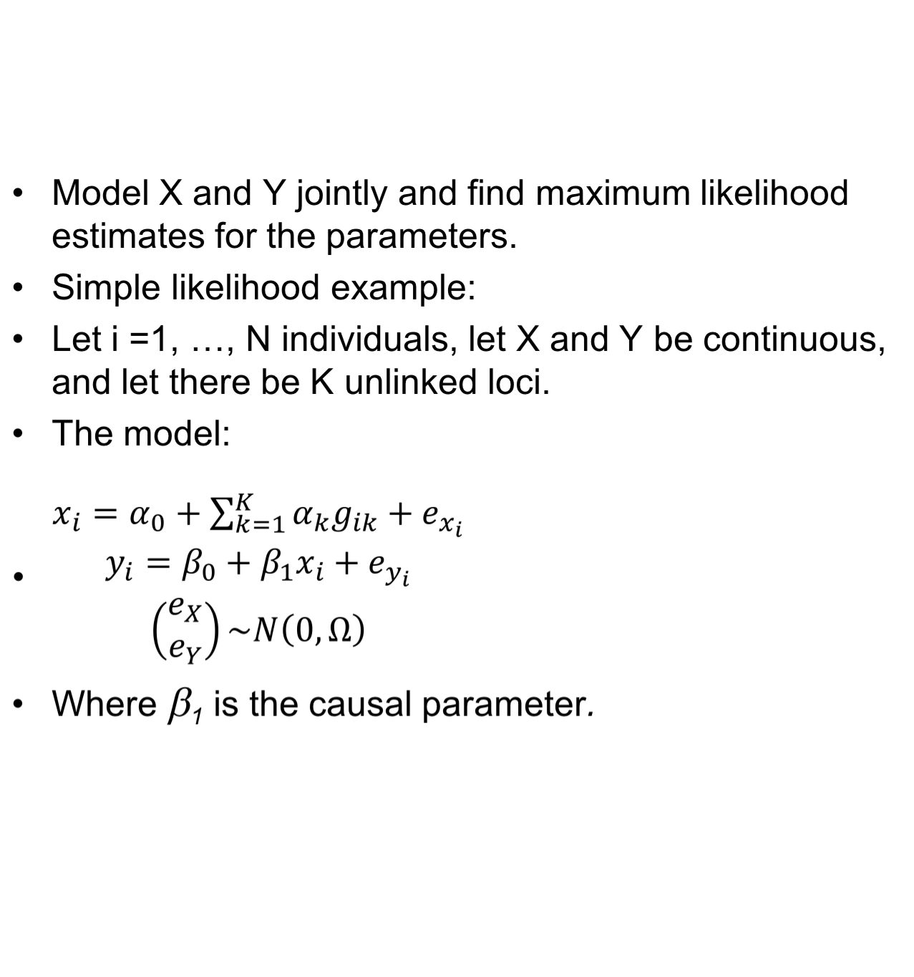
Likelihood and Bayesian Approaches
U
G
X
Y

Slide 21
Potential Problems with Mendelian Randomization
“Assignment” of alleles not random: e.g. assortative mating or selection with regards to the locus used as an IV or ascertainment induced (variant effects likelihood of being in the study, e.g. survivor bias).
Pleiotropy effects of the IV induce another connection between the locus and the outcome.
Association between locus and exposure is weak. There are issues both with loss of power and upwardly biased estimates. Bigger sample sizes, covariate adjustment and combining studies through meta analysis can help.
Developmental compensation (Canalization) can reduce the exposure difference for individuals with different variants.
Bias introduced if assumptions not met and it is difficult to assess validity of modeling assumptions.
U
G
X
Y

Slide 22
Mendelian Randomization with Genomic Data
Question of interest: Can Mendelian randomization help us understand the causality of pathways implicated with expression data?
Do assumptions of MR apply? What are the pitfalls? This is an active area of research.
Variant 1
Gene expression high
Increased risk of clinical phenotype
eQTLs
Variant 2
Gene expression low
Decreased risk of clinical phenotype

Slide 23
MR with Family Data?
Yes, with linear mixed models. see computer exercises for details.

Slide 24
Note: Mediation Analysis is a much Bigger Field than just Mendelian Randomization
Forms of Mediation Analysis cover questions MR can’t address. E.g. suppose we are interested in determining the extent that genetic variation at a locus (the exposure, G) acts on a phenotype (outcome, Y) through a molecular intermediate (mediator, X)
MR is no longer the appropriate approach. G is no longer an IV because we allow for a direct effect.
A number of methods exist to address this question. It can be tackled in a generalized linear regression framework. Example: Natural Effect Models.
G
X
Y

Slide 25
Summary
Mendelian randomization provides a way to assess causality in observational studies.
Randomized clinical trials may provide better evidence but are not always possible to perform.
Care must be taken in the selection of the loci and in the analysis methods.
Mediation analysis and causal inference methods abound in epidemiology – MR is just one example.

Slide 26
A Few Select References – (there are a lot more; it’s a big field)
Mendelian Randomization
  S.Burgess and S. G.Thompson (2015). Mendelian Randomization: Methods for Using Genetic Variants in Causal Estimation.Chapman & Hall/CRC Press.
  I. Pichler et al. (2013) Serum iron levels and the risk of Parkinson’s disease: a Mendelian randomization study. Plos Medicine 19:10.1371
  K. Baicker and A. Chandra (2017) Evidence-Based Health Policy. N Engl J Med 377:2413-2415
  V. Didelez etal (2010). Assumptions of IV methods for observational epidemiology. Stat.Sci. 25:22-40.
Mediation analysis applied to genomic data
  R.C. Richmond et al. (2016) Challenges and novel approaches for investigating molecular mediation. Hum. Mol. Genet. 25(R2):R149-R156
  R. Barfield et al. (2017) Testing for the indirect effect under the null for genome-wide mediation analysis. Genet. Epid. 41:824-833.
Mediation analysis and Causal Inference Theory
  Judea Pearl, (2014) Interpretation and Identification of Causal Mediation. Psych. Methods 19:459-481
  Judea Pearl (2009) Causality: models,, reasoning and inference. Camb. U. Press.
  T.J. VanderWeele (2015) Explanation in causal inference: methods for mediation and interaction. Oxford. U. Press.
  T.J. VanderWeele (2016) Mediation Analysis: A Practitioner’s Guide. Anm Rev. Pub. Health. 37:17-32

Slide 27
Illustrative Mendelian Randomization Study
Serum iron levels and risk of Parkinson’s disease. I. Pichler et al. (2013) PLOS Medicine 10:e1001462
Prior evidence from Observational Studies is confusing:
  Autopsy study in which increased iron found in PD brains versus unaffected brains.
  Most but not all, case (Parkinson’s patients) - control studies of serum Iron levels show reduced levels in cases.

Slide 28
Iron - Parkinson’s Disease Continued
Pichler et al. used three variants: two in HFE (not in LD) and one in TMPRSS6.
Effect of the variant on serum iron comes from GWAS meta analysis. Effect of the variant on PD risk from meta analysis of GWAS and candidates studies. Serum iron and PD risk GWAS were different.
Variant 1
Iron low
Increased risk of PD
SNPs correlated with Iron levels
Variant 2
Iron High
Decreased risk of PD

Slide 29
Iron-Parkinson’s Example Con’t.
For each locus:
  Iron levels = quantitative exposure, standardized so mean = 0, SD = 1.
  PD = dichotomous
  locus = counts (0,1,2) of variant associated with increased iron. Assumed independence of allelic effects.
  Meta-analysis estimates of (1) per allele OR for PD and (2) per allele in increase in iron values (number of SDs).
  Use Wald type estimate to get the MR estimate,
  log(OR_{PD|iron}) = log(OR_{PD|allele})/β_{iron|allele}
Pool MR estimates across the three loci.
  MR estimate = 0.88 (approximate 95% CI, 0.82 – 0.95, pvalue =0.001)
  Corresponds to 0.3% relative reduction in PD risk per 1 μg/dl increase in serum iron over lifetime (Small effect size).
Variant 1
Iron low
Increased risk of PD
SNPs correlated with Iron levels
Variant 2
Iron High
Decreased risk of PD

Slide 30
Iron-Parkinson’s Example Con’t.
  Validity checks conducted:
    All three loci assessed to be strong IVs.
    Three IVs show similar results - No evidence of heterogeneity (suggesting the no pleiotropy assumption holds).
    Sensitivity analysis (by excluding particular studies used in meta-analyses) in order to determine if population stratification a factor provided similar results to the primary analysis.
Variant 1
Iron low
Increased risk of PD
SNPs correlated with Iron levels
Variant 2
Iron High
Decreased risk of PD

