Slide 1


Final Project
华羽霄 岳翼遥 施永祺

Slide 2
1 Division of labor
CONTENTS
2 Navigation
3 Grasp

Slide 3
1. Division of labor
Navigation
Grasp
华羽霄
岳翼遥 施永祺

Slide 4
2. Navigation
调库：turtlebot4_navigation nav2
qA = quaternion_from_euler(0.0,
0.0,
np.deg2rad(90.0))
PointA = PoseStamped(
header=Header(frame_id='map'),
pose=Pose(
position=Point(x=0.25,
y=-3.3,
z=0.0),
orientation=Quaternion(x=qA[0],
y=qA[1],
z=qA[2],
w=qA[3])
)
)
controller.goToPose(PointA)
Navigator是“客户端-服务器”类型，而ArmController需要spin，两者冲突。
方案一：整合成一个大类，既方便传参，也方便交互。原来的spin改写成while循环。不好使！
方案二：写成两个类，通过线程进行管理。
Notes:
触觉传感器数据采集，需要用到的外设

Slide 5
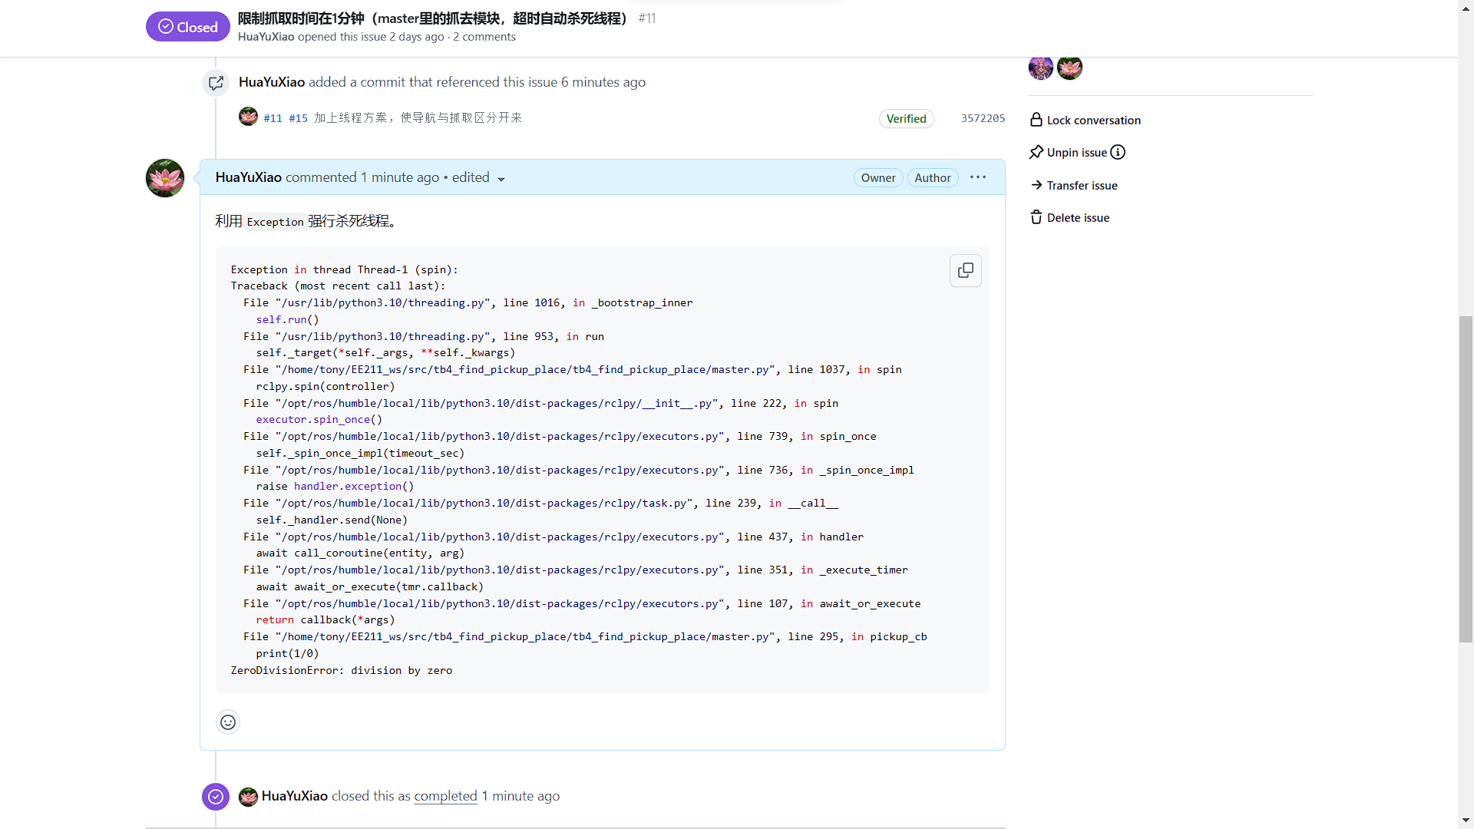
2. Add up together
我们的程序依靠bug运行！
timer不太方便终止，thread终止的方法试了效果不佳，于是我们大胆地在程序里塞入一个bug，然后！
case 'QUIT':
self.pub_timer.destroy()
print(1/0)
return

Slide 6
3. Grasp
Steps
Marker detection
Calculate marker to base matrix
Inverse kinematics
Grasp
$${}_{Marker}^{Base}{T={}_{Camera}^{Base}{T×{}_{Marker}^{Camera}T}}$$
tf reader
Aruco_poses
Quat to matrix

Slide 7
3. Grasp
Marker detection
launch aruco recognizer
subsribe aruco_poses topic
compute transformation matrix from marker to camera

Slide 8
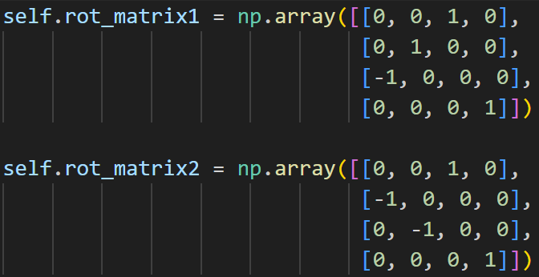
3. Grasp
Calculate marker to base matrix
$$T_{camera2base}×T_{rot_matrix2}×T_{marker2camera}×T_{rot_matrix1}$$

Slide 9
3. Grasp
Grasp procedure
Pickup
Place
Arriving at point A
INIT: Sleep position
Case0 & Case1: Move near to marker
Case2: Move to marker & Grasp
Case3: Lift after Grasping
Case4: Go to sleep position
Move point A to point B ······
Arriving at point B
INIT: Lift
Case0: Gripper release
Case1: Go to sleep position
Go back to Start point

Slide 10
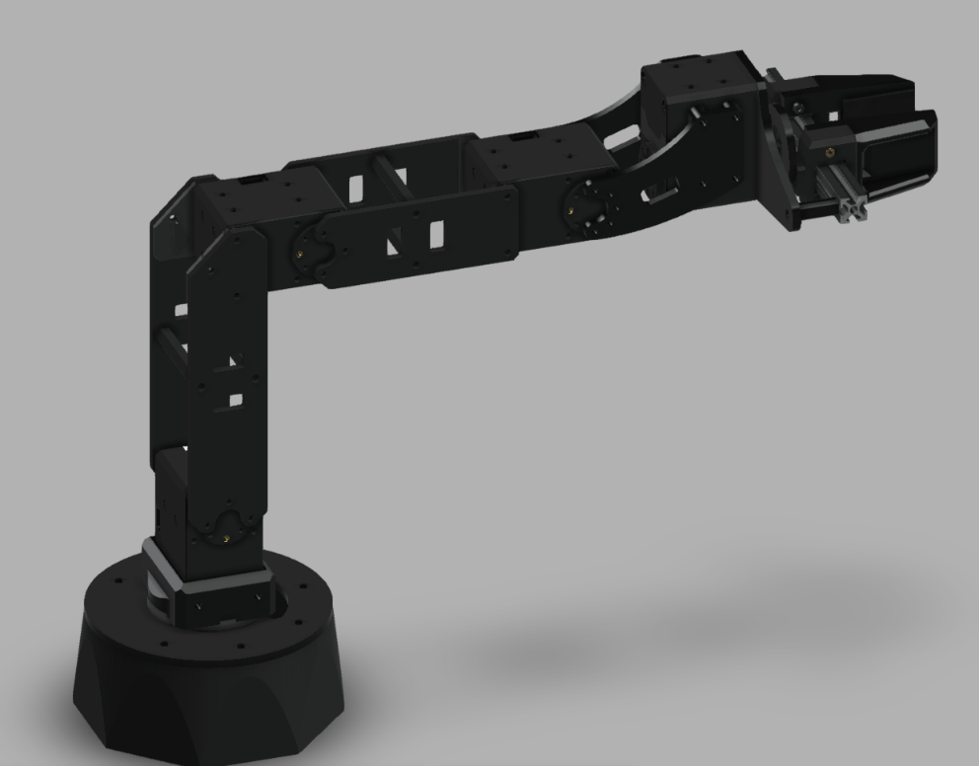
3. Grasp
Inverse Kinematics
Initial guess
Current transform
Current joint values
Error between target matrix and current matrix
Target transform
Value of waist position
Computed joint values

Slide 11
Thanks for listening

