Slide 1
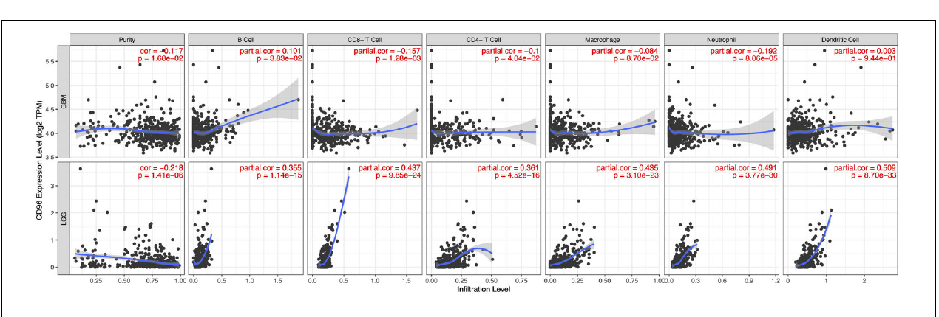
FIGURE 6
CD96 expression and
immune infiltration in glioma
TIMER analysis · purity-adjusted correlations · GBM versus LGG
Association is strong in LGG but weak in GBM
Notes:
Introduce Figure 6 as a tumor-microenvironment analysis testing whether CD96 expression tracks inferred immune-cell abundance.
[Sources]
- https://doi.org/10.3389/fbioe.2020.00592

Slide 2
BIOLOGICAL QUESTION
Figure 6 asks whether CD96 tracks immune-cell abundance
Bulk-tumor
CD96 expression
TIMER immune
deconvolution
Six inferred
immune populations
•
Does CD96 increase as immune infiltration increases across tumors?
•
Are associations preserved after accounting for tumor purity?
•
Do the patterns differ between GBM and LGG?
FIGURE 6 · CD96 AND IMMUNE INFILTRATION
02
Notes:
The outcome is inferred immune infiltration, not directly counted immune cells. The analysis is performed separately for glioblastoma and lower-grade glioma.
[Sources]
- https://doi.org/10.3389/fbioe.2020.00592

Slide 3
DECONVOLUTION
TIMER estimates immune infiltration from bulk RNA profiles
1
2
3
4
Bulk RNA-seq
Reference signals
Deconvolution
Infiltration score
Mixed tumor and
non-tumor cells
Cell-type-specific
expression patterns
Separate overlapping
transcript signals
Relative abundance
per tumor
Cell types evaluated: B cells, CD8+ T cells, CD4+ T cells, macrophages, neutrophils, and dendritic cells
FIGURE 6 · CD96 AND IMMUNE INFILTRATION
03
Notes:
TIMER uses bulk transcriptomic patterns to infer the relative abundance of major immune populations. The values are computational estimates rather than flow-cytometry measurements.
[Sources]
- https://doi.org/10.1158/0008-5472.CAN-17-0307

Slide 4
PURITY ADJUSTMENT
Tumor purity is a major confounder in bulk expression
Observed CD96
Tumor purity
Partial correlation
Tumor cells
+ immune cells
+ stromal cells
High purity
= more tumor cells
Low purity
= more non-tumor cells
Association between
CD96 and infiltration
after conditioning on
purity
Without adjustment, CD96–infiltration correlation may simply reflect changing tumor-cell fraction.
FIGURE 6 · CD96 AND IMMUNE INFILTRATION
04
Notes:
Purity adjustment attempts to separate the CD96-infiltration association from the mechanical dilution effect created by varying tumor-cell content.
[Sources]
- https://doi.org/10.1158/0008-5472.CAN-17-0307

Slide 5
STATISTICAL PRINCIPLE
Partial Spearman correlation tests a monotonic association
Remove the purity
component
Correlate residual
rank signals
Rank CD96
r(X,Y | P) = cor( residuals[X ~ P],
residuals[Y ~ P] )
X = ranked CD96 expression
Y = ranked infiltration estimate
P = tumor purity
A positive partial rho means higher CD96 accompanies higher infiltration at comparable purity.
FIGURE 6 · CD96 AND IMMUNE INFILTRATION
05
Notes:
TIMER reports purity-adjusted Spearman rho. The rank transformation reduces sensitivity to non-normal distributions and tests monotonic rather than strictly linear relationships.
[Sources]

Slide 6
READING THE PLOT
Each mini-panel shows one cell type within one tumor class
Black points
Individual tumor samples
Blue curve
Smoothed expression trend
Gray band
Uncertainty around the trend
Red annotation = partial rho and P value
FIGURE 6 · CD96 AND IMMUNE INFILTRATION
06
Notes:
The upper row is GBM and the lower row is LGG. The purity column is a direct correlation with purity; immune-cell columns report purity-adjusted partial correlations.
[Sources]
- https://doi.org/10.3389/fbioe.2020.00592

Slide 7
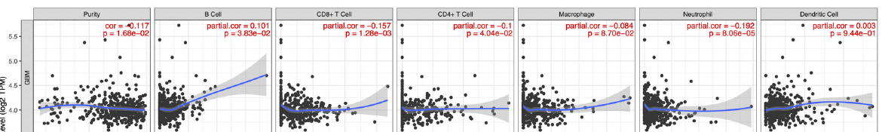
GBM RESULTS
GBM shows weak or negligible immune associations
Largest magnitude
Positive association
Essentially null
Neutrophils
ρ = −0.192
B cells
ρ = 0.101
Dendritic cells
ρ = −0.003
Even statistically significant GBM correlations are small in magnitude.
FIGURE 6 · CD96 AND IMMUNE INFILTRATION
07
Notes:
GBM partial correlations range from approximately -0.192 to 0.101. Statistical significance for some cell types does not imply a strong biological association.
[Sources]
- https://doi.org/10.3389/fbioe.2020.00592

Slide 8
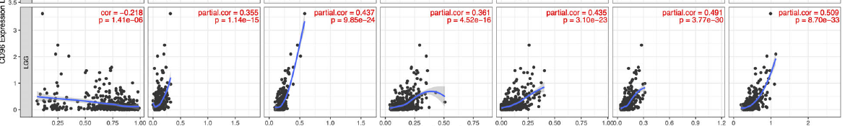
LGG RESULTS
LGG shows broad positive immune infiltration signals
Dendritic cells
Neutrophils
CD8+ T cells
ρ = 0.509
ρ = 0.491
ρ = 0.437
All six immune-cell estimates are positively associated with CD96 in LGG.
FIGURE 6 · CD96 AND IMMUNE INFILTRATION
08
Notes:
LGG shows consistent positive associations with B cells, CD8+ T cells, CD4+ T cells, macrophages, neutrophils, and dendritic cells. The strongest is dendritic-cell infiltration.
[Sources]
- https://doi.org/10.3389/fbioe.2020.00592

Slide 9
GBM VERSUS LGG
The CD96–immune relationship differs sharply by grade
Cell type
GBM ρ
LGG ρ
Contrast
B cell
0.101
0.355
Stronger in LGG
CD8+ T cell
−0.157
0.437
Direction reversal
CD4+ T cell
−0.100
0.361
Direction reversal
Macrophage
−0.084
0.435
Direction reversal
Neutrophil
−0.192
0.491
Direction reversal
Dendritic cell
−0.003
0.509
Near-null → strong
The pattern suggests tumor-grade-specific microenvironmental context.
FIGURE 6 · CD96 AND IMMUNE INFILTRATION
09
Notes:
The comparison is descriptive. A formal interaction test would be needed to establish that the correlations differ statistically between GBM and LGG.
[Sources]

Slide 10
BIOLOGICAL INTERPRETATION
CD96 may mark immune-rich LGG rather than drive infiltration
Supported by Figure 6
Not established
•
CD96 co-varies with multiple immune populations in LGG
•
CD96 recruits immune cells into tumors
•
The strongest signals involve dendritic cells and neutrophils
•
A specific immune cell is the source of CD96
•
The association persists after purity adjustment
•
CD96 blockade will improve clinical outcomes
Bulk-tumor correlation is compatible with immune-cell admixture and shared inflammatory activation.
FIGURE 6 · CD96 AND IMMUNE INFILTRATION
10
Notes:
A careful interpretation is that CD96 is a marker of an immune-rich or inflammatory LGG microenvironment. The data do not establish direction of effect.
[Sources]

Slide 11
CAVEATS
Deconvolution and observational correlation impose limitations
1
Estimated cells
TIMER infers abundance from bulk RNA; estimates depend on reference signatures.
2
Residual confounding
Purity adjustment does not control grade, subtype, treatment, or molecular alterations.
3
Non-independence
CD96 expression may itself originate from infiltrating immune cells.
4
Curve interpretation
The blue smoother can look nonlinear even though the reported statistic is rank correlation.
5
Cross-group claims
GBM-versus-LGG differences require formal interaction testing.
FIGURE 6 · CD96 AND IMMUNE INFILTRATION
11
Notes:
These limitations should accompany any presentation of the results. In particular, cell-origin ambiguity is central because CD96 is an immune receptor.
[Sources]

Slide 12
TAKE-HOME
Figure 6 identifies an LGG-specific immune context
1
TIMER estimates six immune populations from bulk tumor expression.
2
Purity-adjusted correlations are weak in GBM but consistently positive in LGG.
3
The results support CD96 as an immune-microenvironment marker—not a proven causal driver.
FIGURE 6 · CD96 AND IMMUNE INFILTRATION
12
Notes:
Close with the central result: the CD96 association with immune infiltration is strongly context-dependent and most evident in lower-grade glioma.
[Sources]
- https://doi.org/10.3389/fbioe.2020.00592

