Slide 1
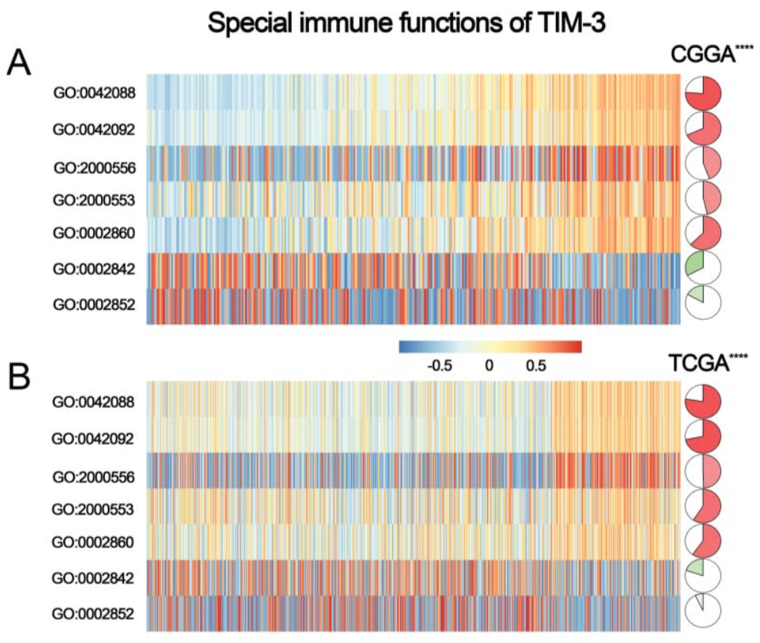
FIGURE 5
Complete reproduction of
CD96 immune-function analysis
GSVA heatmaps · correlation pies · checkpoint matrices
CGGA discovery · TCGA validation
Notes:
The updated workflow now covers all four Figure 5 panels: GSVA-based T-cell immunity panels A-B and checkpoint correlation panels C-D.
[Sources]
- https://doi.org/10.3389/fbioe.2020.00592
- https://doi.org/10.1186/1471-2105-14-7

Slide 2
ANALYTICAL QUESTION
Figure 5 combines pathway activity and gene co-expression
7 immune GO
pathways
Immune-checkpoint
genes
CD96 expression
•
Panels A-B ask whether sample-level pathway activity changes with CD96 expression.
•
Panels C-D ask whether CD96 is co-expressed with other checkpoint markers.
•
CGGA and TCGA are analyzed separately to evaluate reproducibility.
FIGURE 5 · COMPLETE REPRODUCTION
02
Notes:
Separate the two statistical questions: pathway-level association in A-B and gene-level co-expression in C-D.
[Sources]
- https://doi.org/10.3389/fbioe.2020.00592

Slide 3
FOUR-PANEL MAP
Each panel has a distinct input and statistical target
A
B
C
D
CGGA GSVA
TCGA GSVA
CGGA checkpoints
TCGA checkpoints
Input
Input
Input
Input
Full expression matrix
Full expression matrix
7 gene expressions
7 gene expressions
Association
Association
Association
Association
Spearman
Spearman
Pearson
Pearson
FIGURE 5 · COMPLETE REPRODUCTION
03
Notes:
A-B require full expression matrices because GSVA scores each pathway in every sample. C-D require only the selected checkpoint genes.
[Sources]

Slide 4
INPUT STRUCTURE
The two expression matrices use different gene identifiers
CGGA
TCGA
Gene symbols × 325 samples
Ensembl IDs × tumor samples
•
First column: A1BG, A2M, CD96…
•
Remove Ensembl version suffix
•
Remaining columns: CGGA_1001…
•
Map Ensembl → gene symbol
•
RSEM abundance values
•
Retain sample type 01
•
No ID conversion required
•
Collapse duplicated symbols
Rows must represent genes; columns must represent individual tumors.
FIGURE 5 · COMPLETE REPRODUCTION
04
Notes:
The supplied CGGA excerpt confirms a symbol-by-sample matrix. The full local file is required for GSVA; the excerpt is only sufficient for format validation.
[Sources]

Slide 5
GENE SETS
Seven prespecified GO terms define T-cell immune functions
GO:0042088
T-helper 1 immune response
Gene-set source
GO:0042092
Type 2 immune response
Current GO annotations are retrieved locally from org.Hs.eg.db.
GO:2000556
Th1 cytokine production
Historical rule
GO:2000553
Th2 cytokine production
If GO:0002852 is unavailable, use MUC4 as in the supplied code.
GO:0002860
NK cytotoxicity against tumor
GO:0002842
T-cell response to tumor
GO:0002852
T-cell cytotoxicity against tumor
FIGURE 5 · COMPLETE REPRODUCTION
05
Notes:
The pathways are prespecified biological functions, not selected from the current enrichment tables. The GO:0002852 fallback is retained for historical replication but is biologically weak because it reduces the set to one gene.
[Sources]

Slide 6
GSVA PRINCIPLE
GSVA converts gene expression into sample-level pathway scores
Gene-set enrichment
within each sample
Gene-expression ranks
GSVA score
•
For each tumor, GSVA contrasts expression ranks inside versus outside a pathway gene set.
•
Positive score: coordinated pathway genes are relatively high in that sample.
•
Negative score: pathway genes are relatively low—not a negative expression value.
Output: 7 pathways × N tumors
FIGURE 5 · COMPLETE REPRODUCTION
06
Notes:
GSVA is unsupervised: CD96 is not used to calculate the pathway score. CD96 enters only after scoring, for ordering and correlation.
[Sources]
- https://doi.org/10.1186/1471-2105-14-7

Slide 7
ORDERING AND ASSOCIATION
Sample ordering makes the CD96 gradient visible
cd96 <- expr["CD96", ]
ord <- order(cd96)
expr <- expr[, ord]
scores <- run_gsva_compatible(expr, go_sets)
cor.test(scores[pathway, ], cd96[ord],
method = "spearman")
1 · Order samples
Left = low CD96; right = high CD96
2 · Keep pathway scores
Do not cluster columns after ordering
3 · Test monotonic trend
Spearman rho is robust to non-normal expression
FIGURE 5 · COMPLETE REPRODUCTION
07
Notes:
Ordering does not affect the correlation coefficient; it only makes the heatmap trend interpretable. Spearman correlation evaluates whether pathway scores increase or decrease monotonically with CD96.
[Sources]

Slide 8
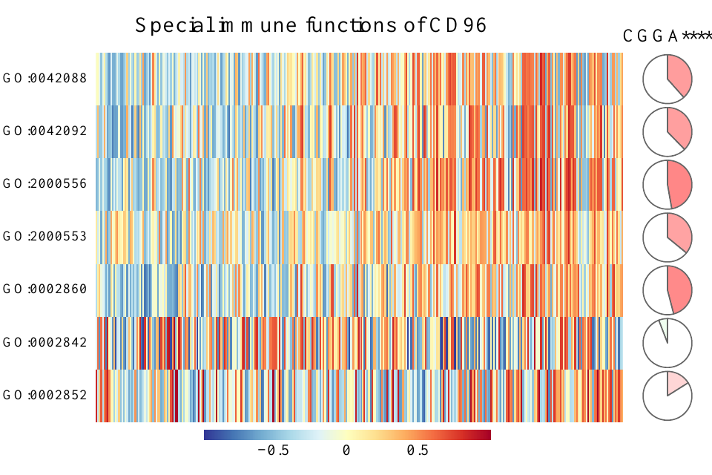
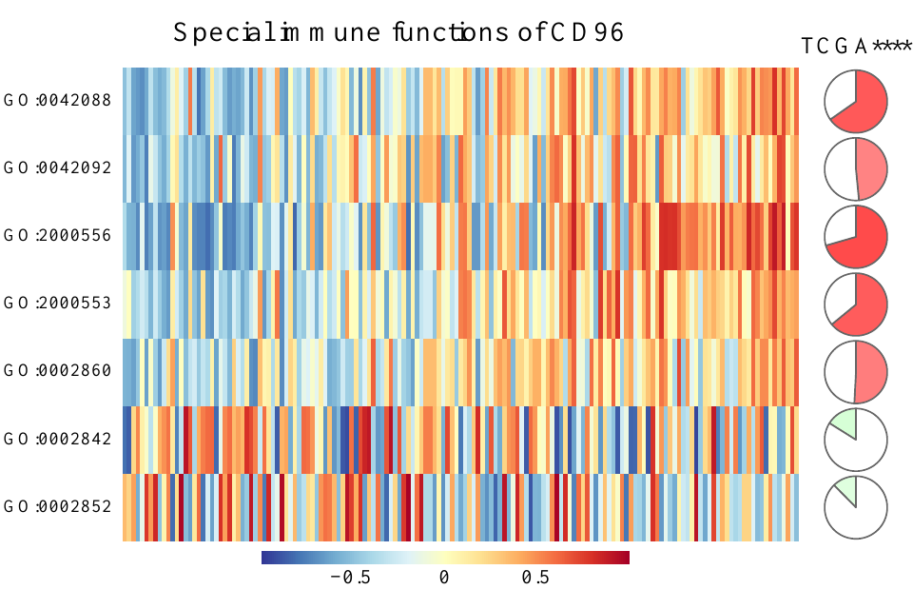
GSVA HEATMAPS
Panels A-B display pathway activity across ordered tumors
CGGA
TCGA
Blue = lower GSVA activity · Red = higher GSVA activity
FIGURE 5 · COMPLETE REPRODUCTION
08
Notes:
The heatmap cells are GSVA scores, not individual gene-expression values. Each column is one tumor ordered by CD96 expression.
[Sources]
- https://doi.org/10.3389/fbioe.2020.00592

Slide 9
CORRELATION PIES
The pie summarizes strength, direction, and significance
Positive
Negative
P-value stars
Red · clockwise
Green · counterclockwise
* P < 0.05
** P < 0.01
*** P < 0.001
**** P < 0.0001
filled fraction = |ρ|
filled fraction = |ρ|
white fraction = 1 − |ρ|
white fraction = 1 − |ρ|
The revised code calculates stars; they are not hard-coded.
FIGURE 5 · COMPLETE REPRODUCTION
09
Notes:
The original tutorial hard-coded four stars in the cohort label. The revised workflow derives significance symbols for each pathway from its Spearman test.
[Sources]

Slide 10
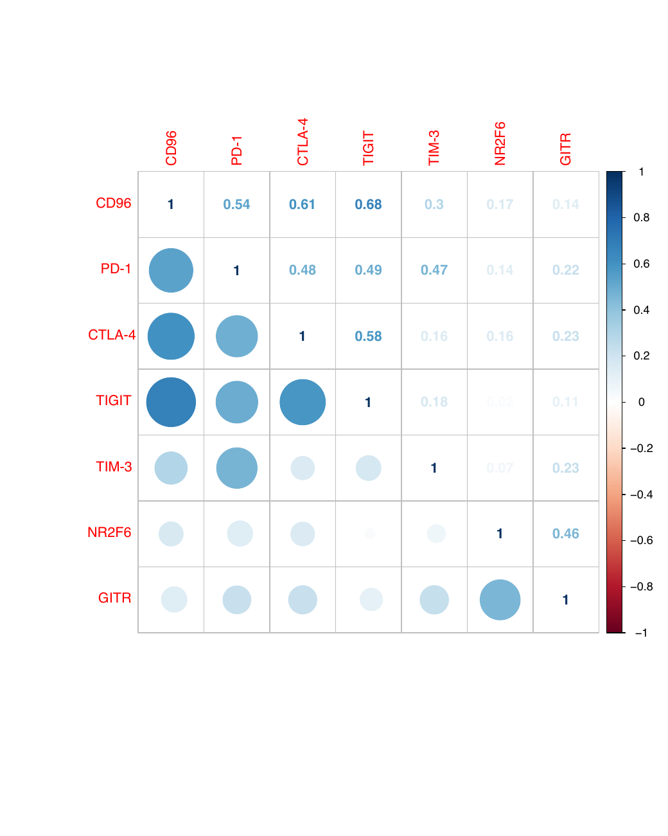
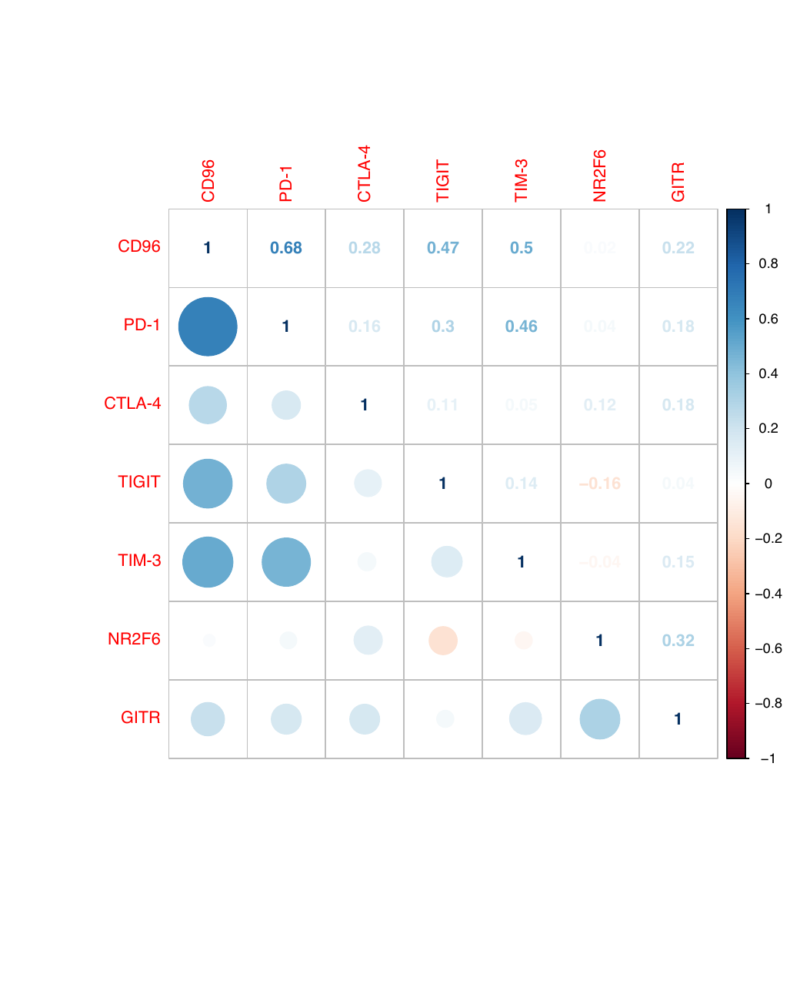
CHECKPOINT MATRICES
Panels C-D test checkpoint co-expression directly
CGGA
TCGA
FIGURE 5 · COMPLETE REPRODUCTION
10
Notes:
These panels use Pearson correlations across tumor samples. Circle size and color encode r in the lower triangle; numeric r values appear in the upper triangle.
[Sources]
- https://doi.org/10.3389/fbioe.2020.00592

Slide 11
CODE · CGGA
The loader handles the full CGGA matrix without ID conversion
read_cgga <- function(path) {
x <- read.table(path, sep = "\t", header = TRUE,
row.names = 1, check.names = FALSE)
x[] <- lapply(x, as.numeric)
rownames(x) <- trimws(rownames(x))
collapse_duplicate_genes(as.matrix(x))
}
cgga_expr <- read_cgga(
"CGGA.mRNAseq_325.RSEM-genes.20190909.txt"
)
Validated from the excerpt
•
Gene symbols in row names
•
325 CGGA sample columns
•
Tab-delimited numeric values
•
Full file remains local
The six-line excerpt cannot run GSVA because most pathway genes are absent.
FIGURE 5 · COMPLETE REPRODUCTION
11
Notes:
The full CGGA file can remain on the analysis server. Only its path is passed to the script; it does not need to be uploaded to the presentation workflow.
[Sources]

Slide 12
CODE · TCGA
The TCGA loader standardizes IDs and tumor samples
ensembl <- sub("\\..*$", "", rownames(x))
map <- AnnotationDbi::select(
org.Hs.eg.db, keys = ensembl,
keytype = "ENSEMBL", columns = "SYMBOL"
)
sample_type <- substr(colnames(x), 14, 15)
x <- x[, sample_type == "01"]
rownames(x) <- map$SYMBOL
x <- collapse_duplicate_genes(x)
Why every step matters
•
Versions prevent direct ID matching
•
Some Ensembl IDs lack symbols
•
Barcode 01 identifies primary tumor
•
Multiple IDs can map to one symbol
TCGA input is already log2(FPKM + 1).
FIGURE 5 · COMPLETE REPRODUCTION
12
Notes:
The supplied TCGA easy input contains Ensembl version suffixes and a mix of sample barcodes. The revised code standardizes both dimensions before GSVA.
[Sources]

Slide 13
CODE · GSVA
The script supports both old and current GSVA interfaces
if (packageVersion("GSVA") >= "1.50.0") {
param <- gsvaParam(
exprData = expr, geneSets = go_sets,
kcdf = "Gaussian", minSize = 1
)
scores <- gsva(param, verbose = FALSE)
} else {
scores <- gsva(
expr, go_sets, method = "gsva",
kcdf = "Gaussian", min.sz = 1
)
}
Automatic scale handling
Large non-negative RSEM values are transformed as log2(x + 1).
Gene-set overlap is audited
The output table reports annotation size and the number of genes found in each cohort.
FIGURE 5 · COMPLETE REPRODUCTION
13
Notes:
The revised wrapper avoids failure when the local GSVA package uses the newer parameter-object API. It also documents gene-set coverage, an important reproducibility check.
[Sources]
- https://bioconductor.org/packages/GSVA

Slide 14
RUN AND OUTPUTS
One command generates the complete figure and audit tables
Rscript Figure5_CD96_correlation_analysis.R \
CGGA.mRNAseq_325.RSEM-genes.20190909.txt \
easy_input_expr.csv easy_input_GO.txt \
corrgram_CGGA.txt corrgram_TCGA.txt \
Figure5_outputs
Primary output
Figure5_complete_reproduction.pdf
Audit outputs
CGGA/TCGA GSVA matrices · pathway rho/P/FDR tables · checkpoint r matrices
Reproducibility
Every plotted value is preserved in a CSV file.
FIGURE 5 · COMPLETE REPRODUCTION
14
Notes:
The complete CGGA matrix is expected to reside locally. The script writes both presentation-ready graphics and the underlying numeric results.
[Sources]

Slide 15
QUALITY CONTROL
Four checks prevent a visually correct but invalid figure
1
Gene mapping
Confirm CD96 and all seven gene sets overlap the expression matrix.
2
Sample identity
Use tumors only and remove duplicate sample identifiers.
3
Pathway size
Flag single-gene or very small GO sets, especially GO:0002852.
4
Interpretation
Association can reflect immune-cell abundance; it is not causal regulation.
FIGURE 5 · COMPLETE REPRODUCTION
15
Notes:
These checks are essential because GSVA will still return a score even for very small gene sets, and bulk-tumor co-expression can be driven by cellular composition.
[Sources]

Slide 16
TAKE-HOME
Figure 5 is now reproducible from raw matrices to final panels
A-B
Full expression → GO gene sets → GSVA → CD96 ordering → Spearman pies
C-D
Checkpoint expression → Pearson correlation matrices
Reproducibility
The revised script exports the complete figure plus every underlying score and coefficient.
CGGA full matrix is used locally; the uploaded excerpt validates format only.
FIGURE 5 · COMPLETE REPRODUCTION
16
Notes:
Close by emphasizing that the workflow is end-to-end and auditable, while retaining clear limitations for the obsolete GO term and bulk-expression correlations.
[Sources]
- https://doi.org/10.3389/fbioe.2020.00592

