Slide 1
Practical Public-Data
Bioinformatics
From TCGA / GEO to a realistic, publishable small bioinformatics study
DATA
ANALYZE
VALIDATE
WRITE
A summary teaching deck for personal-computer and web-based workflows
Target use case: public bulk-omics + clinical data; no wet lab required for the computational workflow.
Important: “IF 3–5” is a journal-range goal, not an analysis recipe or publication guarantee.
Notes:
This deck is a practical overview of how public-data bioinformatics studies are commonly designed when the main resources are a personal computer, R or Python, and public databases such as TCGA and GEO. The target is not a guaranteed impact factor. Instead, we are discussing the level of workflow often seen in small-to-mid impact bioinformatics papers using bulk omics and clinical data. The main message is that you usually do not need a cluster to begin. Processed expression matrices, clinical tables, mutation files, and web-based tools are sufficient for many projects. The challenge is not producing many plots. The challenge is building a coherent question, using appropriate statistics, validating the result independently, and writing a logical biological story.

Slide 2
Executive summary
OVERVIEW
What you should remember before learning individual analyses
1. Most work is feasible on a PC
2. A paper is a logic chain
3. Validation is the differentiator
Use processed expression matrices, clinical tables, MAF files, and curated GEO series. R can handle differential expression, survival, enrichment, immune scores, and many models on a normal workstation.
A stronger manuscript connects phenotype → molecular signal → biological mechanism → clinical relevance → independent validation. “Stacking websites” without a question is weak.
Independent GEO/TCGA cohorts, multivariable Cox analysis, sensitivity checks, and non-leaky modeling usually matter more than adding a tenth analysis.
Best beginner strategy: choose one disease + one biological question + one discovery cohort + one external validation cohort.
Notes:
There are three ideas to remember from the entire presentation. First, most common bulk-transcriptomic analyses are feasible on a normal personal computer if we start from processed data instead of raw sequencing reads. Second, a manuscript should be a logic chain, not a collection of unrelated website outputs. A strong sequence is phenotype, molecular signal, biological interpretation, clinical relevance, and independent validation. Third, validation usually adds more value than another decorative analysis. A second GEO cohort, multivariable Cox regression, sensitivity analysis, or properly separated test data can make the study much more credible. For a beginner, a good starting design is one disease, one biological question, one discovery cohort, and one external validation cohort.

Slide 3
What does a realistic “3–5 IF” public-data paper look like?
POSITIONING
The exact standard varies by journal and is rising over time
Often acceptable ingredients
Increasingly weak / saturated patterns
• Clear disease/clinical question
• Public cohort discovery + external validation
• Reproducible statistics in R/Python
• Biological interpretation (GO/KEGG/GSEA/GSVA)
• Clinical relevance (KM/Cox/ROC where appropriate)
• One or two orthogonal analyses (immune, mutation, network, drug response)
• Transparent limitations
• Single-gene “database stacking” with no novelty
• Dozens of websites producing disconnected figures
• Only P-values, no effect sizes or confidence intervals
• No external cohort
• LASSO model built and tested on the same data
• Nomogram added merely for decoration
• Claiming mechanism from correlation alone
A small paper can be computationally simple but must be methodologically coherent.
Notes:
A realistic public-data paper in this journal range usually contains several basic ingredients: a clear disease or clinical question, a discovery cohort, external validation, reproducible statistics, biological interpretation, and some form of clinical relevance when appropriate. One or two orthogonal analyses, such as immune infiltration or mutation context, can strengthen the story if they directly answer the central question. What is increasingly weak is the older pattern of taking a single gene and stacking many databases around it without a specific hypothesis. Reviewers are also more sensitive to overfitting, arbitrary cutoffs, missing external validation, and mechanistic claims based only on correlation. So the goal is not to maximize the number of analyses. It is to maximize methodological coherence and evidential strength.

Slide 4
Public data sources: what each one is good for
DATA
Use sources according to the data type you need
TCGA / GDC
GEO
cBioPortal
Optional add-ons
Cancer RNA-seq, clinical data, mutations, CNV, methylation and other harmonized datasets. Best for discovery cohorts and multi-omics context.
Microarray and RNA-seq studies from many diseases and experimental designs. Excellent for independent external validation and disease-specific cohorts.
Interactive exploration of mutations, copy number, expression, clinical attributes and survival across curated cancer studies.
GTEx for normal-tissue context; CPTAC for proteomics in selected cancers; disease-specific resources such as CGGA when appropriate.
Official sources used in this deck: NCI Genomic Data Commons (GDC), NCBI GEO, cBioPortal documentation.
Notes:
This slide separates the major public resources by function. TCGA, accessed through GDC or curated portals, is usually best for cancer discovery because it combines RNA expression, clinical data, mutations, copy number, methylation, and other omics. GEO is broader and often ideal for independent validation because it contains many disease-specific microarray and RNA-seq studies. cBioPortal is excellent for quick exploration of mutations, copy-number changes, expression, clinical variables, and survival in curated cancer cohorts. Additional resources can be added when they serve a specific purpose—for example, GTEx for normal-tissue context, CPTAC for proteomic confirmation, or CGGA for glioma-specific validation. The practical principle is to choose the database because of the required data type, not because the website is popular.

Slide 5
What can be done on a personal computer?
COMPUTE
A practical compute map for bulk bioinformatics
Task
Difficulty
Typical RAM
Best route
Comment
Expression matrix + clinical data
Easy
8–16 GB RAM
R / Python
Most TCGA/GEO analyses
Differential expression / survival / enrichment
Easy
8–16 GB RAM
R
Minutes to tens of minutes
Immune scoring / GSVA / WGCNA
Moderate
16–32 GB RAM
R
Depends on genes × samples
MAF mutation analysis / CNV summaries
Easy–Moderate
16 GB RAM
R / cBioPortal
Processed files recommended
Raw RNA-seq FASTQ alignment
Heavy
32+ GB / many cores
Server / cloud
Avoid for a first public-data paper
Large single-cell / spatial datasets
Heavy
32–128+ GB
Workstation / server
Not required for a basic study
Rule of thumb: download processed matrices first. Raw-read processing is a separate bioinformatics project.
Notes:
A useful beginner question is: what can I actually run on my own computer? For processed bulk-omics data, the answer is most of the common workflow. Expression matrices, clinical analysis, differential expression, survival analysis, pathway enrichment, and mutation summaries are usually easy with 8 to 16 gigabytes of RAM. GSVA, immune scoring, and WGCNA may benefit from 16 to 32 gigabytes, depending on matrix size. The tasks that become genuinely heavy are raw FASTQ alignment and very large single-cell or spatial datasets. For a first public-data paper, there is usually no need to start from raw reads. Downloading processed matrices is not a shortcut in a negative sense; it simply places the project at the statistical-analysis layer rather than the sequence-processing layer.

Slide 6
Four common manuscript archetypes
DESIGN
Choose one architecture before choosing tools
Single gene / immune checkpoint
Expression → clinicopathology → survival → pathways → immune context → validation
A
Prognostic gene signature
DEGs → candidate genes → LASSO/Cox → risk score → validation → nomogram/biology
B
Hub-gene / network study
DEGs or WGCNA modules → PPI / hub genes → validation → survival / function
C
Immune / pathway score
GSVA/ssGSEA or immune score → subtype/phenotype → survival → immune checkpoint / therapy relevance
D
Notes:
Before choosing software, choose the manuscript architecture. This slide shows four common patterns. A single-gene or immune-checkpoint paper follows expression, clinical association, prognosis, pathways, immune context, and validation. A prognostic-signature paper starts from a candidate gene space, performs feature selection and Cox modeling, creates a risk score, and requires careful internal and external validation. A hub-gene paper uses differential expression or WGCNA, then PPI or network analysis, and finally validates prioritized genes. An immune or pathway-score paper uses GSVA, ssGSEA, or deconvolution scores as the central feature. These are not rigid templates, but choosing one architecture early prevents the project from becoming a collection of disconnected analyses.

Slide 7
The end-to-end workflow
WORKFLOW
A paper is a sequence of decisions, not a pile of plots
1
2
3
4
5
6
7
8
Question
Cohorts
QC
Discovery
Mechanism
Clinical
Validation
Manuscript
Discovery asks
Mechanism asks
Validation asks
What molecular feature differs, predicts, or clusters the phenotype?
Which pathways, immune processes, networks, or genomic features track with it?
Does the result survive a second cohort, covariate adjustment, and sensitivity checks?
If a step does not answer a manuscript question, it probably does not belong in the main figures.
Notes:
This is the end-to-end workflow I recommend using as a mental model. Begin with a question, then choose cohorts, perform quality control, identify the main molecular signal, interpret its biology, test clinical relevance, validate it independently, and only then assemble the manuscript. Each step has a distinct question. Discovery asks what differs, predicts, or clusters the phenotype. Mechanistic analysis asks what pathways, immune processes, networks, or genomic features accompany that signal. Validation asks whether the result survives a second cohort, covariate adjustment, and sensitivity checks. A simple rule is that every main figure should answer one manuscript question. If an analysis does not strengthen the central claim, it probably belongs in the supplement or should be removed.

Slide 8
Step 1 — Start from a biological or clinical question
QUESTION
Good questions constrain the analysis menu
Weak starting point
Better starting point
Best starting point
“I found gene X. What analyses can I add?”
This tends to produce disconnected survival, immune, PPI, drug, and pathway plots with no central claim.
“Is gene X a marker of an aggressive immune phenotype in disease Y, and does it carry independent prognostic information?”
Now each analysis has a job.
Define population, endpoint, exposure/feature, comparison, discovery cohort, validation cohort, and one plausible biological mechanism before coding.
Design sentence template: “In [disease], we test whether [molecular feature] is associated with [phenotype/end point] and validate the finding in [independent cohort].”
Notes:
The quality of the project is often determined before any code is written. A weak starting point is, 'I found gene X; what analyses can I add?' That encourages database stacking. A better question is specific: for example, is gene X associated with an aggressive immune phenotype in disease Y, and does it provide independent prognostic information? The best formulation goes one step further and defines the population, endpoint, molecular feature, comparison, discovery cohort, validation cohort, and plausible biological mechanism. The sentence at the bottom is a useful template for a proposal or introduction. If you can state the study in one sentence before coding, it becomes much easier to decide which analyses are necessary and which are merely decorative.

Slide 9
Step 2 — Preprocessing and quality control
QC
Most irreproducible mistakes happen before statistics
Confirm sample IDs, tumor/normal status, duplicate samples, and endpoint definitions.
Know the expression unit: raw counts, TPM/FPKM, log2-transformed intensity, or normalized microarray values.
Use a method compatible with the data type: DESeq2/edgeR for counts; limma for normalized continuous expression or voom-transformed counts.
For merged GEO datasets, inspect platform differences and batch effects before combining cohorts.
Document missing clinical variables and pre-specify how they will be handled.
Minimum QC outputs
Sample count table
Clinical missingness summary
PCA / clustering when relevant
Expression distribution check
Do not do this
Mix counts and TPM in the same model
Treat all “0” values as missing
Merge cohorts before checking platform/batch
Change endpoint definitions after seeing results
Notes:
Preprocessing is one of the least glamorous but most important stages. Before any statistical test, confirm sample identifiers, tumor versus normal labels, duplicate samples, and endpoint definitions. You must know whether the expression values are raw counts, TPM or FPKM, log-transformed values, or normalized microarray intensities because the appropriate method depends on the data type. DESeq2 and edgeR are designed for counts, while limma is commonly used for normalized continuous expression or voom-transformed counts. When combining GEO cohorts, platform differences and batch effects must be evaluated. Also document missing clinical data in advance. Many irreproducible results come from silently mixing data types, changing endpoints after looking at the results, or merging cohorts before inspecting batch structure.

Slide 10
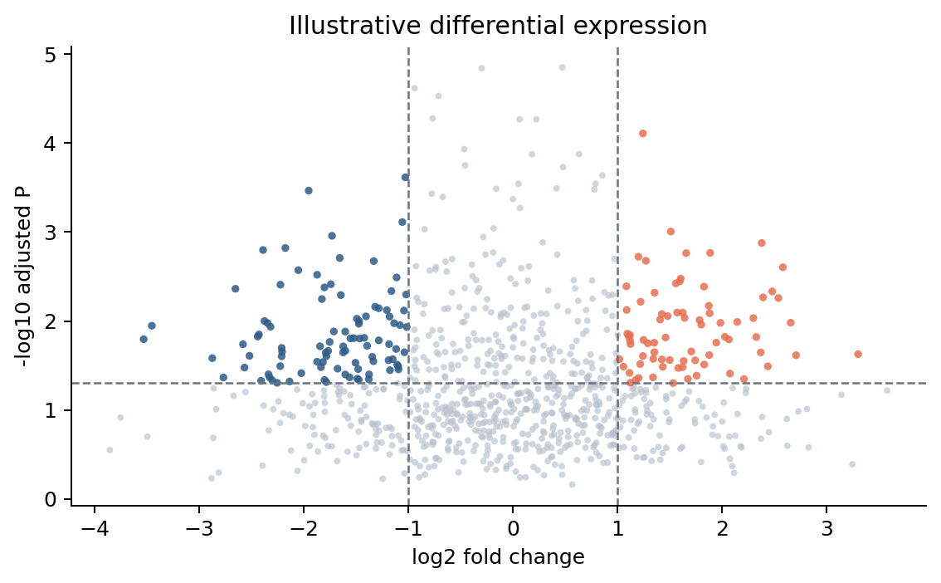
Step 3 — Differential expression and phenotype association
DISCOVERY
Two distinct questions: “what differs?” and “what correlates?”
Differential expression
Compare predefined biological groups: tumor vs normal, high vs low phenotype, responder vs non-responder. Report log2FC + adjusted P/FDR, not P-value alone.
Clinical association
Use boxplots or regression to test grade, stage, molecular subtype, mutation status, age, sex, etc. The correct test depends on variable type and distribution.
Common outputs: volcano plot • heatmap • box/violin plots • effect-size table
Figure is synthetic and only illustrates plot structure.
Notes:
This slide separates two questions that are often confused. Differential expression asks whether gene expression differs between predefined biological groups—for example, tumor versus normal or responder versus non-responder. The result should include an effect size such as log2 fold change together with an adjusted P value or FDR. Clinical association asks whether expression or a score is related to grade, stage, subtype, mutation status, age, sex, or another phenotype. The statistical test depends on the variable type and distribution. Typical outputs include volcano plots, heatmaps, box or violin plots, and effect-size tables. A good manuscript should not treat these graphics as endpoints by themselves. Each plot should establish a specific part of the biological or clinical argument.

Slide 11
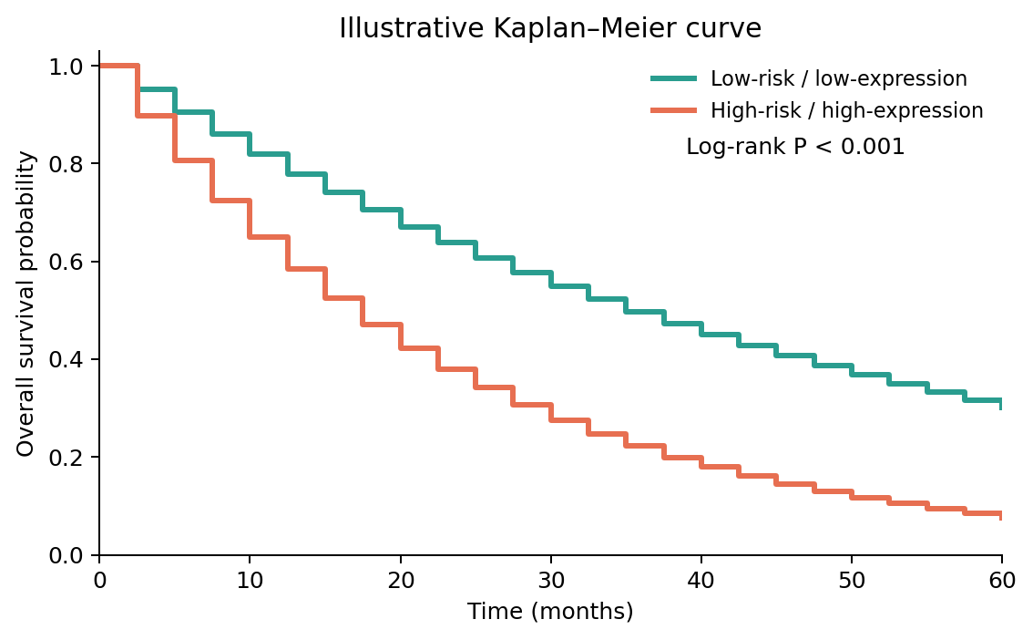
Step 4 — Survival and prognostic analysis
CLINICAL
Separate visualization, association, and independence
Kaplan–Meier + log-rank
Shows survival curves for predefined groups. Median splits are simple, but biologically justified cutoffs or continuous models are often preferable.
Univariate Cox
Tests whether each variable is associated with hazard. Report HR, 95% CI, and P-value.
Multivariable Cox
Asks whether the feature retains information after adjusting for major clinical covariates. Check proportional-hazards assumptions when feasible.
Cox model idea: hazard(t) = baseline hazard × exp(β₁X₁ + β₂X₂ + …)
Notes:
Survival analysis has three levels that should be kept conceptually separate. Kaplan–Meier curves are mainly visualization plus an unadjusted group comparison using the log-rank test. Univariate Cox regression estimates the hazard association of each variable and should report the hazard ratio, 95 percent confidence interval, and P value. Multivariable Cox regression asks whether the molecular feature retains prognostic information after adjustment for important clinical covariates. The Cox model represents hazard as a baseline hazard multiplied by an exponential function of the predictors. When possible, also examine the proportional-hazards assumption. A common mistake is to call a marker an independent prognostic factor based only on a Kaplan–Meier curve. Independence is a multivariable modeling question, not a visual one.

Slide 12
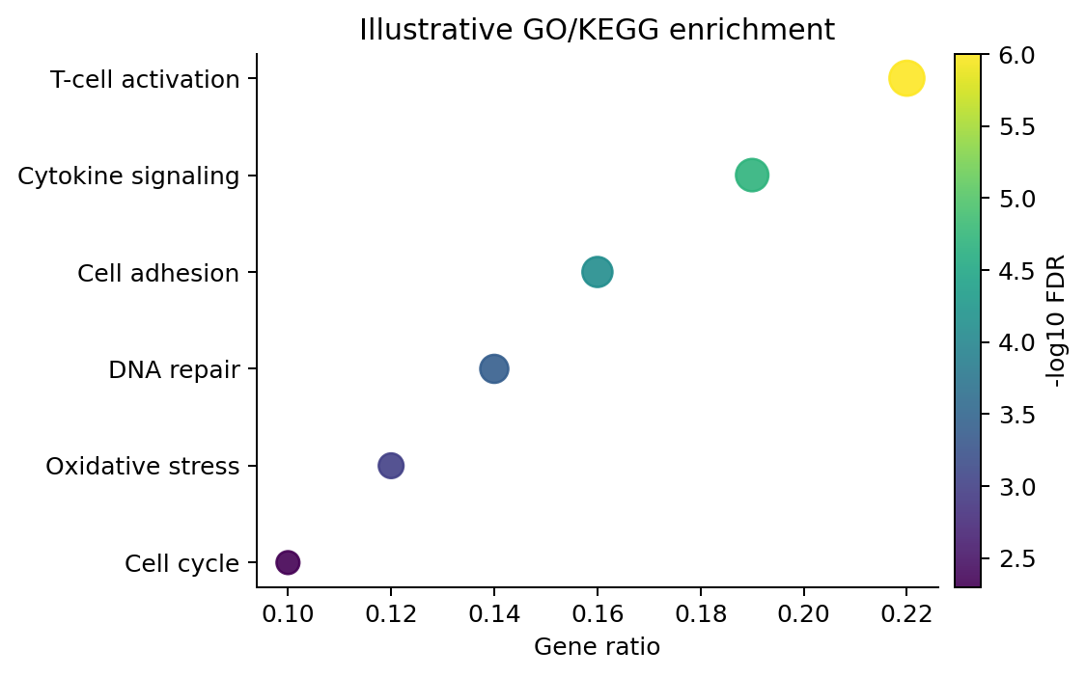
Step 5 — Functional interpretation
MECHANISM
Turn a gene list or expression pattern into biological hypotheses
GO / KEGG over-representation
Input: selected genes. Output: enriched terms. Sensitive to the cutoff used to select genes.
GSEA
Input: ranked gene list. Avoids an arbitrary DEG cutoff and asks whether predefined pathways shift toward one phenotype.
GSVA / ssGSEA
Input: expression matrix. Produces per-sample pathway scores that can be correlated with clinical or immune features.
Interpretation rule: enrichment supports pathway association — it does not prove biochemical mechanism.
Notes:
After identifying a molecular signal, we usually need to interpret what biology it may represent. Over-representation analysis with GO or KEGG starts from a selected gene list and asks which annotations are enriched, but the result depends on the cutoff used to select genes. GSEA instead starts from a ranked list and tests whether predefined gene sets accumulate toward one end, reducing dependence on an arbitrary DEG threshold. GSVA and ssGSEA work at the sample level: they convert an expression matrix into pathway scores for each patient, which can then be compared with clinical or immune features. The critical interpretation rule is that pathway enrichment supports association with a biological program. It does not prove that the pathway is mechanistically activated by the candidate gene.

Slide 13
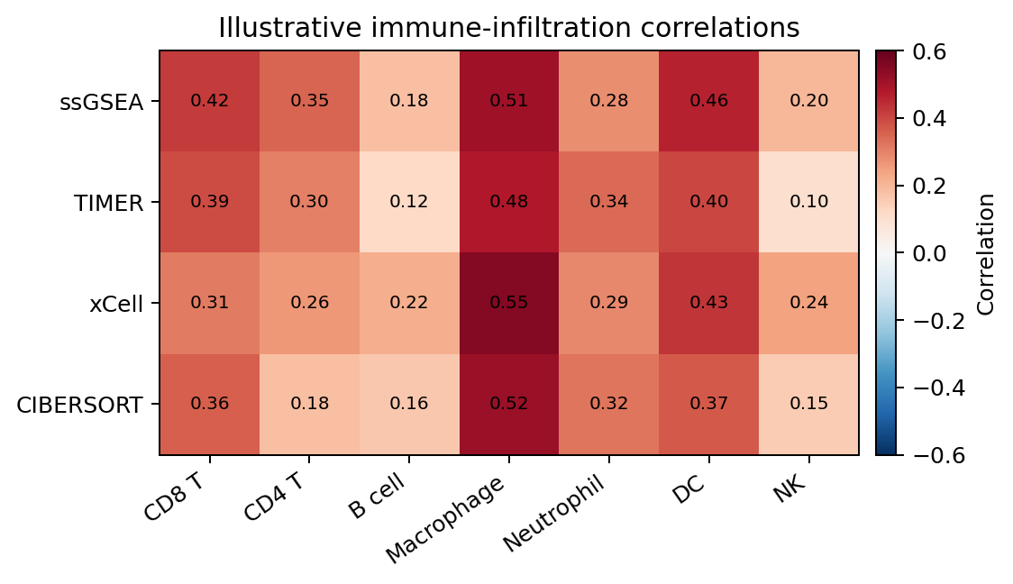
Step 6 — Tumor immune microenvironment analysis
IMMUNE
Useful when the biological question is genuinely immune-related
Common analyses
Immune-cell abundance scores, stromal/immune scores, checkpoint genes, cytolytic activity, HLA-related genes, immune subtypes.
Common tools
TIMER/TIMER2, xCell, CIBERSORT-family methods, ESTIMATE, ssGSEA/GSVA, TISCH/single-cell portals for contextual validation.
Reviewer concern
Figure is synthetic and only illustrates a correlation matrix.
Different deconvolution methods can disagree. Do not describe inferred cell abundance as direct histology.
Notes:
Immune-microenvironment analysis is useful when immunity is central to the biological question. Common outputs include inferred immune-cell abundance, stromal and immune scores, checkpoint expression, cytolytic activity, HLA-related genes, and immune subtypes. Tools such as TIMER, xCell, CIBERSORT-family methods, ESTIMATE, and ssGSEA provide different types of estimates. These methods are valuable, but they are computational deconvolution, not direct histology. Different algorithms can disagree because they use different marker sets and assumptions. A stronger paper may therefore compare more than one method or use single-cell and pathology resources for contextual support. The main point is to interpret immune estimates as inferred relative abundance or association, not as a direct cell count measured under a microscope.

Slide 14
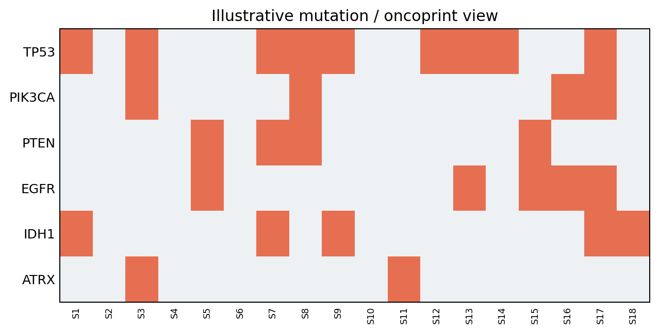
Step 7 — Genomic alterations and multi-omics context
GENOMICS
Add this only when it sharpens the story
Mutation / TMB
Use MAF data and maftools or cBioPortal to compare mutation frequencies, co-occurrence, or TMB-related patterns.
Copy number / methylation
Ask whether expression may be linked to amplification/deletion or promoter methylation.
Protein / pathway confirmation
Where available, CPTAC or RPPA can provide orthogonal evidence beyond transcript abundance.
Avoid “multi-omics” as a label if the analyses are merely decorative correlations.
Notes:
Genomic and multi-omics analyses can strengthen a paper when they explain the central expression or clinical signal. Mutation analysis can compare mutation frequencies, co-occurrence patterns, or tumor mutation burden using MAF files and tools such as maftools or cBioPortal. Copy-number and methylation data can help explain why a gene is overexpressed or underexpressed. Protein-level resources such as CPTAC or RPPA can provide evidence that extends beyond mRNA. However, 'multi-omics' should not become a label for several unrelated correlation plots. Add another omics layer only if it tests a specific hypothesis—for example, whether promoter methylation is inversely related to expression or whether copy-number amplification explains a high-expression subgroup.

Slide 15
Step 8 — Networks and hub genes
NETWORK
Useful for prioritization, not automatic proof of importance
STRING / PPI
Gene B
Gene D
Prioritize proteins with known/predicted functional associations. Network centrality is hypothesis-generating.
Gene A
Hub
Gene C
Gene E
WGCNA
Find co-expression modules associated with phenotype; suitable for moderate sample sizes and careful QC.
Typical route: DEG/WGCNA module → PPI → candidate hub genes → clinical + external validation
Key warning
“Hub gene” ≠ causal driver. Validate with independent evidence.
Notes:
Networks are mainly tools for prioritization. STRING or other PPI resources connect proteins with known or predicted functional relationships, and network centrality can help nominate candidates for further study. WGCNA approaches the problem from co-expression: it identifies modules of genes that vary together and then tests whether module eigengenes are associated with a phenotype. A common route is to identify a DEG set or WGCNA module, build a PPI network, select candidate hubs, and then validate those candidates clinically and in an external cohort. The important warning is that a network hub is not automatically a causal driver. Connectivity is evidence for prioritization, not proof of biological necessity. Strong claims require independent functional or experimental support.

Slide 16
Step 9 — Prognostic signatures and machine learning
MODELING
The main challenge is overfitting, not software
Discovery cohort
Internal validation
External cohort
Model-building options
Evaluation
Non-negotiable safeguards
Univariate screening
LASSO / elastic net
Multivariable Cox
Random forest / boosting (when justified)
Risk score construction
C-index
Time-dependent AUC
Calibration
Decision-curve analysis
KM separation
Train/test separation
Cross-validation inside training data
No feature selection on the test set
External validation if possible
Data leakage can make a weak model look excellent. AUC alone is not validation.
Notes:
Prognostic signatures and machine-learning models are attractive because the code is accessible, but they are also easy to overfit. Typical model-building options include univariate screening, LASSO or elastic net, multivariable Cox regression, and sometimes tree-based methods. After a risk score is constructed, evaluation may include the C-index, time-dependent AUC, calibration, decision-curve analysis, and Kaplan–Meier separation. The safeguards are more important than the model type. Training and test information must remain separated, cross-validation should occur within the training data, feature selection must not use the test set, and external validation is highly desirable. A high AUC from a leaky pipeline is not evidence of a good model. The real objective is performance that survives new patients and a new cohort.

Slide 17
Step 10 — External validation
VALIDATION
The best “extra analysis” is often a second cohort
Same cohort, same endpoint
Weakest — useful only as exploratory analysis
Level 1
Train/test split
Better — but both subsets share collection/platform biases
Level 2
Independent GEO/TCGA cohort
Strong — tests portability across studies/platforms
Level 3
Orthogonal modality or experiment
Strongest — protein, single-cell, pathology, or wet-lab confirmation
Level 4
Validation should reproduce the direction and practical effect — not merely produce another P < 0.05.
Notes:
External validation is often the highest-value additional analysis in a public-data paper. Reanalyzing the same cohort gives only exploratory support. A train-test split is better, but both subsets still share platform and collection biases. An independent GEO or TCGA cohort is stronger because it tests portability across studies and sometimes across technologies. Orthogonal validation—such as protein data, single-cell context, pathology, or wet-lab experiments—is stronger still. The purpose of validation is not simply to obtain another P value below 0.05. We want the direction of effect, practical magnitude, and biological interpretation to remain reasonably consistent. If the finding disappears in an independent cohort, that is important information and should influence the final claim.

Slide 18
Website toolbox: fast exploration and independent checks
WEB TOOLS
Web tools are excellent for validation and figure prototyping
GDC Data Portal
TCGA/TARGET harmonized files and cohort building
Primary data access
GEO / GEO2R
Study search, metadata, expression, quick differential analysis
External validation
cBioPortal
Mutation/CNV/expression/clinical exploration and survival
Genomic context
TIMER / TIMER2
Immune infiltration and gene–immune associations
Immune context
GEPIA2
TCGA/GTEx expression and survival exploration
Quick expression check
STRING
Protein association networks + functional enrichment
PPI / network
g:Profiler / Enrichr
GO/pathway enrichment
Fast functional annotation
Use web tools to confirm or explore. For the final manuscript, keep a reproducible local analysis whenever possible.
Notes:
Web tools are extremely useful for exploration, rapid validation, and figure prototyping. GDC is the primary route for harmonized TCGA and TARGET data. GEO and GEO2R help locate studies and perform quick study-level differential analyses. cBioPortal is useful for genomic alterations, expression, clinical variables, and survival. TIMER focuses on immune infiltration, GEPIA2 offers convenient TCGA and GTEx expression and survival checks, STRING builds protein-association networks, and enrichment portals provide fast functional annotation. The key workflow principle is to use websites to explore and cross-check, but keep the core manuscript analysis reproducible locally whenever possible. A reviewer should be able to understand the exact cohort, preprocessing, statistical test, and parameters rather than relying on a website state that may later change.

Slide 19
Local R toolbox: the practical core
R WORKFLOW
A small set of packages covers most bulk-data papers
Data / plotting
tidyverse, data.table, ggplot2, ComplexHeatmap
Network
WGCNA, igraph; STRING via web/API
Differential expression
limma, edgeR, DESeq2
Models
glmnet, rms, caret / tidymodels
Survival
survival, survminer, timeROC / riskRegression
TCGA access
TCGAbiolinks or downloaded GDC files
Enrichment
clusterProfiler, enrichplot, fgsea, GSVA
GEO access
GEOquery
Mutation
maftools
You do not need to memorize every package. Learn the statistical question first, then the package.
Notes:
For local analysis, you do not need hundreds of R packages. A compact toolbox covers most bulk-data projects. Tidyverse, data.table, ggplot2, and ComplexHeatmap handle data manipulation and visualization. limma, edgeR, and DESeq2 cover the main differential-expression settings. survival and survminer handle standard survival workflows. clusterProfiler, fgsea, and GSVA cover much of functional analysis. maftools is widely used for mutation summaries, WGCNA and igraph for networks, glmnet and modeling frameworks for signatures, TCGAbiolinks for TCGA access, and GEOquery for GEO. The most important learning principle is not memorizing package syntax. First understand the statistical question, the required input, and the assumptions; then choose the package that implements that analysis correctly.

Slide 20
Example blueprint A — A focused single-gene paper
BLUEPRINT
A coherent 6–8 figure manuscript is better than 15 disconnected analyses
Fig. 1
Cohort + expression
Tumor/normal or subtype/grade association
Fig. 5
Immune context
Immune infiltration + checkpoint correlation
Fig. 2
Clinical phenotype
Mutation status, stage/grade, ROC if diagnostic question
Fig. 6
Genomic context
Mutation/CNV/methylation only if biologically relevant
Fig. 3
Prognosis
KM + univariate/multivariable Cox
Fig. 7
External validation
Independent GEO/TCGA/CGGA cohort
Fig. 4
Mechanism
High vs low expression → DEGs → GSEA/GO/KEGG
Fig. 8
Integrated model
Optional nomogram / drug response only if justified
Best use case: a biologically motivated gene/pathway with a specific phenotype and credible external cohort.
Notes:
This is a practical blueprint for a focused single-gene paper. Figure 1 establishes the cohort and expression pattern. Figure 2 connects the gene to clinical or molecular phenotype. Figure 3 tests prognosis using Kaplan–Meier and Cox models. Figure 4 provides biological interpretation through differential expression and enrichment. Figure 5 examines immune context if it is relevant. Figure 6 adds genomic or epigenetic information only if it helps explain the signal. Figure 7 is external validation in an independent cohort. An optional final figure may integrate a nomogram or another clinically justified model. Notice the logic: each figure has a different job. A coherent six-to-eight figure manuscript is usually stronger than a fifteen-figure manuscript where every analysis repeats the same basic association.

Slide 21
Example blueprint B — A prognostic signature paper
BLUEPRINT
Modeling papers need stronger validation than single-gene association papers
1. Candidate space
DEGs, pathway genes, immune genes, or literature-defined gene set
2. Training
Univariate Cox → LASSO/elastic net → multivariable model
3. Risk score
Score = Σ(coefficient × expression)
4. Internal validation
Cross-validation / bootstrap; C-index and time-dependent AUC
5. External validation
Apply frozen coefficients to an independent cohort
6. Clinical utility
Independent Cox, calibration, optional nomogram/DCA
7. Biology
GSEA/immune/drug analyses comparing high- vs low-risk groups
Most common failure: selecting genes using the entire dataset before splitting — this leaks test-set information into the model.
Notes:
A prognostic-signature paper requires stricter modeling discipline. Start with a defensible candidate space such as pathway genes, immune genes, or a discovery-derived DEG set. Build the model only within the training cohort, using methods such as univariate Cox screening followed by LASSO or elastic net and a final multivariable model. The risk score is calculated as the sum of each selected gene expression multiplied by its fixed coefficient. Internal validation estimates optimism, but external validation should apply the frozen coefficients without reselecting genes or retuning the model. Clinical utility can then be examined with independent Cox analysis, calibration, and possibly a nomogram or decision-curve analysis. The most dangerous error is selecting features using the entire dataset before splitting, because that leaks test information into the model.

Slide 22
What reviewers commonly attack
QUALITY
Fix these before adding more analyses
Statistical / design weaknesses
Interpretation / reporting weaknesses
• No external validation
• Inconsistent preprocessing
• Unclear endpoint or censoring
• Multiple testing ignored
• Confounding not adjusted
• Arbitrary cutoffs everywhere
• Overfitted LASSO/model
• Data leakage
• Mechanistic claims from correlation
• Website-only reproducibility
• No effect sizes / CIs
• Plots are redundant rather than complementary
Before submission, ask: “Which result would still convince a reviewer if every decorative figure were removed?”
Notes:
This slide is essentially a pre-submission checklist from the reviewer’s perspective. Common statistical weaknesses include no external validation, inconsistent preprocessing, unclear survival endpoints, failure to control multiple testing, inadequate confounder adjustment, and arbitrary cutoffs. Common interpretation problems include overfitted LASSO models, data leakage, claiming mechanism from correlation, relying entirely on websites, reporting only P values without confidence intervals, and producing many redundant figures. A useful test is to imagine removing every decorative plot. Which result would still persuade a skeptical reviewer that the central claim is real? If the answer is not clear, more figures are unlikely to fix the project. Strengthen the design, validation, or statistical reasoning instead.

Slide 23
Recommended learning order for a beginner
LEARNING
Learn the 80% that appears in most bulk-data manuscripts first
Data frames + ggplot2
Read expression and clinical tables; merge IDs; make boxplots/heatmaps
Week 1
Statistics + DEGs
t/Wilcoxon, linear models, FDR; limma/DESeq2 basics
Week 2
Survival
Surv object, KM, log-rank, Cox, HR/CI interpretation
Week 3
Enrichment
GO/KEGG/GSEA/GSVA and how to interpret them
Week 4
Immune + genomics
TIMER/ESTIMATE/ssGSEA, maftools/cBioPortal
Week 5
Validation + manuscript
Independent cohort, reproducible scripts, figure story, limitations
Week 6
Do not begin with single-cell, deep learning, or raw FASTQ processing unless your research question truly requires them.
Notes:
For a beginner, I recommend learning the high-frequency methods before advanced topics. Week one should focus on data frames, merging clinical and expression tables, and ggplot2. Week two adds basic statistical tests, multiple-testing correction, and differential-expression workflows. Week three covers survival objects, Kaplan–Meier curves, log-rank tests, Cox models, hazard ratios, and confidence intervals. Week four focuses on enrichment and the difference between GO/KEGG, GSEA, and GSVA. Week five adds immune and genomic context. Week six focuses on external validation, reproducible scripts, figure organization, and manuscript logic. There is no need to begin with single-cell analysis, deep learning, or raw FASTQ processing unless the scientific question genuinely requires those technologies.

Slide 24
Take-home checklist
SUMMARY
A compact standard for planning your first public-data bioinformatics paper
Before you start coding
The minimal “good” chain
□ One precise biological/clinical question
□ Discovery cohort + independent validation cohort
□ Correct data type and endpoint definitions
□ Core analysis selected because it answers the question
□ Multivariable adjustment when prognosis is claimed
□ FDR/effect sizes/CI reported
□ No data leakage in predictive modeling
□ Limitations stated honestly
Question → clean cohort → discovery → mechanism → clinical relevance → external validation → reproducible figures
Official starting points
NCI Genomic Data Commons (TCGA)
NCBI Gene Expression Omnibus (GEO)
cBioPortal
STRING
R/Bioconductor documentation
Core principle: fewer analyses, stronger logic, cleaner validation.
Notes:
This final checklist is the compact planning standard. Before coding, define one precise question and identify both a discovery cohort and an independent validation cohort. Confirm the data type and endpoint definitions, and choose each analysis because it answers part of the question. If you claim prognosis, use appropriate multivariable adjustment. Report effect sizes, confidence intervals, and FDR where relevant. If you build a predictive model, prevent data leakage. State limitations clearly. The minimal strong chain is question, clean cohort, discovery, biological interpretation, clinical relevance, external validation, and reproducible figures. The most important principle is shown at the bottom: fewer analyses with stronger logic and cleaner validation are usually more convincing than a large number of loosely connected analyses.

Slide 25
Selected resources and documentation
REFERENCES
Use current official documentation when implementing a workflow
NCI Genomic Data Commons (GDC): harmonized TCGA/TARGET cancer genomic and clinical data.
NCBI Gene Expression Omnibus (GEO): public functional genomics repository; GEO2R for quick study-level comparisons.
cBioPortal for Cancer Genomics: interactive exploration of multidimensional cancer genomic and clinical datasets.
STRING: known and predicted protein–protein / functional association networks and enrichment.
Bioconductor packages: limma, edgeR, DESeq2, clusterProfiler, GSVA, GEOquery, TCGAbiolinks.
R survival ecosystem: survival and survminer for Kaplan–Meier and Cox proportional-hazards analysis.
This deck is a methodological teaching summary. It does not imply that any specific analysis combination guarantees acceptance or a particular impact factor.
Notes:
These are the main resources to keep bookmarked when implementing the workflow. GDC is the official starting point for harmonized TCGA and TARGET data. GEO is the major public repository for functional genomics studies and is especially useful for finding external validation cohorts. cBioPortal provides convenient multidimensional cancer-genomics exploration, and STRING supports protein-association and functional-network analysis. For local work, Bioconductor documentation is the authoritative starting point for packages such as limma, edgeR, DESeq2, clusterProfiler, GSVA, GEOquery, and TCGAbiolinks. The survival and survminer ecosystem covers standard survival analysis. The final reminder is methodological: no specific combination of analyses guarantees publication or a particular impact factor. Journal fit, novelty, validation quality, biological plausibility, and transparent reporting all matter.

