Slide 1
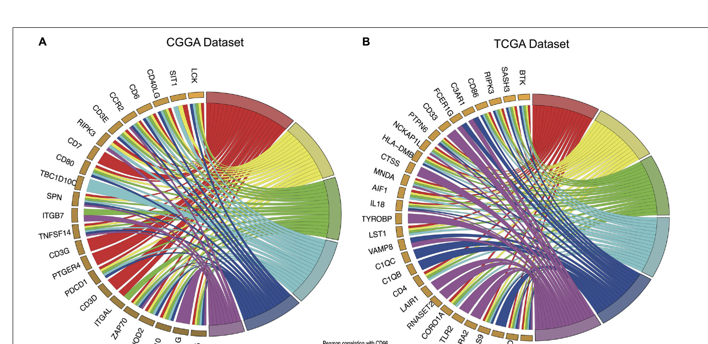
Reproducing CD96 Glioma Figure 3
GO enrichment visualization with clusterProfiler and GOplot
What this deck covers
• Clean and reusable R code
• Reproduce Figure 3-style GOChord plots
• Add alternative visualizations: bubble, bar, lollipop, cnet, GO circle, and GO cluster
• Interpret CD96-associated immune biology
Example datasets: CGGA and TCGA top 50 CD96-correlated genes
R workflow: clusterProfiler + GOplot + enrichplot
1
Notes:
Hello everyone. In this presentation, I will show how to organize the R code needed to reproduce Figure 3 from the CD96 glioma paper and how to extend the analysis with several additional GO enrichment plots. The original Figure 3 summarized Gene Ontology Biological Process enrichment for the top 50 genes most relevant to CD96 in the CGGA and TCGA cohorts. The main plot type was a GOChord plot, which connects enriched GO terms with the genes contributing to each term. In this deck, we will first review the analytical logic, then walk through the cleaned R workflow, and finally compare different plot types that can be used in a manuscript, presentation, or classroom demonstration.

Slide 2
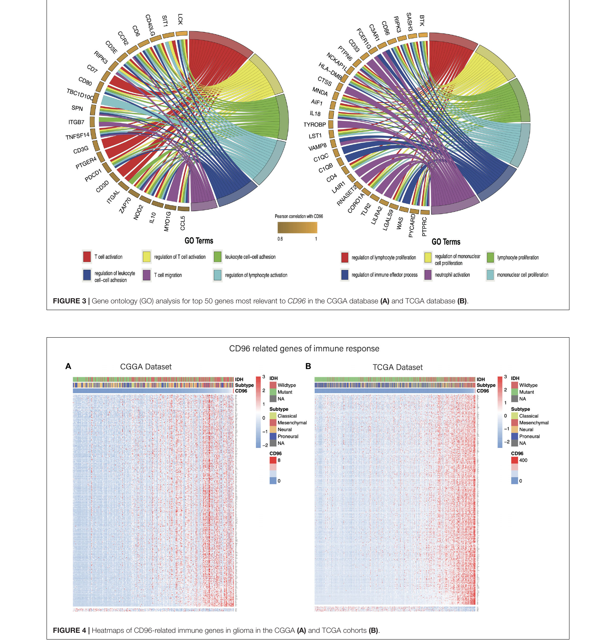
GO enrichment visualization | CD96 glioma Figure 3 reproduction
Background: what Figure 3 is showing
Original analysis logic
The paper used Spearman correlation to identify genes most strongly related to CD96. The top 50 genes were used for GO Biological Process enrichment, and Figure 3 visualized enriched immune-related terms in CGGA and TCGA.
CGGA dominant themes
TCGA dominant themes
T cell activation, regulation of T cell activation, leukocyte cell-cell adhesion, lymphocyte activation, and T cell migration.
Lymphocyte proliferation, mononuclear cell proliferation, immune effector regulation, neutrophil activation, and leukocyte adhesion.
Teaching point
The figure is not only a decorative chord diagram. It summarizes a gene-term relationship: which CD96-associated genes support which immune-related biological processes.
R workflow: clusterProfiler + GOplot + enrichplot
2
Notes:
This slide anchors the workflow to the original figure. In the paper, Figure 3 appears together with the section reporting that CD96 was significantly associated with immune functions in glioma. The CGGA panel emphasizes T cell activation and lymphocyte activation, whereas the TCGA panel emphasizes lymphocyte and mononuclear cell proliferation, immune effector regulation, and neutrophil activation. For students, the key point is that a GOChord plot combines two layers of information. The colored GO sectors represent biological processes, and the gene sectors represent the genes that contribute to those processes. This lets the reader see both pathway-level enrichment and gene-level support.

Slide 3
GO enrichment visualization | CD96 glioma Figure 3 reproduction
Overall workflow
1
2
3
4
5
Input
Map IDs
enrichGO
simplify
Plot
Top 50 genes
SYMBOL + log2fc
SYMBOL → ENTREZID
org.Hs.eg.db
GO Biological
Process enrichment
Remove redundant
GO terms
GOChord + bubble
+ bar + cnet + cluster
Run the full workflow
Rscript reproduce_CD96_glioma_Fig3_GO_plots.R
Inputs:
CGGA_top50.csv
TCGA_top50.csv
Outputs:
CD96_GO_reproduce_outputs/
R workflow: clusterProfiler + GOplot + enrichplot
3
Notes:
This slide summarizes the workflow. We start with two simple input files, one for CGGA and one for TCGA. Each file contains gene symbols and a log2 fold-change-like value or correlation-derived score for the top 50 CD96-associated genes. Next, we map gene symbols to ENTREZ IDs because clusterProfiler's enrichGO function works reliably with ENTREZ identifiers. We then run GO Biological Process enrichment and simplify redundant GO terms. Finally, we generate several figures. The main output for reproducing Figure 3 is the GOChord plot, and additional outputs include bubble plots, bar plots, lollipop plots, cnet plots, GO circle plots, and GO cluster plots.

Slide 4
GO enrichment visualization | CD96 glioma Figure 3 reproduction
Step 1: prepare top 50 gene input
Input cleaning
Why clean first?
read_gene_fc <- function(file) {
x <- readr::read_csv(file, show_col_types = FALSE)
stopifnot(all(c("SYMBOL", "log2fc") %in% colnames(x)))
x %>%
mutate(SYMBOL = as.character(SYMBOL),
log2fc = as.numeric(log2fc)) %>%
filter(!is.na(SYMBOL), !is.na(log2fc)) %>%
distinct(SYMBOL, .keep_all = TRUE)
}
The original code worked for a single dataset, but a reproducible script should check required columns, remove missing values, and avoid duplicated gene symbols before ID mapping.
Expected files
CGGA_top50.csv and TCGA_top50.csv, each with two columns: SYMBOL and log2fc. The same function can process both datasets.
Key improvement
The revised code is functionalized, so CGGA and TCGA can be analyzed with the same pipeline rather than repeated copy-paste blocks.
R workflow: clusterProfiler + GOplot + enrichplot
4
Notes:
The first step is input preparation. The original script had useful code, but it mixed R Markdown markers, a hard-coded local working directory, and dataset-specific blocks. In the cleaned script, I make the input step into a function. This function checks that the required columns are present, converts data types, removes missing values, and removes duplicated gene symbols. This makes the workflow safer and easier to reuse for both CGGA and TCGA.

Slide 5
GO enrichment visualization | CD96 glioma Figure 3 reproduction
Step 2: map gene symbols and run GO enrichment
ID mapping + enrichGO
GO enrichment requires a valid gene ID system.
ENTREZ ID mapping makes the workflow compatible with clusterProfiler.
The ontology is set to BP because Figure 3 focuses on Biological Process.
BH adjustment controls the false discovery rate across GO terms.
The result table includes GO ID, Description, GeneRatio, p.adjust, geneID, and Count.
map_symbol_to_entrez <- function(gene_fc) {
id_map <- bitr(gene_fc$SYMBOL,
fromType = "SYMBOL",
toType = "ENTREZID",
OrgDb = org.Hs.eg.db)
gene_fc %>%
left_join(id_map, by = "SYMBOL") %>%
filter(!is.na(ENTREZID)) %>%
distinct(ENTREZID, .keep_all = TRUE)
}
ego <- enrichGO(gene = entrez_fc$ENTREZID,
OrgDb = org.Hs.eg.db, keyType = "ENTREZID",
ont = "BP", pAdjustMethod = "BH",
pvalueCutoff = 0.05, qvalueCutoff = 0.05)
R workflow: clusterProfiler + GOplot + enrichplot
5
Notes:
The next step is ID mapping and enrichment. In R, gene symbols are easy to read, but enrichment tools usually require more stable identifiers. Here I use clusterProfiler's bitr function to map gene symbols to ENTREZ IDs using org.Hs.eg.db. After mapping, enrichGO tests whether the input genes are overrepresented in GO Biological Process terms. We use the Benjamini-Hochberg method for adjusted p values. This is also where we align our code with the paper, because the paper described GO Biological Process analysis of the top 50 genes most relevant to CD96.

Slide 6
GO enrichment visualization | CD96 glioma Figure 3 reproduction
Step 3: simplify redundant GO terms
Redundancy reduction
Why simplify?
ego2 <- simplify(
ego,
cutoff = 0.70,
by = "p.adjust",
select_fun = min
)
write_csv(as.data.frame(ego2),
file.path(out_dir, paste0(prefix,
"_enrichGO_simplify_BP.csv")))
GO terms are hierarchical and often redundant. Similar terms such as “T cell activation” and “regulation of T cell activation” may appear together.
How the script handles this
The simplify() function removes semantically similar terms and keeps the term with the smallest adjusted p value.
Practical recommendation
For reproduction, keep the enrichment and simplified tables. The unsimplified table preserves all GO results, while the simplified table is better for clean visualization.
R workflow: clusterProfiler + GOplot + enrichplot
6
Notes:
GO enrichment often produces many overlapping terms because the Gene Ontology is hierarchical. If we plot too many terms, the figure becomes difficult to read. The simplify step reduces redundancy by using semantic similarity. In the revised script, I keep both outputs: the original enrichment table and the simplified table. This is important for transparency. The original table is useful for supplementary results, while the simplified table is better for presentation-quality figures.

Slide 7
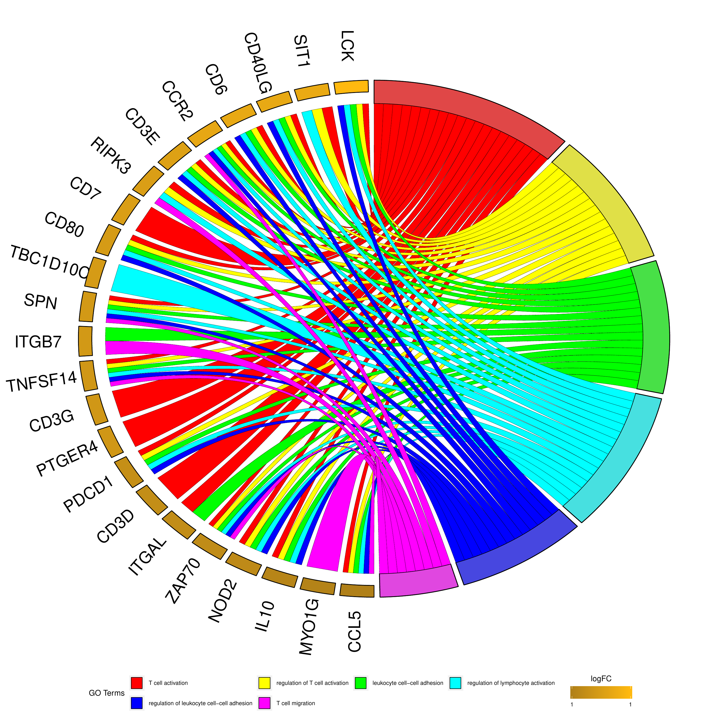
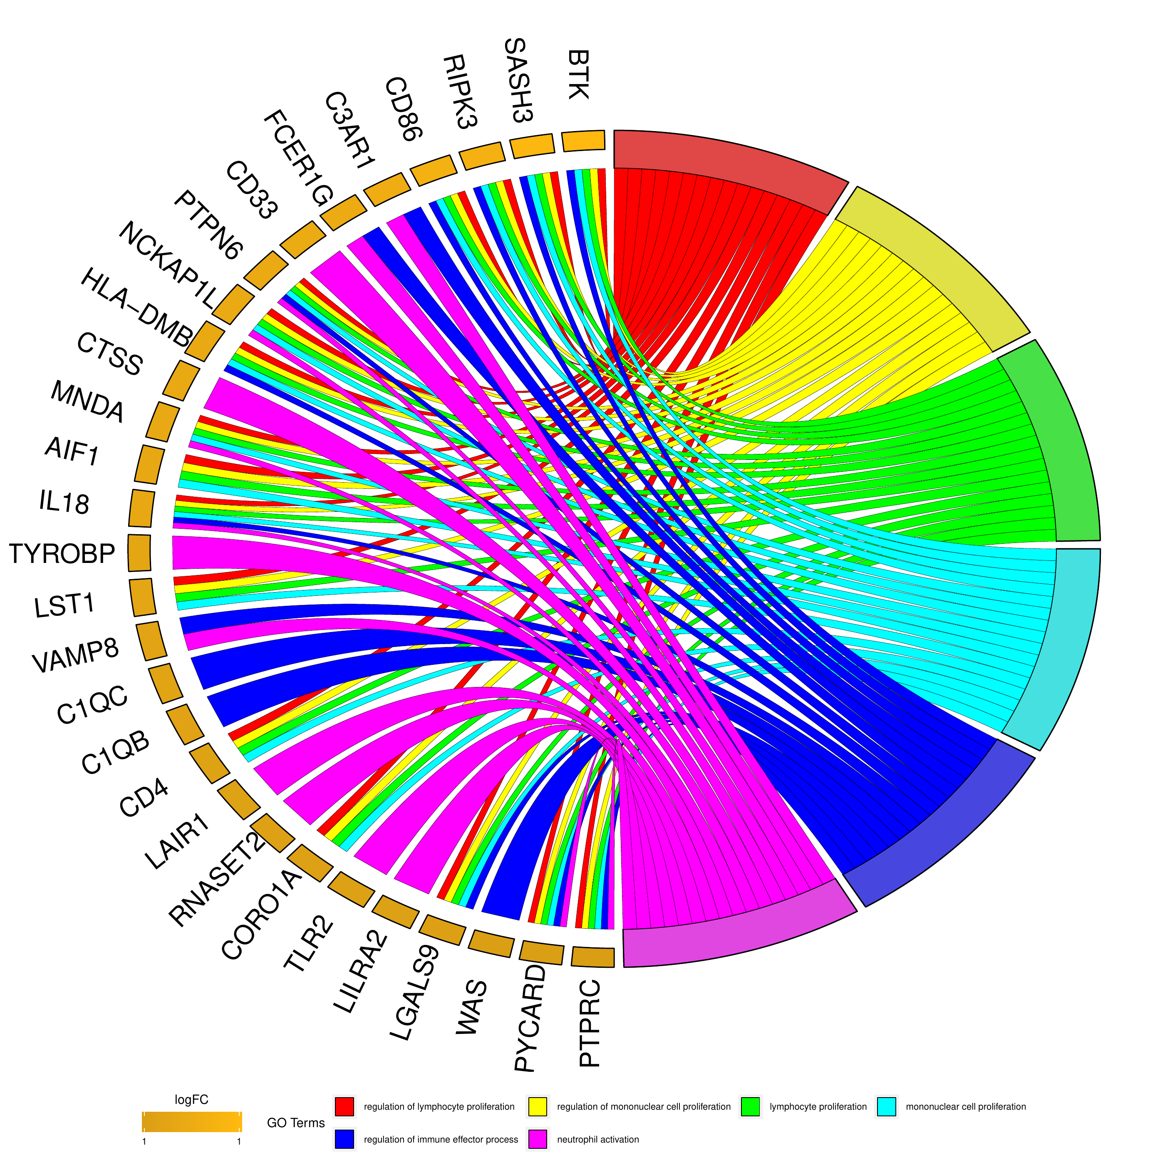
GO enrichment visualization | CD96 glioma Figure 3 reproduction
Step 4: reproduce Figure 3-style GOChord plots
CGGA GOChord
TCGA GOChord
R workflow: clusterProfiler + GOplot + enrichplot
7
Notes:
This slide shows the Figure 3-style output for both cohorts. The circular sectors on the right side of each chord plot are GO terms. The smaller sectors around the left side are genes. The ribbons indicate which genes belong to which GO terms. In the CGGA cohort, the strongest themes are T cell activation and related lymphocyte processes. In the TCGA cohort, the strongest themes include lymphocyte proliferation, mononuclear cell proliferation, immune effector regulation, and neutrophil activation. The biological interpretation is consistent: CD96-associated genes are strongly linked to immune activation and immune-cell interactions in glioma.

Slide 8
GO enrichment visualization | CD96 glioma Figure 3 reproduction
GOChord code: convert enrichment results to GOplot format
GOplot workflow
circle_dat() combines GO results with gene-level values.
chord_dat() selects the GO terms to display in the chord diagram.
GOChord() draws gene–term ribbons and gene-level color bars.
The script converts row names from ENTREZ IDs back to gene symbols for readable labels.
Use a small number of GO terms, usually 4–8, to avoid overcrowding.
go <- data.frame(Category = "BP",
ID = ego_df$ID,
Term = ego_df$Description,
Genes = gsub("/", ", ", ego_df$geneID),
adj_pval = ego_df$p.adjust)
genelist <- data.frame(ID = entrez_fc$ENTREZID,
logFC = entrez_fc$log2fc)
circ <- circle_dat(go, genelist)
chord <- chord_dat(circ, genelist, go$Term[1:6])
GOChord(chord_symbol, gene.order = "logFC",
lfc.col = c("darkgoldenrod1", "black", "cyan1"),
gene.space = 0.25, gene.size = 5,
border.size = 0.1, process.label = 8)
R workflow: clusterProfiler + GOplot + enrichplot
8
Notes:
This slide shows the key code structure for GOChord. GOplot requires its own format, so we first transform the enrichGO result into a data frame with category, ID, term, genes, and adjusted p value. Then circle_dat combines this GO table with the gene-level values. Next chord_dat selects the GO terms to display. Finally GOChord draws the plot. A practical detail is that the chord plot is much easier to read if the row names are gene symbols rather than ENTREZ IDs, so the revised script performs that conversion automatically.

Slide 9
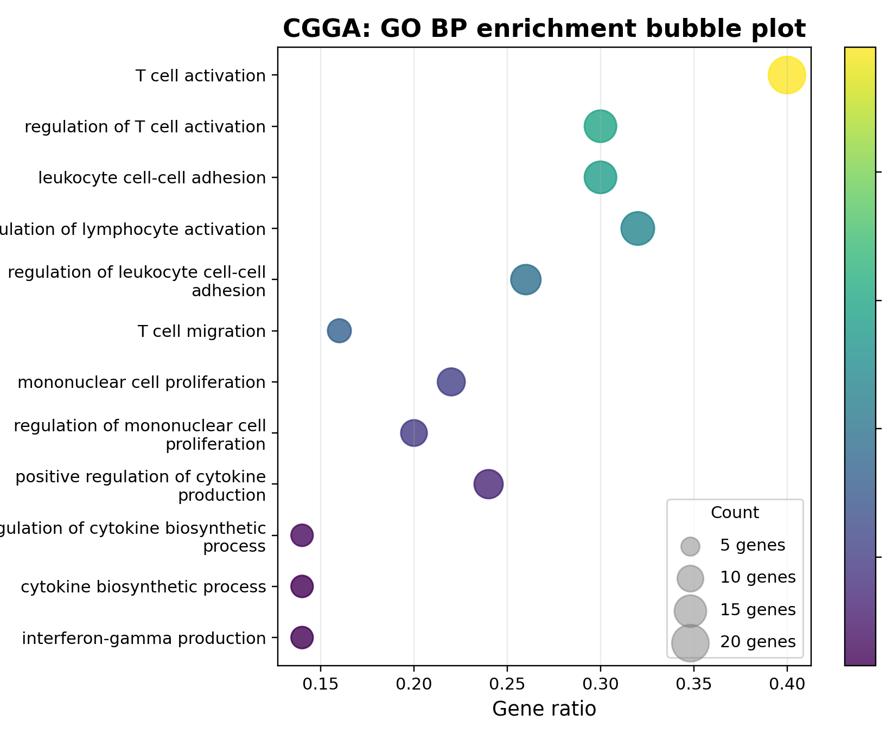
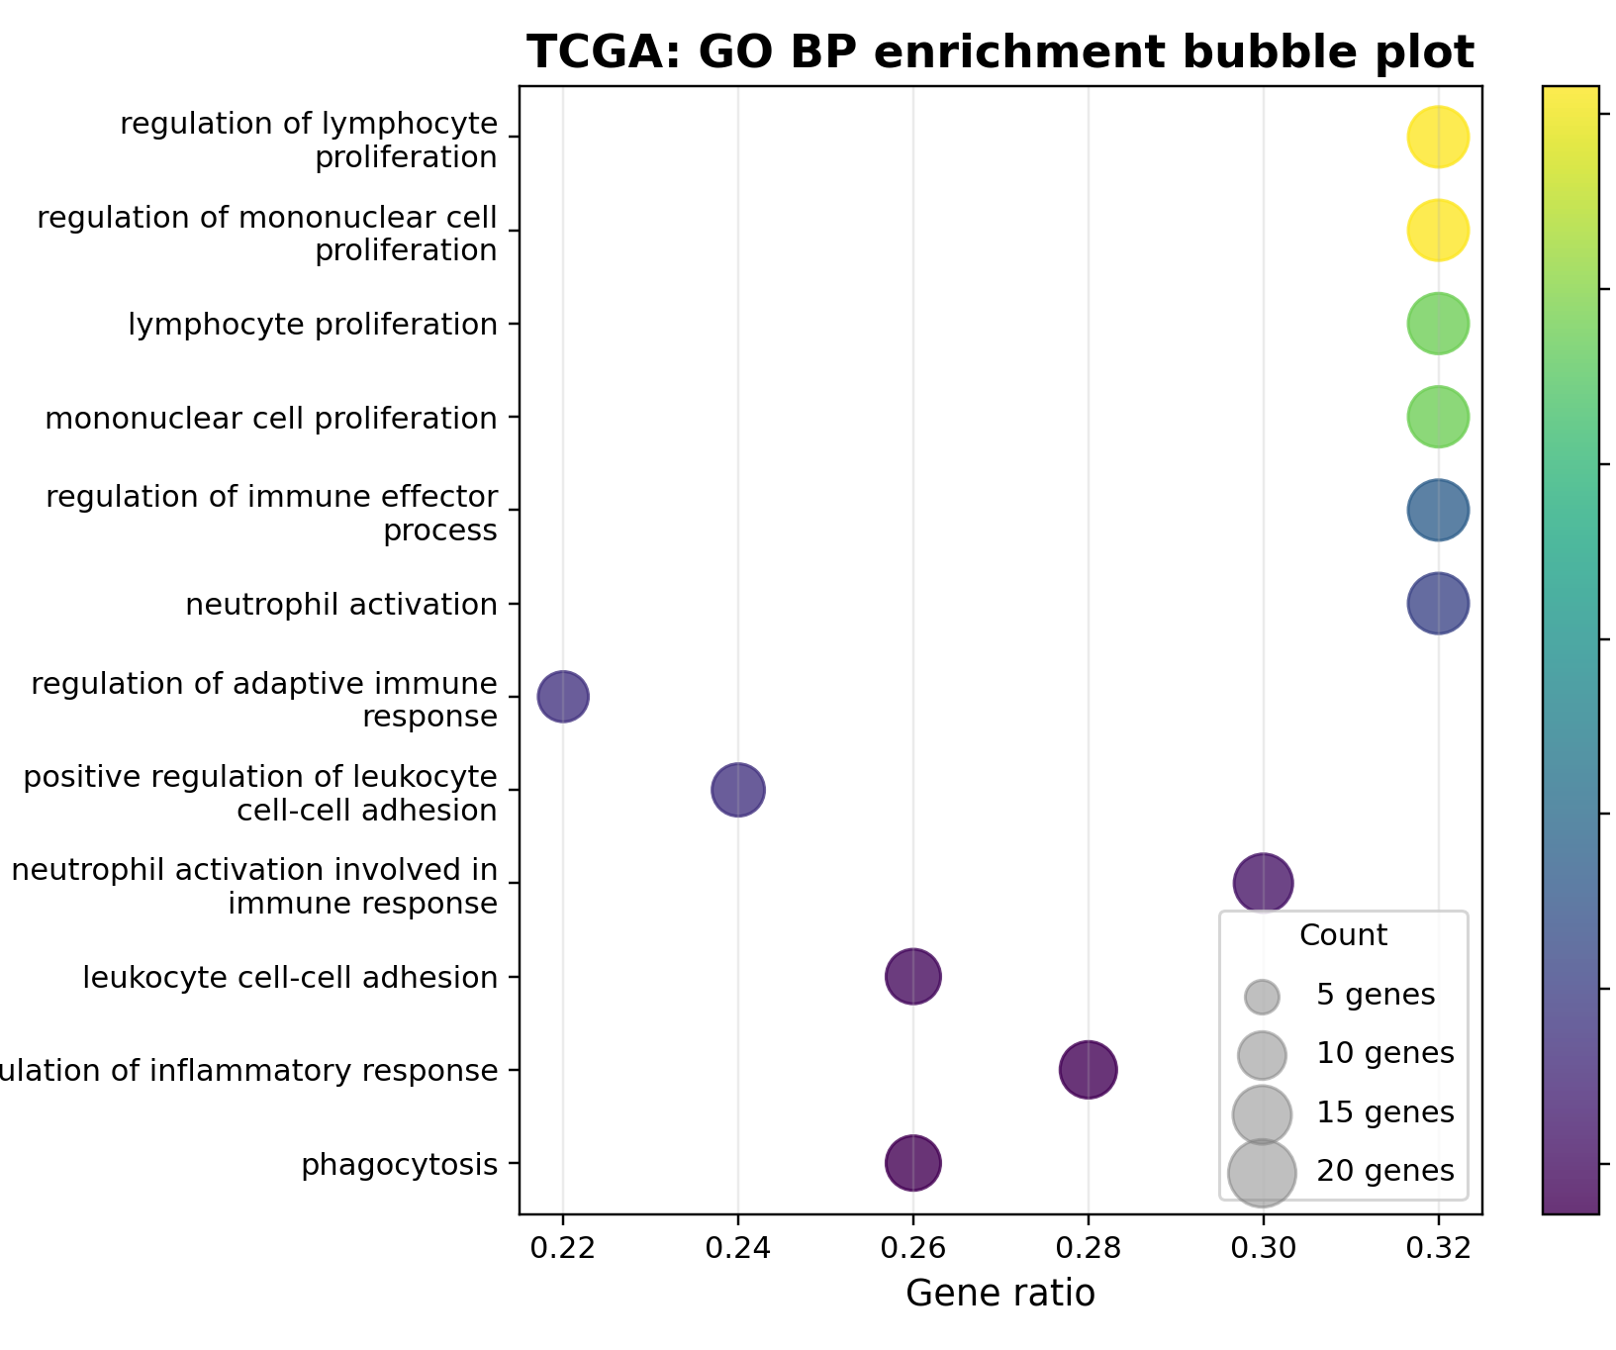
GO enrichment visualization | CD96 glioma Figure 3 reproduction
Alternative visualization 1: bubble plots
How to read bubble plots
Y-axis: GO Biological Process term. X-axis: gene ratio. Bubble size: number of genes. Color: enrichment significance, usually -log10 adjusted p-value.
R workflow: clusterProfiler + GOplot + enrichplot
9
Notes:
Bubble plots are often easier for a general audience than chord plots. They do not show exactly which genes belong to each term, but they are excellent for comparing enrichment strength, gene ratio, and gene count. In a manuscript, I would use bubble plots when the goal is to summarize the top enriched biological processes clearly. In a presentation, bubble plots are also effective because the audience can quickly see which processes are strongest in CGGA and TCGA.

Slide 10
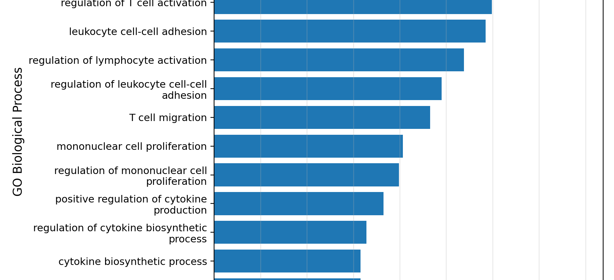
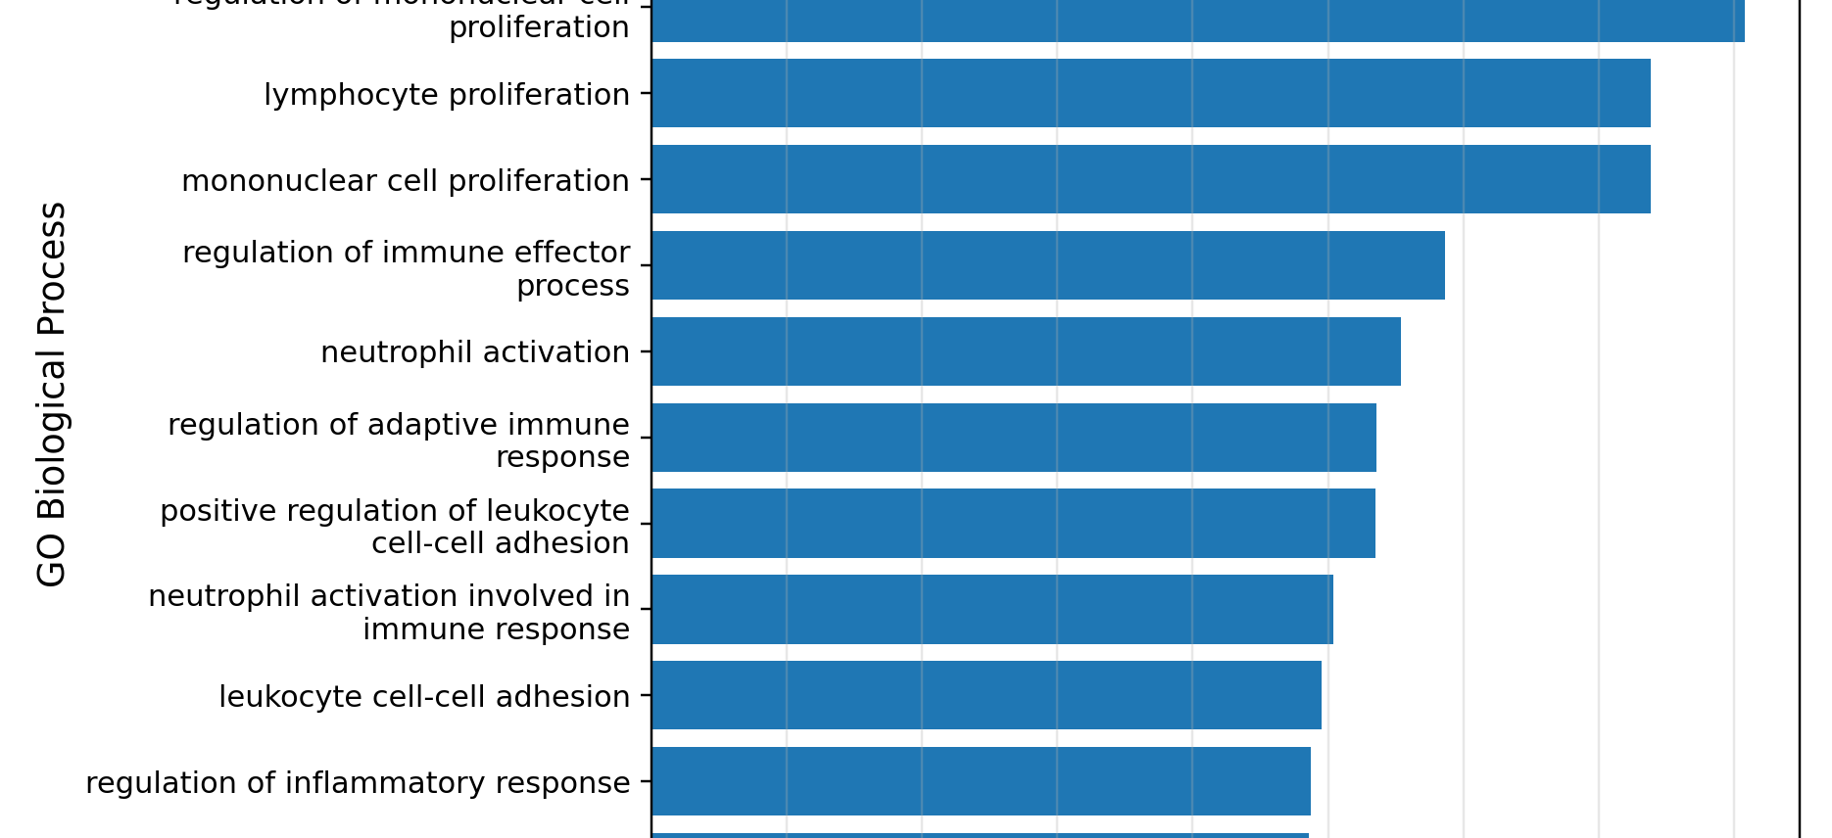
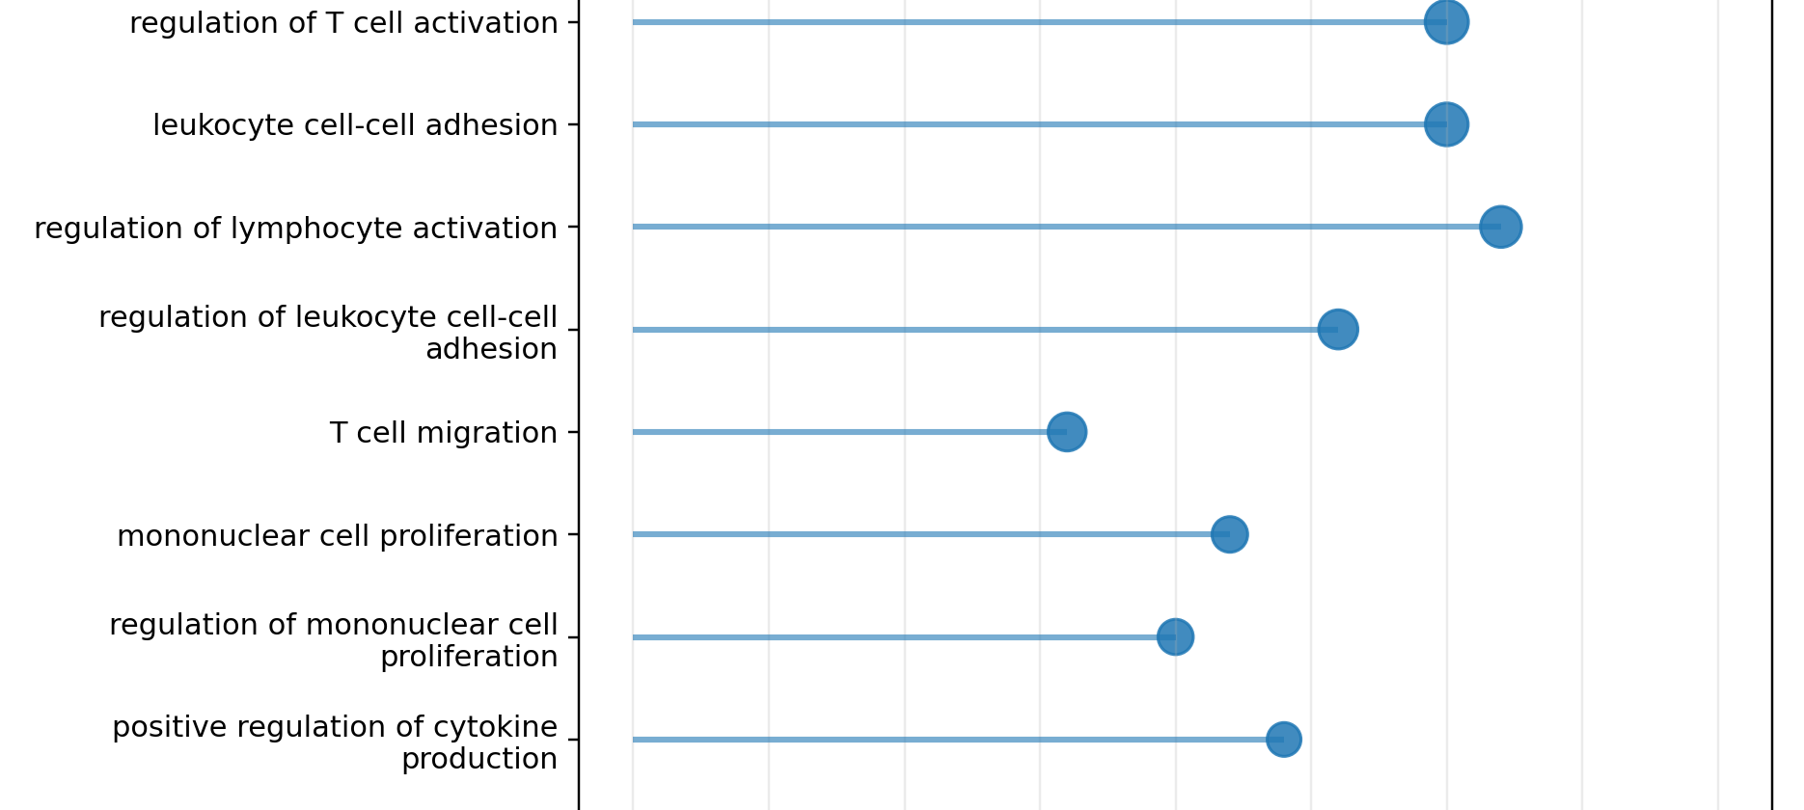
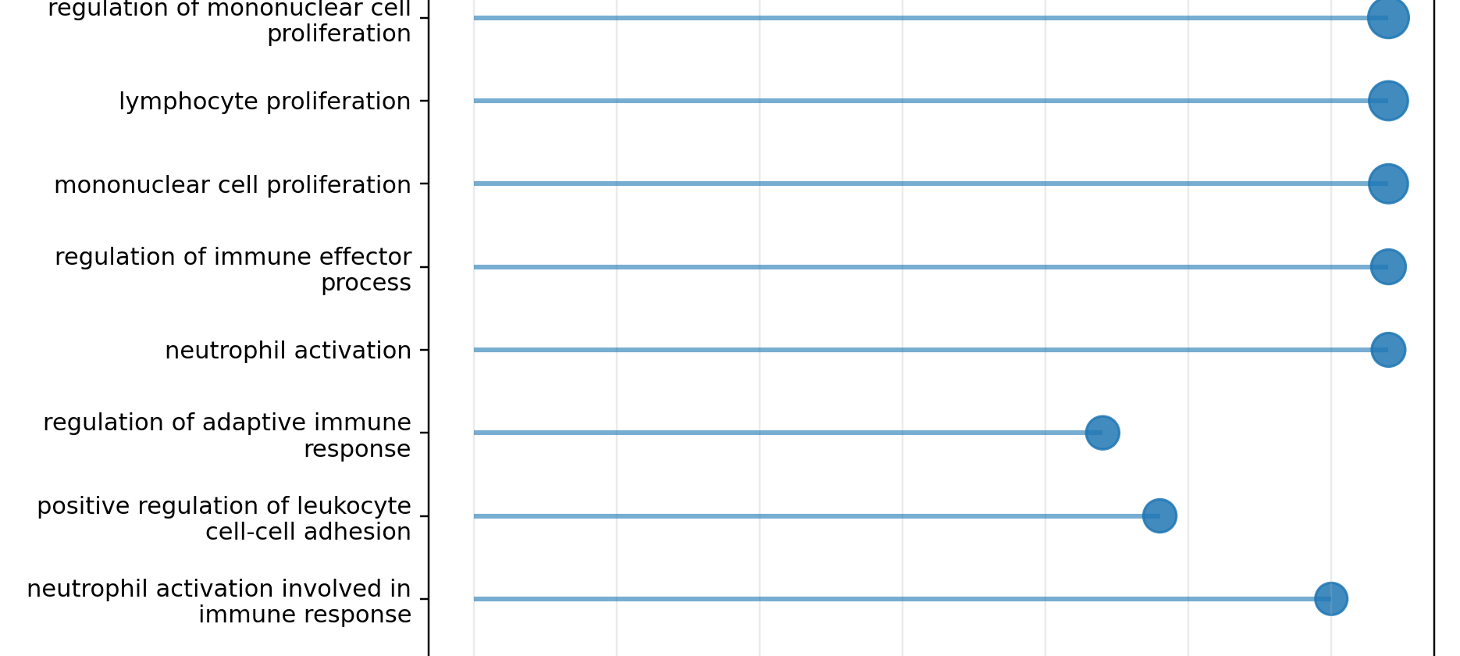
GO enrichment visualization | CD96 glioma Figure 3 reproduction
Alternative visualization 2: bar and lollipop plots
R workflow: clusterProfiler + GOplot + enrichplot
10
Notes:
Bar plots and lollipop plots are good alternatives when the audience needs a clean ranking of GO terms. The bar plot ranks biological processes by enrichment significance. The lollipop plot emphasizes gene ratio, and the dot size or color can encode gene count or adjusted p value. These plots are less visually complex than chord diagrams and are often better for teaching. I would use a GOChord plot for a detailed gene-term relationship and a bubble or bar plot for a quick summary.

Slide 11
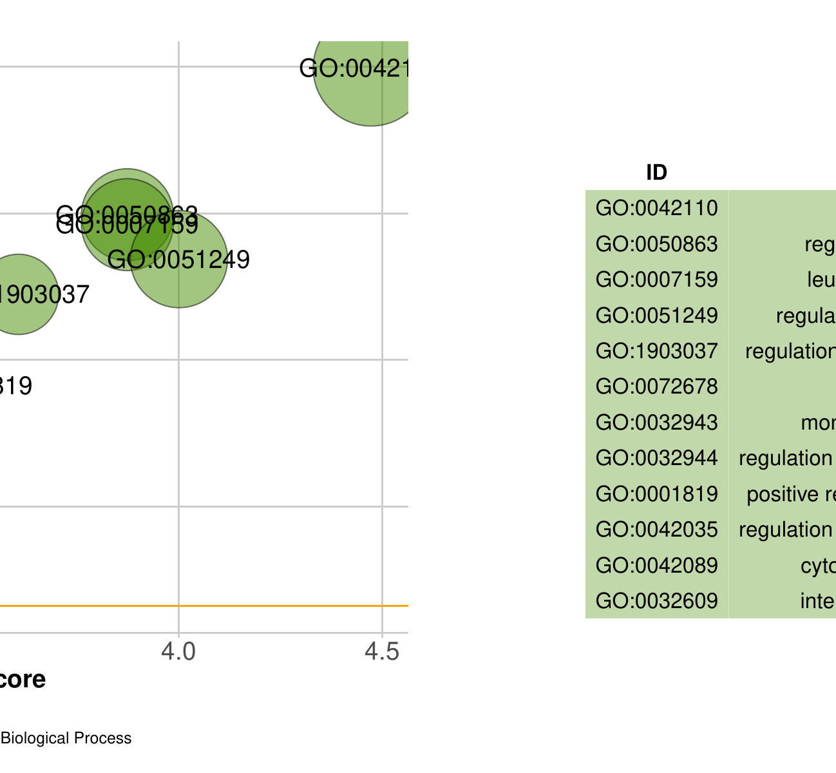
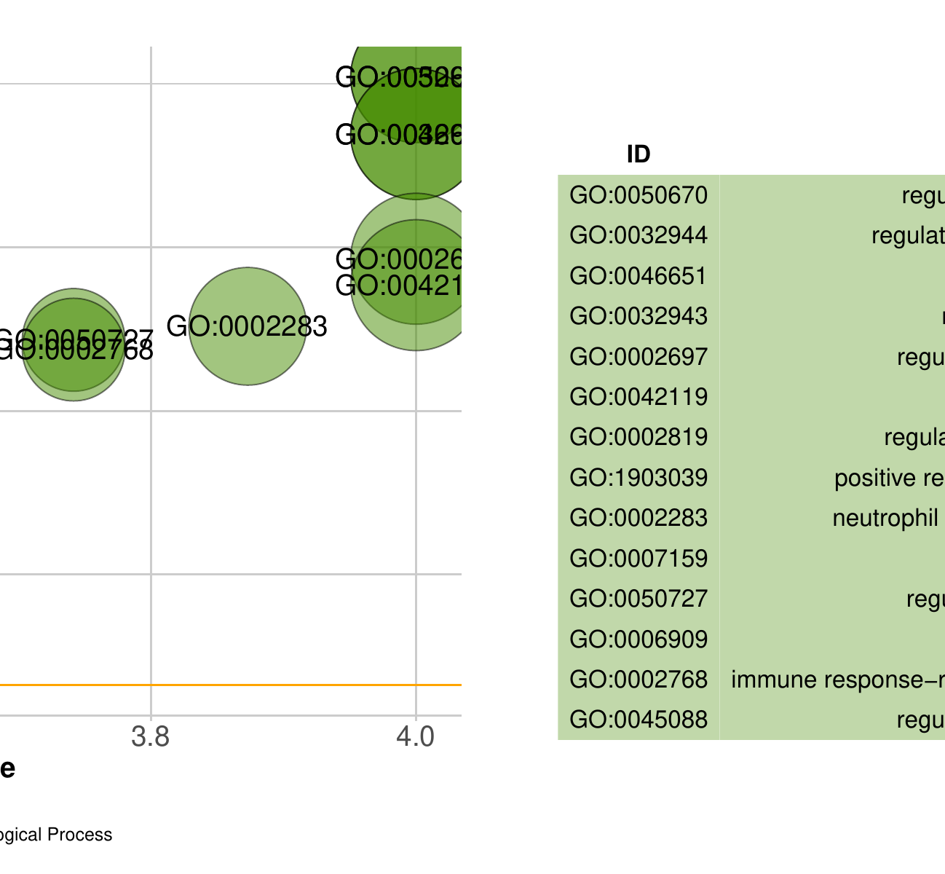
GO enrichment visualization | CD96 glioma Figure 3 reproduction
GOplot GOBubble: z-score and significance
R workflow: clusterProfiler + GOplot + enrichplot
11
Notes:
GOplot's GOBubble is another style of enrichment plot. Instead of plotting gene ratio, it places terms by z-score and negative log adjusted p value. The z-score in GOplot gives a directional summary based on the gene-level fold-change values within each term. In this CD96 example, many terms show positive z-scores because the selected CD96-associated genes tend to move in the same positive direction. This plot is useful when we want to connect enrichment significance with directional gene-level information.

Slide 12
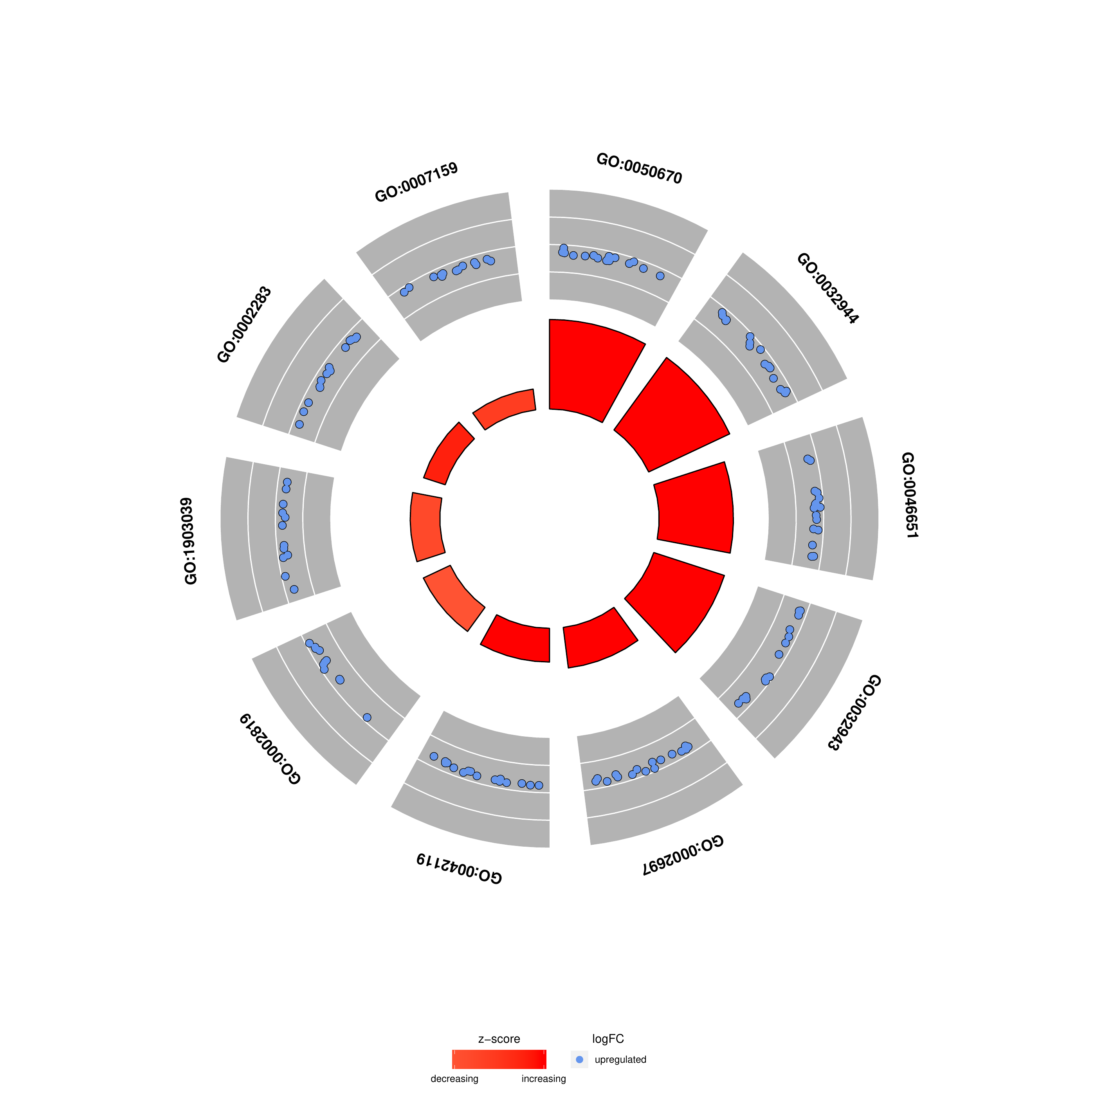
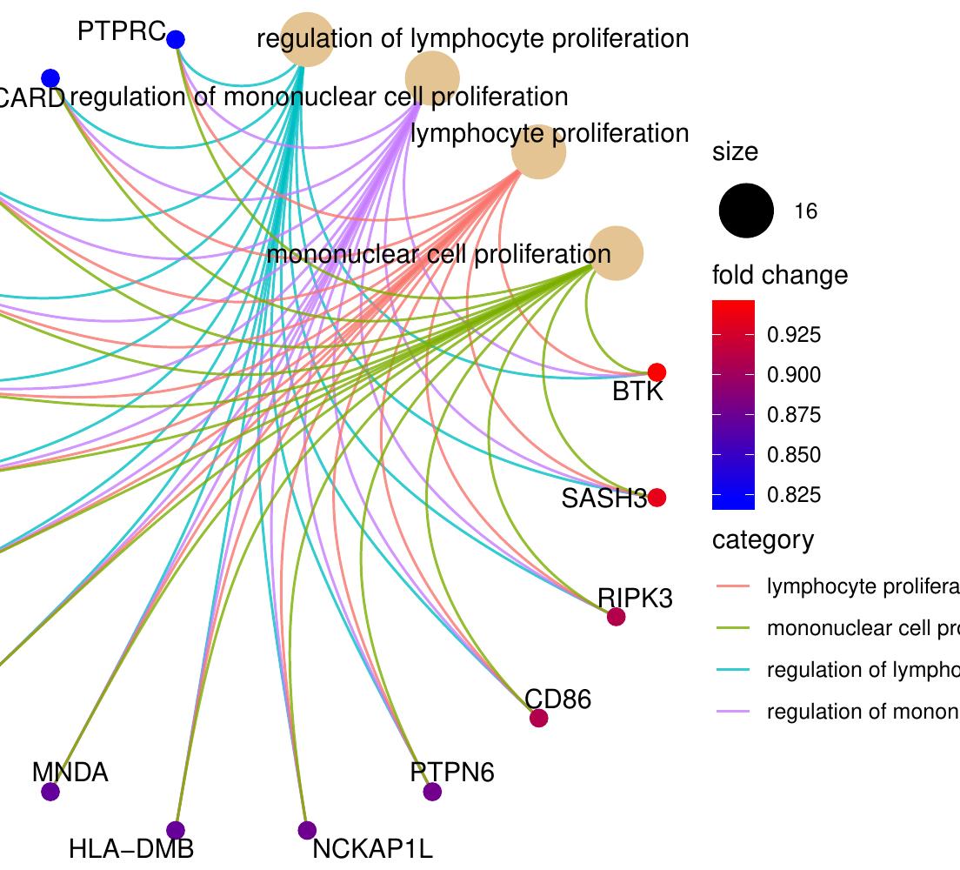
GO enrichment visualization | CD96 glioma Figure 3 reproduction
Circular “bagua-style” views: GO circle and cnet
These circular plots are attractive for presentations, but use them sparingly in manuscripts because dense labels can reduce readability.
R workflow: clusterProfiler + GOplot + enrichplot
12
Notes:
This slide shows two circular styles. The GO circle or bagua-style plot gives a compact view of GO terms and gene-level changes around a circle. The cnet circular plot from clusterProfiler also emphasizes gene-term connections. These plots are visually appealing and useful for presentations, but they can become crowded very quickly. For manuscript figures, I recommend using them only when the number of terms and genes is limited.

Slide 13
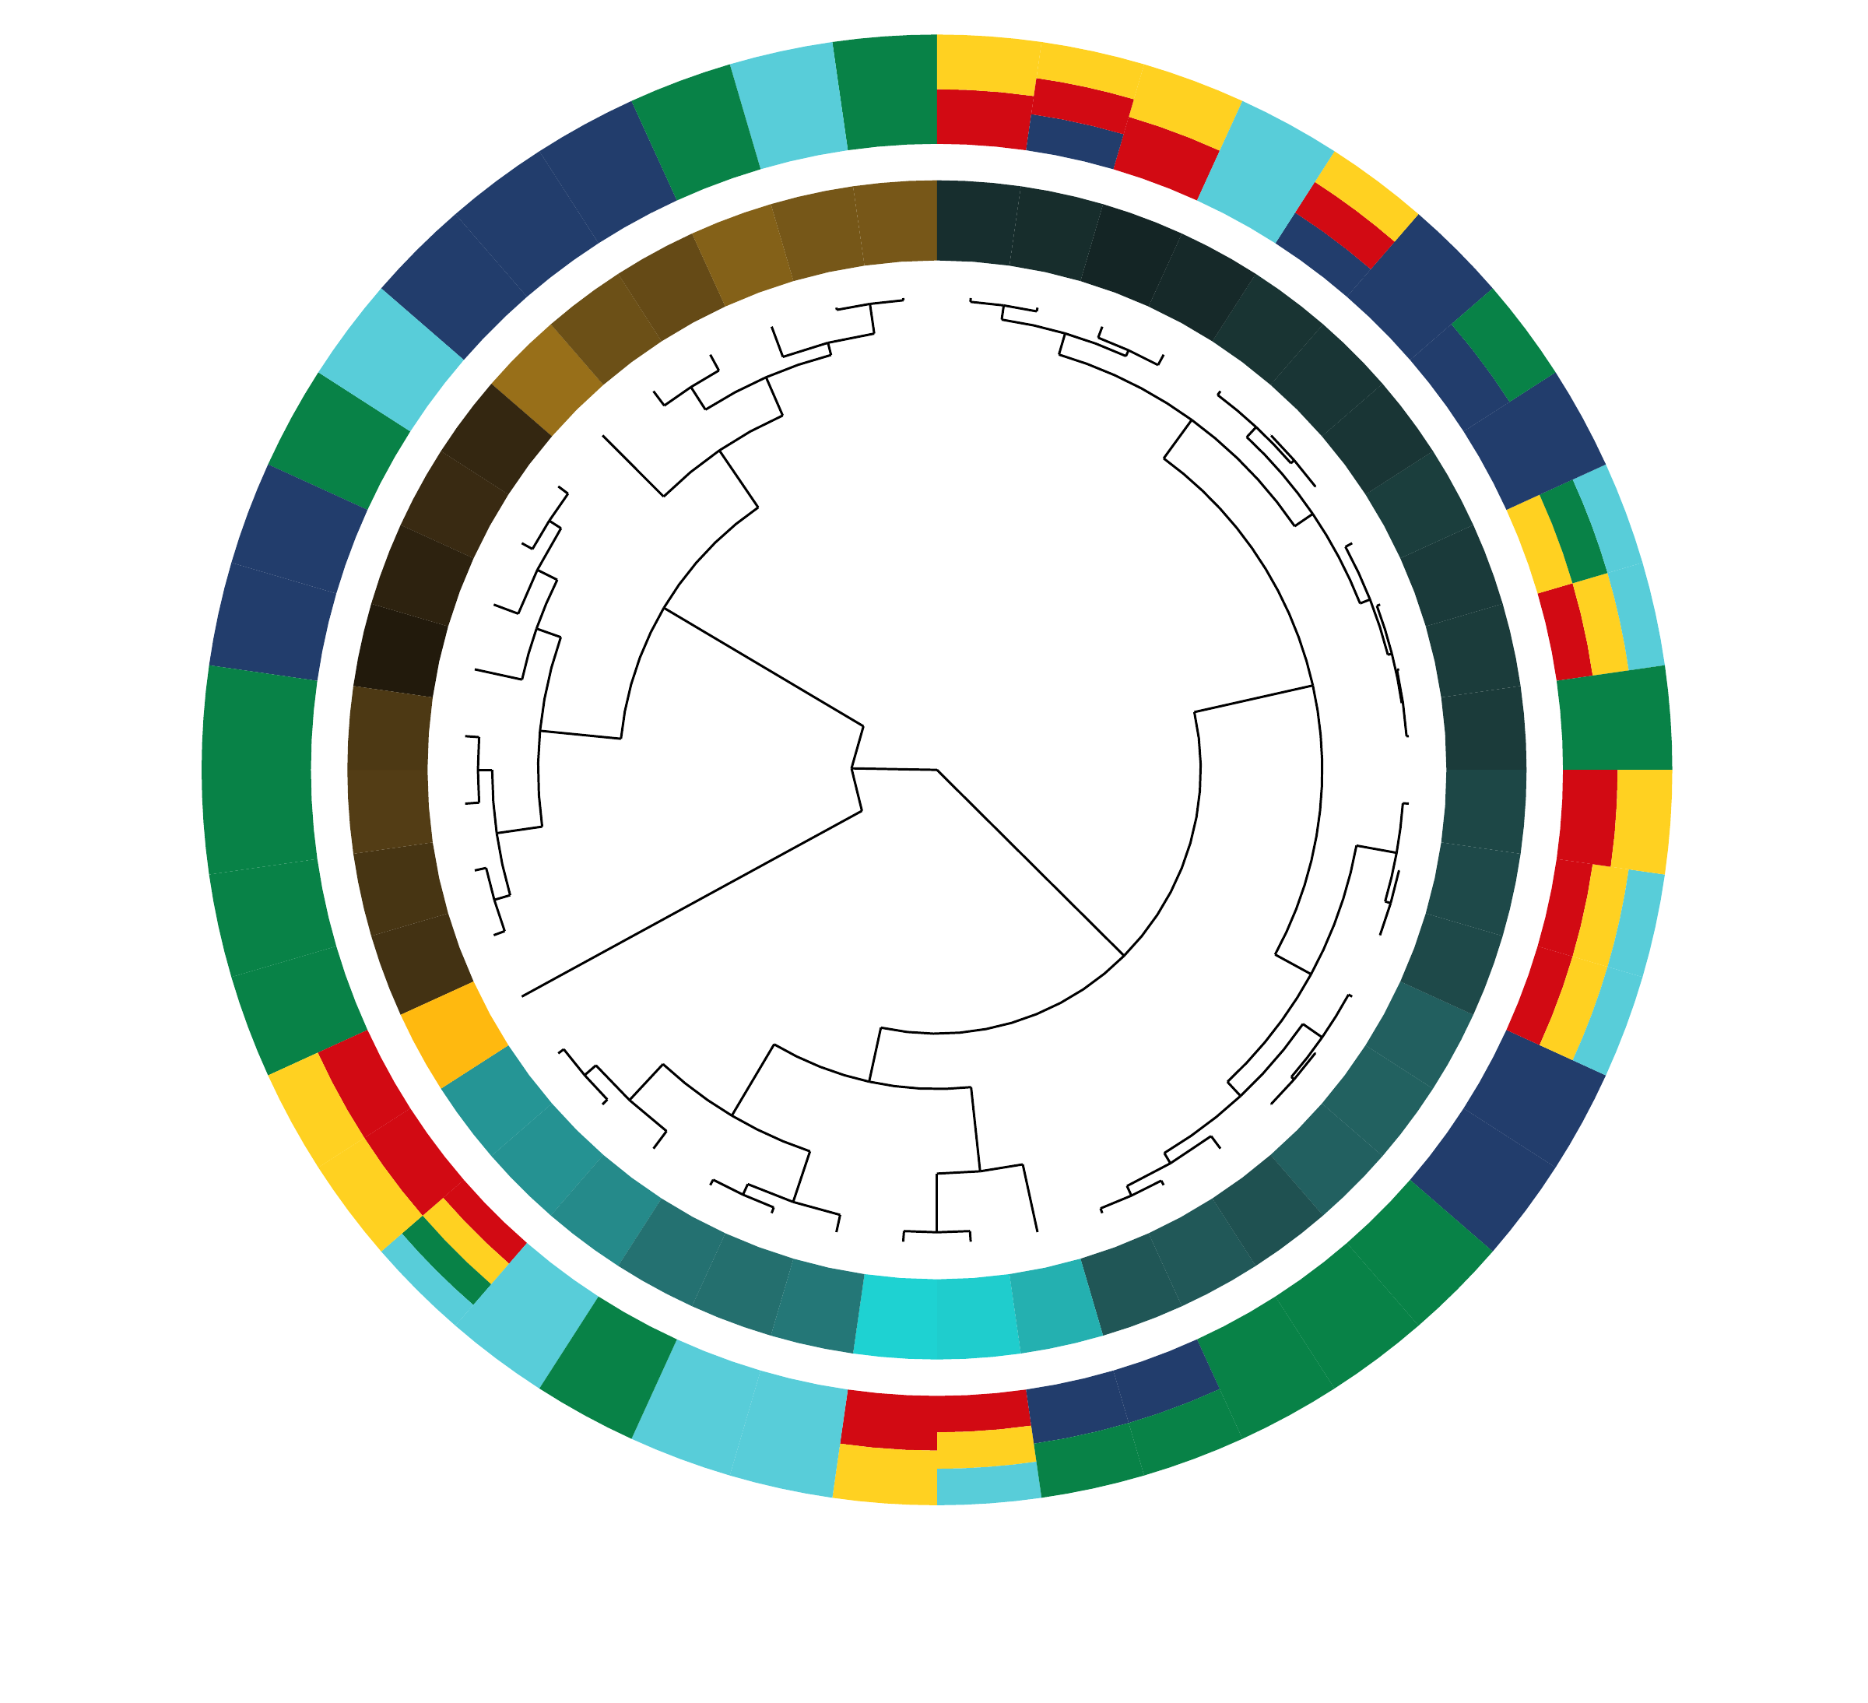
GO enrichment visualization | CD96 glioma Figure 3 reproduction
GOCluster: grouping genes by term membership and logFC
GOCluster combines a dendrogram with circular gene/term annotations.
The inner tree clusters genes by the chosen variable, such as logFC.
The outer rings show gene membership in selected GO terms.
Useful when you want to show whether genes contributing to immune terms share similar change patterns.
Most effective for a focused set of terms, not for all enriched GO terms.
R workflow: clusterProfiler + GOplot + enrichplot
13
Notes:
GOCluster is a more advanced circular plot. It combines clustering with term membership. In the revised script, genes can be clustered by logFC, and the outer rings indicate whether a gene belongs to each selected GO term. This helps answer a different question from the bubble plot. Instead of asking which terms are most enriched, GOCluster asks whether the genes that support those terms show similar expression or correlation patterns.

Slide 14
GO enrichment visualization | CD96 glioma Figure 3 reproduction
Clean code organization
Main wrapper
run_one_dataset <- function(prefix, top50_file) {
gene_fc <- read_gene_fc(top50_file)
entrez_fc <- map_symbol_to_entrez(gene_fc)
enrich_res <- run_go_enrichment(entrez_fc, prefix)
ego2 <- enrich_res$ego_simplified
gene_list <- make_gene_list(entrez_fc)
plot_clusterprofiler(ego2, gene_list, prefix)
ego2_df <- as.data.frame(ego2)
plot_custom_gg(ego2_df, prefix)
goplot_data <- make_goplot_data(ego2_df, entrez_fc)
plot_goplot_family(goplot_data, prefix)
}
run_one_dataset("CGGA", "CGGA_top50.csv")
run_one_dataset("TCGA", "TCGA_top50.csv")
Input once, run twice
The same function processes both CGGA and TCGA, which reduces copy-paste errors.
Output consistency
Every output file is named with the dataset prefix, making downstream checking easier.
Reproducibility
The script writes sessionInfo.txt so package versions are recorded.
Teaching use
Students can modify the input gene list while keeping the plotting workflow unchanged.
R workflow: clusterProfiler + GOplot + enrichplot
14
Notes:
This slide shows the main wrapper function. The most important improvement is that CGGA and TCGA are no longer separate chunks of copy-pasted code. Instead, one function runs the entire pipeline for any dataset prefix and top 50 gene file. This is cleaner for teaching and more reliable for research. It also makes the script easy to adapt to another gene, another cancer type, or another list of correlated genes.

Slide 15
GO enrichment visualization | CD96 glioma Figure 3 reproduction
Biological interpretation of the reproduced result
CGGA interpretation
TCGA interpretation
Consistent message
CD96-associated genes are enriched for T cell activation, regulation of T cell activation, leukocyte adhesion, lymphocyte activation, and T cell migration.
CD96-associated genes are enriched for lymphocyte and mononuclear cell proliferation, immune effector regulation, neutrophil activation, and leukocyte adhesion.
Across both cohorts, CD96 is connected to immune activation and immune-cell communication in glioma.
Use chord/cnet plots when the gene-term relationship is important.
Use bubble/bar/lollipop plots when the ranked enrichment summary is more important.
Use GOCluster when the question concerns gene grouping and shared term membership.
Avoid overinterpreting GO enrichment as causal evidence; it is a functional annotation summary.
R workflow: clusterProfiler + GOplot + enrichplot
15
Notes:
The biological interpretation is straightforward and consistent with the original paper. In both datasets, genes associated with CD96 are enriched in immune-related biological processes. The exact top terms differ between CGGA and TCGA, but both point to immune activation, immune-cell proliferation, and leukocyte communication. However, it is important to remind students that GO enrichment is not causal evidence. It summarizes functional annotation patterns in a gene list. Experimental validation or independent mechanistic analysis is needed to establish causality.

Slide 16
GO enrichment visualization | CD96 glioma Figure 3 reproduction
Take-home message
1. Reproducibility
2. Figure 3 reproduction
3. Better storytelling
Use functions, relative paths, explicit package checks, and saved session information. This makes the workflow easier to rerun and teach.
The core method is top CD96-correlated genes → ENTREZ mapping → GO BP enrichment → simplified terms → GOChord visualization.
Use multiple plot types for different purposes: chord for gene-term links, bubble for overview, bar/lollipop for ranking, and GOCluster for patterns.
Recommended deliverables: R script + output folder + PPT with figure interpretation
R workflow: clusterProfiler + GOplot + enrichplot
16
Notes:
To summarize, this workflow has three main lessons. First, clean code matters. Functionalized R code is much easier to reproduce than a long manually edited script. Second, the original Figure 3 can be reproduced by using clusterProfiler for GO Biological Process enrichment and GOplot for the chord diagram. Third, different plot types serve different communication goals. A good analysis does not need to use every plot, but it should choose plots based on the story being told. Thank you.

