Slide 1
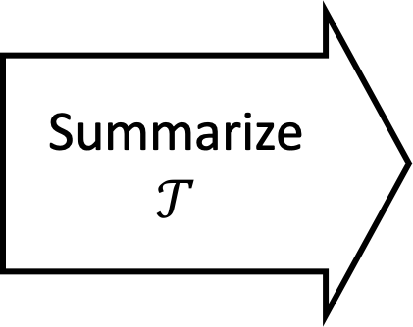




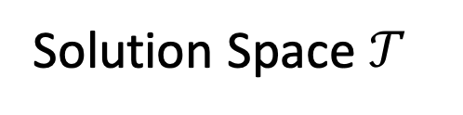
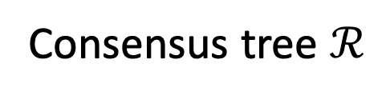
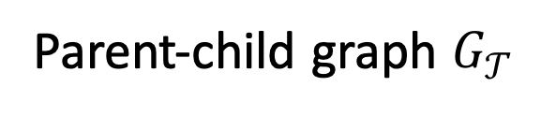





(a)
(b)
(c)
Single Consensus Trees (k = 1)
$$𝒯_{1}$$
Bulk/single-cell sequencing
…AATGGCATAG…
Tumor phylogeny inference
$$𝒯_{3}$$
Consensus tree $ℛ$
4 edges
3 edges
2 edges
Heterogeneous Tumor
1 edge
Summarize
$$𝒯$$
Parent-child graph $G_{𝒯}$
$$𝒯_{2}$$
(d)
Multiple Consensus Trees (k = 3)
1-1
$$ℛ_{1}$$
$$ℛ_{2}$$
$$ℛ_{3}$$
Phylogenetic Tree
Mutation Tree
Solution Space $𝒯$
$$G_{𝒯_{1}}$$
$$G_{𝒯_{2}}$$
$$G_{𝒯_{3}}$$

