Slide 1
Image Processing (I)
Instructor : Prof. Sei-Wang Chen, PhD (陳世旺)
Office : Applied Science Building,
Room 101
Contact : Tel: 7749-6661
E-mail: schen@csie.ntnu.edu.tw
Class Room: 理圖 003
Class Hr. : Thur. 9:10AM – 10:30AM
10:50AM – 12:00NOON

Slide 2
Teaching assistant : 俞柏承
Office : Applied Science Building,
Room 108
Telephone : 7749-6668
E-mail : 61147013s@gapps.ntnu.edu.tw
Office Hrs. :

Slide 3
Teaching Intention
Study on image processing, focusing
on practical techniques for 2D images.
This course covers a wide range
of application problems commonly encountered in image processing
and provides detailed algorithmic
and practical treatments for each.
Familiar with Opencv library and
Python language.

Slide 4
Textbook:
A Computational Introduction to
Digital Image Processing 2nd Ed.
Alasdair McAndrew, 2016
開發圖書公司
(02)82423988
魏錦鈴
0939852332

Slide 5
Contents
Ch.1: Introduction
Ch.2: Files and File Types
Ch.3: Image Display
Ch.4: Point Processing
Ch.5: Neighborhood Processing
Ch.6: Image Geometry
Ch.7: Fourier Transform
Ch.8: Image Restoration
Ch.9: Image Segmentation

Slide 6
Ch.10: Mathematical Morphology
Ch.11: Image Topology
Ch.12: Shapes and Boundaries
Ch.13: Color Processing
Ch.14: Image Coding and Compression
Ch.15: Wavelets
Ch.16: Special Effects
App. A: Introduction to MATLAB and Octave
App. B: Python, OpenCV, and ChatGPT
App. C: Fast Fourier Transform

Slide 7
Syllabus
Week Content
1 Chs0,1
2 AppB, Ch2
3 Chs3,4
4 Ch5
5 Chs5,6
6 Ch6
7 Ch8
8 Exam.
9 Ch9
10 Chs9,10

Slide 8
Week Content
11 Ch10
12 Ch13
13 Chs13,15
14 Ch15
15 Presentation
16 Presentation

Slide 9
Finding the PPTs of chapters:
(1) 登入Moodle
https://moodle.ntnu.edu.tw/
(2) 點選: 1112影像處理
(Image Processing)
(3) 點選: 上課用章節投影片區
(PPTS OF CHAPTERS)
(4) 下載

Slide 10
Assignment Submission
(A) Prepare the assignment file
File Name: Name.HW# (e.g., 陳世旺.HW1)
Content of the file:
(1) Assignment statement
(2) (i) Written assignment
Answer
(ii) Program assignment
(a) Input/Output data
(b) Source code
  (c) Comments

Slide 11

Example: (i) Written assignment
Homework 1 (Due ___ )
Each point can be labeled in 2 ways as +/–. Show
that for any finite H,

Slide 12
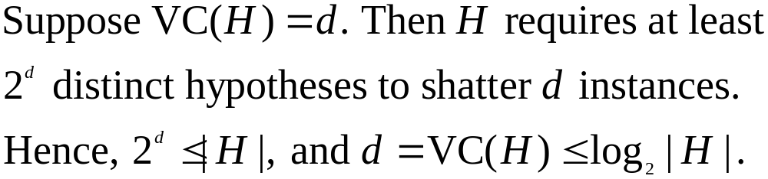
(1) Problem statement
Homework 1
Each point can be labeled in 2 ways as +/–. Show
that for any finite H,
(2) Answer

Slide 13
Example: (ii) Program assignment
Homework 2 (Due )
Input a color image C(R,G,B)
Output the color image C
3. Transform the color image C into a
grayscale image I by I = (R+G+B)/3
4. Show the grayscale image I.
12

Slide 14
(1) Problem statement
Homework 2
1. Input a color image C(R,G,B)
2. Output the color image C
3. Transform the color image C into a
grayscale image I by I = (R+G+B)/3
4. Show the grayscale image I.

Slide 15
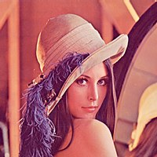
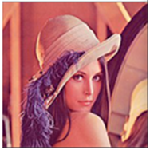
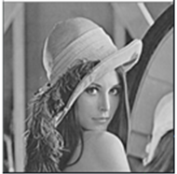
(2) (a) Input/output images
Color image C
Input:
Color image C Grayscale image I
Output:

Slide 16
(b) Source code
# Import libraries
import sys
import numpy as np
import matplotlib.pyplot as plt
import matplotlib.image as mpimg
#Convert RGB color image to grayscale image
#I=(R+G+B)/3
def rgb2gray(rgb):
return np.dot(rgb[..., :3],[0.2,0.5,0.3])
# Standard input image file name
img=mpimg.imread(sys.argv[1])

Slide 17
#Call RGB to grayscale function
gray=rgb2gray(img)
#Save output image file
plt.imsave(sys.argv[1].split('.')[-2]+"_1"+
sys.argv[1].split('.')[-1],img)
plt.imsave(sys.argv[1].split('.')[-2]+"_gray."+
sys.argv[1].split('.')[-],gray,cmap='gray')
#Plot input and output images
figure,ax=plt.subplots(1,2)
ax[0].imshow(img)
ax[1].imshow(gray,cmap='gray')
plt.show()
17

Slide 18
(c) Comments
There are many libraries having functions for transforming color to grayscale images. Their transformation coefficients, e.g., (0.2989, 0.5870, 0.1140), are different from the one (0.333, 0.333, 0.333) used in this homework.
18

Slide 19
(B) Submit assignment
Moodle → 作業繳交區
(ASSIGNMENT SUBMISSION)
作業繳交時間在下一次上課前
Late homework will not be accepted

Slide 20
Presentations
(1) 繳交分組名單, 3人一組 (第 5 週)
(2) 繳交 paper report, 每人都要交一份
小組可以看同篇論文, 但每人需自
己撰寫心得, 且分開繳交. (第 11 週)
(3) 繳交報告用 PPT, 每組限交一份 (第 14 週)
(4) Presentation,
每組報告 __分, Q&A __分 (第 15,16 週)

Slide 21
(A) Paper report:
(a) PDF file of the selected paper
(b) Contents of the paper report, including
(i) Journal, Conference, Year
(ii) Brief review (techniques, applications)
(iii) Comments
(c) Word format of the report:
(i) Number of pages <= 4;
(ii) Word size = 14, Line interval = 1.5;
(iii) Chinese (細明體);
English (Times New Roman).

Slide 22
(B) PPT:
(C) Presentation:
(i) Time: __ mins.
(ii) Q&A: __ mins.

Slide 23
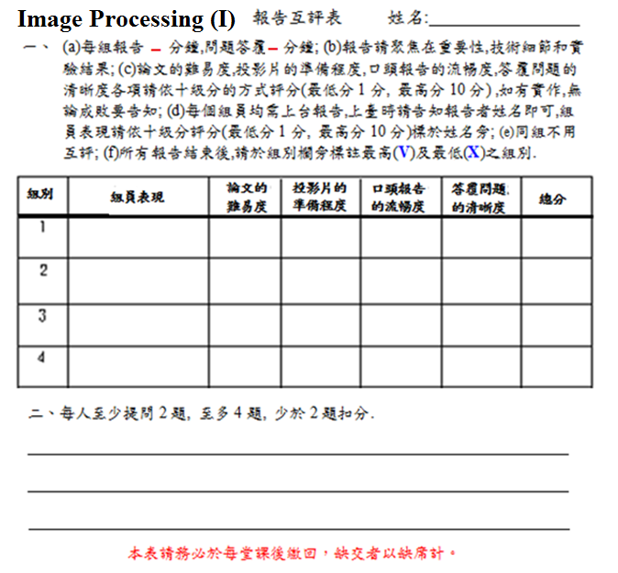

Slide 24
Evaluation
Homework 35%
Examination 25%
Quiz 10%
Presentation 30%
Late -0.5 Absence -1.5
Late: After 9:30AM
Absence: After 10:30AM
Plagiarism is definitely not allowed

Slide 25
References:
Books
(1) Perception by R. Sekuler and R. Blake, 1985
(2) Digital Image Processing by K. R. Castleman,
1996
(3) Handbook of Computer Vision Algorithms in
Image Algebra by G. X. Ritter and J. N.
Wilson, 2001
(4) Digital Image Processing by W. K. Pratt, 2007
(5) Image Processing, Analysis, and Machine
Vision by M. Sonka, V. Hlavac, and R. Boyle,
2015
(6) Digital Image Processing by R. C. Gonzalez
and R. E. Woods, 2018

Slide 26
(B) Journals
(1) IEEE Trans. on Pattern Analysis and
Machine Intelligence
(2) IEEE Trans. on Image Processing
(3) International Journal of Computer
Vision
(4) Computer Vision and Image
Understanding
(5) Pattern Recognition

Slide 27
(C) Conferences
(1) International Conference on Computer
Vision (ICCV)
(2) International Conference on Pattern
Recognition (ICPR)
(3) International Conference on Image
Processing (ICIP)
(4) Computer Vision and Pattern Recognition
(CVPR)

