Slide 1
Assignment Submission
(A) Prepare the assignment file
File Name: Name.HW# (e.g., 陳世旺.HW1)
Content of the file:
(1) Assignment statement
(2) (i) Written assignment
Answer
(ii) Program assignment
(a) Input/Output data
(b) Source code
  (c) Comments

Slide 2

Example: (i) Written assignment
Homework 1 (Due ___ )
Each point can be labeled in 2 ways as +/–. Show
that for any finite H,

Slide 3
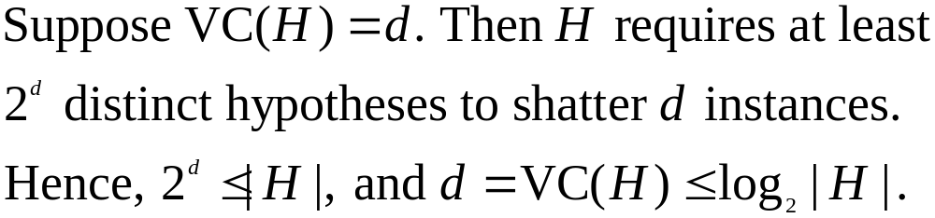
(1) Problem statement
Homework 1
Each point can be labeled in 2 ways as +/–. Show
that for any finite H,
(2) Answer

Slide 4
Example: (ii) Program assignment
Homework 2 (Due )
Input a color image C(R,G,B)
Output the color image C
3. Transform the color image C into a
grayscale image I by I = (R+G+B)/3
4. Show the grayscale image I.
12

Slide 5
(1) Problem statement
Homework 2
1. Input a color image C(R,G,B)
2. Output the color image C
3. Transform the color image C into a
grayscale image I by I = (R+G+B)/3
4. Show the grayscale image I.

Slide 6
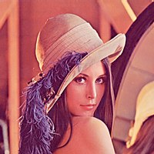
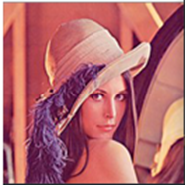
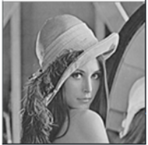
(2) (a) Input/output images
Color image C
Input:
Color image C Grayscale image I
Output:

Slide 7
(b) Source code
# Import libraries
import sys
import numpy as np
import matplotlib.pyplot as plt
import matplotlib.image as mpimg
#Convert RGB color image to grayscale image
#I=(R+G+B)/3
def rgb2gray(rgb):
return np.dot(rgb[..., :3],[0.2,0.5,0.3])
# Standard input image file name
img=mpimg.imread(sys.argv[1])

Slide 8
#Call RGB to grayscale function
gray=rgb2gray(img)
#Save output image file
plt.imsave(sys.argv[1].split('.')[-2]+"_1"+
sys.argv[1].split('.')[-1],img)
plt.imsave(sys.argv[1].split('.')[-2]+"_gray."+
sys.argv[1].split('.')[-],gray,cmap='gray')
#Plot input and output images
figure,ax=plt.subplots(1,2)
ax[0].imshow(img)
ax[1].imshow(gray,cmap='gray')
plt.show()
17

Slide 9
(c) Comments
There are many libraries having functions for transforming color to grayscale images. Their transformation coefficients, e.g., (0.2989, 0.5870, 0.1140), are different from the one (0.333, 0.333, 0.333) used in this homework.
18

Slide 10
(B) Submit assignment
Moodle → 作業繳交區
(ASSIGNMENT SUBMISSION)
作業繳交時間在下一次上課前
Late homework will not be accepted

