Slide 1
Game Center

Slide 2
DATABASE
DATABASE is written in SQLite

Slide 3
UNIT TEST coverage
For all games, the unit tests covers the board, the board manager, and the logical functions in the activity.
Two tests are prepared for each game package: one specifically tests the board-manager (and tests the board through testing its manager), the other specifically tests the logical function in the activity, with an emphasis on the connection between the board-manager (the controller) and the activity (the view)

Slide 4
Important classes
Almost every class that was not substituted by a super class are important, for the following reasons:
Super classes are only intended for serving their children.
If you check the git log, we spent the majority of our time writing those classes in the game packages.
If you check the git log, only 2 members of our group worked on the super-classes, and their job was basically copying and pasting!
We had multiple discussions with Prof. Paul Gries regarding the design, significantly less than 1% of the discussions were on super classes.
It is those classes in the game packages that makes the game great!

Slide 5
Important classes for ui part
Navigation bar
Nav_setting
Nav_changing_password
Nav_Scoreboard
Starting activity
Game activity
Gesture grid view
Custom adapter
Movement controller

Slide 6
Starting activity
Used to display the buttons and views before the start of the game.
When clicking new game it will intent to game activity.

Slide 7
Movement controller
This class will receive the information that is pass from the gesture grid view.(position, manager)
It will process the information by calling the method of the manager class, which will change the board.

Slide 8
Gesture Grid view
The board manager will be pass from game activity class.
There is an init method and when you touch the screen, the init method will be called automatically

Slide 9
Custom adapter
Used to define the size of each button

Slide 10
Game activity
Used for displaying the gesture grid view
When it observe the changes in board or boardmanager class, it will update the button and display them.

Slide 11
Design patterns
Model-View-Controller PATTERN:
The Boards are Models
The Boards’ managers are Controllers
The Game Activities are Views
They collaborates and makes our game design clear and easy to understand.
Observer pattern:
Game activities are the observers
Either the board or its manager are being observed depending on the type of game.
Implementation of this design pattern assures that the users could see the most updated board.
Iterator pattern
Iterator pattern is used to loop through the cells/tiles stored inside the board

Slide 12
Scoreboard Design
There are two types of scoreboard:
one is generated based on score data of a specific user,
the other is generated based on the type of the game

Slide 13
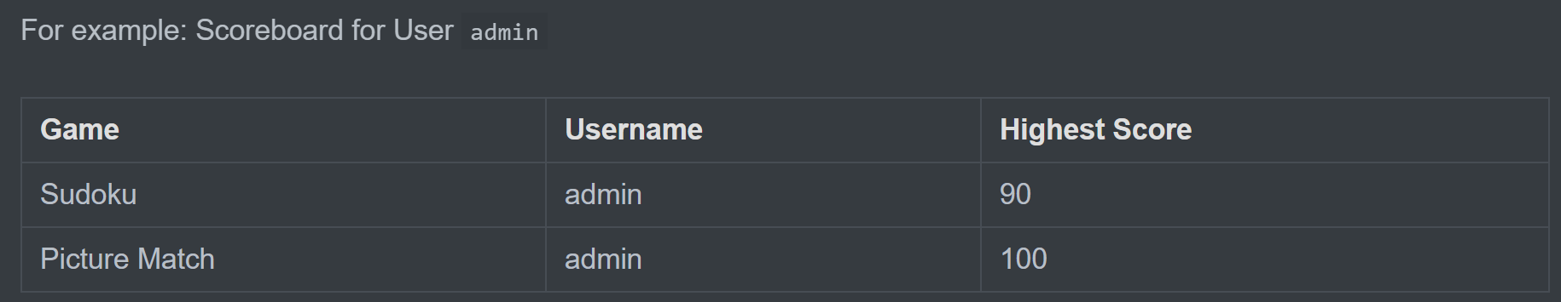
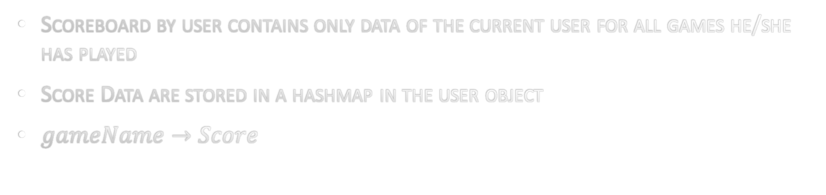
Scoreboard by user
Scoreboard by user contains only data of the current user for all games he/she has played
Score Data are stored in a hashmap in the user object
$gameName→Score$

Slide 14
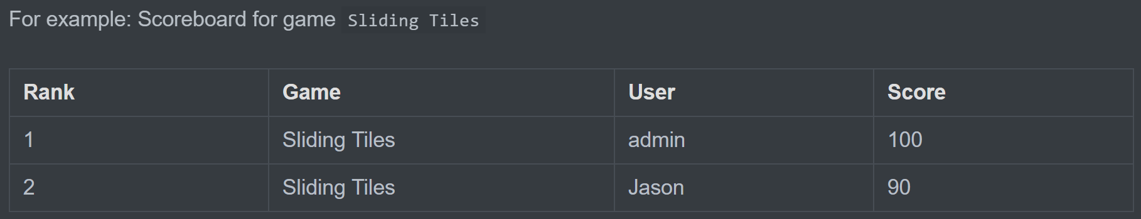
Scoreboard by game
Scoreboard by game contains only data of the specific game

Slide 15
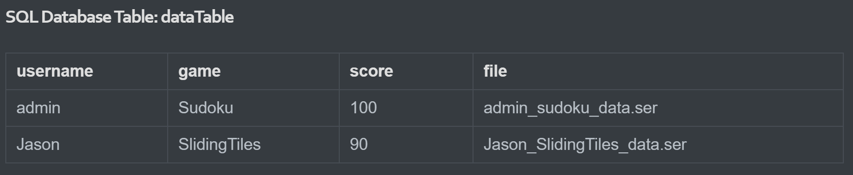
Scoreboard by game
Data are stored in sql database
For Scoreboard by game, we access SQL Database to get a list of data (Rank, Game, User, Score) with a SQL query (data sorted by score in Descending Order )

Slide 16

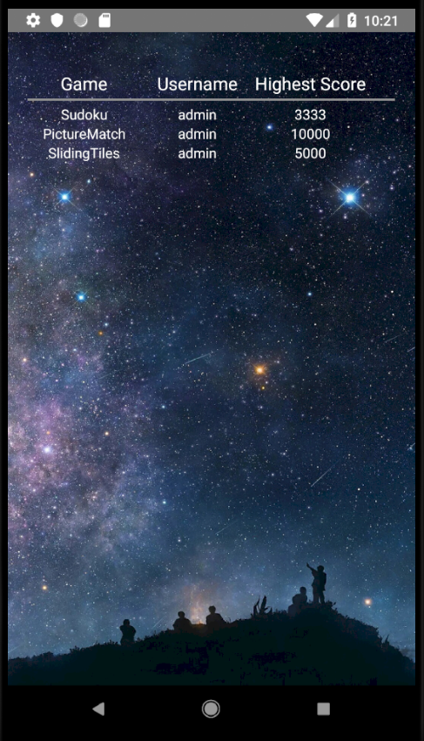
Scoreboard display
Scoreboard is displayed using ScoreboardActivity on layout activity_score_board.
Title is first created, to regulate the number of columns the width of each column.
Data are taken from user object or Database depends on the type of scoreboard as a List<List<String>>.
Each inner list represents a user, game and his highest score in this game.
Each inner list is put into a TableRow, and the TableRow is added to TableLayout

Slide 17
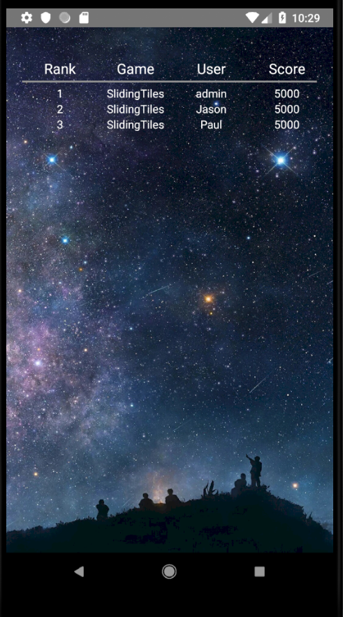
Scoreboard display

