Slide 1
Twitter Sentiment Analysis using Machine Learning
Classifying sentiment in tweets about U.S. airlines

Slide 2

What are we solving?
In the world of real-time digital feedback and social media presence
Brandperception on platform like Twitter matters
Which means
User posts,feedback,complaints,and praise must be monitored effectively
Sentiment must be understood quickly and accurately
Negative feedback should trigger timely responses
Public perception management must be continuous and proactive

Slide 3
Why does it matter?
Current challenges
User posts,feedback,complaints,and praise must be monitored effectively
Sentiment must be understood quickly and accurately
Negative feedback should trigger timely responses
Public perception management must be continuous and proactive

Slide 4
What can we do to achieve this?
Machine learning can help
We collect large volumes of user tweets about airline experiences
These include complaints,praise,suggestions,and neutral feedback
Traditional sentiment tracking is slow and reactive
Negative sentiment ofetn spreads before airlines can respond
Our Goal:
Bulid an ML model to:
Classify tweet sentiment in real life
Detect shifts in public mood early
Help airlines respond proactively and protect brand reputation

Slide 5
How did we achieve this?
How Did We Approach This?
This is a supervised learning problem --we have labeled tweet sentiments
We used TF-IDF to extract features from text
Built a classification model using Support Vector Machine(SVM)
SVM is effective for high-dimensional data like text
Why SVM?
Works well on sparse feature vectors
Handles multi-class classification(positive/neutral/negative)
Deliver strong performance without deep learning complexity

Slide 6
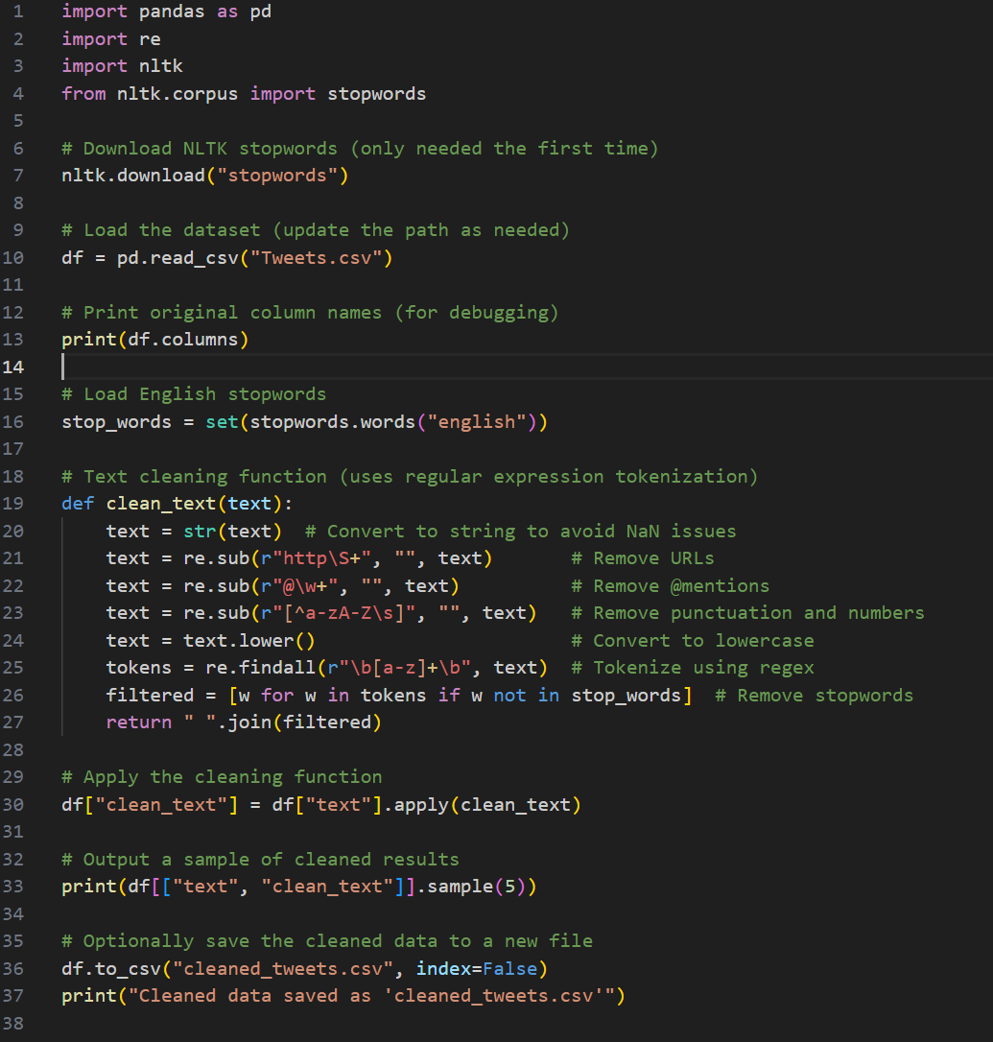
How we wash the data?

Slide 7
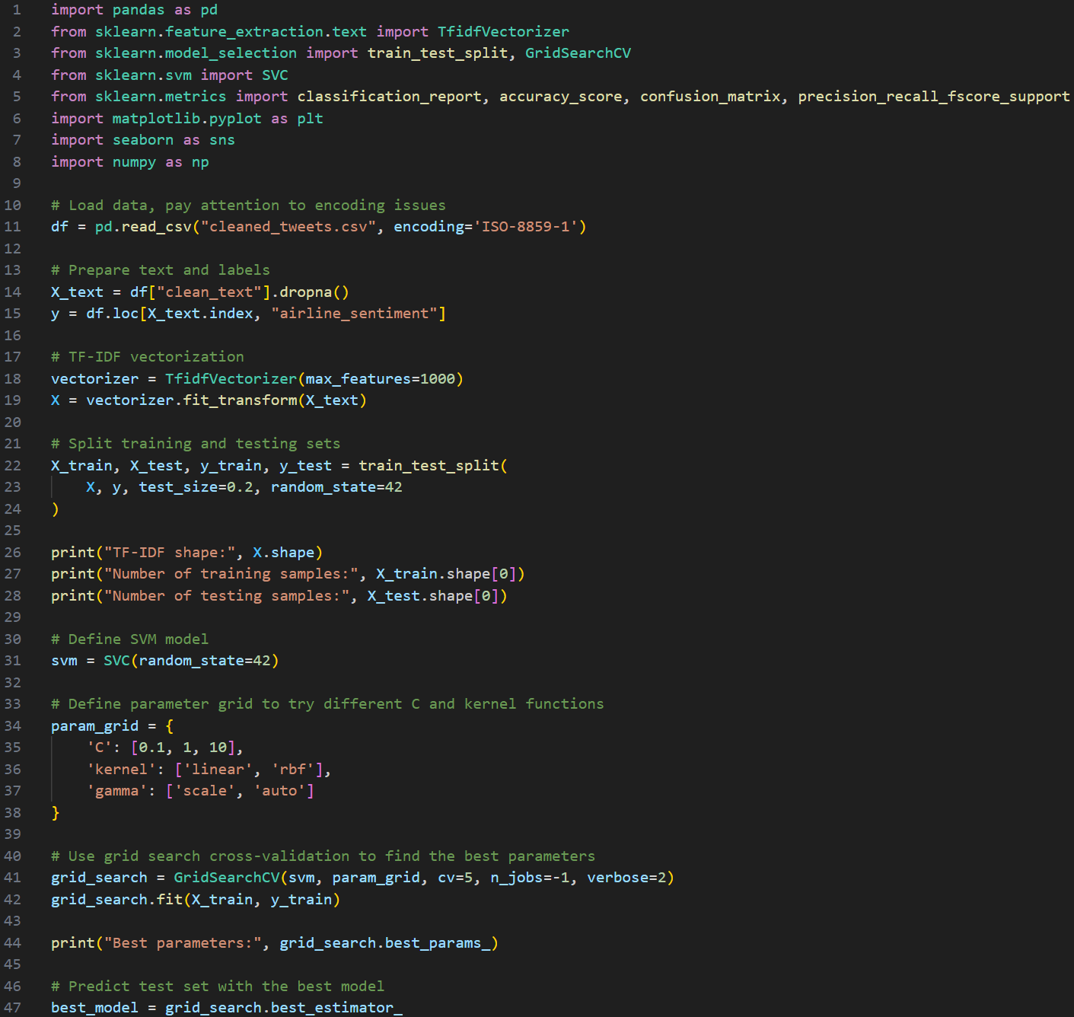
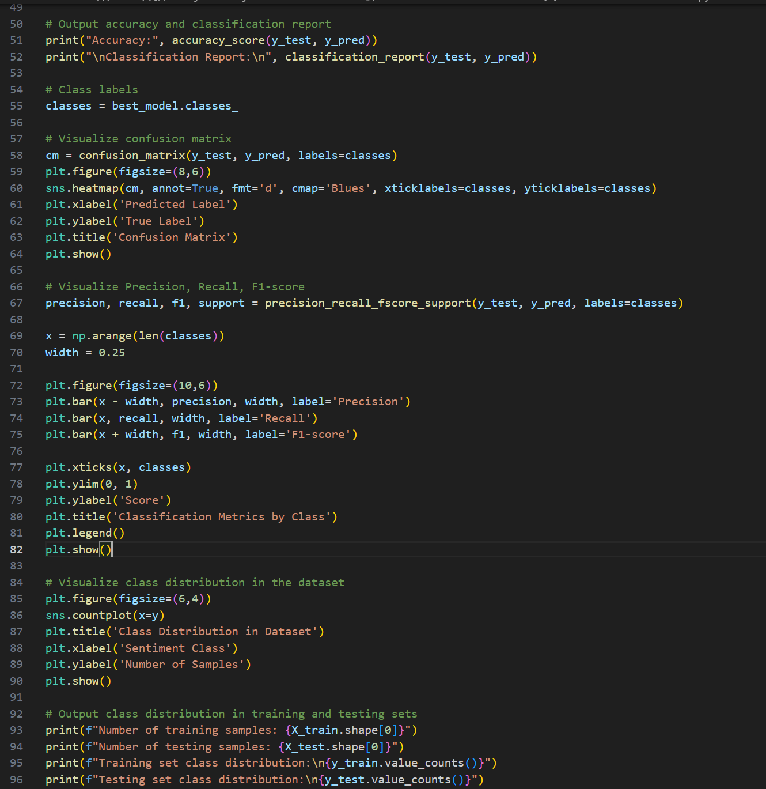
How we get the outcome?

Slide 8
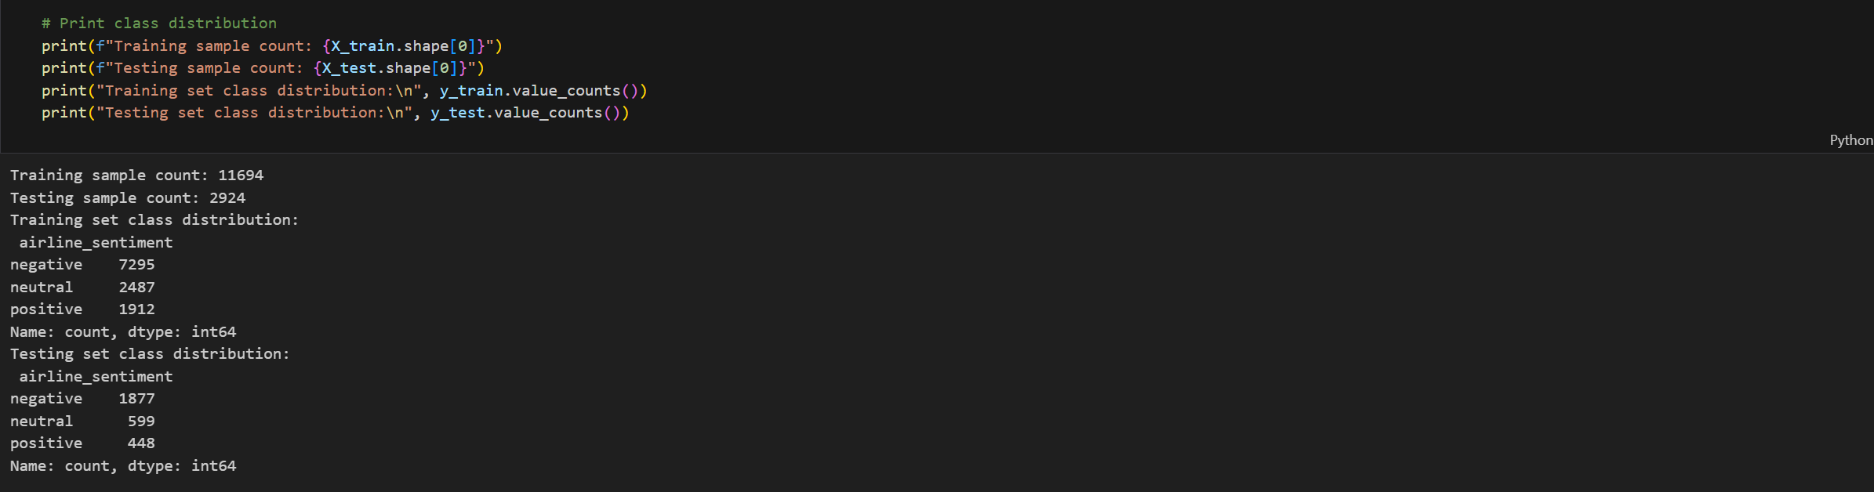
Display The Outcome

Slide 9
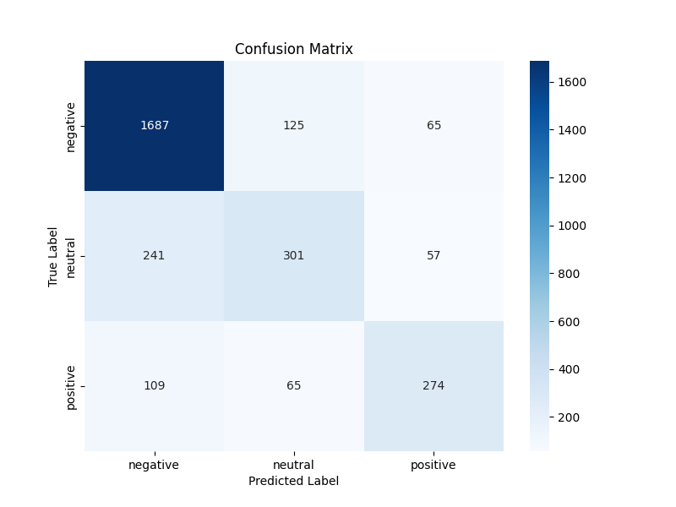
The Confusion Martix

Slide 10
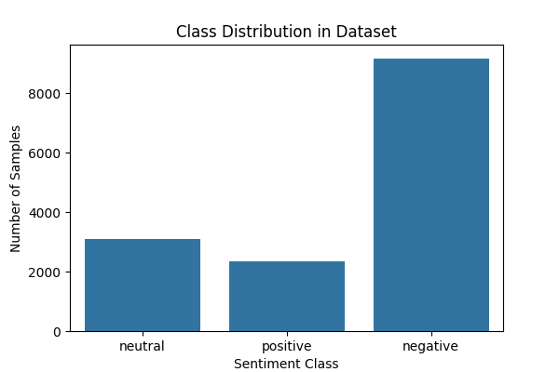
Class Distribution in Dataset

Slide 11
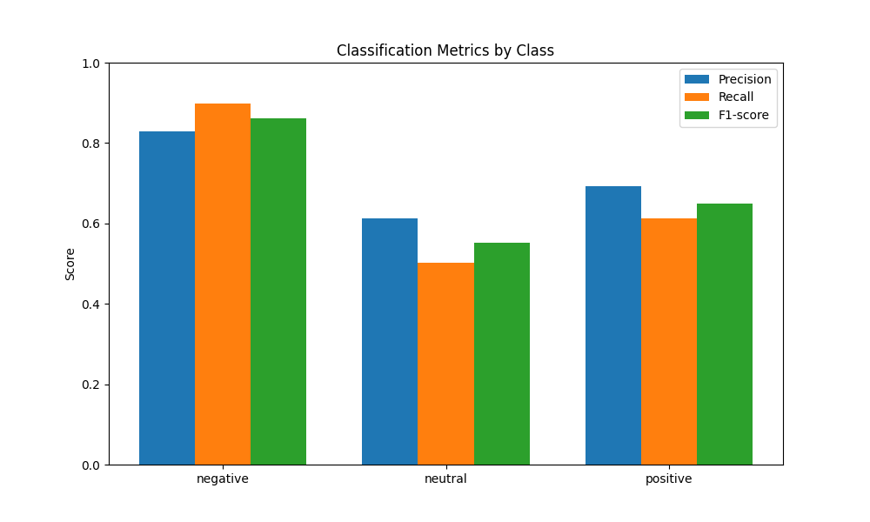
Classification Metrics by Class

Slide 12
Summary
We built an SVM-based sentiment classifier using TF-IDF features extracted from tweets.
The model achieved ~79% accuracy, with strong performance on negative sentiment detection.
Next steps may include deep learning models like BERT to improve recall for neutral and positive classes.

