Slide 1
Data Structure & Algorithm Analysis
--Maze Game : A Simple but Useful Practice
Group Members：
吕钰梁 ， 徐文乐 ， 李煜章

Slide 2
Contents
01
Introduction
02
The reasons
03
Expected functioality
04
Task allocation

Slide 3
Introduction
PART 01

Slide 4

Maze Game -- A practical journey into Data Structures
What is Maze ?
A classical puzzle consists of :
Paths(where you can move);
Walls(obstacles);
A start point;
An end point(or more)
The core objective :
Find a path from the start to the end.

Slide 5
The reasons for choosing it
PART 02

Slide 6

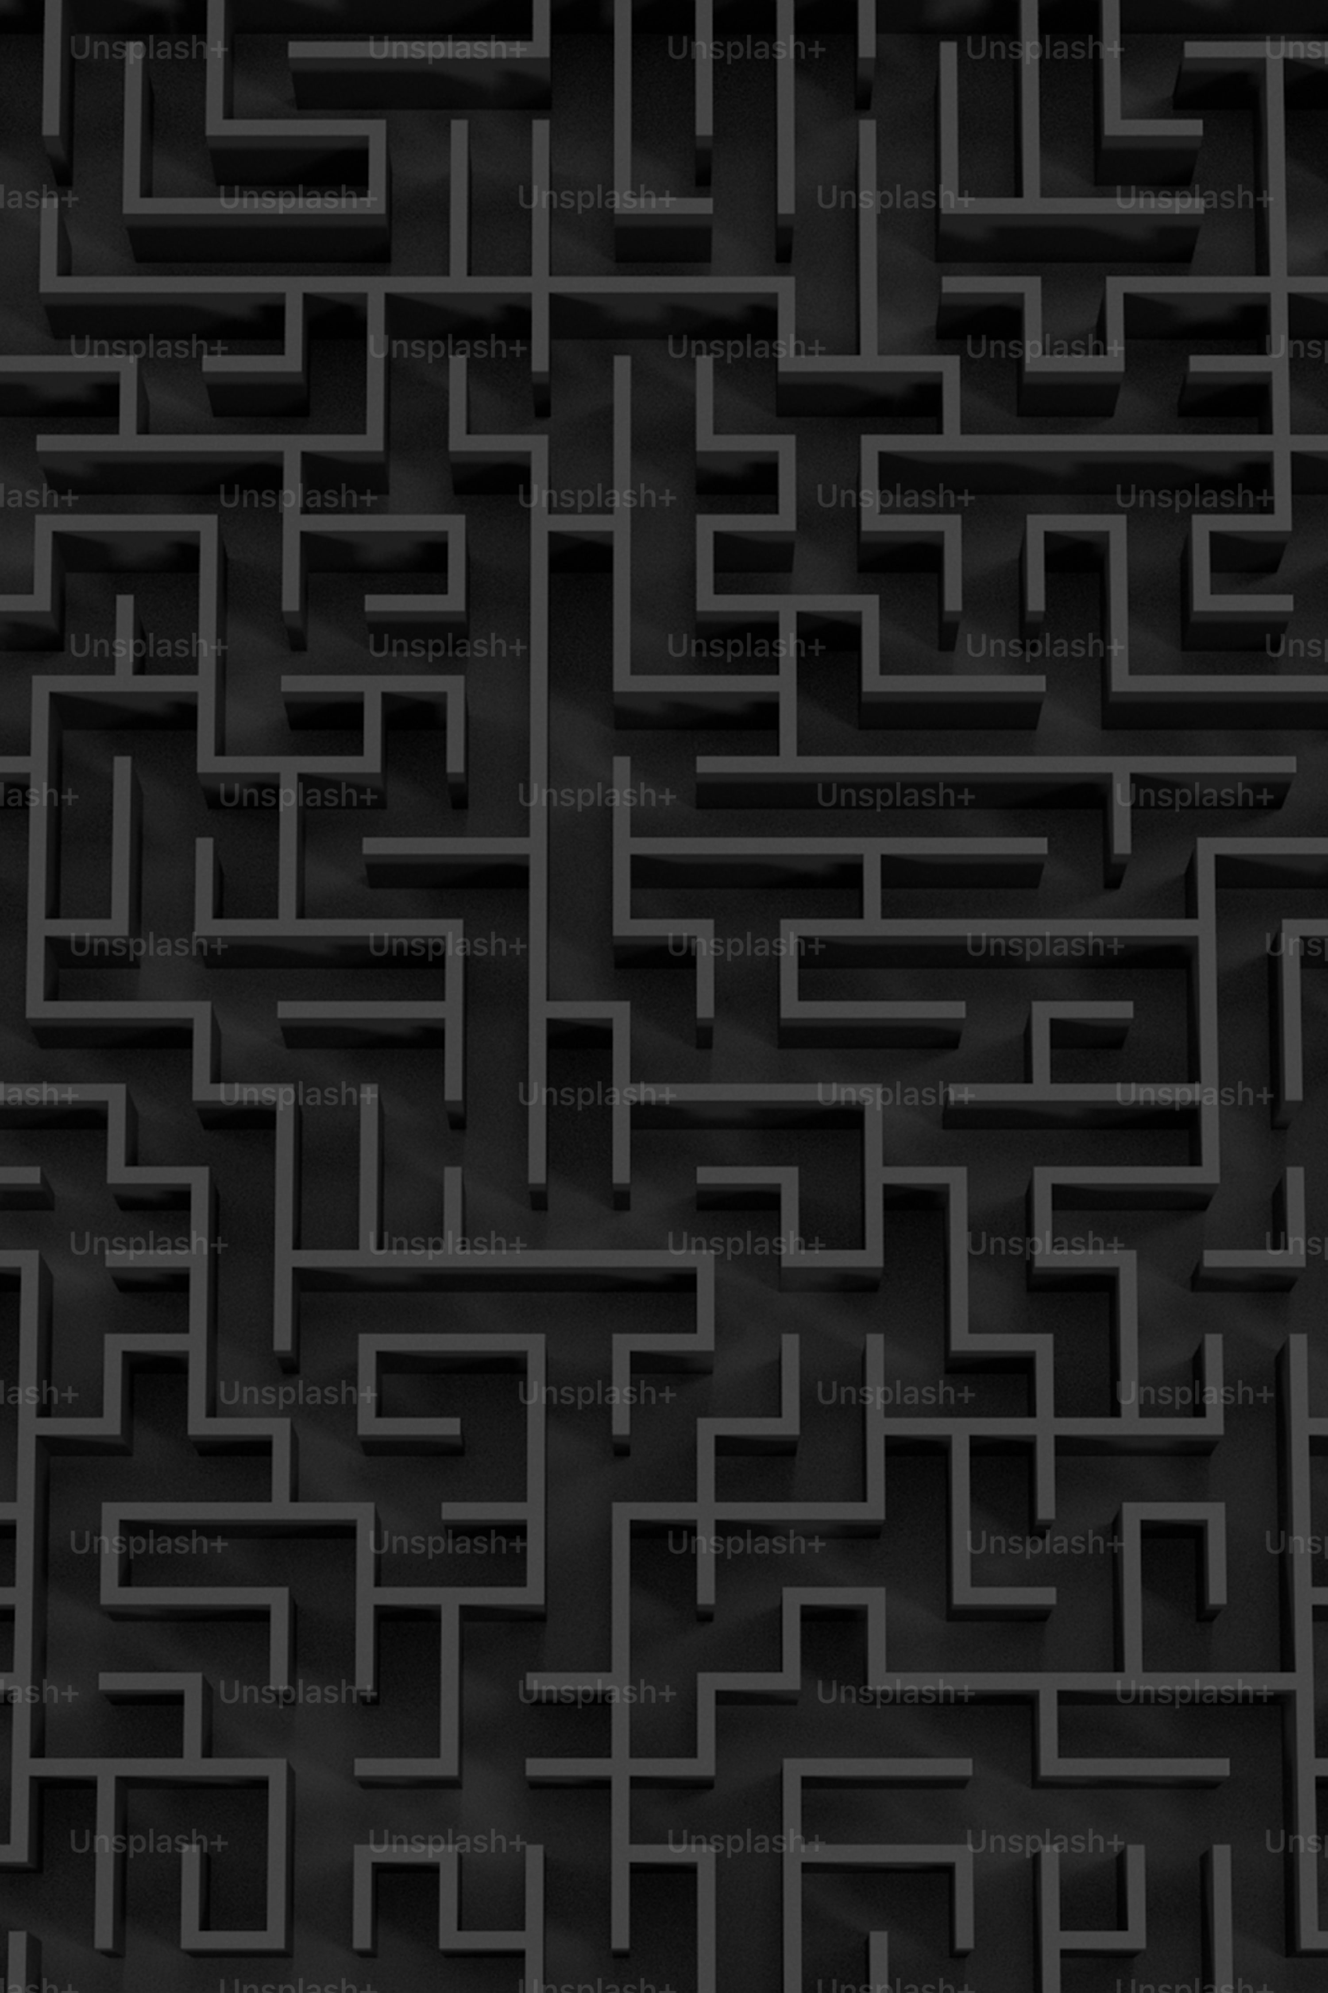
A perfect microcosm for fundamental concepts
From Maze challenges to Data Structure and Algorithms
Maze Challenge | Corresponding knowledge
Maze Generation | Union-Find Sets , Kruskal/Prim MST
Path Finding | BFS(the shortest) , DFS , A*
Representing the Maze | Data Structures(Graphs , 2D Arrays)
Extra | GUI , DataBase,.etc

Slide 7
Expected Functionality
PART 03

Slide 8
Maze Generation
Using the data structure Union-Find Set to generate a maze.
Core idea: Start with a grid full of walls.Knock down walls to connect cells,using Union-Find to ensure that no cycles are formed , generating a “Perfect” maze
Two Algorithms : Kruskal and Prim
Files :
A “Maze.h” to realize the core functionalities such as the generation , the solution and maze elements(start point , end point )
A “Cell.h” to store walls and its operations(check if a direction has a wall , remove the wall in one direction)
A “Utils.h” to assist.

Slide 9
Maze Solution
Implement both BFS and DFS to find a path
Additionally , using the A* algorithm to find a path
Try both recursive and non-recursive modes

Slide 10
Extra Functionality
GUI in Qt :
Creating a graphical interface for the maze;
Realizing player(not automatic) control and adding different sound effects;
Algorithm Comparison :
Implement different algorithms and compare their performance visually and theoretically;
Database access:
Player creating accounts , log-in and log-out , and process saving and loading,.etc.

Slide 11
Group Task Allocation
吕钰梁
徐文乐
李煜章
Responsible for the user interface, maze visualization, and interaction logic.
Responsible for the research, design and implementation of the core algorithms.
Responsible for project coordination, testing, integration and documentation of the final results.

Slide 12
Thanks
吕钰梁，徐文乐，李煜章

