Slide 1
Demystifying incentives in the consensus computer
Loi Luu, Jason Teutsch, Raghav Kulkarni, Prateek Saxena
National University of Singapore

Slide 2



Consensus-based computation (CBC)
Employed by consensus computer
f(x) = ?
Consensus
Computer
f(x) = y
Problem
Giver (G)
Prover
(P)
Verify if y = f(x)
Mine blocks
Verifier
(V)
Notes:
A consensus-based computation (CBC) protocol
G: Problem wants to compute for f() with input x
P: Prover proves that he has s s.t. s=f(x)
V: Verifier verifies if s=f(x) is correct
W_{blk}: work that V always does to get reward

Slide 3
CBC in Bitcoin
Receiver of a TX
Sender of a TX
f: provide a correct signature
y: correct signature
Blockchain
Problem
Giver (G)
Prover
(P)
Verify if signature is correct
Solve PoW
Miner
Verifier
(V)
Notes:
A consensus-based computation (CBC) protocol
G: Problem wants to compute for f() with input x
P: Prover proves that he has s s.t. s=f(x)
V: Verifier verifies if s=f(x) is correct
W_{blk}: work that V always does to get reward

Slide 4
Cryptocurrencies as consensus computers
Bitcoin
f: provide a correct signature
Anyone can produce f via transaction script
Determines applications of cryptocurrencies
Lack of Turing-Completeness
Input:
PreviousTX: ID of previous IX
Index: 0
scriptSig: Sign(PubKey), PubKey
Output:
Value: 1.0
scriptPubKey:
%take Signature and PubKey as params
checkif Hash(PubKey) = Payee's ID,
checkif Sign(PubKey) is valid
Specify the puzzle
1 BTC

Slide 5
Ethereum: Consensus computer with Turing complete language
Support Turing complete script
Can run arbitrary applications
Example
Computation of matrix multiplication
N = matrix_size
A = N*N input matrix
B = N*N input matrix
if msg.data[0] = 1:
C = get_matrix(msg.data[1])
if (C == A * B) //run O(N³)
sendReward()

Slide 6
Problem: correctness of computation?
Assumption: Users always verify and accept only correct solutions
There is no reward for verifiers!
The verification assumption is shaky!
Users are vulnerable to attacks
Rational users have incentive to skip verifications
Computation may be incorrect!

Slide 7
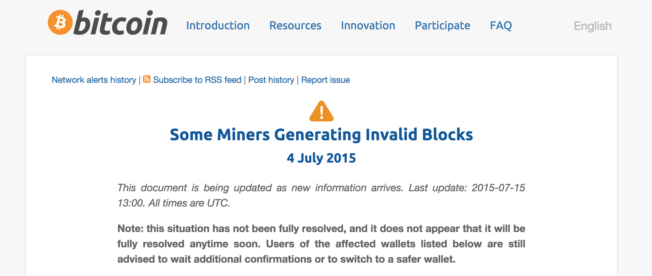
Oops!
5% miners mined an invalid block
Half the network hash rate was mining without fully validating blocks
Build new blocks on top of that invalid block.

Slide 8
Contributions
Consensus computer may produce incorrect results
Verifier’s dilemma
Classes of computations can be performed correctly
Formalize the protocol used by consensus computers
Understand the incentive structure
Techniques to support more applications

Slide 9
Contributions
Consensus computer may produce incorrect results
Verifier’s dilemma
Classes of computations can be performed correctly
Formalize the protocol used by consensus computers
Understand the incentive structure
Techniques to support more applications

Slide 10
Resource exhaustion attack on verifiers
Goal
Create expensive TXs which require more resources & time to verify
Damages
Waste other resources
Gain advantage in finding next blocks
Notes:
- Mention about the defense

Slide 11
Resource exhaustion attack in Bitcoin
Protection mechanism
Only allow basic arithmetic & crypto opcodes
Block size limit
Attacks in Bitcoin
CVE-2013-2292
Attacker includes multiple OP_Checksig in a block-size TX
Miners have to hash 19.1 GB of data to verify
Take relatively 190 seconds CPU-time
Expected time to find a block is only 10 mins
Include as many TXs as possible
Verification time is increased
Notes:
- Mention about the defense

Slide 12
Resource exhaustion attack in Ethereum
Protection mechanism
Pay gas as transaction fee
Gas depends on opcodes
Attack observation
gas fee is credited to the block founder
Attacker = block founder?
Attack with 0-fee
The attack
Include expensive TXs
in its block
N = matrix_size
A = N*N input matrix
B = N*N input matrix
if msg.data[0] = 1:
C = get_matrix(msg.data[1])
if (C == A * B) //run O(N³)
sendReward()
Notes:
- Mention about the defense

Slide 13
Users’ ill-fated choices
Verify
Not Verify
Mine valid blocks
Less advantage in next blocks
Others start ahead
Waste resource
More advantage in finding next blocks
Mine invalid blocks
Waste all efforts on invalid blocks
Verifier’s dilemma
Users do not know to do or skip the verification
Users have incentive to skip verification
TXs and computation on blockchain may be incorrect!

Slide 14
Contributions
Consensus computer may produce incorrect results
Verifier’s dilemma
Classes of computations can be performed correctly
Formalize the protocol used by consensus computers
Understand the incentive structure
Techniques to support more applications

Slide 15
Approach overview
Goal
Determine classes of computations can be performed correctly
Intuition
Limit advantage of skipping verification
Formulate the underlying protocol of consensus computers
Understand incentive structure

Slide 16
Consensus-based computation (CBC)
Employed by consensus computer
Compute f(x)
Consensus
Computer
y = f(x)
Problem
Giver (G)
Prover
(P)
Do W_{b} work
to mine a block and get reward
Verify if y = f(x)
Verifier
(V)
Notes:
A consensus-based computation (CBC) protocol
G: Problem wants to compute for f() with input x
P: Prover proves that he has s s.t. s=f(x)
V: Verifier verifies if s=f(x) is correct
W_{blk}: work that V always does to get reward

Slide 17
Advantage of rational users
Def 1: Advantage of rational users w.r.t a TX:
adv(f) = W_{f} - W_{df}
W_{f}: amount of work to verify f
W_{df}: amount of work in deviated protocol
Generally adv(f) = W_{f} – O(1)
Def 2: Advantage to skip block verification
adv(blk) = =
Threat model:ε- rational users
Def 3:ε- rational users are honest if
adv(blk) ≤εW_{b}
deviate otherwise

Slide 18
Incentivize correct consensus computation
Lemma: Computation that requires less than εW_{b} is computed correctly by consensus computers of ε- rational users
Def 4:ε- Consensus computer requires at most εW_{b} in verifying a block
ε- consensus computer produces correct results w.r.t ε- rational users
Applications that require more than εW_{b} work?
Notes:
εvalue
Represents the acceptable “common good” work
Not straightforward to estimate, depends on
Net-worth of applications
The network properties
The incentive mechanism
Individual miner’s beliefs

Slide 19
Contributions
Consensus computer may produce incorrect results
Verifier’s dilemma
Classes of computations can be performed correctly
Formalize the protocol used by consensus computers
Understand the incentive structure
Techniques to support more applications

Slide 20
Run more applications on ε-consensus computer: Correct computation
Split verification work into multiple TXs across multiple blocks
Each TX is correctly run by aε- Consensus computer
Advantage of rational miners is bounded
Correctness guaranteed
Latency is high
N = matrix_size
A = N*N input matrix
B = N*N input matrix
if msg.data[0] = 1:
C = get_matrix(msg.data[1])
if msg.data[0] > 1:
i, j = get_index(msg.data[0])
check_if (C[i][j] == A[i][] * B[][j]) //require to run O(N)
Each TX checks
one element

Slide 21
Run more applications on ε-consensus computer: Approximate computation
Probabilistic checking
Reduce TXs and latency
guarantee probabilistic correctness
Goal
Ensure y differs from f(x) by at most δ elements with at least probability of, say, 99%
Intuition
If a solution is incorrect, a random check will detect with some probability

Slide 22
Approximate computation in Ethereum
How to randomly sample?
Use next block hash as a random seed
Hard to control
High guarantee of randomness and fairness
N = matrix_size
A = N*N input matrix
B = N*N input matrix
counter = 0
if msg.data[0] = 1:
C = get_matrix(msg.data[1])
if msg.data[0] > 1:
blkHash= get_current_block_hash()
i, j = get_index(blkHash)
if (C[i][j] == A[i][] * B[][j])
if ++counter > THRESHOLD:
return OK
Else return WRONG-SOLUTION
Sample element to check
Accept solution if check enough samples

Slide 23
Other case studies
Correct consensus computation
GCD computation of large numbers
Dot product
Approximate consensus computation
Matrix multiplication
Sorting
k-coloring
Notes:
Mention GCD computation

Slide 24
Conclusion
Computation done by consensus computer is not guaranteed!
Verifier’s dilemma
Determine classes of computations can be executed correctly
Formalize the consensus computer protocol
Understand the incentive structure
Techniques to deploy large applications
Tradeoff between correctness & performance

Slide 25
The end

Slide 26
Related work
Incentive incompatible in Bitcoin Mining
[LSPSB 15] On Power Splitting Games in Distributed Computation: The Case of Bitcoin Pooled Mining
[Eyal 15] The miner’s dilemma
Other Bitcoin attacks
[Rosen 11] Analysis of Bitcoin Pooled Mining Reward Systems
Pool hopping, Lie in wait attack
[EyalSi 13] Majority is not enough: Bitcoin mining is vulnerable
Selfish mining attack
[HKZG 15] Eclipse Attacks on Bitcoin’s Peer-to-Peer Network

Slide 27
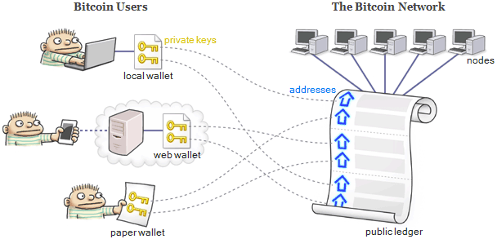
Ethereum system overview
TXs
TXs
Smart Contract
TXs

Slide 28
Steps to verify a block in Bitcoin
If block hash meets difficulty
One SHA256 computation
Merkle tree of N TXs is correctly constructed
O(N) SHA256 computations
If all TXs are valid: Depends on
Number of TXs
Logic in each TX
Currently in a Bitcoin block:
N=500-700 TXs
Verifying a normal TX requires 2 signatures, 2 SHA256
Verifying a Merkle tree is relatively cheap

Slide 29
Attack Bitcoin’s verfiers
Intuition: Bitcoin limits the TX size, but not the number of opcodes
Expensive opcode ~ easy opcode
SHA256, CheckSig, etc
What if a TX requires 10000 signatures verification?
The attack: CVE-2013-2292
Attacker includes multiple OP_Checksig in a block-size TX
Miners have to hash 19.1 GB of data to verify
Take relatively 190 seconds CPU-time
Expected time to find a block is only 10 mins

Slide 30
CBC in existing cryptocurrencies
In Bitcoin
G: sender of a TX
f: decides what a receiver has to do
P: receiver of a TX
proves the ownership of the address
V: miners
verify if receiver’s signature is valid
W_{blk} : solve PoW
In Ethereum
G can define more expressive problem f()
V may have to do more work

Slide 31
CBC in existing cryptocurrencies
Receiver of a TX
Sender of a TX
f: provide a correct signature
y: correct signature
Blockchain
Problem
Giver (G)
Prover
(P)
Verify if signature is correct
Solve PoW
Ethereum
G defines more expressive problems f()
V has to do more work
Miner
Verifier
(V)
Notes:
A consensus-based computation (CBC) protocol
G: Problem wants to compute for f() with input x
P: Prover proves that he has s s.t. s=f(x)
V: Verifier verifies if s=f(x) is correct
W_{blk}: work that V always does to get reward

Slide 32
ε-Consensus computer in existing cryptocurrencies
Goal: limiting εW_{b} work in verifying a block
Method: Limiting work in each TX to
In Ethereum
Leveraging the gas mechanism
In Bitcoin
Introduce TX size
Bound number of expensive opcodes
Only allow predefined standard TXs

Slide 33
gas_limit in Ethereum
Limit the gas in a block
Can be adjusted by miners
Let the “consensus” decide the gas_limit
Different miners have different thresholds for gas_limit
Raise gas_limit to above the gas required in the attack
Some miners are vulnerable

