Slide 1
Random Walk based Proximity Measures in Directed Graphs
Speaker: 李 寰
Notes:
Hi I am going to talk about finding nearest neighbors in large graphs very very quickly. This is joint work with …

Slide 2




Recommender systems¹
Alice
What are the top k movie recommendations for Alice in IMDB?
Bob
Charlie
1. M. Brand. A random walks perspective on maximizing satisfaction and profit. SIAM ‘05.
Notes:
Lets start with a few examples which require ranking on large graphs. Take for example recommender networks.
Here we have a bipartite graph of customers and movies. A customer has a link to a movie if he/she rated that movie. Now the question is…

Slide 3
Content-based search in databases^{1, 2}
maximum
paper-has-word
Find top k papers matching “SVM” in DBLP
margin
Paper #1
classification
paper-cites-paper
paper-has-word
large
Paper #2
scale
SVM
1. S. Chakrabarti. Dynamic personalized pagerank in entity-relation graphs. WWW ‘07.
2. A. Balmin, V. Hristidis, & Y. Papakonstantinou. ObjectRank: Authority-based keyword search in databases. VLDB ‘04.
Notes:
Another example is content based search in databases. We can represent the citeseer dataset by a graph of paper and word-nodes. Papers are connected via citation. Words are connected to the paper if they appeared in the title of the paper. Now we want to ask….

Slide 4
Random walk based proximity measures in directed graphs
Personalized pagerank
G. Jeh & J. Widom (WWW ’03)
Truncated hitting and commute times
P. Sarkar, A. Moore, & A. Prakash (ICML ’08)
Escape probability
H. Tong, Y. Koren, & C. Faloutsos (KDD ’07)
Notes:
Lets start with a few examples which require ranking on large graphs. Take for example recommender networks.
Here we have a bipartite graph of customers and movies. A customer has a link to a movie if he/she rated that movie. Now the question is…

Slide 5
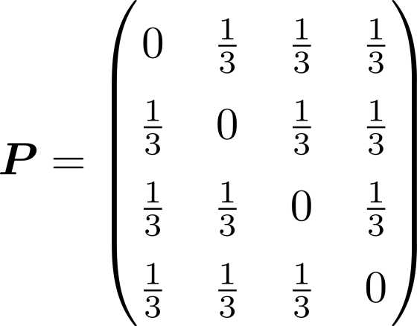



Random walks
t=1
2
2
t=0
Start at 1
Move to a neighbor j randomly
Continue
Transition matrix¹
1
3
4
4
t=2
1. A. Blum, J. Hopcroft, & R. Kannan. Foundations of Data Science. 2016.

Slide 6

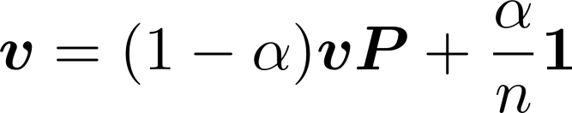


Personalized pagerank
Stationary distribution
Pagerank¹
Rank web-pages by distribution satisfying
Personalized pagerank²
Using a non-uniform restart distribution
e.g. when computing proximities from node i
1. S. Brin & L. Page. The anatomy of a large-scale hypertextual web search engine. WWW ‘98.
2. G. Jeh & J. Widom. Scaling personalized web search. WWW ’03.
Notes:
Lets start with a few examples which require ranking on large graphs. Take for example recommender networks.
Here we have a bipartite graph of customers and movies. A customer has a link to a movie if he/she rated that movie. Now the question is…

Slide 7





Hitting and commute times
Hitting time
Expected length of the path
Commute time
Expected length of the path
Drawbacks^{1, 2}
Take into account very long paths
is small whenever j has a large stationary probability
Alice likes cartoons, so her top 10 recommendations should not be the 10 most popular movies
1. D. Liben-Nowell & J. Kleinberg. The link predication problem for social networks. CIKM ‘03.
2. M. Brand. A random walks perspective on maximizing satisfaction and profit. SIAM ’05.
Notes:
Lets start with a few examples which require ranking on large graphs. Take for example recommender networks.
Here we have a bipartite graph of customers and movies. A customer has a link to a movie if he/she rated that movie. Now the question is…

Slide 8
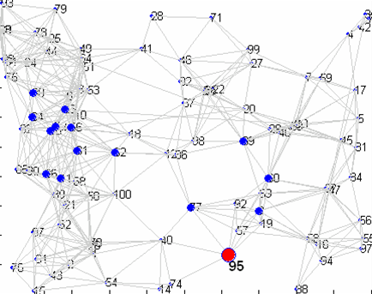
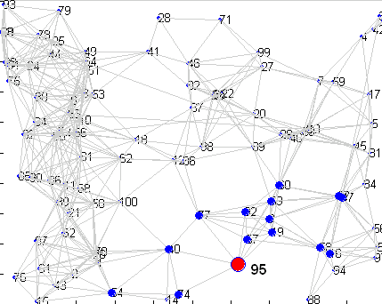
Truncated hitting and commute times¹
Truncated version of hitting time and commute times
Only considers paths of length at most T
15 most proximate nodes to node 95 in red
a) Un-truncated hitting time
b) Truncated hitting time
1. P. Sarkar, A. Moore, & A. Prakash. Fast Incremental Proximity Search in Large Graphs. ICML ‘08.
Notes:
Lets start with a few examples which require ranking on large graphs. Take for example recommender networks.
Here we have a bipartite graph of customers and movies. A customer has a link to a movie if he/she rated that movie. Now the question is…

Slide 9

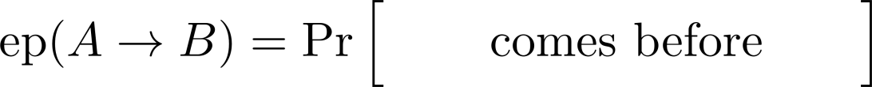
Escape probability¹
The escape probability from node A to node B
Denoted as
Pr [ starting at A, reaches B before returning to A ]
the remaining
graph
A
B
1. H. Tong, Y. Koren, & C. Faloutsos. Fast direction-aware proximity for graph mining. KDD ‘07.

Slide 10
Asymmetry of escape probability
Notes:
Lets start with a few examples which require ranking on large graphs. Take for example recommender networks.
Here we have a bipartite graph of customers and movies. A customer has a link to a movie if he/she rated that movie. Now the question is…

Slide 11



Issue 1: “Degree-1 node” effect
Adding an absorbing node

Slide 12
Issue 2: Weakly connected pair
Partial symmetry
Notes:
Lets start with a few examples which require ranking on large graphs. Take for example recommender networks.
Here we have a bipartite graph of customers and movies. A customer has a link to a movie if he/she rated that movie. Now the question is…

Slide 13



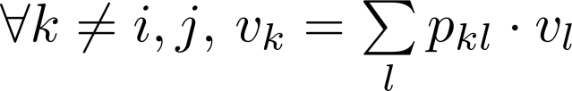
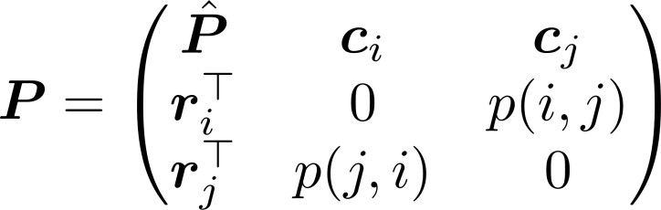

Solving ep(i -> j)
The generalized voltage
Calculating
, ,
Split and
Then
Notes:
Lets start with a few examples which require ranking on large graphs. Take for example recommender networks.
Here we have a bipartite graph of customers and movies. A customer has a link to a movie if he/she rated that movie. Now the question is…

Slide 14

Solving ep(i -> j)
The generalized voltage
Calculating
, ,
Split and
Then
Computing all ep(i -> j) requires
matrix inversions
Notes:
Lets start with a few examples which require ranking on large graphs. Take for example recommender networks.
Here we have a bipartite graph of customers and movies. A customer has a link to a movie if he/she rated that movie. Now the question is…

Slide 15
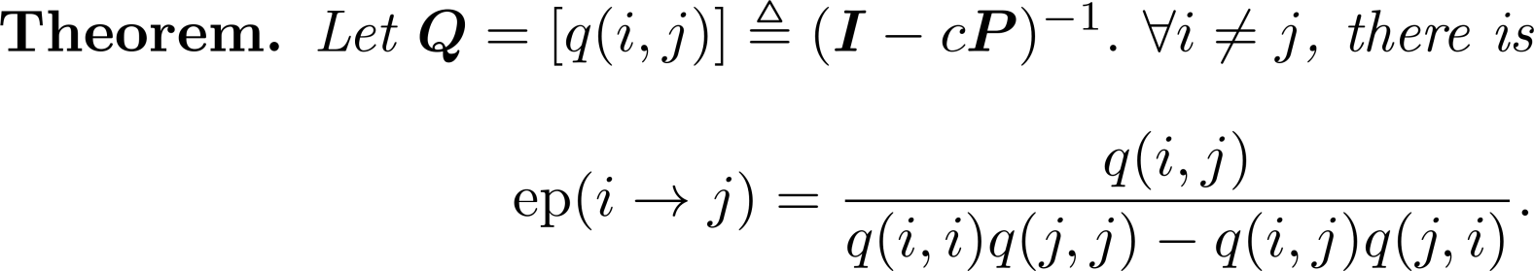


Fast solution for all-pair proximities
Proved by Block Matrix Inversion Lemma
Fast solution to all-pair proximilities
Compute
For all pair of nodes, compute
Time complexity
Notes:
Lets start with a few examples which require ranking on large graphs. Take for example recommender networks.
Here we have a bipartite graph of customers and movies. A customer has a link to a movie if he/she rated that movie. Now the question is…

Slide 16
Fast solution for one-pair proximity
Fast solution to one-pair proximity
Only need two columns of Q
Taylor expansion
Computing i^{th} column of Q
Notes:
Lets start with a few examples which require ranking on large graphs. Take for example recommender networks.
Here we have a bipartite graph of customers and movies. A customer has a link to a movie if he/she rated that movie. Now the question is…

Slide 17

Fast solution for one-pair proximity
….
x
x
x
Fast solution to one-pair proximity
Only need two columns of Q
Taylor expansion
Computing i^{th} column of Q
Time complexity
Notes:
Lets start with a few examples which require ranking on large graphs. Take for example recommender networks.
Here we have a bipartite graph of customers and movies. A customer has a link to a movie if he/she rated that movie. Now the question is…

Slide 18
Experimental results
Effectiveness
Link Prediction
Existence
Direction
Efficiency
Fast all-pair proximities
Fast one-pair proximity
Notes:
We want to check both the effectiveness and efficiency of our DAP.

Slide 19
Datasets (all real)
Name | Node # | Edge # | Directionality
WL | 4k | 10k | A-links to-B
PC | 36k | 64k | Who-contact-whom
EP | 76k | 509k | Who-trust-whom
CN | 28k | 353k | A-cites-B
AE | 38k | 115k | Who-email to-whom
Notes:
Now we will show some experimental results to
We use five datasets and all of them are directed, such as web-link graph, who-trust-whom, who-emails-to whom and so on.

Slide 20

Link Prediction: existence
density
with link
density
no link

Slide 21

Link Prediction: existence
Q: Given a pair of nodes i and j, is there a link between them?
A: Yes iff reaches a given threshold
Dataset | Accuracy
WL | 65.40%
PC | 79.60%
AE | 81.51%
CN | 86.71%
EP | 92.21%

Slide 22


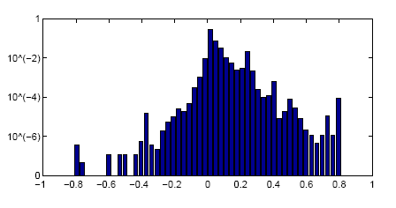
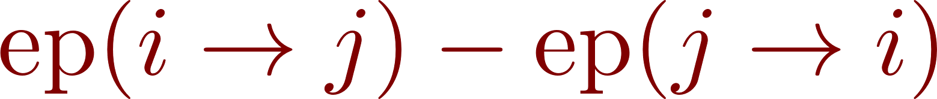
Link Prediction: direction
Q: Given the existence of the link between i and j, what is the direction of it?
A: Compare and , pick the greater one
>70%
density

Slide 23
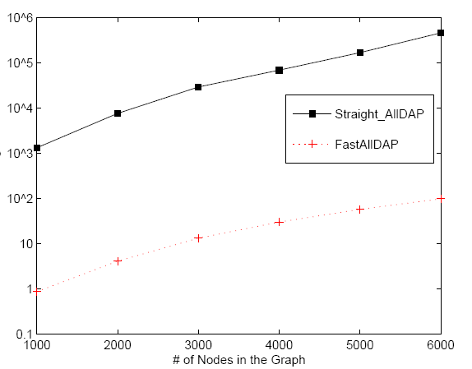
Efficiency: Fast all-pair proximities
Time (sec)
Straight-Solver
1,000x
faster!
FastAllDAP
Size of Graph

Slide 24
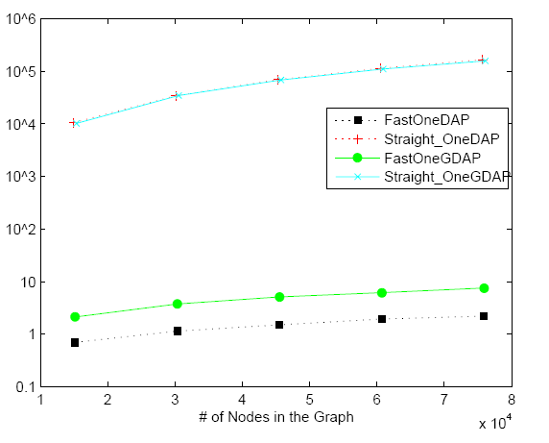
Efficiency: Fast one-pair proximity
Time (sec)
Straight-Solver
1,0000x
faster!
FastOneDAP
Size of Graph
Notes:
Similar observation for computing one single proximity

Slide 25
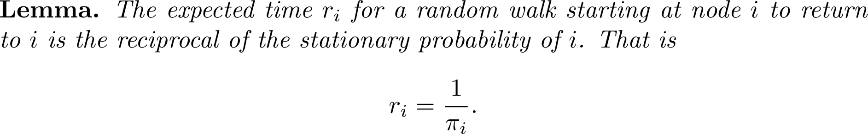
Relation to commute times
Notes:
Lets start with a few examples which require ranking on large graphs. Take for example recommender networks.
Here we have a bipartite graph of customers and movies. A customer has a link to a movie if he/she rated that movie. Now the question is…

Slide 26


Relation to commute times
Intuitively¹
A long walk always ends up in stationary distribution
Suppose the walk length is T, then the expected number it visits i is
The average time between two visits is
1. L. Lovász. Random walks on graphs: A survey. 1993.
Notes:
Lets start with a few examples which require ranking on large graphs. Take for example recommender networks.
Here we have a bipartite graph of customers and movies. A customer has a link to a movie if he/she rated that movie. Now the question is…

Slide 27
Relation to commute times
Intuitively¹
A long walk always ends up in stationary distribution
Suppose the walk length is T, then the expected number it visits i is
The average time between two visits is
Rigorously proved by the Strong Law of Large Numbers²
1. L. Lovász. Random walks on graphs: A survey. 1993.
2. A. Blum, J. Hopcroft, & R. Kannan. Foundations of Data Science. 2016.
Notes:
Lets start with a few examples which require ranking on large graphs. Take for example recommender networks.
Here we have a bipartite graph of customers and movies. A customer has a link to a movie if he/she rated that movie. Now the question is…

Slide 28
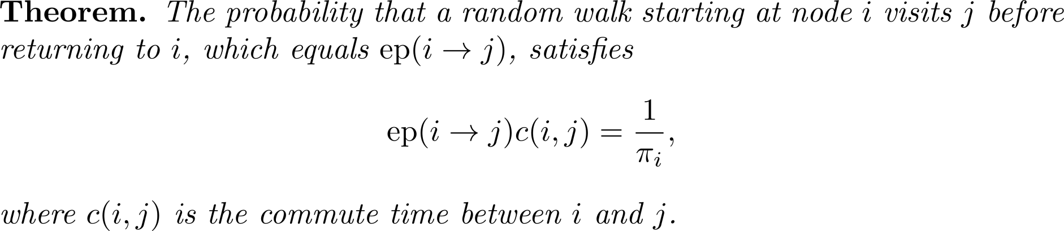
Relation to commute times
Notes:
Lets start with a few examples which require ranking on large graphs. Take for example recommender networks.
Here we have a bipartite graph of customers and movies. A customer has a link to a movie if he/she rated that movie. Now the question is…

Slide 29


Relation to commute times
Proof¹
Consider a random walk w starting at i, and random variables
X = the first time w returns to i
Y = the first time w returns to i after visiting j
By definition and
1. L. Lovász. Random walks on graphs: A survey. 1993.
Notes:
Lets start with a few examples which require ranking on large graphs. Take for example recommender networks.
Here we have a bipartite graph of customers and movies. A customer has a link to a movie if he/she rated that movie. Now the question is…

Slide 30
Relation to commute times
Proof¹
Consider a random walk w starting at i, and random variables
X = the first time w returns to i
Y = the first time w returns to i after visiting j
By definition and
Cleary X ≤ Y, and
1. L. Lovász. Random walks on graphs: A survey. 1993.
Notes:
Lets start with a few examples which require ranking on large graphs. Take for example recommender networks.
Here we have a bipartite graph of customers and movies. A customer has a link to a movie if he/she rated that movie. Now the question is…

Slide 31
Relation to commute times
Proof¹
Consider a random walk w starting at i, and random variables
X = the first time w returns to i
Y = the first time w returns to i after visiting j
By definition and
Cleary X ≤ Y, and
1. L. Lovász. Random walks on graphs: A survey. 1993.
Notes:
Lets start with a few examples which require ranking on large graphs. Take for example recommender networks.
Here we have a bipartite graph of customers and movies. A customer has a link to a movie if he/she rated that movie. Now the question is…

Slide 32
Relation to commute times
Proof¹
Consider a random walk w starting at i, and random variables
X = the first time w returns to i
Y = the first time w returns to i after visiting j
By definition and
Cleary X ≤ Y, and
Also
1. L. Lovász. Random walks on graphs: A survey. 1993.
Notes:
Lets start with a few examples which require ranking on large graphs. Take for example recommender networks.
Here we have a bipartite graph of customers and movies. A customer has a link to a movie if he/she rated that movie. Now the question is…

Slide 33
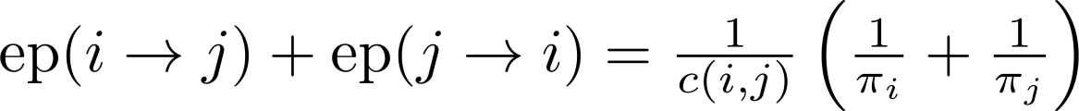


Relation to commute times
Recall that is small whenever is large
Bad for personalization
To alleviate this
Sarkar et al. restrict the length of random walk¹
Tong et al. reduce the dependence on stationary distribution²
1. P. Sarkar, A. Moore, & A. Prakash. Fast Incremental Proximity Search in Large Graphs. ICML ‘08.
2. H. Tong, Y. Koren, & C. Faloutsos. Fast direction-aware proximity for graph mining. KDD ‘07.
Notes:
Lets start with a few examples which require ranking on large graphs. Take for example recommender networks.
Here we have a bipartite graph of customers and movies. A customer has a link to a movie if he/she rated that movie. Now the question is…

Slide 34
The End

