Slide 1
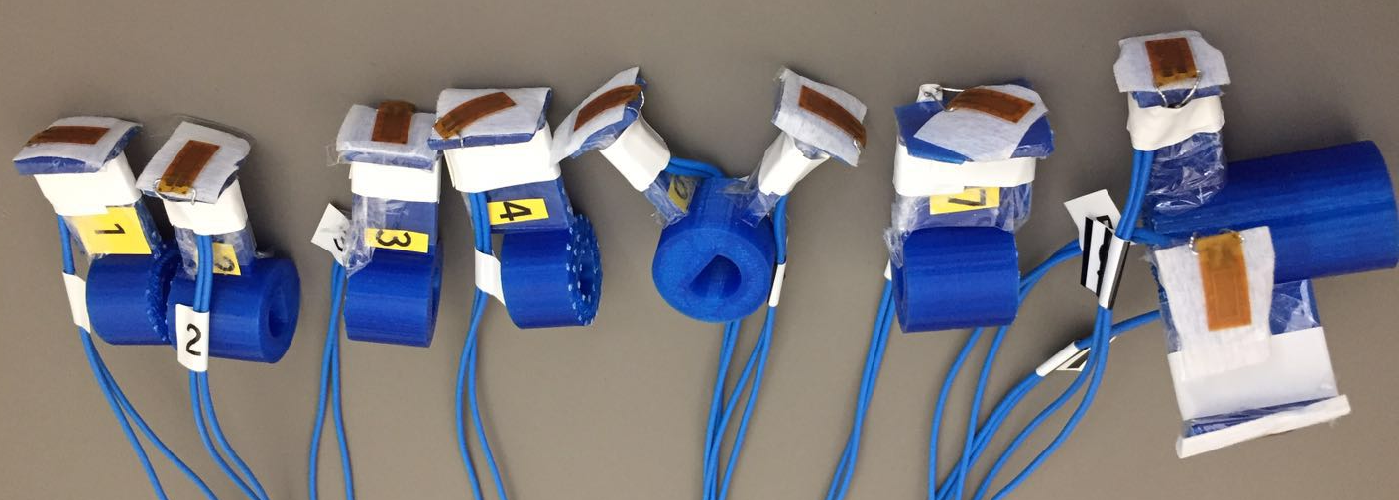
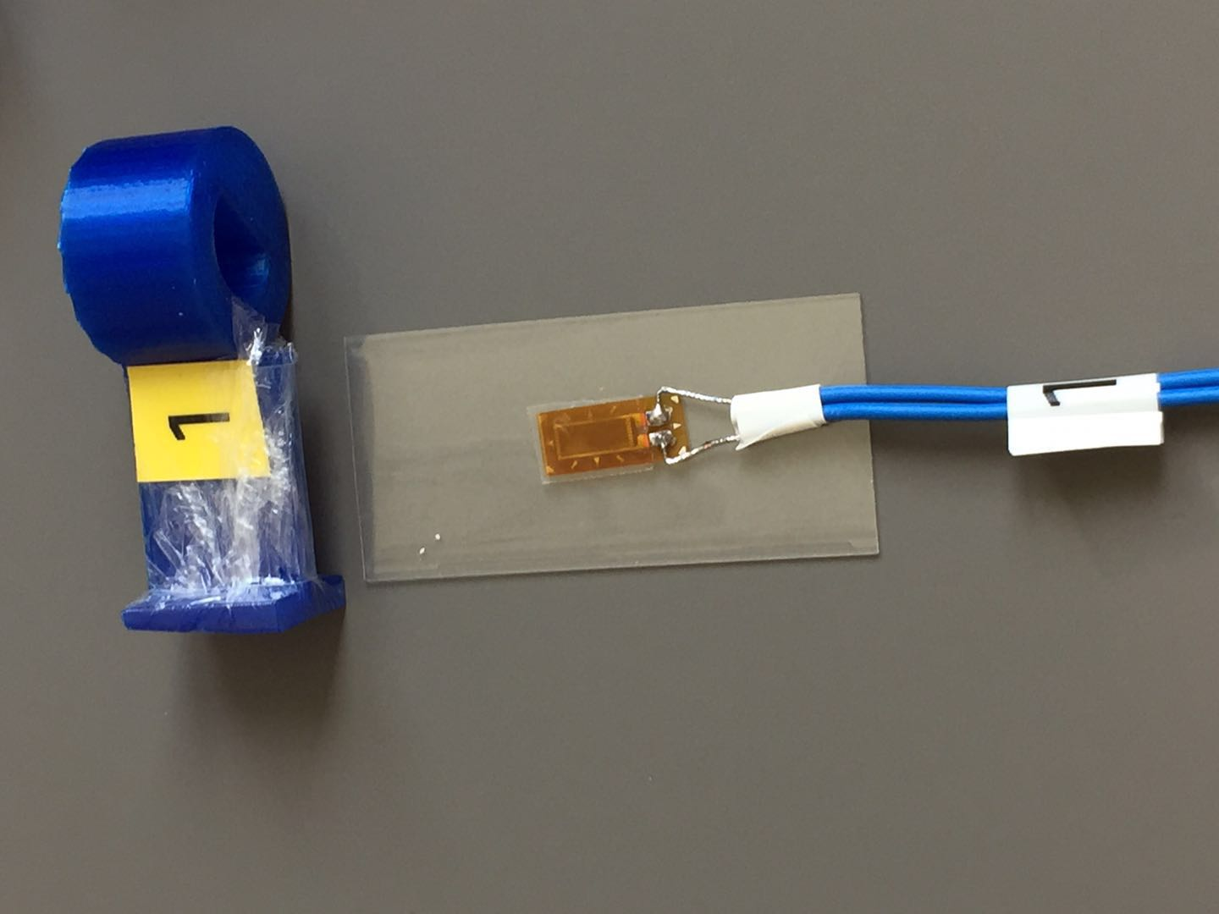
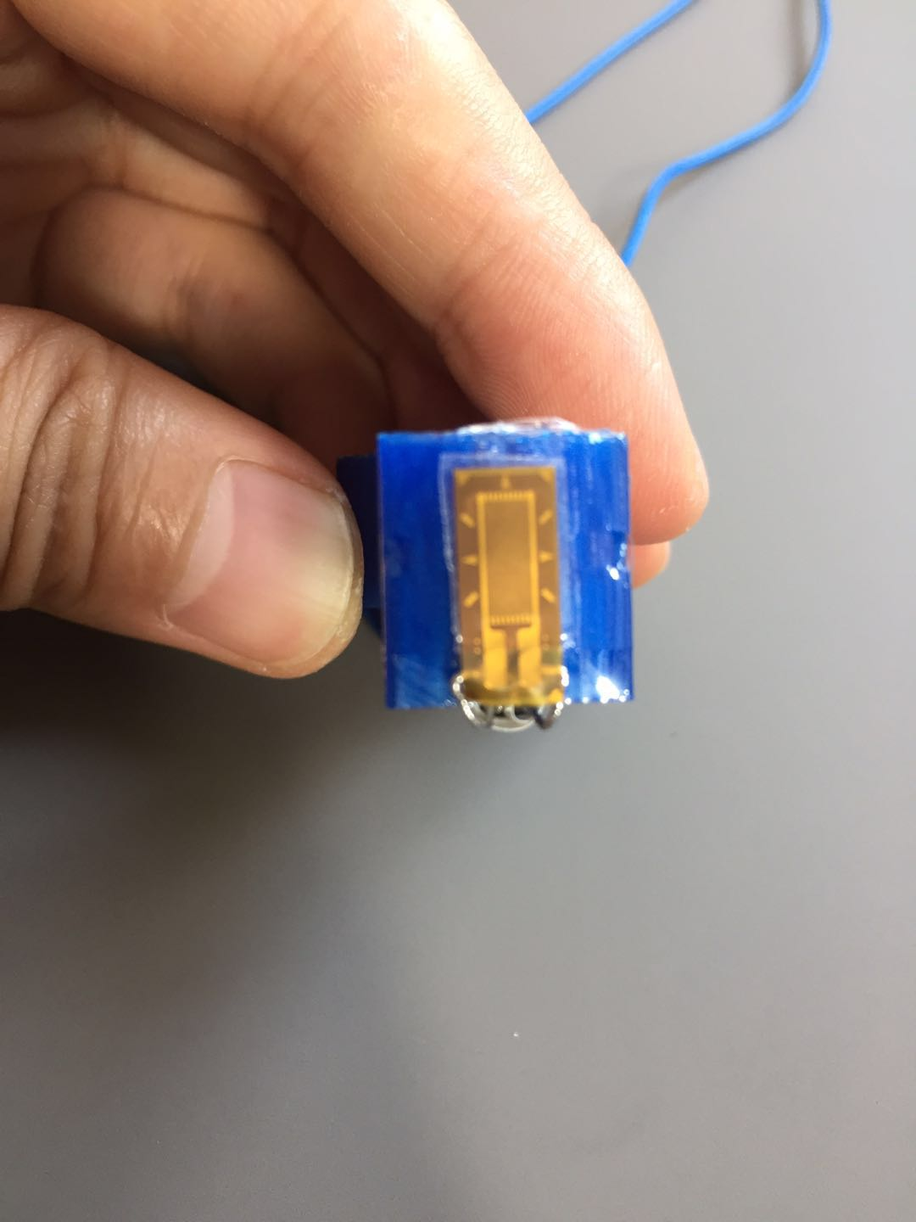
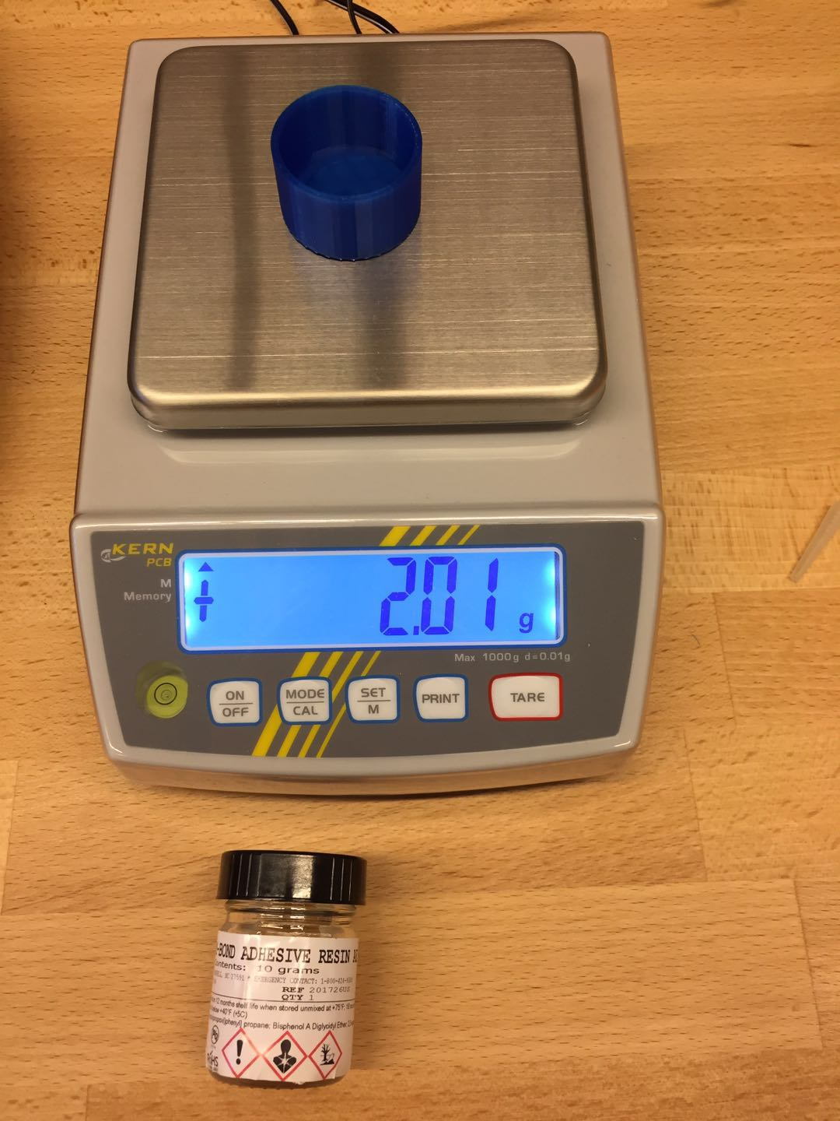
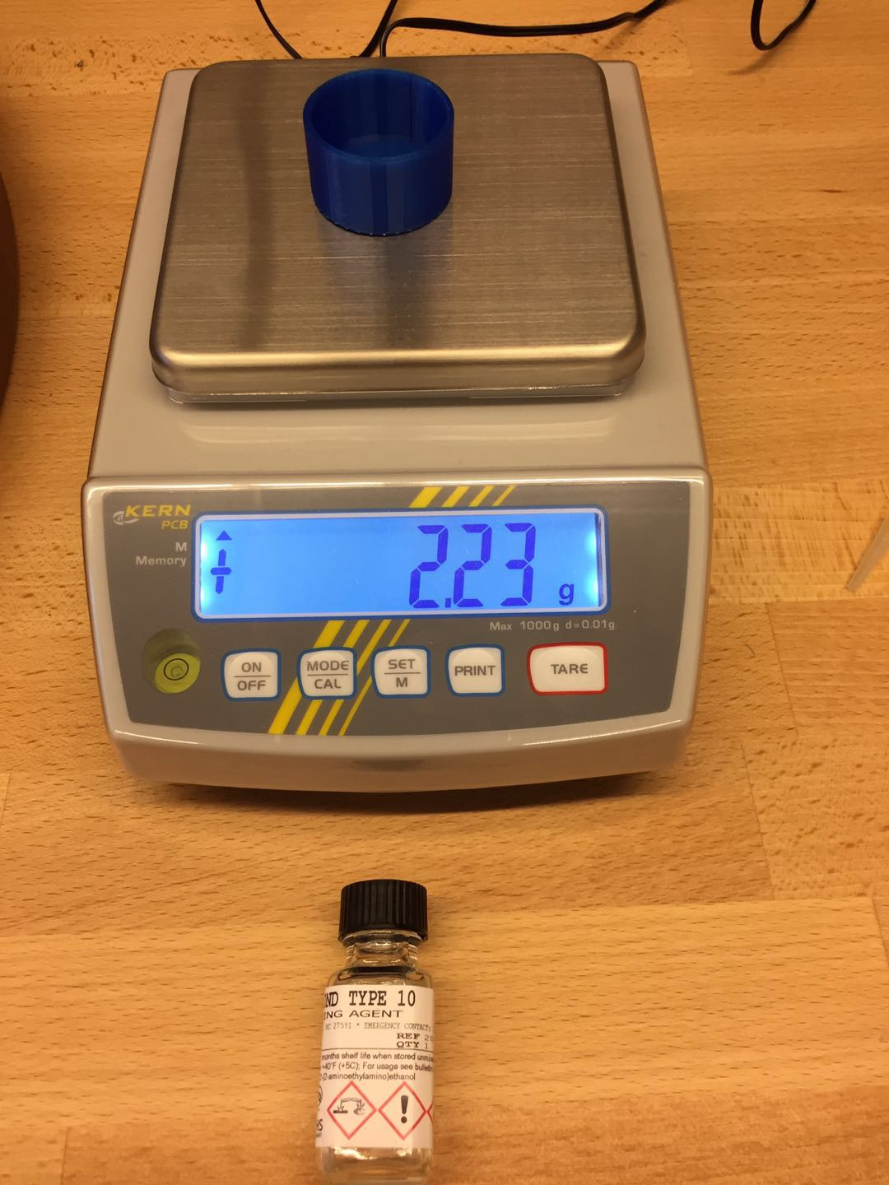
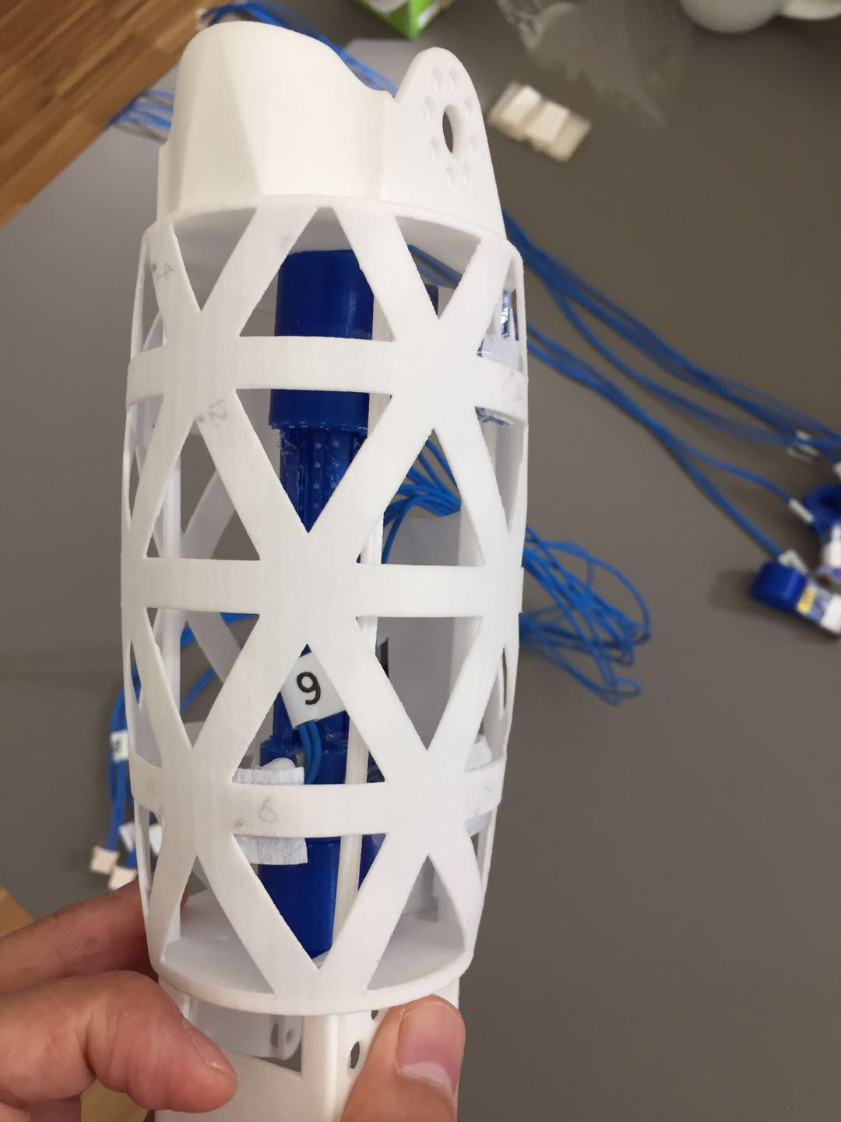
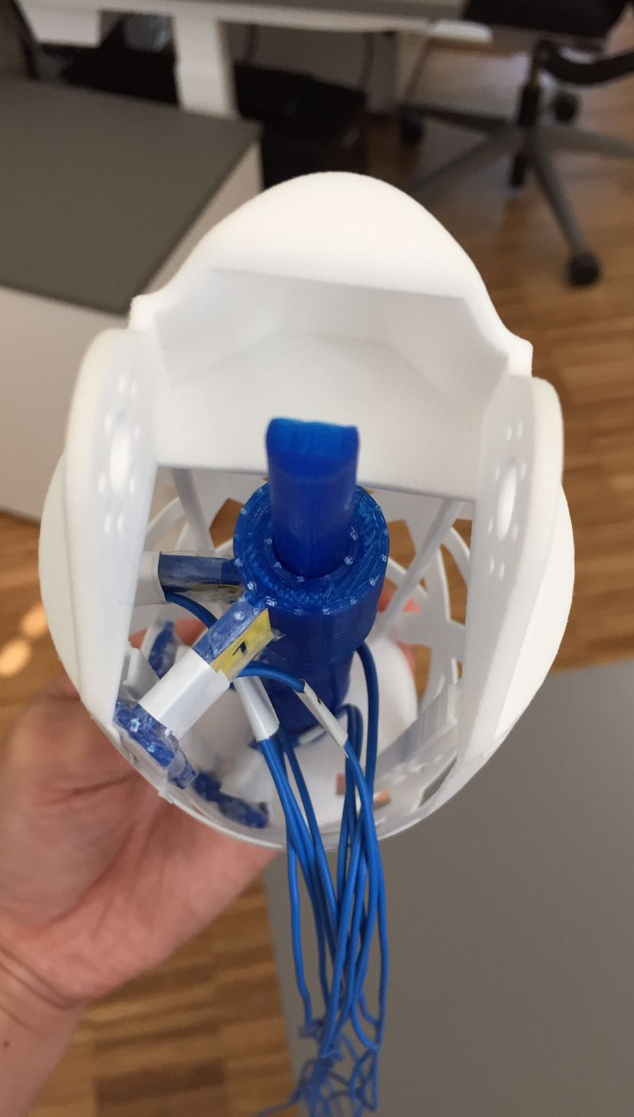
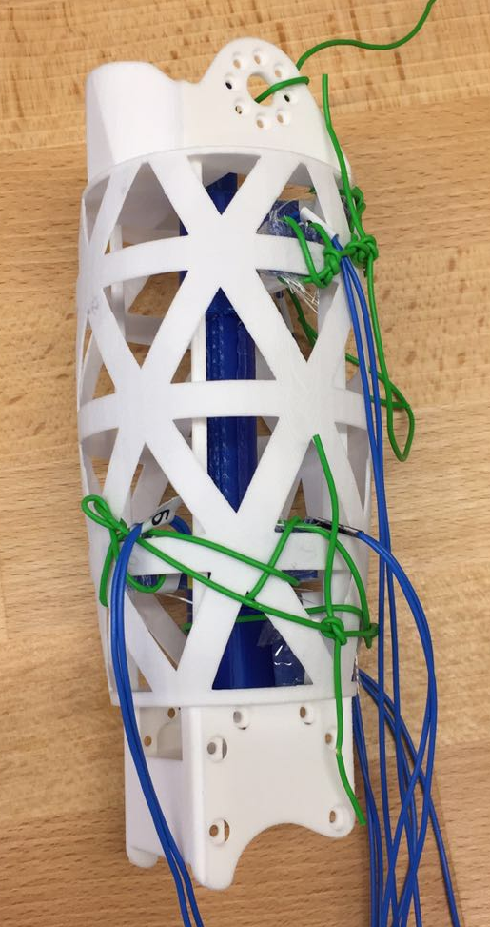
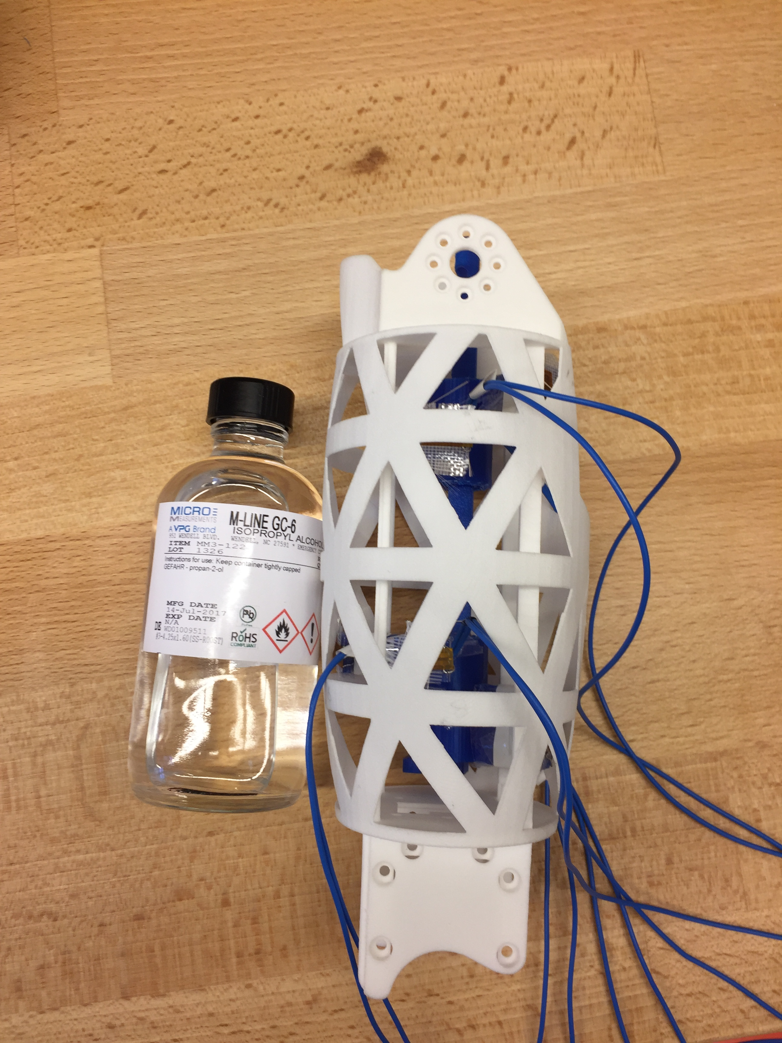
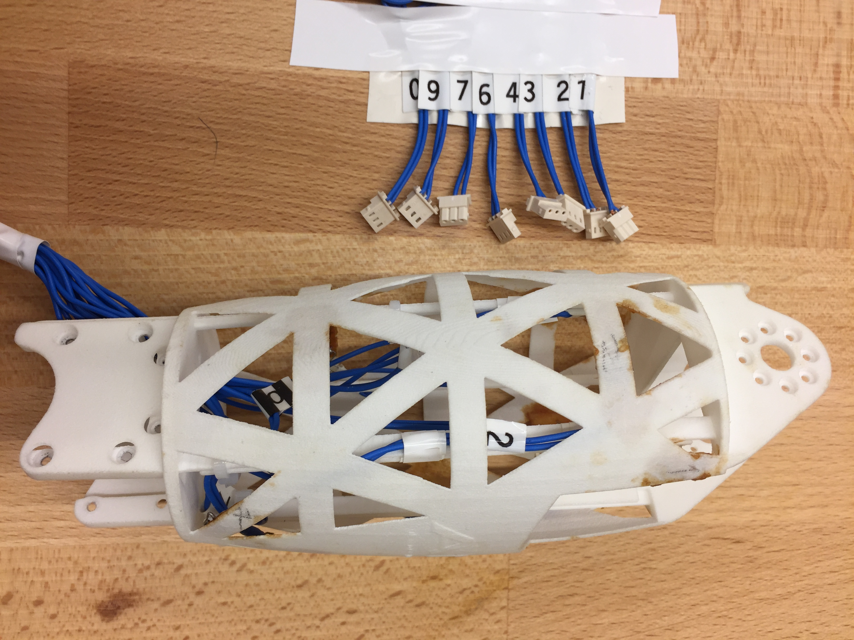
1
2
3
4
5
6
7
8
1 | Cover SS with preservative film to isolate adhesive.
2 | Wire SG and cover SG with scotch tap to isolate adhesive.
3 | Insert absorbent wool between SS and SG to absorb adhesive.
4 | Mix AE Resin with Curing Agent 10 by weight ratio of 10.0/1.5
5 | Clean SG surface and internal surface of skeleton
6 | Coat SG with internal skeleton surface with prepared adhesive.
7 | Pre-tighten and curing
8 | Disassemble SS

