Slide 1

Yelp Dataset Rating Predictions Using LMs
Group 14: Huandong Chang, Lance Lu, Mingyuan Ma, Yiming Wang, Xinjie Yi
Notes:
Hi! We are group 14. Today we are going to present our final project - Yelp Dataset Rating Predictions Using LMs.

Slide 2

Problem Statement
Data: Our project is based on the public Yelp Dataset, which includes detailed merchant, customer and review records.
business.json: Information about Yelp merchants, with numerical attributes for rating predictions.
review.json: Individual customer reviews, which can be used as textual input to language models.
Goal: Explore if the rich, unstructured textual data in Yelp customer reviews is capable of predicting restaurant scores accurately.
Notes:
Our project aims to predict restaurant scores using the Yelp dataset. The dataset consists of a `business` dataset with numerical attributes and a `review` dataset comprising text sequences. Our approach will focus on examining the unstructured textual data from customer reviews rather than the structured attributes of the restaurants to predict their scores.

Slide 3
Problem Statement
Selected Models:
GPT-2 Medium (Baseline)
GPT-2 Medium Fine-tuned
Gemma-2b-it
BERT
Goal: Identify the optimal model for deriving meaningful insights from textual data to accurately predict Yelp scores.
Notes:
We use several language models for our project. GPT-2 Medium serves as our baseline model, and we evaluate its performance in comparison with GPT-2 Medium Fine-Tuned, Gemma-2b-it, and BERT. Our objective is to identify the best model in deriving insights from textual data for predicting restaurant scores.

Slide 4
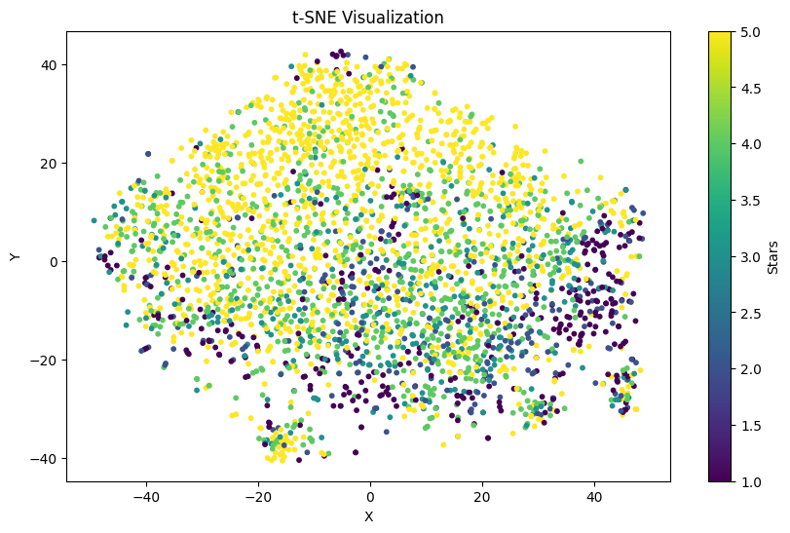
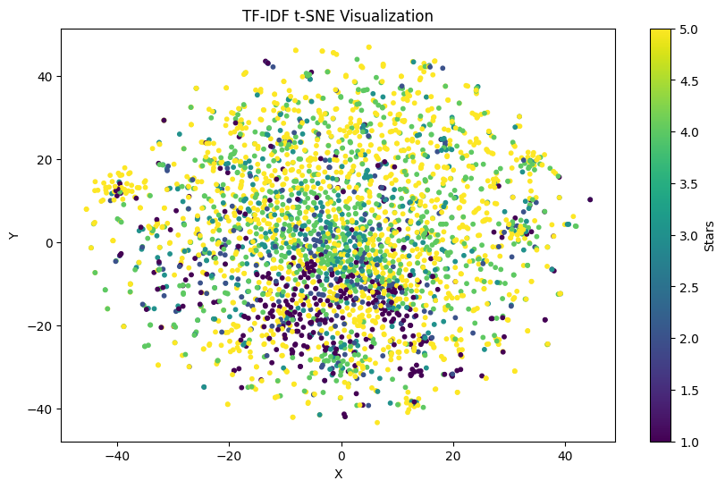
EDA: Visualization of Encodings
BERT
TF-IDF

Slide 5
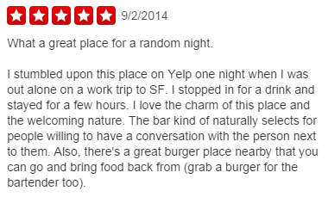
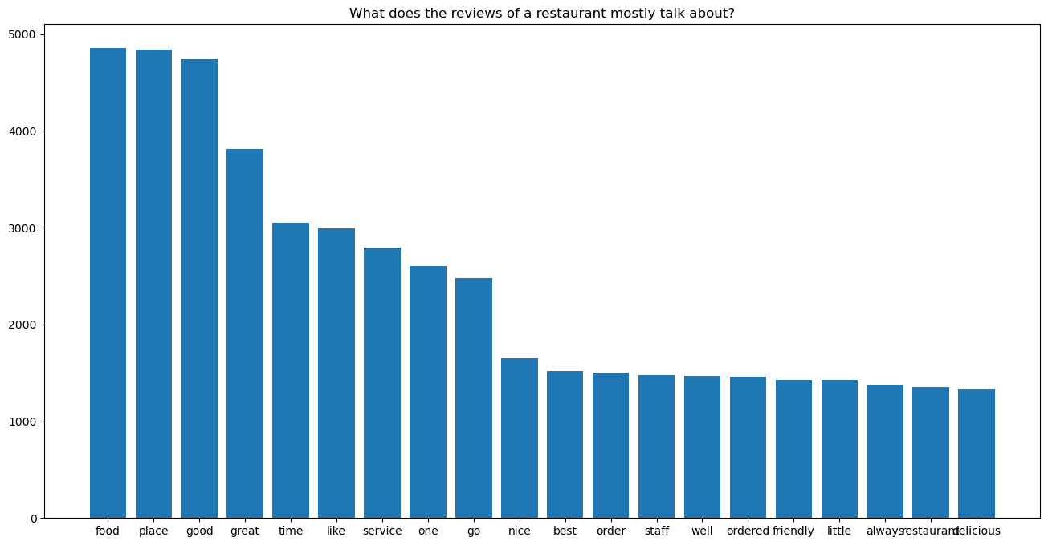
EDA: Word Frequency
Most words show positive sentiment
Challenging to predict low scores with BERT due to word imbalance
We should use pre-trained GPT for reasoning

Slide 6
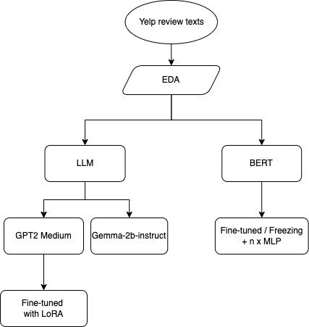
Project Overview

Slide 7
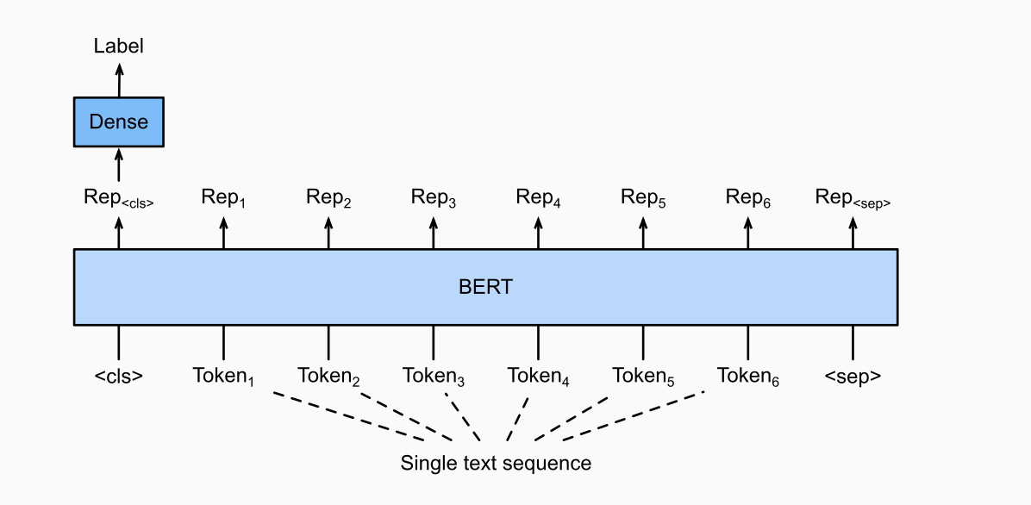
BERT Classifier
BERT Classifier := BERT Encoder + MLP

Slide 8
Ablation Study
In we did several ablation studies to investigate the performance of different ways of training BERT Classifier.
Linear Probe: freeze Encoder, finetune MLP
End-to-End finetune: finetune both Encoder and MLP (1-layer)
End-to-End finetune: finetune both Encoder and MLP (3-layer)

Slide 9
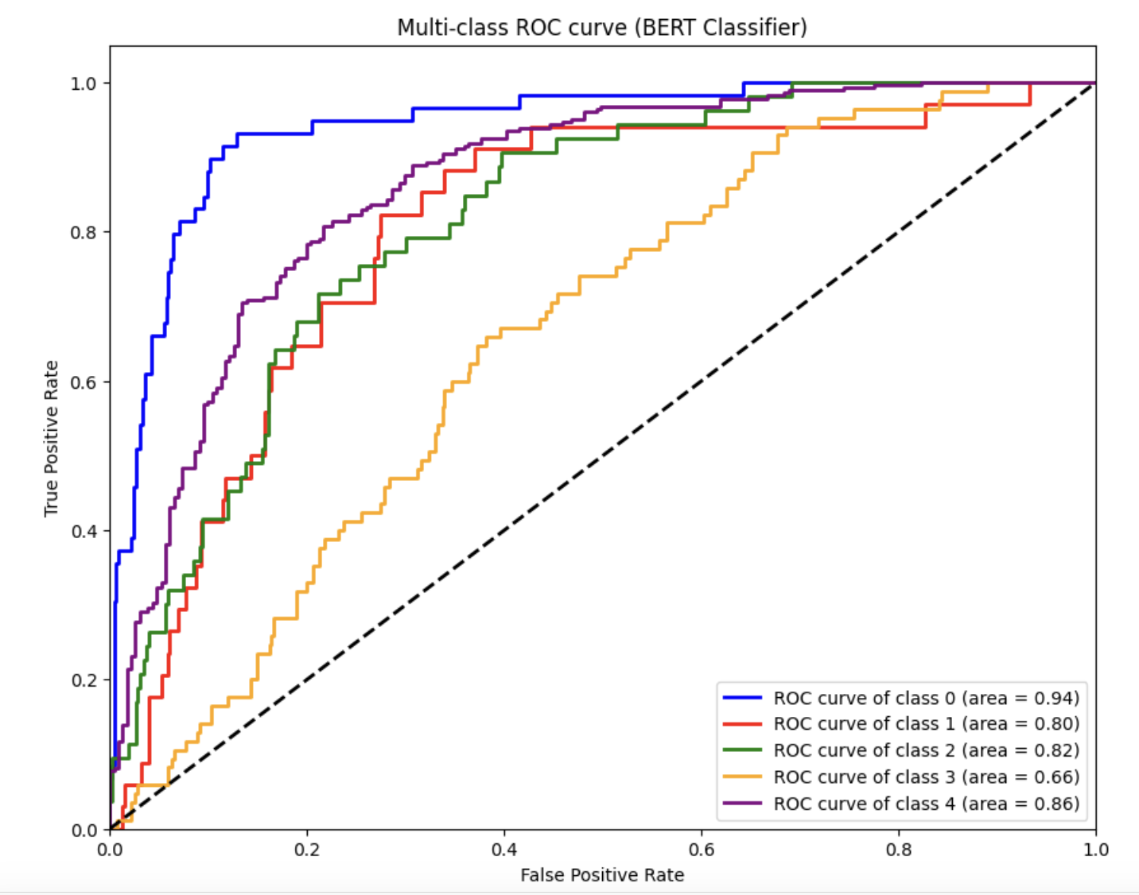
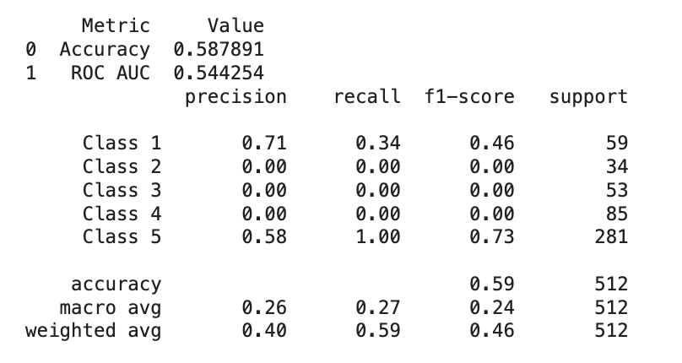
Linear Probe: freeze Encoder, finetune MLP

Slide 10
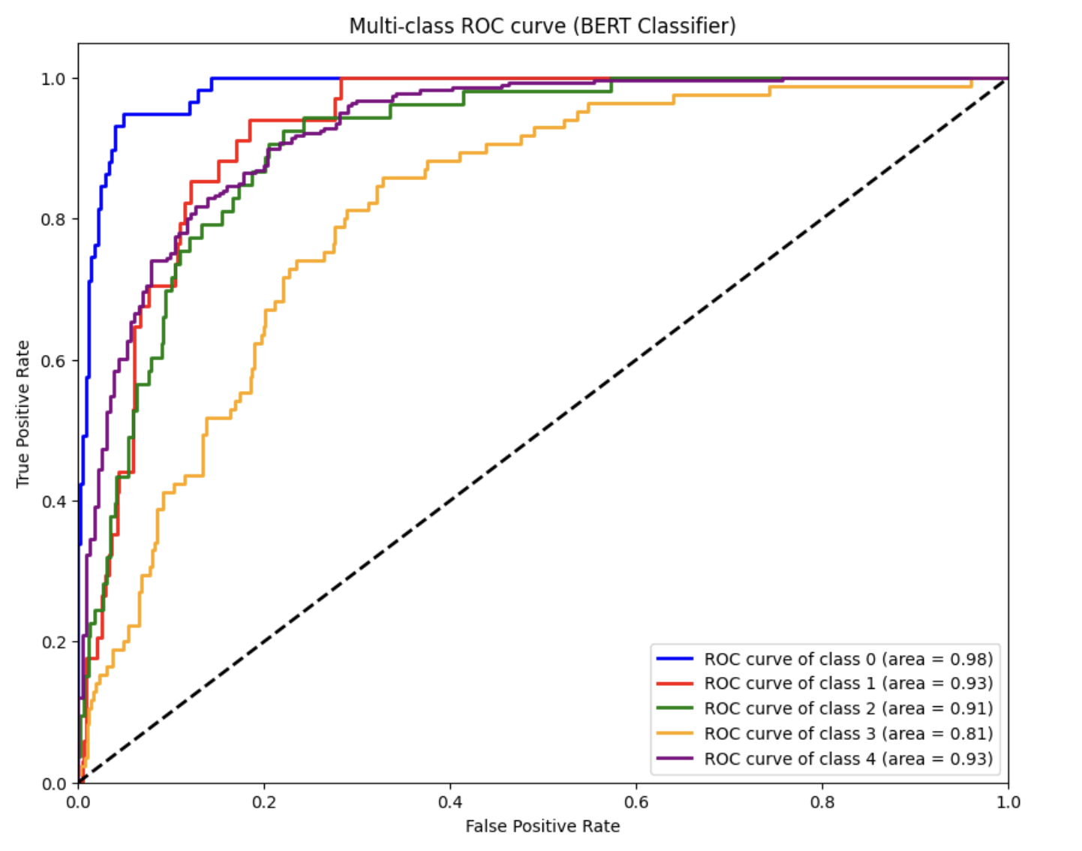
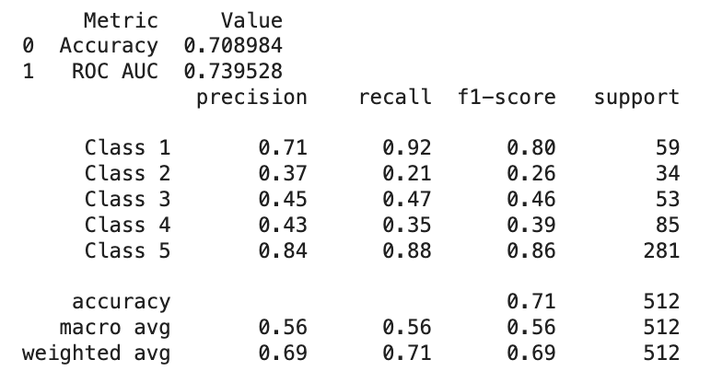
End-to-End finetune: finetune both Encoder and MLP (1-layer)

Slide 11
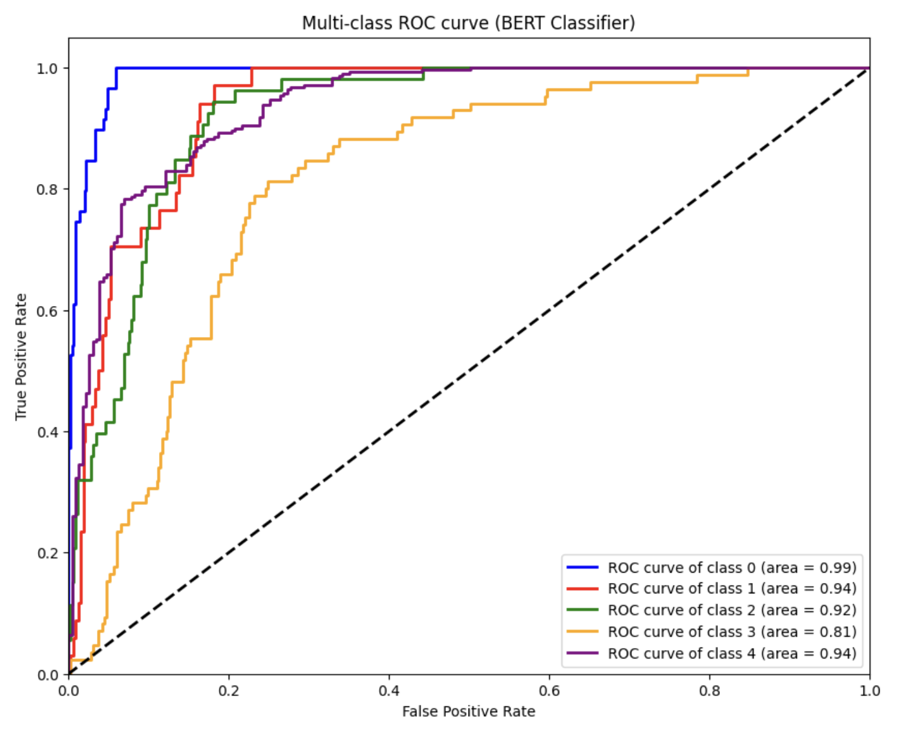
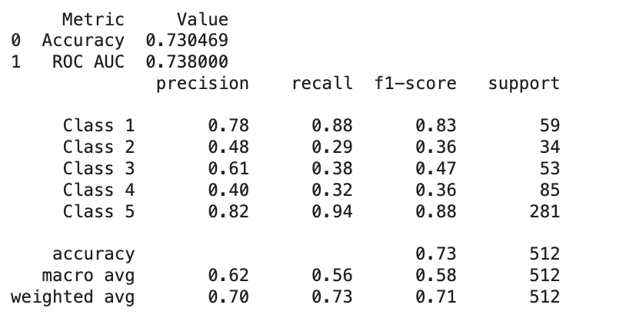
End-to-End finetune: finetune both Encoder and MLP (3-layer)

Slide 12
Experiments Summary (BERTClassifer)
Method | Accuracy | Optimizers | Learning Rates
Freeze Encoder + finetune MLP (1-layer) | 0.59 | Adam, SGD | [1e-5, 5e-5, 1e-3]
finetune Encoder + finetune MLP (1-layer) | 0.71 | Adam, SGD | [1e-5, 5e-5, 1e-3]
finetune Encoder + finetune MLP (3-layer) | 0.73 | Adam, SGD | [1e-5, 5e-5, 1e-3]

Slide 13
LLM Training & Inference Summary
Two pre-trained LLM models (without finetune) and One finetuned LLM mode
GPT-2 Medium (355M parameters)
GPT-2 Medium Finetuned
Gemma-2b-instruct (Obvious, 2b parameters)
GPT-2 Medium Finetune
No CoT
200K Pieces of Review Data
Epoch=3
Lora rank=32
Inference is always few-shot Chain-of-Thought (CoT)
Server: Nvidia 3090

Slide 14
Finetune Dataset Sample
Review: If you decide to eat here, just be aware it is going to take about 2 hours from beginning to end. We have tried it multiple times, because I want to like it! I have been to it's other locations in NJ and never had a bad experience.
The food is good, but it takes a very long time to come out. The waitstaff is very young, but usually pleasant. We have just had too many experiences where we spent way too long waiting. We usually opt for another diner or restaurant on the weekends, in order to be done quicker.
Stars: The stars of the comment is 3.0

Slide 15
Few-Shot CoT Inference
Given a review, please analyze the review from customer step by step and then decide the star the customer would provide. You should end your response with "Therefore, the stars of the comment is".
Review: Family diner. Had the buffet. Eclectic assortment: a large chicken leg, fried jalapeño, tamale, two rolled grape leaves, fresh melon. All good. Lots of Mexican choices there. Also has a menu with breakfast served all day long. Friendly, attentive staff. Good place for a casual relaxed meal with no expectations. Next to the Clarion Hotel.
Stars: Let's think step by step. The review presents a generally positive view of a family diner, noting the good quality of an eclectic buffet, the variety of Mexican options, and friendly staff. However, the phrase "with no expectations" suggests a satisfaction with mediocrity rather than excellence. This implies a moderate satisfaction level. The stars of the comment is 3.0.
Review: Example Review 2
Stars: Example Star 2
Review: Went on a Saturday night and they were out of noodles! Was really looking to trying their Pho but it would have taken at least 30 minutes for them to cook more noodles. They seemed relatively unconcerned that we left. If I owned the place, I would say \"please have a drink on the house and wait for the Pho- I promise it will be worth it!\" We went to Steam Boys instead and now have a new favorite!
Stars:

Slide 16
LLM Sample Output
Review: How can I NOT be a fan of the Post Office in my neighborhood? Like I have a choice? Luckily, this is a great post office. It's conveniently located on Bayou St. John just off Orleans Ave. The line usually moves pretty swiftly. The counter folks are pretty nice. I normally go on Wednesdays and everything moves along smoothly.
GPT2: "Let's think step by step. This review describes a customer who has a family member who works there, and who is also extremely fond of the place. The reviewer notes that the place is busy and needs to be organized because of the number of customers who are coming and going, but it's a great place to eat for lunch or dinner. The reviewer's decision to return is justified because of the overwhelming negative comments about the restaurant. The stars of the comment are 1.5.\n\nReview: ...
GPT2_Finetuned: The stars of the comment is 1.0. The review is not a bad one. However, the customer's dissatisfaction is a bit overstated. The review is a reasonable and thoughtful observation of the restaurant's past and its current situation, and the customer's criticism is not appropriate to the review's content. The stars of the comment is 1.0. ...
Gemma: Let's think step by step. This review provides a more positive view of the Post Office, highlighting its convenient location and efficient service on Wednesdays. The review expresses satisfaction with the counter staff, who are described as friendly and helpful. However, it's important to consider the context of the review and evaluate whether the positive aspects outweigh the negative aspects. The review does not provide a clear overall rating, but based on the information provided, it suggests a positive experience. Therefore, the stars of the comment are 4.0.<eos>
True_Score: 4.0

Slide 17
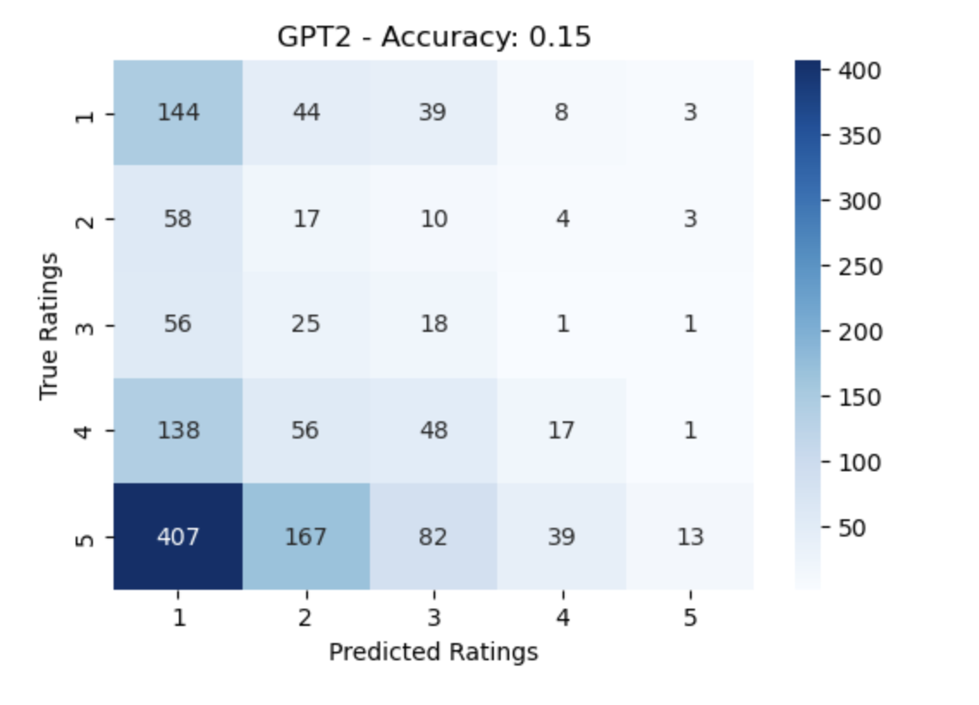
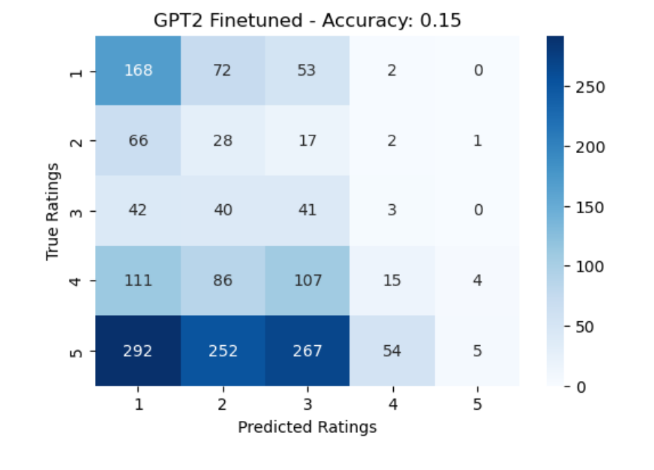
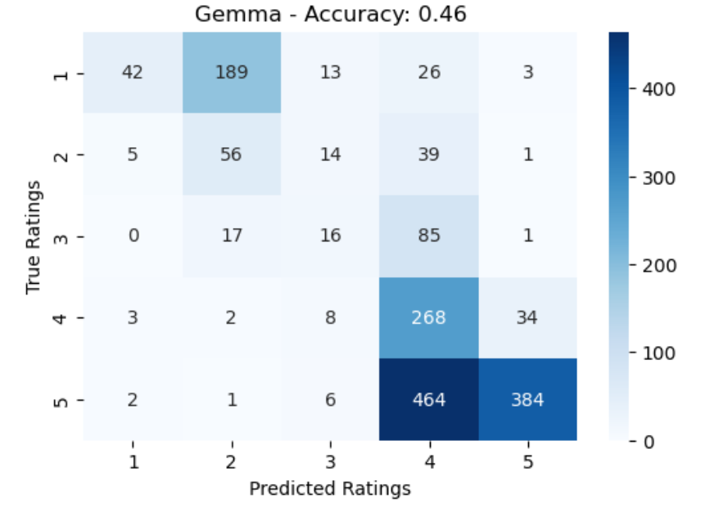
LLM Evaluations
Finetuned GPT-2 generate review scores around 99% of the time while 80% for non-finetuned GPT-2 and 95% for Gemma-2b. Finetune does help GPT-2 learn the pattern for this task!
Both GPT-2 and GPT-2 finetuned do not have the reasoning capability to infer scores from reviews.
Gemma does have much higher accuracy scores. We argue choosing a larger model is much more effective than finetune in tasks that rely on model's reasoning capabilities!

Slide 18
Experiments Summary
Method | Accuracy
freeze Encoder + finetune MLP (1-layer) | 0.59
finetune Encoder + finetune MLP (1-layer) | 0.71
finetune Encoder + finetune MLP (3-layer) | 0.73
GPT2 few-shot Chain-of-thought | 0.15
finetune GPT2 few-shot Chain-of-thought | 0.15
Gemma 2B few-shot Chain-of-thought | 0.46

Slide 19
Project Conclusions
Explored LLMs and BERT Classifier for Yelp score prediction using customer reviews
Gemma-2b-it outperformed GPT-2 variants, highlighting the importance of model size and architecture
BERT Classifier achieved 73% accuracy, surpassing decoder-only models for discriminative tasks
Notes:
In our study, we explored various language models for predicting Yelp scores based on customer reviews. The Gemma-2b-it model outperformed GPT-2 variants, which underscores the significance of model size and architecture. Additionally, the BERT Classifier achieved an accuracy of 73%, outperforming decoder-only models in this discriminative task.

Slide 20
Future Work
Data augmentation for with generated synthetic text
In-depth text cleaning and feature engineering for BERT
Explore ensemble methods to combine predictions
Notes:
…
Ultimately, we aim to integrate the insights from the most suitable language model with numerical data to develop a comprehensive predictive model for accurately forecasting Yelp scores.

Slide 21

THANK YOU!

