Slide 1
Research Paper Classification by Abstract
Authors: Huandong Chang, Elijah Tamarchenko

Slide 2
Introduction
Goal: Build a Natural Language Processing (NLP) pipeline to predict which subject a research paper belongs to based on its abstract.
Data: 15,000 papers from the arxiv dataset on Kaggle. Subjects include Computer Science, Mathematics, Physics, Quant. Bio, and Statistics.
Model 1: Long-short Term Memory (LSTM)
Model 2: DistilBERT (Transformers)

Slide 3
Data Example
We show that a determinant of Stirling cycle numbers counts unlabeled acyclic single-source automata. The proof involves a bijection from these automata to certain marked lattice paths and a sign-reversing involution to evaluate the determinant.
This is a Mathematics Paper!!!

Slide 4
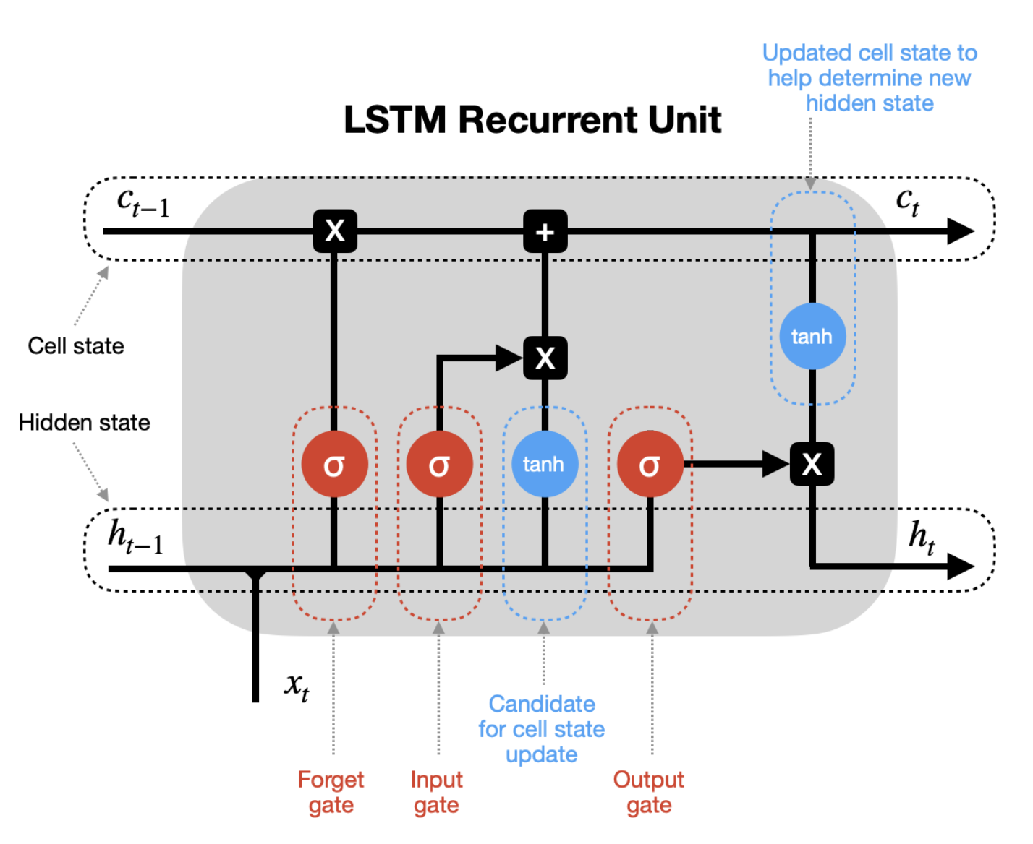
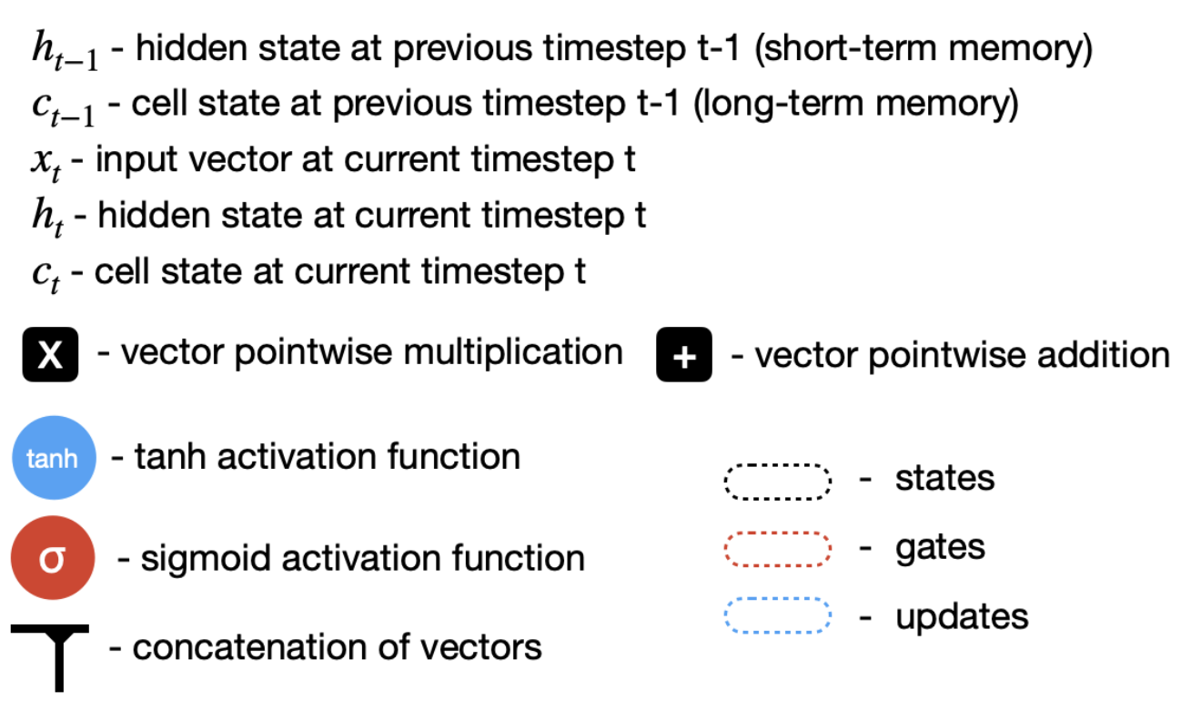
Model 1: Long-short term memory (LSTM)
Source: Google Photos

Slide 5
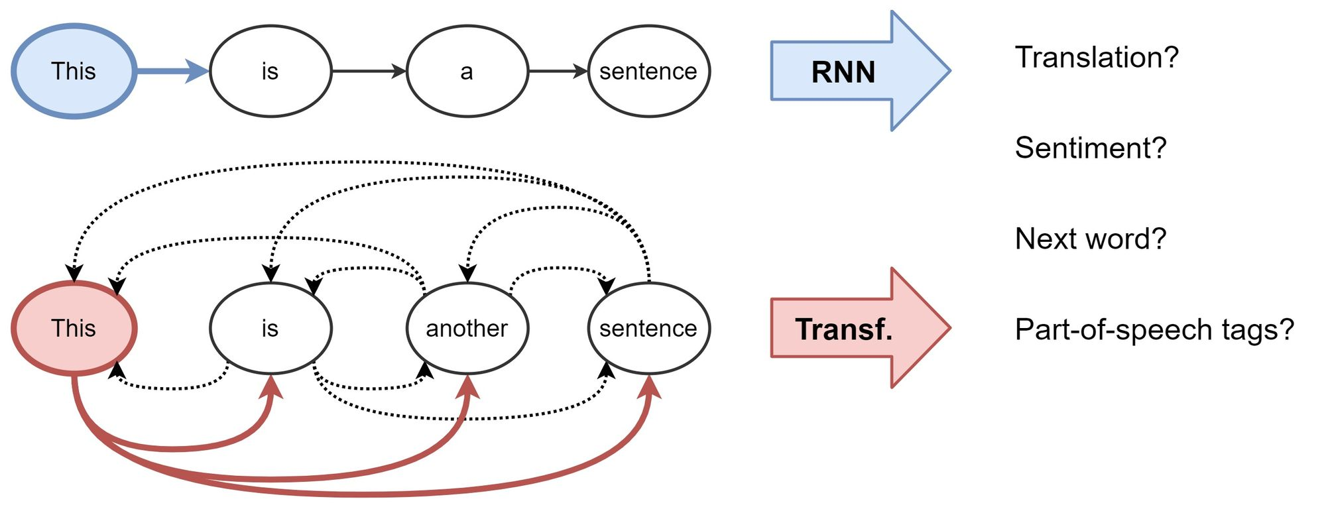
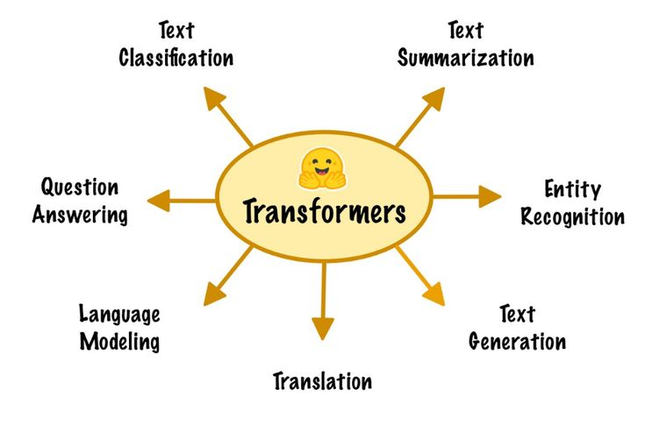
Model 2: DistilBERT (Transformers)
Context and attention
Relationships between words

Slide 6
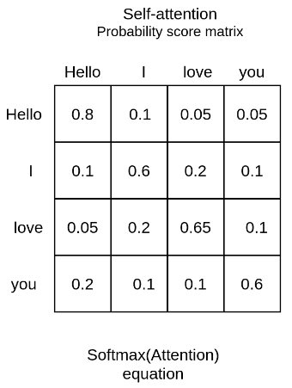
Transformers (cont’d)
Words are represented as vectors
Take in the whole sentence at once for each word

Slide 7
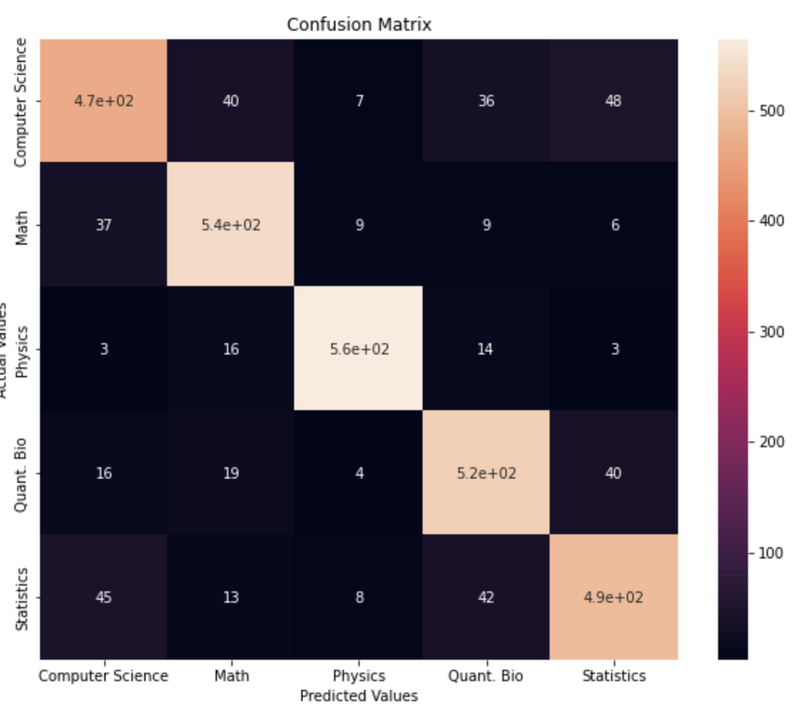
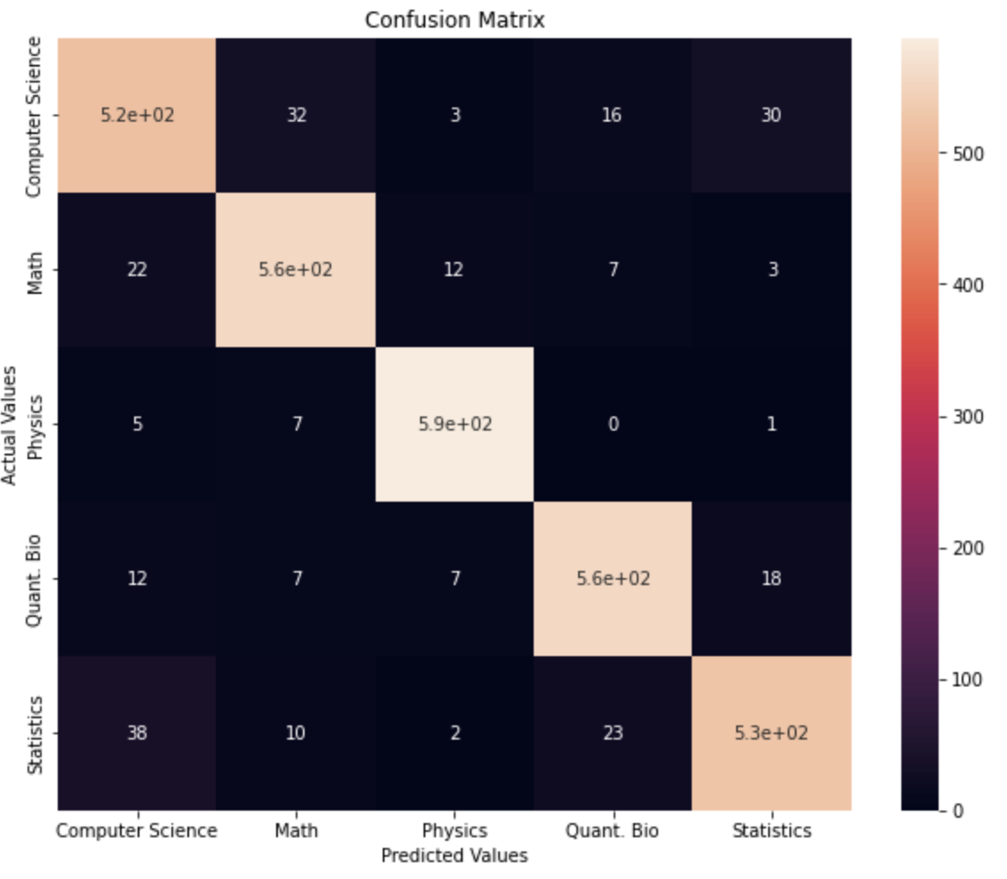
Result Analysis
LSTM (86% Accuracy)
DistilBERT(92% Accuracy)

Slide 8
Misclassification Example
"In the process of training Support Vector Machines (SVMs) by decomposition methods, working set selection is an important technique, and some exciting schemes were employed into this field. To improve working set selection, we propose a new model for working set selection in sequential minimal optimization (SMO) decomposition methods. In this model, it selects B as working set without reselection. Some properties are given by simple proof, and experiments demonstrate that the proposed method is in general faster than existing methods."
This is a Computer Science paper classified as Statistics!

Slide 9
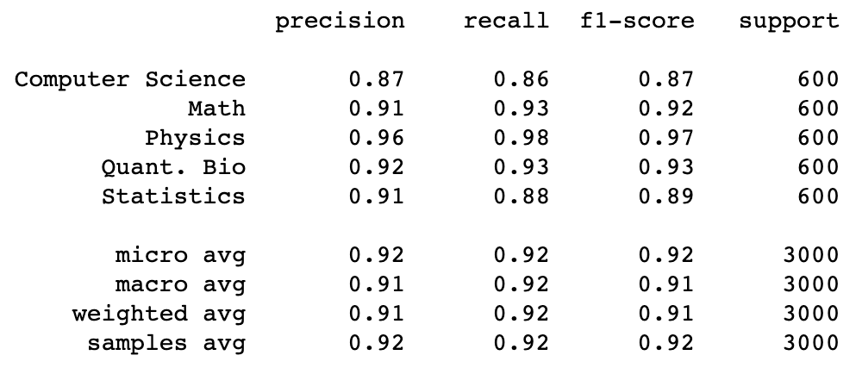
DistilBERT Classification Report

Slide 10
Conclusion
More categories and more data
Using the rest of the metadata for each paper
Use topics and material that is covered rather than scientific fields as categories
Use model in research journal searching system

