Slide 1
Correctness of Edmonds-Karp
An edge serves as bottleneck at most n/2 times

Slide 2
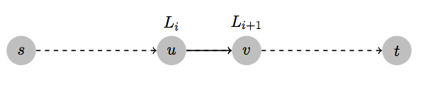
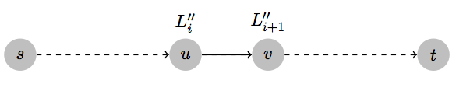
An edge serves as bottleneck
Step k:
Step k’’:

Slide 3
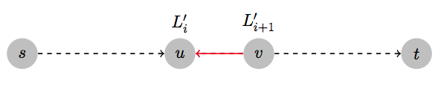
Bottleneck edge
Step k:
Step k+1
Step k’’:

Slide 4
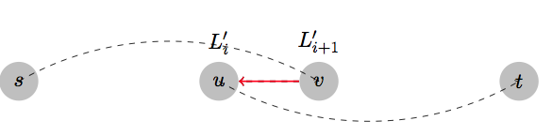
Bottleneck edge
Step k:
Step k+1
Step k’
Step k’’:

Slide 5
The level number never decreases

Slide 6


The k-th iteration
Residual graph
2
4
4
4
4
6
2
8
6
6
s
1
3
9
5
1
t
9
9
BFS tree: the edges in red
Level 3
2
4
4
4
4
6
2
8
6
6
s
1
3
9
5
1
t
9
9
Level 0
Level 1
Level 2

Slide 7
The (k+1)-th iteration
Residual graph
2
4
4
5
4
1
5
2
6
6
7
s
1
3
9
5
t
9
10
BFS tree: the edges in red
Level 3
2
4
4
5
4
1
6
6
5
2
7
s
1
3
9
5
t
9
9
Level 0
Level 1
Level 2
Level 4

