Slide 1
Review
Linear Systems
Objective
To provide background material in support of topics in Digital Image Processing that are based on linear system theory.

Slide 2
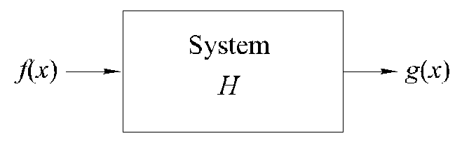
Some Definitions
With reference to the following figure, we define a system as a unit that converts an input function f(x) into an output (or response) function g(x), where x is an independent variable, such as time or, as in the case of images, spatial position. We assume for simplicity that x is a continuous variable, but the results that will be derived are equally applicable to discrete variables.

Slide 3

Some Definitions (Con’t)
It is required that the system output be determined completely by the input, the system properties, and a set of initial conditions. From the figure in the previous page, we write
where H is the system operator, defined as a mapping or assignment of a member of the set of possible outputs {g(x)} to each member of the set of possible inputs {f(x)}. In other words, the system operator completely characterizes the system response for a given set of inputs {f(x)}.

Slide 4
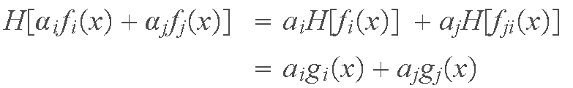

Some Definitions (Con’t)
An operator H is called a linear operator for a class of inputs {f(x)} if
for all f_{i}(x) and f_{j}(x) belonging to {f(x)}, where the a's are arbitrary constants and
is the output for an arbitrary input f_{i}(x) ∈{f(x)}.

Slide 5
Some Definitions (Con’t)
The system described by a linear operator is called a linear system (with respect to the same class of inputs as the operator). The property that performing a linear process on the sum of inputs is the same that performing the operations individually and then summing the results is called the property of additivity. The property that the response of a linear system to a constant times an input is the same as the response to the original input multiplied by a constant is called the property of homogeneity.

Slide 6
Some Definitions (Con’t)
An operator H is called time invariant (if x represents time), spatially invariant (if x is a spatial variable), or simply fixed parameter, for some class of inputs {f(x)} if
for all f_{i}(x) ∈{f(x)} and for all x₀. A system described by a fixed-parameter operator is said to be a fixed-parameter system. Basically all this means is that offsetting the independent variable of the input by x₀ causes the same offset in the independent variable of the output. Hence, the input-output relationship remains the same.

Slide 7
Some Definitions (Con’t)
An operator H is said to be causal, and hence the system described by H is a causal system, if there is no output before there is an input. In other words,
Finally, a linear system H is said to be stable if its response to any bounded input is bounded. That is, if
where K and c are constants.

Slide 8

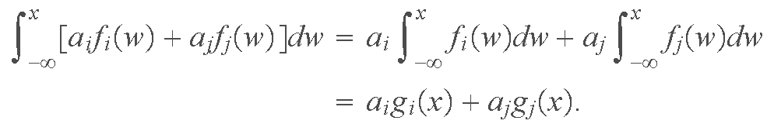
Some Definitions (Con’t)
Example: Suppose that operator H is the integral operator between the limits −∞ and x. Then, the output in terms of the input is given by
where w is a dummy variable of integration. This system is linear because

Slide 9
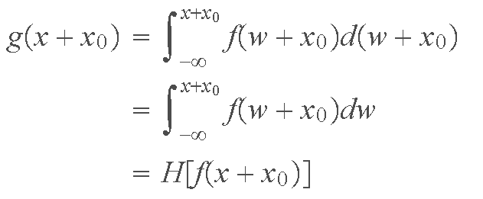
Some Definitions (Con’t)
We see also that the system is fixed parameter because
where d(w + x₀) = dw because x₀ is a constant. Following similar manipulation it is easy to show that this system also is causal and stable.

Slide 10

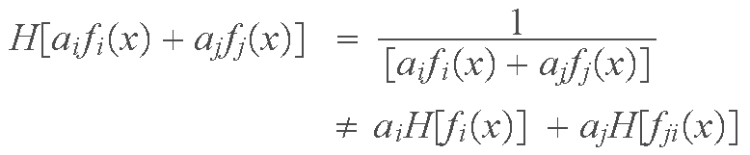
Some Definitions (Con’t)
Example: Consider now the system operator whose output is the inverse of the input so that
In this case,
so this system is not linear. The system, however, is fixed parameter and causal.

Slide 11

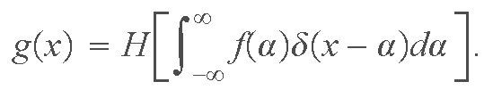
Linear System Characterization-Convolution
A unit impulse, denoted δ(x − a), is defined by the expression
From the previous sections, the output of a system is given by g(x) = H[f(x)]. But, we can express f(x) in terms of the impulse just defined, so

Slide 12

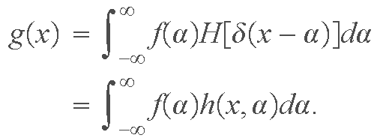
System Characterization (Con’t)
Extending the property of addivity to integrals (recall that an integral can be approximated by limiting summations) allows us to write
Because f(α) is independent of x, and using the homogeneity property, it follows that

Slide 13

System Characterization (Con’t)
The term
is called the impulse response of H. In other words, h(x, α) is the response of the linear system to a unit impulse located at coordinate x (the origin of the impulse is the value of α that produces δ(0); in this case, this happens when α = x).

Slide 14

System Characterization (Con’t)
The expression
is called the superposition (or Fredholm) integral of the first kind. This expression is a fundamental result that is at the core of linear system theory. It states that, if the response of H to a unit impulse [i.e., h(x, α)], is known, then response to any input f can be computed using the preceding integral. In other words, the response of a linear system is characterized completely by its impulse response.

Slide 15


System Characterization (Con’t)
If H is a fixed-parameter operator, then
and the superposition integral becomes
This expression is called the convolution integral. It states that the response of a linear, fixed-parameter system is completely characterized by the convolution of the input with the system impulse response. As will be seen shortly, this is a powerful and most practical result.

Slide 16


System Characterization (Con’t)
Because the variable α in the preceding equation is integrated out, it is customary to write the convolution of f and h (both of which are functions of x) as
In other words,

Slide 17
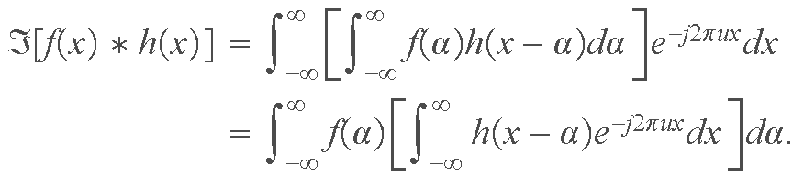

System Characterization (Con’t)
The Fourier transform of the preceding expression is
The term inside the inner brackets is the Fourier transform of the term h(x − α ). But,

Slide 18
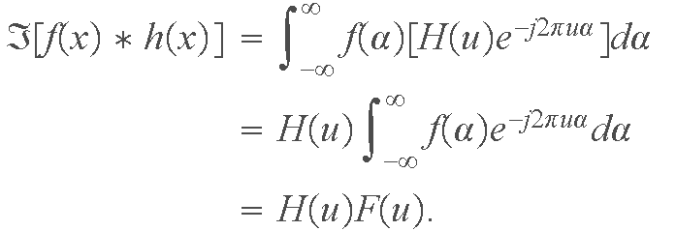
System Characterization (Con’t)
so,
We have succeeded in proving the important result that the Fourier transform of the convolution of two functions is the product of their Fourier transforms. As noted below, this result is the foundation for linear filtering

Slide 19


System Characterization (Con’t)
Following a similar development, it is not difficult to show that the inverse Fourier transform of the convolution of H(u) and F(u) [i.e., H(u)*F(u)] is the product f(x)g(x). This result is known as the convolution theorem, typically written as
and
where " ⇔ " is used to indicate that the quantity on the right is obtained by taking the Fourier transform of the quantity on the left, and, conversely, the quantity on the left is obtained by taking the inverse Fourier transform of the quantity on the right.

Slide 20


System Characterization (Con’t)
The mechanics of convolution are explained in detail in the book. We have just filled in the details of the proof of validity in the preceding paragraphs.
Because the output of our linear, fixed-parameter system is
if we take the Fourier transform of both sides of this expression, it follows from the convolution theorem that

Slide 21
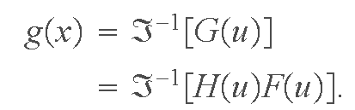
System Characterization (Con’t)
The key importance of the result G(u)=H(u)F(u) is that, instead of performing a convolution to obtain the output of the system, we computer the Fourier transform of the impulse response and the input, multiply them and then take the inverse Fourier transform of the product to obtain g(x); that is,
These results are the basis for all the filtering work done in Chapter 4, and some of the work in Chapter 5 of Digital Image Processing. Those chapters extend the results to two dimensions, and illustrate their application in considerable detail.

