Slide 1
Genome mutation analysis

Slide 2
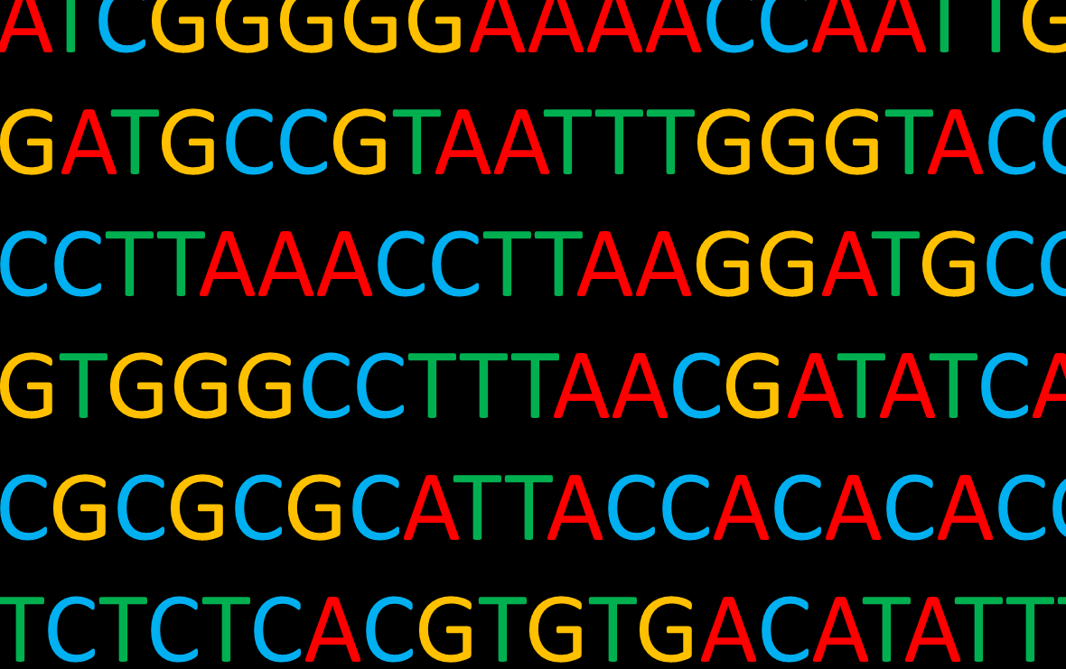

Next Generation Sequence
All scripts of self-compiling Python script :
https://github.com/HuangDeneil/genome_analysis_python_version
突變位置分析
Python script
Mutation position data after vcftools
fastq file
確定突變方升位置 & 並且註記是否出現在CDS區域
Quality control
Removing adaptor & low quality reads
check_mutation_position.py
coding_or_not.py
Trimomatic
fastq file
Aligning to genome sequence
Alignment
Non-coding region mutation
1. 確認胺基酸序列是否改變
2. 匯出發生改變胺基酸序列的所有序列資訊
bwa
sam or bam file
Variance calling
mutation position data extraction
vcf file
Find nearby protein coding
check_aa_sequence.py
samtools & vcftools
sam >>> Sequence Alignment/Map (紀錄所有reads alignment 情況)
bam >>> sam file binary format (sam壓縮格式)
vcf >>> Varient Calling File (記錄所有突變發生位點/突變狀況)
Figure 1. The Bioinformatics pipeline of the present study.

Slide 3
Python programing
read/write file
if / else ; for loop
regex

Slide 4
Regex (Regular expression 正規表示式)
Python 中使用 re 的模組來實現，因此開始使用前需要先:
import re
四種比對方式:
re.match ( pattern, string[, flags] )
re.search ( pattern, string[, flags] )
re.findall ( pattern, string[, flags] )
re.finditer ( pattern, string[, flags] )
https://www.itread01.com/p/435642.html

Slide 5
regex 語法
regex 語法 | 意義
. | 任意字元
\d | 數字(digit)，如 0 到 9
\D | 非數字
\w | 文字(word)
\W | 非文字
\s | 廣義的空白符號(whitespace)，如空白、tab 等
\S | 非空白
Note
通常 \w 代表的是 [A-Za-z0-9_]，但在 Python3 中，\w 也可以是中文字。

Slide 6
Check mutation position

Slide 7
Check_mutation_position.py
Part I
read vcf
Part II
read gff file & 把突變位置做annotation
Part III
Output result

Slide 8


dictionary

Slide 9
Work flow
VCF file
gff file
Mution_dict =
“Posion1” = “ref1, alt1”,
“Posion2” = “ref2, alt2”,
“Posion3” = “ref3, alt3”,
“Posion4” = “ref4, alt4”,
“Posion5” = “ref5, alt5”,
.
.
.
RefSeq | region | 1 | 3940880 | . | + | .
RefSeq | gene | 467 | 1807 | . | + | .
Protein Homology | CDS | 467 | 1807 | . | + | 0
RefSeq | gene | 2064 | 3164 | . | + | .
Protein Homology | CDS | 2064 | 3164 | . | + | 0
RefSeq | gene | 3195 | 3401 | . | + | .
Protein Homology | CDS | 3195 | 3401 | . | + | 0
RefSeq | gene | 3447 | 4538 | . | + | .

Slide 10
Dictionary 禁止呼叫 未定義鍵質對
dict_test[new_key]=(new_value)
try:
dict_test[new_key] = (new_value)
except KeyError:
dict_test[new_key] = (new_value)

Slide 11
VCF (Variance Calling File)
##fileformat=VCFv4.2
##FILTER=<ID=PASS,Description="All filters passed">
##bcftoolsVersion=1.11+htslib-1.11
.
.
.
##bcftools_callCommand=call -mv -Ob -o HOL1.bwa.sorted.raw.bcf; Date=Mon Nov 30 07:10:41 2020
##bcftools_viewVersion=1.11+htslib-1.11
##bcftools_viewCommand=view -i %QUAL>=20 -Ov -o HOL1.bwa.sorted.filted.vcf HOL1.bwa.sorted.raw.bcf; Date=Mon Nov 30 07:28:32 2020
#CHROM POS ID REF ALT QUAL FILTER INFO FORMAT HOL1.bwa.sorted.bam
NC_003030.1 196943 . TAAAAAA TAAAAA 109 . INDEL;IDV=121;IMF=0.960317;DP=126;VDB=0.999386;SGB=-0.693147;MQSB=1;MQ0F=0;AC=2;AN=2;DP4=4,3,57,62;MQ=60 GT:PL 1/1:136,228,0
NC_003030.1 303842 . T G 225 . DP=138;VDB=0.557095;SGB=-0.693147;MQSB=1;MQ0F=0;AC=2;AN=2;DP4=0,0,58,80;MQ=60 GT:PL 1/1:255,255,0
NC_003030.1 310671 . TA T 228 . INDEL;IDV=137;IMF=0.971631;DP=141;VDB=0.686628;SGB=-0.693147;MQSB=0.999581;MQ0F=0.0070922;AC=2;AN=2;DP4=2,1,74,64;MQ=57 GT:PL 1/1:255,255,0
NC_003030.1 345919 . A G 135 . DP=43;VDB=2.89699e-05;SGB=-0.69168;RPB=3.21474e-06;MQB=6.47595e-07;MQSB=0.738371;BQB=0.557051;MQ0F=0.465116;AC=2;AN=2;DP4=12,8,10,9;MQ=12 GT:PL 1/1:162,6,0
NC_003030.1 345995 . C T 228 . DP=59;VDB=7.42243e-17;SGB=-0.693147;RPB=0.849057;MQB=0.0188679;MQSB=0.455468;BQB=0.358491;MQ0F=0.0508475;AC=2;AN=2;DP4=0,2,32,21;MQ=41 GT:PL 1/1:255,131,0
NC_003030.1 346085 . C G 225 . DP=95;VDB=0.0140058;SGB=-0.693147;MQSB=0.956968;MQ0F=0;AC=2;AN=2;DP4=0,0,52,42;MQ=50 GT:PL 1/1:255,255,0
NC_003030.1 389758 . T A 225 . DP=120;VDB=0.357508;SGB=-0.693147;MQSB=1;MQ0F=0;AC=2;AN=2;DP4=0,0,68,51;MQ=60 GT:PL 1/1:255,255,0

Slide 12
gff file (genome annotation file)
##gff-version 3
#!gff-spec-version 1.21
#!processor NCBI annotwriter
#!genome-build ASM876v1
#!genome-build-accession NCBI_Assembly:GCF_000008765.1
#!annotation-date 10/25/2020 10:26:40
#!annotation-source NCBI RefSeq
##sequence-region NC_003030.1 1 3940880
##species https://www.ncbi.nlm.nih.gov/Taxonomy/Browser/wwwtax.cgi?id=272562
NC_003030.1 RefSeq region 1 3940880 . + . ID=NC_003030.1:1..3940880;Dbxref=ATCC:824,taxon:272562;Is_circular=true;Name=ANONYMOUS;gbkey=Src;genome=chromosome;mol_type=genomic DNA;strain=ATCC 824;type-material=type strain of Clostridium acetobutylicum
NC_003030.1 RefSeq gene 467 1807 . + . ID=gene-CA_RS00005;Name=dnaA;gbkey=Gene;gene=dnaA;gene_biotype=protein_coding;locus_tag=CA_RS00005;old_locus_tag=CA_C0001
NC_003030.1 Protein Homology CDS 467 1807 . + 0 ID=cds-WP_010963330.1;Parent=gene-CA_RS00005;Dbxref=Genbank:WP_010963330.1;Name=WP_010963330.1;gbkey=CDS;gene=dnaA;inference=COORDINATES: similar to AA sequence:RefSeq:WP_010963330.1;locus_tag=CA_RS00005;product=chromosomal replication initiator protein DnaA;protein_id=WP_010963330.1;transl_table=11
NC_003030.1 RefSeq gene 2064 3164 . + . ID=gene-CA_RS00010;Name=CA_RS00010;gbkey=Gene;gene_biotype=protein_coding;locus_tag=CA_RS00010;old_locus_tag=CA_C0002
NC_003030.1 Protein Homology CDS 2064 3164 . + 0 ID=cds-WP_010963331.1;Parent=gene-CA_RS00010;Dbxref=Genbank:WP_010963331.1;Name=WP_010963331.1;gbkey=CDS;inference=COORDINATES: similar to AA sequence:RefSeq:WP_010963331.1;locus_tag=CA_RS00010;product=DNA polymerase III subunit beta;protein_id=WP_010963331.1;transl_table=11
NC_003030.1 RefSeq gene 3195 3401 . + . ID=gene-CA_RS00015;Name=yaaA;gbkey=Gene;gene=yaaA;gene_biotype=protein_coding;locus_tag=CA_RS00015;old_locus_tag=CA_C0003
NC_003030.1 Protein Homology CDS 3195 3401 . + 0 ID=cds-WP_010963332.1;Parent=gene-CA_RS00015;Dbxref=Genbank:WP_010963332.1;Name=WP_010963332.1;gbkey=CDS;gene=yaaA;inference=COORDINATES: similar to AA sequence:RefSeq:WP_003451038.1;locus_tag=CA_RS00015;product=S4 domain-containing protein YaaA;protein_id=WP_010963332.1;transl_table=11
NC_003030.1 RefSeq gene 3447 4538 . + . ID=gene-CA_RS00020;Name=recF;gbkey=Gene;gene=recF;gene_biotype=protein_coding;locus_tag=CA_RS00020;old_locus_tag=CA_C0004
NC_003030.1 Protein Homology CDS 3447 4538 . + 0 ID=cds-WP_010963333.1;Parent=gene-CA_RS00020;Dbxref=Genbank:WP_010963333.1;Name=WP_010963333.1;gbkey=CDS;gene=recF;inference=COORDINATES: similar to AA sequence:RefSeq:WP_010963333.1;locus_tag=CA_RS00020;product=DNA replication/repair protein RecF;protein_id=WP_010963333.1;transl_table=11
NC_003030.1 RefSeq gene 4558 4821 . + . ID=gene-CA_RS00025;Name=CA_RS00025;gbkey=Gene;gene_biotype=protein_coding;locus_tag=CA_RS00025;old_locus_tag=CA_C0005

