Slide 1




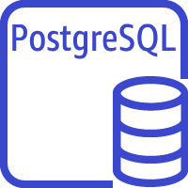
Load Balancing
Harbor
Redis
Harbor
Amazon S3
docker images bucket
Amazon Aurora PostgreSQL Serverless

