Slide 1


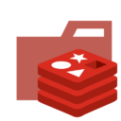

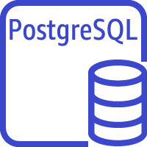
Load Balancing
Harbor
Redis
Harbor
Amazon S3
docker images bucket
Amazon Aurora PostgreSQL Serverless

Slide 2

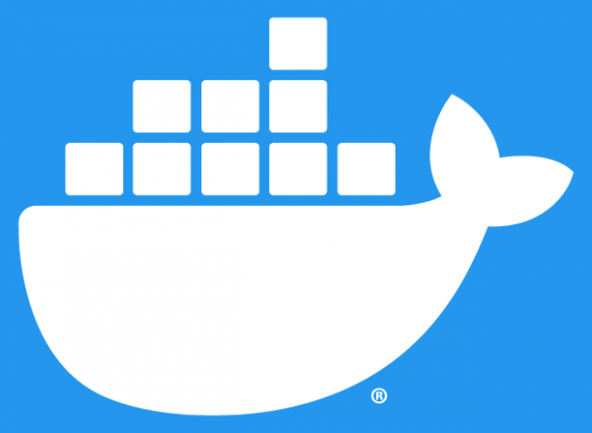
Region 1
Region 2
Region N
replicate
Harbor
Docker Registry
Docker Registry
......
Amazon S3
docker images bucket
Amazon Aurora PostgreSQL Serverless
Amazon S3 docker images bucket
Amazon S3 docker images bucket

Slide 3

Beijing
Shenzhen
Dalian
replicate
replicate
Local S3
Harbor
Local S3
Harbor
Local File
System
Harbor
......
Local
PostgreSQL
Local
PostgreSQL
Local
PostgreSQL
replicate

Slide 4
Intranet
Internet
Shenzhen
Region 2
Local S3
Harbor
Replicate
Docker Registry
AWS S3
Local PostgreSQL
Replicate
Replicate
Beijing
Region 1
Replicate
Local S3
Replicate
AWS S3
Harbor
HA Harbor
Local PostgreSQL
Aurora PostgreSQL Serverless
Replicate
Replicate
Dalian
Replicate
Region N
Replicate
File System
Harbor
Docker Registry
AWS S3
Local PostgreSQL

Slide 5

Intranet
Internet
Shenzhen
Region 2
Push
Local CI
Pull
Pull
Harbor
Replicate
Docker Registry
Cloud CD
Local CD
Replicate
Replicate
Beijing
Region 1
Push
Push
Local CI
Replicate
Cloud CI
Pull
Harbor
HA Harbor
Pull
Local CD
Cloud CD
Replicate
Replicate
Dalian
Region N
Push
Replicate
Local CI
Pull
Pull
Harbor
Docker Registry
Cloud CD
Local CD

Slide 6


Beijing
Push
Pull
Local CI
Harbor
Local CD
Docker Image
Pull
Local S3
Team Member

Slide 7
Beijing
Push
Local CI
Harbor
Local S3
Docker Image
Replicate
Shenzhen
Pull
Harbor
Local CD
Pull
Local S3
Team Member

Slide 8
Beijing
Region 1
Local S3
AWS S3
Push
Replicate
Pull
Local CI
Harbor
HA Harbor
Cloud CD
Docker Image
Replicate
Shenzhen
Harbor
Local S3

Slide 9
Beijing
Region 1
Local S3
AWS S3
Push
Replicate
Local CI
Harbor
HA Harbor
Docker Image
Replicate
Replicate
Shenzhen
Region 2
Pull
Harbor
Docker Registry
Cloud CD
Local S3
AWS S3

