Slide 1


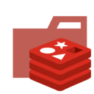

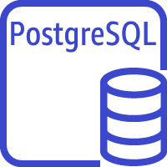
Load Balancing
Harbor
Redis
Harbor
Amazon S3
docker images bucket
Amazon Aurora PostgreSQL Serverless

Slide 2
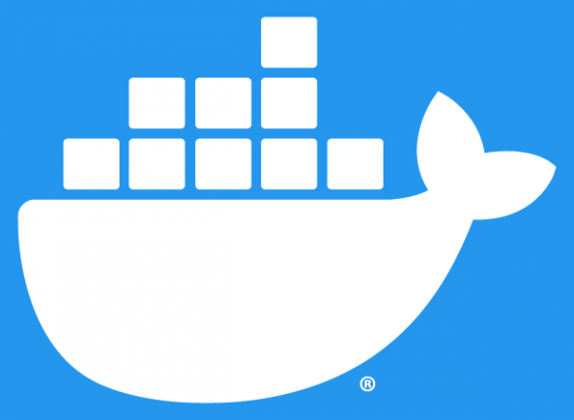
region 1
region 2
region N
replicate
Harbor
replicate
......
Docker Registry
Docker Registry
Amazon S3
docker images bucket
Amazon Aurora PostgreSQL Serverless
Amazon S3
docker images bucket
Amazon S3
docker images bucket

Slide 3

region 1
region N
pull
replicate
pull
Continuous Deployment
Harbor
Docker Registry
Continuous Deployment
push
Amazon S3
docker images bucket
Amazon Aurora PostgreSQL Serverless
Amazon S3
docker images bucket
Continuous Integration

Slide 4
intranet
internet
Shenzhen
Region N
Docker Registry
Docker Registry
replicate
replicate
Amazon S3
docker images bucket
S3 docker images bucket
Beijing
push
replicate
push
Region 1
Harbor
Harbor
Continuous Integration
？
Continuous Integration
S3 docker images bucket
Amazon Aurora
PostgreSQL Serverless
Amazon S3
docker images bucket
PostgreSQL

