Slide 1
Title： A hierarchical approach to real-time activity recognition in body sensor networks
AUthor：Liang WanG, Tao Gu, Xianping Tao, Jian Lu
reporter：何知涵

Slide 2
Topic
Sensor-based real-time activity recognition
Pervasive computing
Application: health care, assisted living, sports coaching
So, How about in Real life?

Slide 3
Challenging issues in real time
Demanding for
1. a one-pass algorithm with short real-time delay
2. less network communication from sensor node to server
3. mobile and portable device as server

Slide 4
Motivation
a high-level activity typically includes :
(1). a sequence of physical gestures and
(2). ambulation in the execution

Slide 5
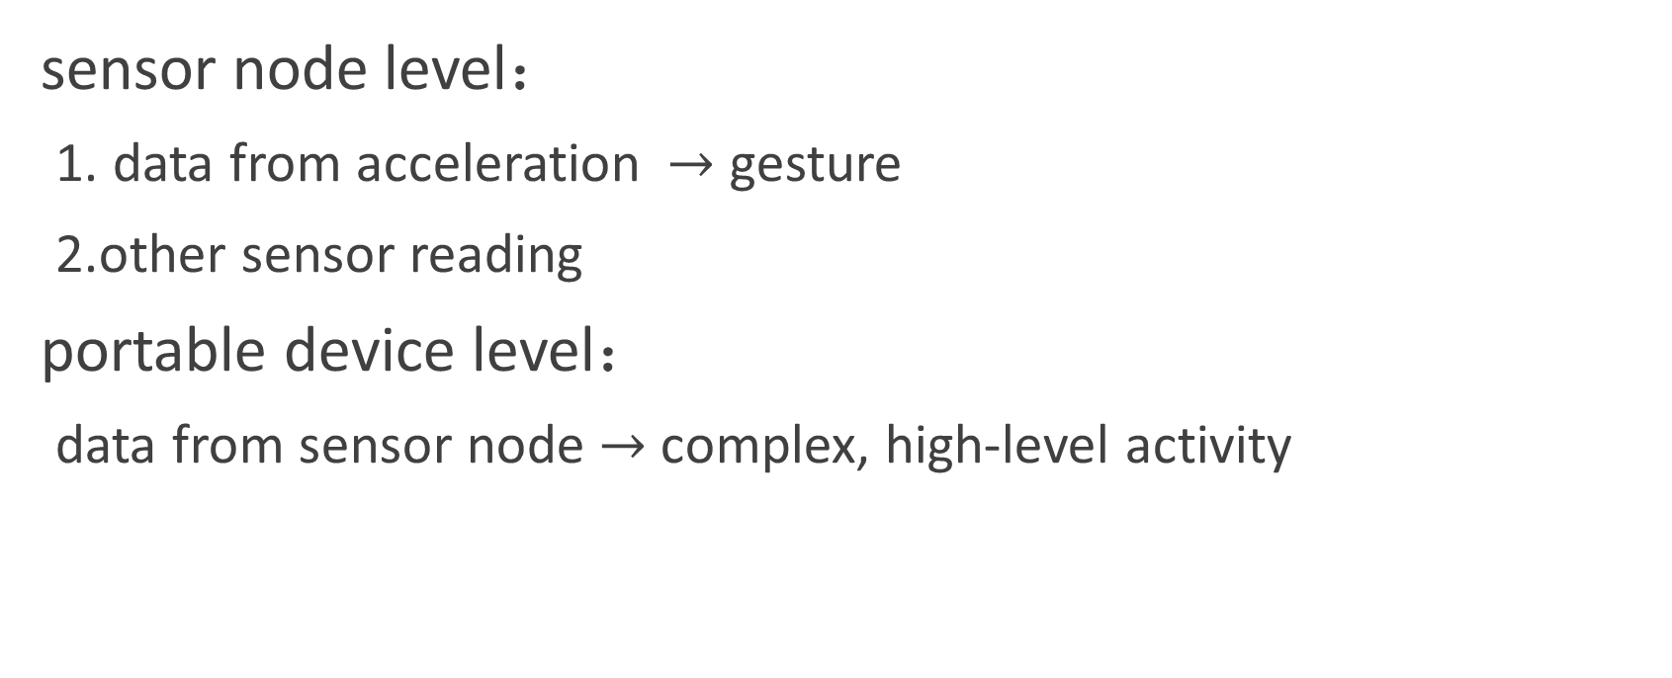
Hierarchical Approach
sensor node level：
1. data from acceleration $→$ gesture
2.other sensor reading
portable device level：
data from sensor node $→$ complex, high-level activity

Slide 6
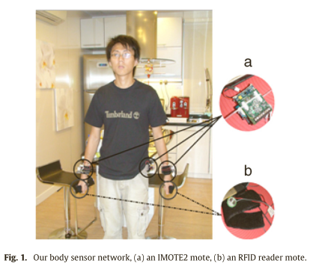
body sensor network
5 sensor nodes—3 IMOTE2 motes and 2 RFID reader motes.
IMOTE2 mote :
an IPR2400 processor/radio board
an ITS400 sensor board with a 3-axis accelerometer
to capture hand and body movement

Slide 7
body sensor network
RFID reader mote :
a MICA2Dot mote
a coin-size, short-range RFID reader
detect the presence of a tagged object within
a few centimeters
to capture object use

Slide 8
body sensor network
In addition, an UHF RFID reader is located in each room to sense the proximity of a subject wearing a UHF tag.
To detecting the user’s location at room-level granularity

Slide 9
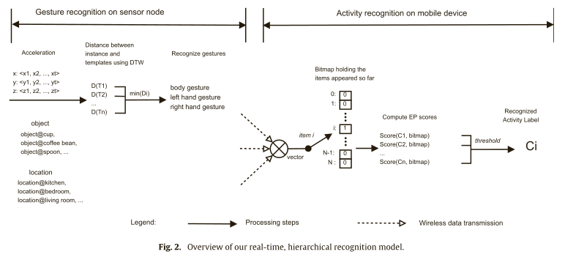
body sensor network

Slide 10

Gesture recognition（ sensor node level ）
Sensor data collection (by IMOTE2 mote with 3-axis accelerater)
the data format is shown as follows:
$[time_stamp]\left\langle sensor_id\right\rangle \left\langle x\right\rangle \left\langle y\right\rangle \left\langle z\right\rangle$

Slide 11
Gesture recognition
Gesture templates
define a set of gesture templates for left hand, right hand and body
supervised learning?
1. labeling such training data is very time consuming
2. there is no common vocabulary for all the gestures performed in real life

Slide 12
Gesture recognition
unsupervised learning
K-Medoids clustering method
ten patterns for hand movements
moving forward, backward, left, right, left and up, left and down, right and up, right and down
five patterns for body gestures
moving up, sitting down (contain both a moving down and moving backwards), moving left, right and forward

Slide 13
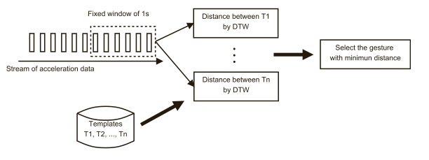
Gesture recognition
Identifying gestures
a sliding window with a fixed length of 1s to segment the data stream
match the instance with the pre-defined templates using DTW（Dynamic Time Warping）
—— a classic dynamic programming based algorithm to match two time series with temporal dynamics.

Slide 14

Real-time activity recognition（ mobile device level ）
recognized gestures, tagged objects and user locations
$→$ complex, high-level activities
an offline, Emerging Pattern based algorithm to real-time requirements

Slide 15
Real-time activity recognition（ mobile device level ）
Emerging Pattern (EP) describes significant differences between different classes of data.
An EP —— a representative pattern of its class.
An EP is a set of items, and it occurs frequently in one class and rarely in all the other classes.
The class in which an EP occurs the most frequently is called the class of the EP.

Slide 16
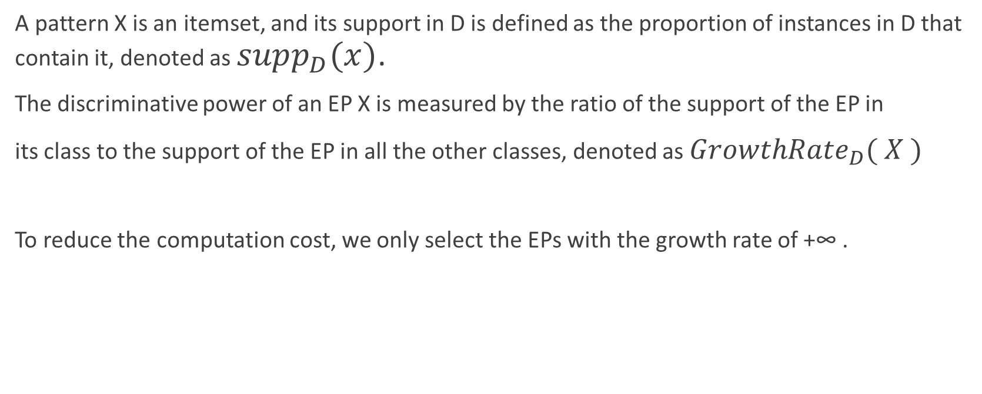
Real-time activity recognition（ mobile device level ）
A pattern X is an itemset, and its support in D is defined as the proportion of instances in D that contain it, denoted as $supp_{D}(x)$.
The discriminative power of an EP X is measured by the ratio of the support of the EP in
its class to the support of the EP in all the other classes, denoted as $GrowthRate_{D}( X )$
To reduce the computation cost, we only select the EPs with the growth rate of +∞ .

Slide 17
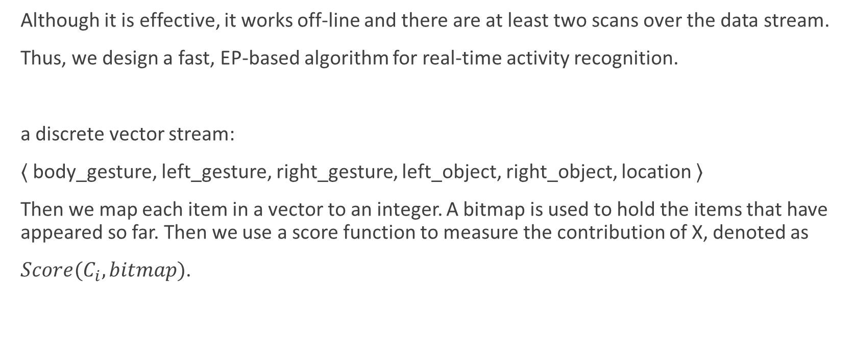
Real-time activity recognition（ mobile device level ）
Although it is effective, it works off-line and there are at least two scans over the data stream.
Thus, we design a fast, EP-based algorithm for real-time activity recognition.
a discrete vector stream:
⟨ body_gesture, left_gesture, right_gesture, left_object, right_object, location ⟩
Then we map each item in a vector to an integer. A bitmap is used to hold the items that have appeared so far. Then we use a score function to measure the contribution of X, denoted as
$Score(C_{i},bitmap)$.

Slide 18
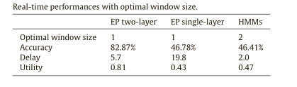
Empirical studies

Slide 19
Thank you~

