Slide 1
证明LUP分解算法的正确性
廖玺然

Slide 2
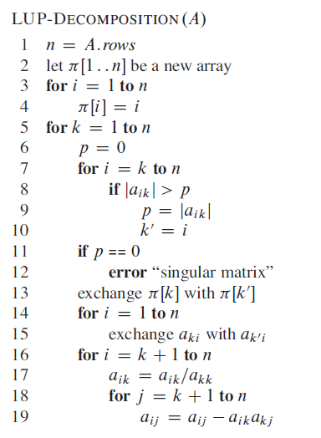
Algorithm

Slide 3


Invariant

Slide 4
Process
Initialization:
L’: 1×1, U’: 1×1.

Slide 5




Process
Maintenance:

Slide 6


Process

Slide 7

Process

Slide 8
Process
Termination:
L: n×n, U: n×n.

Slide 9
谢谢！

