Slide 1
计算机问题求解 – 论题2-12 - Hashing方法
2018年05月23日

Slide 2
Hashing
问题1:
所谓“Hashing”方法是用来解决什么问题的？
Notes:
Possible keys, actual keys
Hash表是数组的扩展，节省空间，保持访问的高效性

Slide 3
Hashing: the Idea
In feasible size
Very large, but only a small part is used in an application at a certain time
E[0]
Index distribution
Collision handling
E[1]
x
Hash Function
Key Space
E[k]
H(x)=k
Value of a specific key
A calculated array index for the key
E[m-1]

Slide 4
问题2：
Collision是什么意思？它是如何产生的？

Slide 5
问题3:
假设分配的存储区为k个单元，插入n个键值。对于某个特定位置，落到该位置的对象的期望值是多少？为什么？
顺便问一下，只插入2个键值，发生碰撞的概率是多大？
Notes:
a=n/k

Slide 6
模型: 将插入n个对象看作n个独立试验的序列。每个试验的结果是{1,2,…,k}中的一个值。
假设：每个实验的结果是任意一个允许值的概率是一样的。
(uniformly distributed)
α: loading factor(负载因子)
Notes:
期望：随机变量及其概率乘积的和：“加权平均值”

Slide 7
现在考虑特定单元为空的概率
同样的independent trials process，可以根据需要指定不同的outcomes:
k个不同的outcomes: 单元1,2,…,k
2个outcomes: 单元i, 非单元i
问题4：
插入n个对象后，单元i仍然是空的，概率是多少？
问题4’：
插入n个对象后,空单元的期望是多少？为什么？

Slide 8
一个概率悖论
假设有n个存储单元，在插入n个对象后
第i个单元已放入对象数期望值是：
整个存储区内空单元的期望数是：
换句话说，没有空的单元
（？）
问题5：
你能解释这个“悖论”吗？
Notes:
冲突的存在

Slide 9
冲突: 可能性有多大？
在k个单元的存储区内插入n个对象：
找一点感觉：
假如在100个单元的存储区内插入100个对象，发生的碰撞数的期望值就是大约37次。

Slide 10
没有空单元：需要插入多少对象？
先考虑一个“子问题”：使得被占单元数从达到 i-1 增加到达到 i, 需要插入多少对象（期望）？
,
, ……
给你一点感觉：
当k=10000, 这个值大约是98000。
Notes:
X2：将某个元素hash到新单元，使得有两个单元被占用的概率：k-1/k
将元素hash到单元中，是一个独立试验过程。
E(X2)=1/((k-1)/k)

Slide 11
问题6： 上面的讨论与实际的Hashing有什么差别？
In feasible size
Very large, but only a small part is used in an application at a certain time
E[0]
Index distribution
Collision handling
E[1]
x
Hash Function
Key Space
E[k]
H(x)=k
Value of a specific key
A calculated array index for the key
E[m-1]
选择好的Hashing函数很重要!
Notes:
Hash function 要实现将

Slide 12
两种设计Hashing函数的简单方法

Slide 13
问题7：
为什么在除法方法中，应该避免m是2的整次幂，而在乘法方法中却往往选择m的值为2的整次幂？
Notes:
除法方法中，h(k)是k的低p位。不符合hash值pattern avoid的要求（应该尽可能依赖k的所有位信息）
Unless we know that all low-order p-bit patterns are equally likely, we are better off designing the hash function to depend on all the bits of the
key.

Slide 14
Multiplication Method
问题8：
你能解释一下这个图吗？
Notes:
选择2的整数p次幂为table大小：
乘以s就是取小数部分
K的每一位都参与了计算

Slide 15
问题9：
“Hashing by division and Hashing by multiplication are heuristic in nature.”
这是什么意思？
universal hashing
Notes:
性能是不可证明的，universal hashing

Slide 16
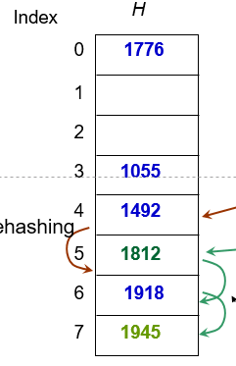
Collision Resolution
Chaining
Open Addressing

Slide 17
Collision Resolution by Chaining
Closed addressing

Slide 18
问题10:
采用Hashing by Chaining, 不成功搜索的平均代价是多少?为什么?

Slide 19
Hashing by Chaining: 不成功搜索
Assumption: simple uniform hashing:
for j=0,1,2,...,k-1, the average length of the list at E[j] is n/k=α.
The average cost of an unsuccessful search:
Any key that is not in the table is equally likely to hash to any of the k addresses. The average cost to determine that the key is not in the list E[h(k)] is the cost to search to the end of the list, which is α. So, the total cost is Θ(1+ α).
Notes:
分析结果取决与我们对hashing分布的假设

Slide 20
问题11:
采用Hashing by Chaining 计算成功搜索与不成功搜索的代价有什么不同?

Slide 21
Hashing by Chaining: 成功搜索
For successful search: (assuming that x_{i} is the ith element inserted into the table, i=1,2,...,n)
For each i, the probability of that x_{i} is searched is 1/n.
For a specific x_{i}, the number of elements examined in a successful search is t+1, where t is the number of elements inserted into the same list as x_{i}, after x_{i} has been inserted. And for any j, the probability of that x_{j} is inserted into the same list of x_{i} is 1/m. So, the cost is:
Expected number of elements in front of the searched one in the same linked list.
Cost for computing hashing

Slide 22
Hashing by Chaining: 成功搜索
The average cost of a successful search:
Define α=n/k as load factor,
Number of elements in front of the searched one in the same linked list.
Cost for computing hashing
Notes:
更一般的解释？

Slide 23

例子：JAVA 1.7 HashMap漏洞
static int hash(int h) {
h ^= (h >>> 20) ^ (h >>> 12);
return h ^ (h >>> 7) ^ (h >>> 4);
}
In Java 7 after calculating hash from hash function if more then one element has same hash than they are searched by linear search so it's complexity is (n).
In Java 8 that search is performed by binary search so the complexity will become log(n).

Slide 24
另一种冲突处理方法：Open Addressing
All elements are stored in the hash table, no linked list is used. So, α, the load factor, can not be larger than 1.
Collision is settled by “rehashing”:
a function is used to get a new hashing address for each collided address, i.e. the hash table slots are probed successively, until a valid location is found.
The probing sequence can be seen as a permutation of (0,1,2,..., m-1)
<h(k,0), h(k,1),…, h(k,m-1)>
Notes:
节省的地址，可以用来开辟更大的hash空间。
冲突时：follow取代以compute
Permutation：fill up！probing sequence不重复

Slide 25
Linear Probing: an Example
Index
H
Hash function: h(x)=5x mod 8
0
1776
1
2
1812
3
1055
hashing
4
1492
1945
rehashing
hashing
5
1812
6
1918
Rehash function: rh(j)=(j+1) mod 8
7
1945
chain of rehashings
Notes:
可以使用不同的rehashing function，但是要遍历所有的slot

Slide 26
问题12：
Open Addressing方法为什么不适合用于支持删除操作的结构？
Notes:
删除的key会使得chain断裂，再次搜索时可能无法找全

Slide 27

Commonly Used Probing
Linear probing:
Given an ordinary hash function h’, which is called an auxiliary hash function, the hash function is: (clustering may occur)
h(k,i) = (h’(k)+i) mod m (i=0,1,...,m-1)
Quadratic Probing:
Given auxiliary function h’ and nonzero auxiliary constant c₁ and c₂, the hash function is: (secondary clustering may occur)
h(k,i) = (h’(k)+c₁i+ c₂i²) mod m (i=0,1,...,m-1)
Double Hashing:
Given auxiliary functions h₁ and h₂, the hash function is:
h(k,i) = (h₁(k)+ ih₂(k)) mod m (i=0,1,...,m-1)
Notes:
Offset的不一样（规律性），导致clustering现象不一样
好的probing方法：均匀分布！
线性探查：概率为(i+1)/m是因为前i个hashing value会导致占用，再加上自身。

Slide 28
问题13：
一般如何判断一种probing方法的好坏？

Slide 29
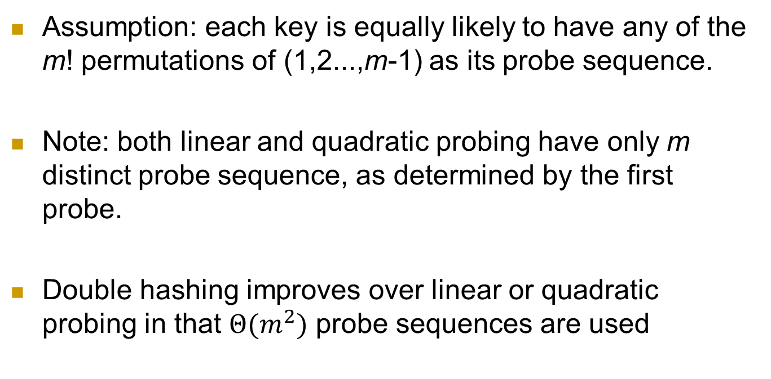
Equally Likely Permutations
Assumption: each key is equally likely to have any of the m! permutations of (1,2...,m-1) as its probe sequence.
Note: both linear and quadratic probing have only m distinct probe sequence, as determined by the first probe.
Double hashing improves over linear or quadratic probing in that $Θ(m^{2})$ probe sequences are used

Slide 30
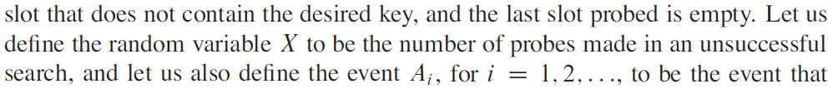
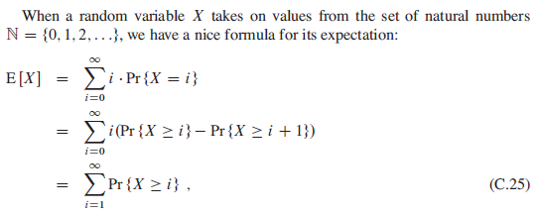
Analysis for Open Address Hashing
Assuming uniform hashing, what is the average number of probes in an unsuccessful search？

Slide 31
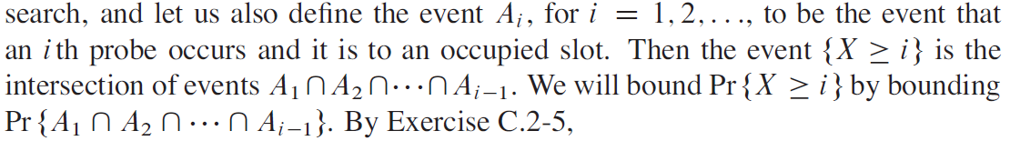

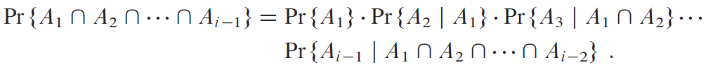
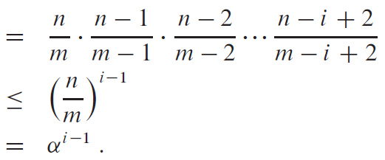
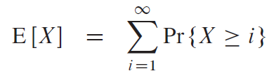
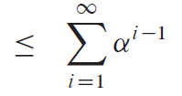
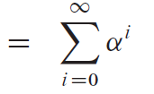

Analysis for Open Address Hash
Assuming uniform hashing, the average number of probes in an unsuccessful search is at most 1/(1-α) (α=n/m<1)

Slide 32
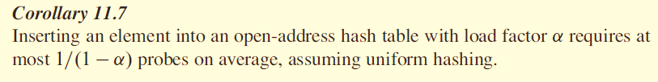

问题14:
采用Open Addressing, 插入一个对象的代价是多少?

Slide 33

Assuming uniform hashing, the average cost of probes in an successful search is at most (α=n/m<1)
For your reference:
Half full: 1.387; 90% full: 2.559

Slide 34
Open Topic
1. 介绍Universal Hashing
2. 介绍Hashing 的经典应用场景和有关Hashing的经典故事

