Slide 1
NeC4.5 —— Neural Ensemble Based C4.5
Author Yuan Jiang ，Zhi-hua Zhou
Reporter Zhen-xing Ge

Slide 2
Why NeC4.5
Comprehensibility
Generalization

Slide 3
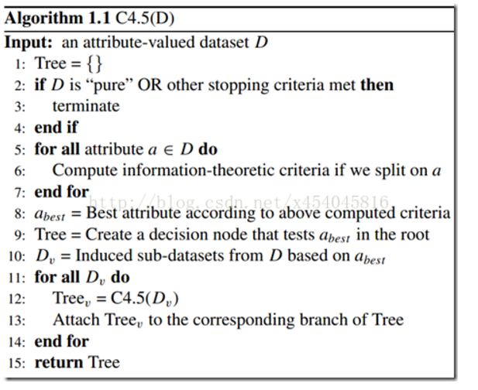
Some about C4.5
What is C4.5?
Pseudocode

Slide 4





Gain-ratio
Info_gain
Disadvantage：
Attribute that has most types.
gain-ratio
Attribute that has fewer types.

Slide 5
Why C4.5?
Handling both continuous and discrete attributes
Handling training data with missing attribute values
Handling attributes with differing costs.
Pruning trees after creation

Slide 6
NeC4.5
Introduction:
Train a neural network ensemble.
Enlarge the training set.
Get the decision tree.
Pseudocode:

Slide 7
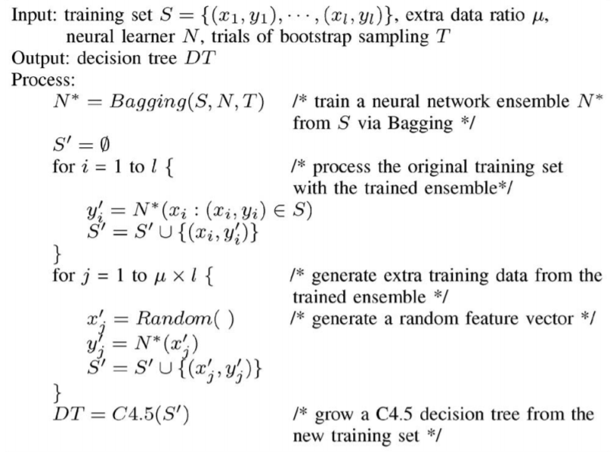
Pseudocode:

Slide 8
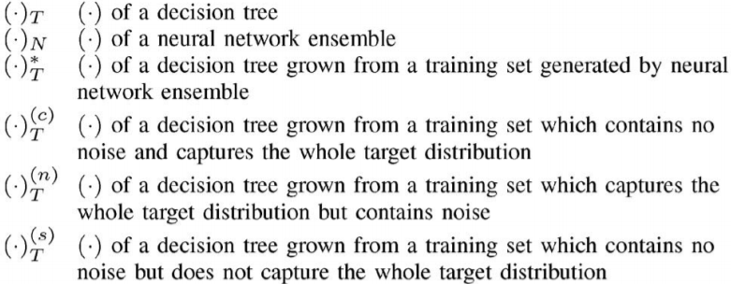






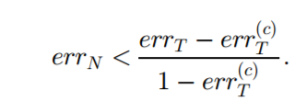

Why NeC4.5?

Slide 9
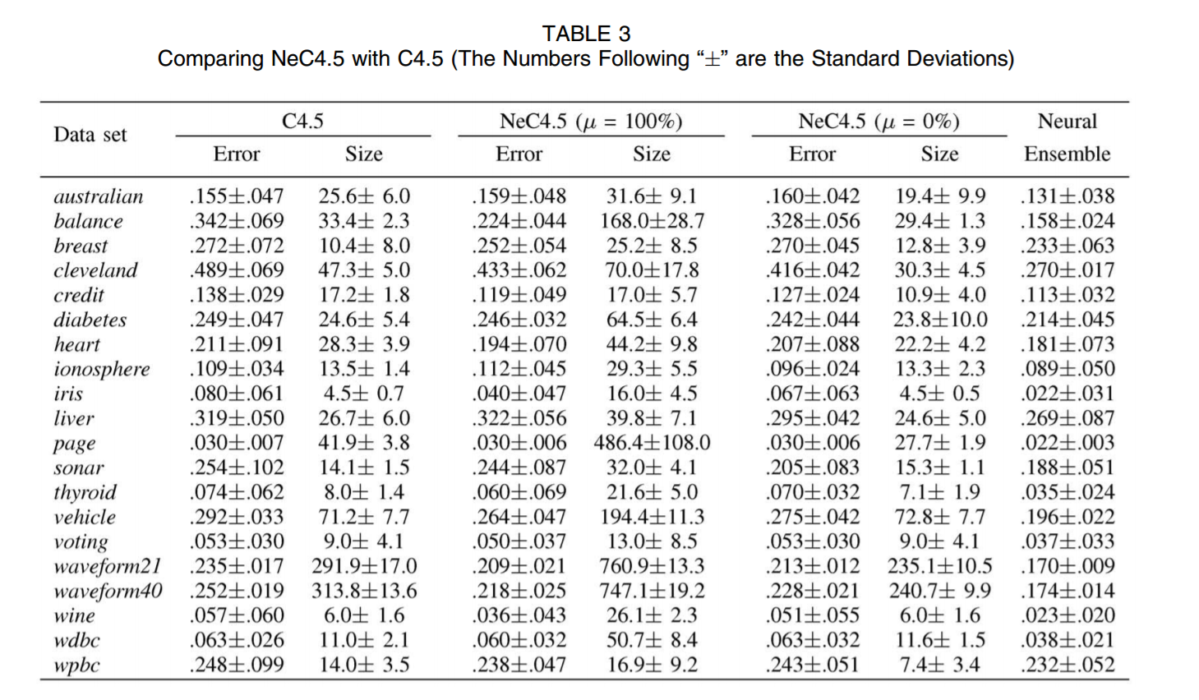

Slide 10
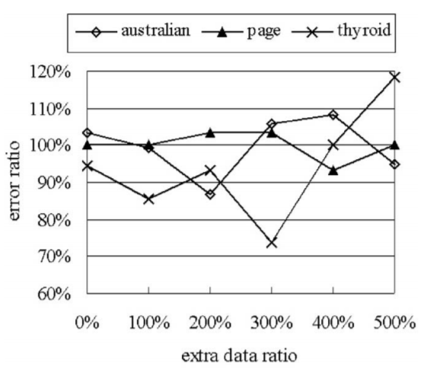
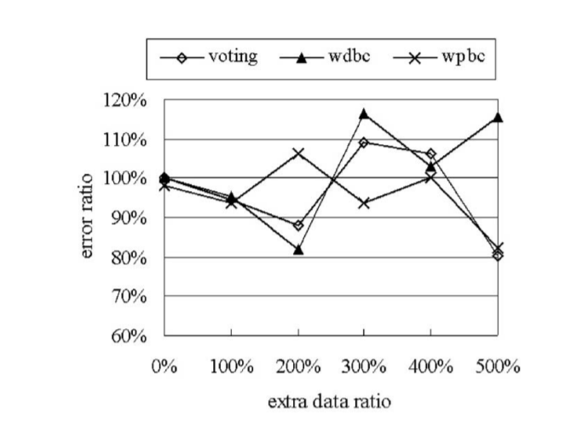



Slide 11
Thanks for listening！

