Slide 1
计算机问题求解 – 论题1-15
- 问题的难度
2018年12月25日

Slide 2
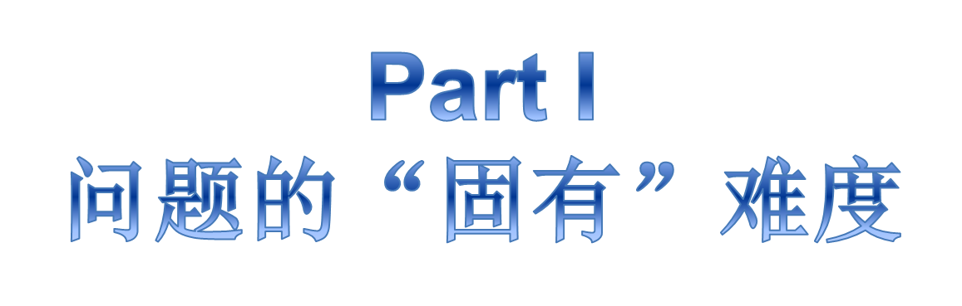

Slide 3
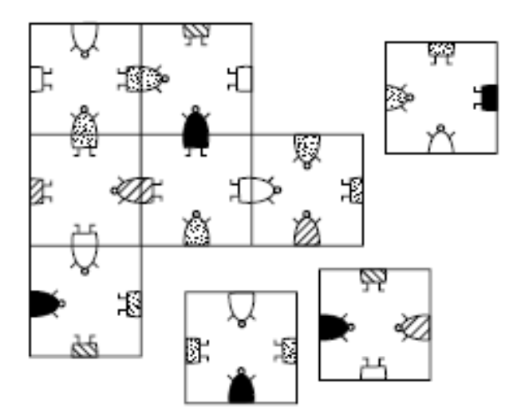
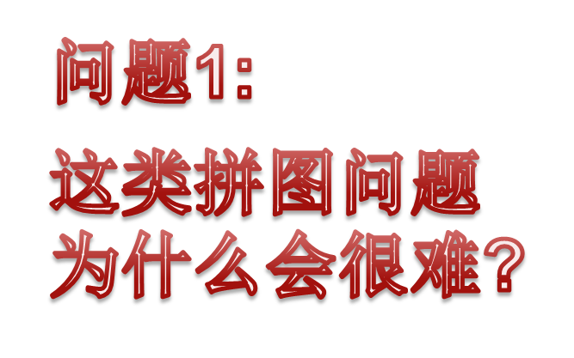
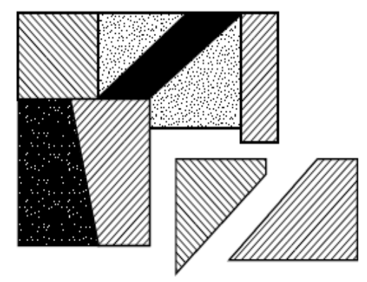
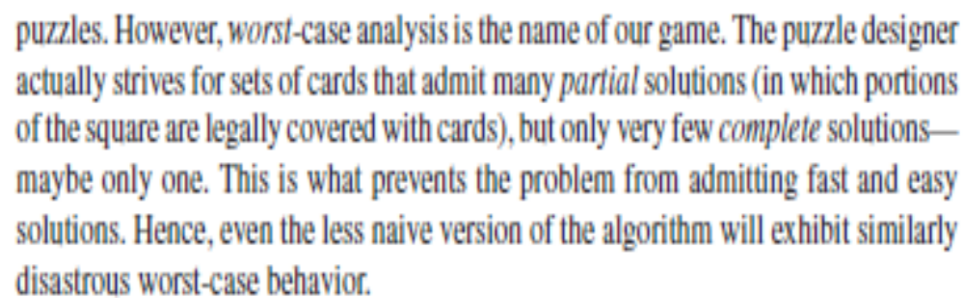

Slide 4
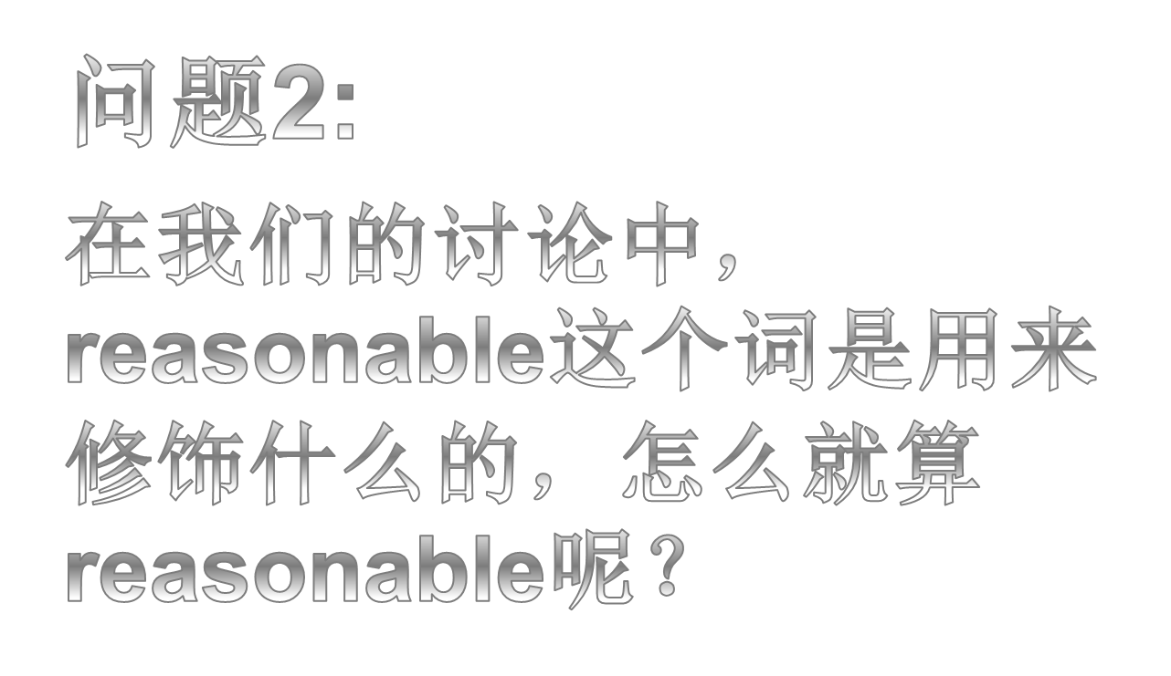

Slide 5
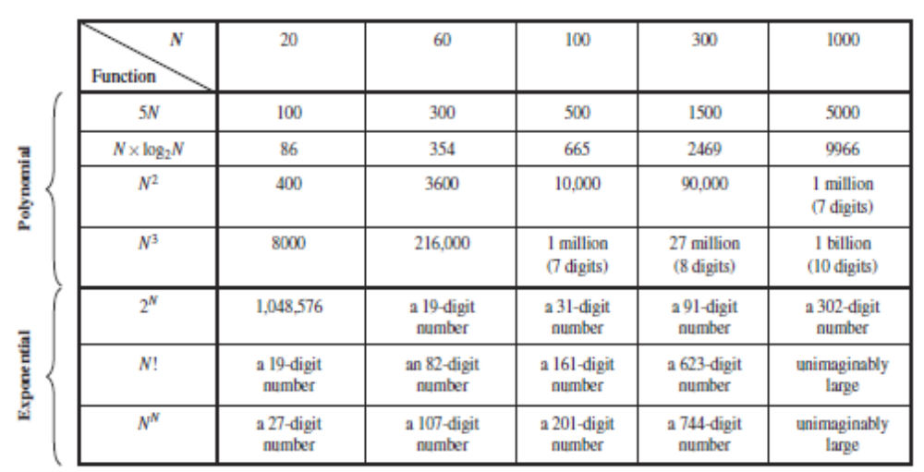
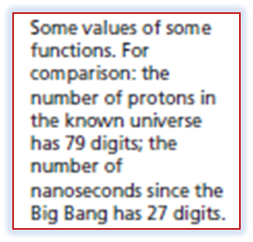
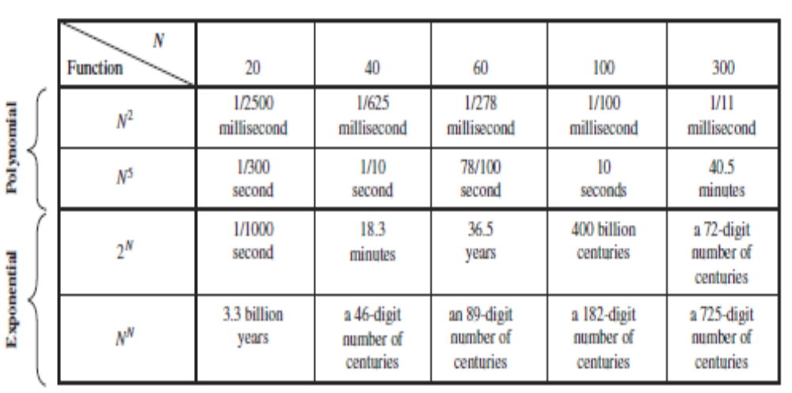
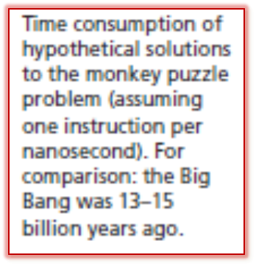

Slide 6
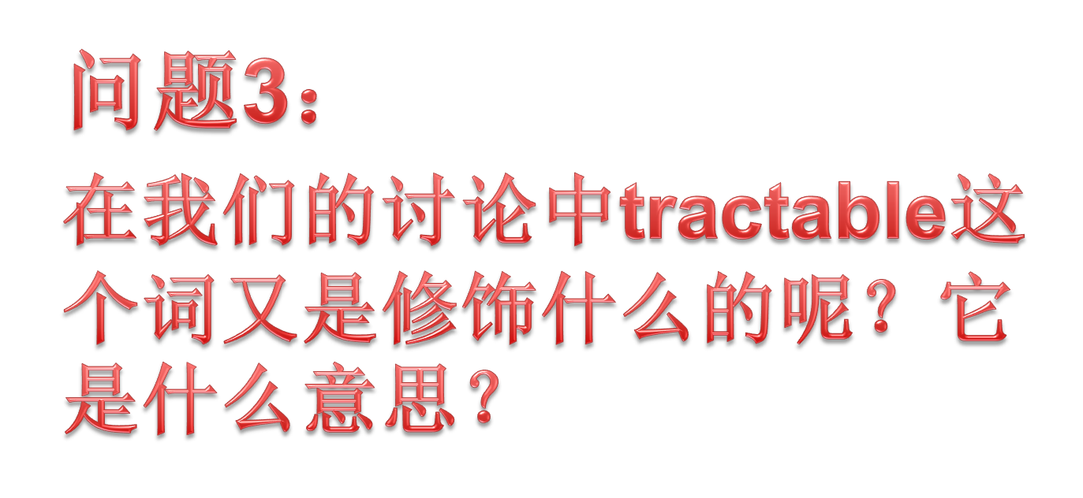

Slide 7
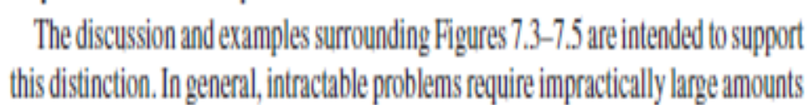
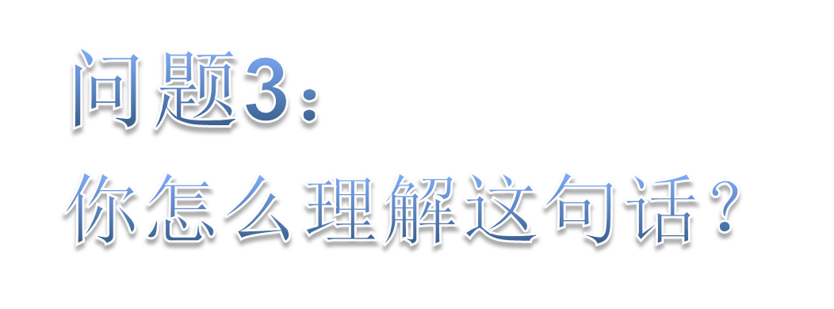

Slide 8
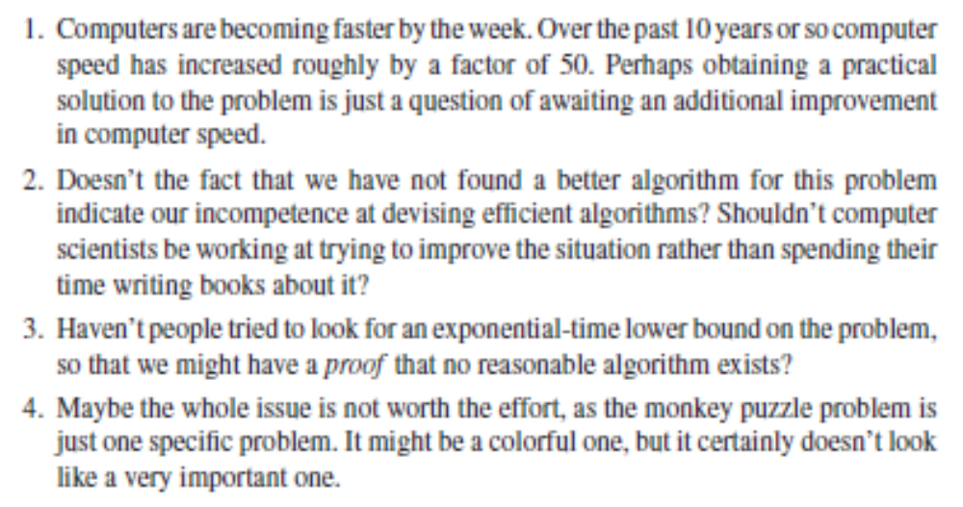
Something that slightly annoys or upset you

Slide 9
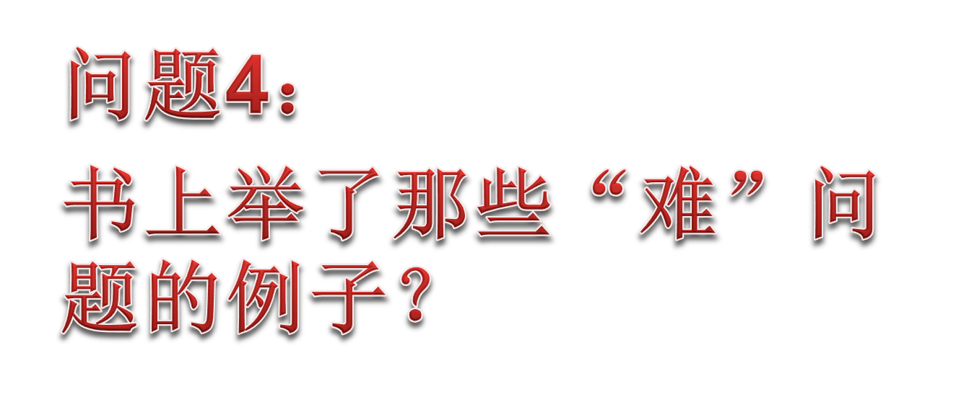

Slide 10
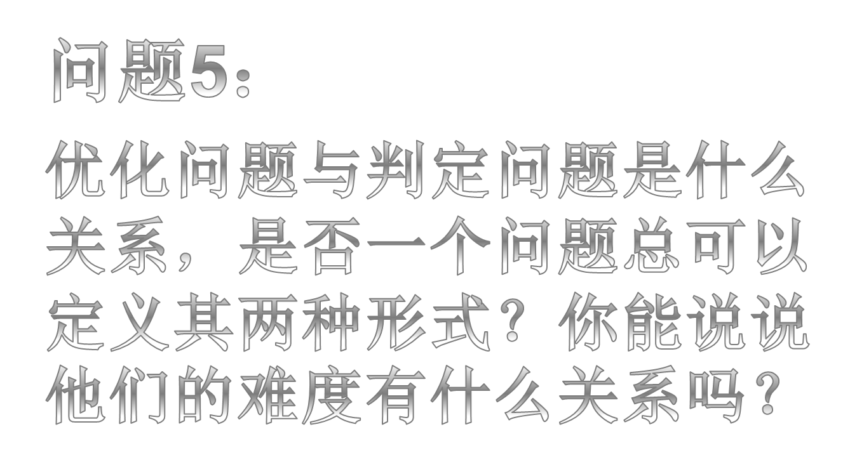

Slide 11
Max Clique: an Example
A maximal complete subgraph of a graph G is called a clique, whose size is the number of vertices in it.
  Optimization problem: Find the maximal clique in a given graph G.
  Decision problem: Has G a clique of size at least k for some given k?

Slide 12
Max Clique Revisited
The max clique problem can be solved in polynomial time iff. the corresponding decision problem can be solved in polynomial time.
  If the size of a max clique can be found in time g(n), the corresponding decision may be settled in that time of course.
  If deciClique is algorithm for the decision problem with k in the complexity of f(n), then we apply the algorithm at most n time, for k=n, n-1, ..., 2, 1, and we can solve the optimization problem, and with the complexity no worse than nf(n), which is polynomial only if f(n) is polynomial.

Slide 13
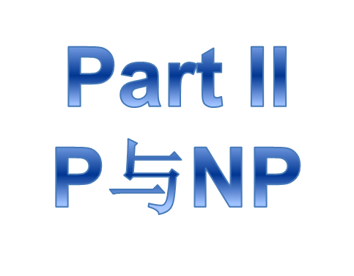

Slide 14


Slide 15


Nondeterministic vs. Deterministic
void nondetSearch(int k; int[ ] S)
int i =genCertif();
if (S[i]=k)
Output “yes”;
return;
In O(1)
Note: Ω(n) for deterministic algorithm
void nondetSort(int[ ] S; int n)
int i, j; int[ ] out=0;
for i =1 to n do
j= genCertif();
if out[j ]≠0 then return;
out[j]=S[i ];
for i =1 to n-1 do
if out[i ]>out[i+1] then return;
S=out;
Output(yes);
return
In O(n)
Note: Ω(nlogn) for deterministic algorithm

Slide 16

Max Clique Problem is in NP
void nondeteClique(graph G; int n, k)
set S=φ;
for int i=1 to k do
int t=genCertif();
if t∈S then return;
S=S∪{t };
for all pairs (i,j) with i,j in S and i≠j do
if (i,j ) is not an edge of G
then return;
Output(“yes”);
In O(n)
In O(k²)
So, we have an algorithm for the maximal clique problem with the complexity of O(n+k²)=O(n²)

Slide 17

Satisfiability Problem
An example of propositional conjunctive normal form (CNF) is like this:
Satisfiability Problem
Given a CNF formula, is there a truth assignment that satisfies it?
In other words, is there a assignment for the set of propositional variable in the CNF, such that the value of the formula is true.
void nondetSat(E, n)
boolean p[ ];
for int i =1 to n do
p[i ]= genCertif(true, false);
if E(p[1], p[2], ..., p[n])=true
then Output(“yes”);
So, the problem is in NP

Slide 18
Solving a Problem Indirectly
T(x)
x
T
Algorithm for Q
yes or no
answer
an input for Q
(an input for P )
Algorithm for P
The correct answer for P on x is yes if and only if the correct answer for Q on T(x) is yes.

Slide 19
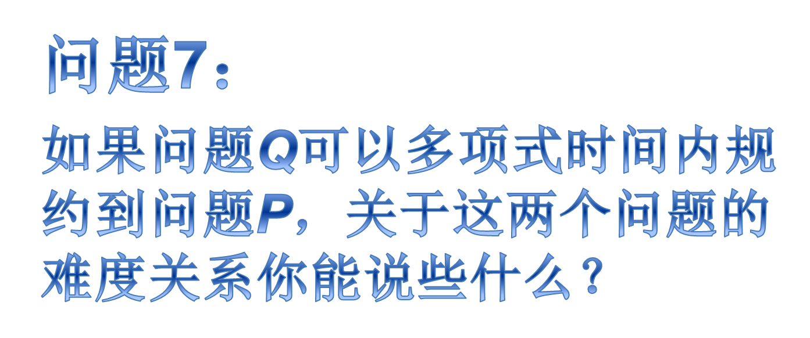

Slide 20
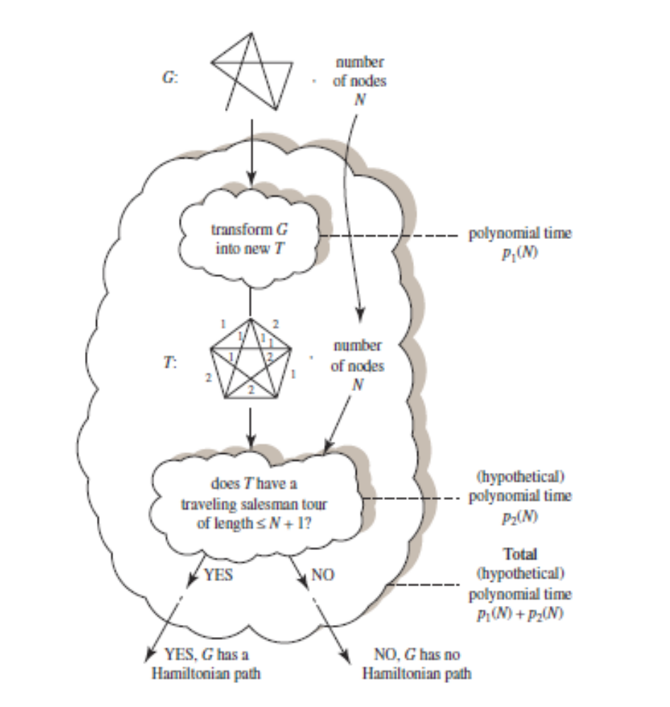
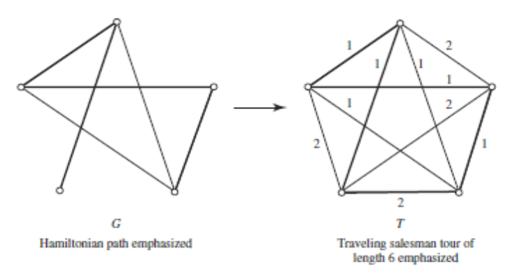
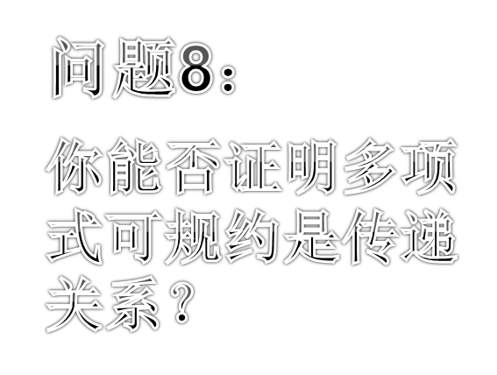

Slide 21
NP-complete Problems
A problem Q is NP-hard if every problem P in NP is reducible to Q, that is P≤_{P}Q.
  (which means that Q is at least as hard as any problem in NP )
A problem Q is NP-complete if it is in NP and is NP-hard.
  (which means that Q is at most as hard as to be solved by a polynomially bounded nondeterministic algorithm)

Slide 22
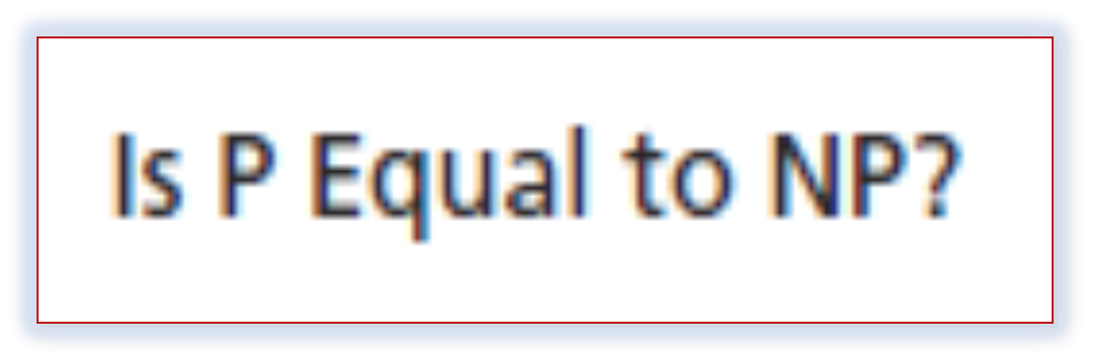
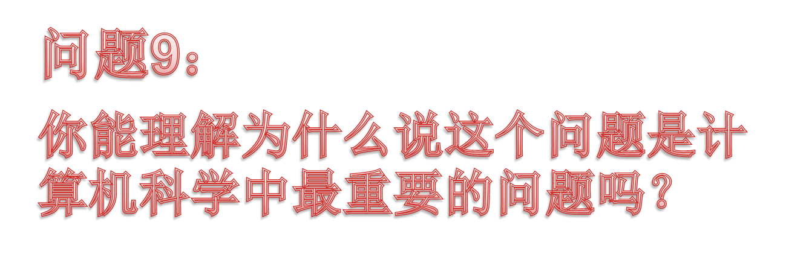

Slide 23
课外作业
DH pp.186-
  7.2, 7.4, 7.6, 7.10,

