Slide 1
问题10中的结论
鄢振宇

Slide 2
TOC
问题10 Review
Proof(s)
Another comprehension

Slide 3
问题10：下图中的kernel和f⁻¹(a’)之间有什么结论？
群G
群G’
同态f
e’
a’
kernel
e
f⁻¹(a’)
a
Kernel和任意的G’中非单位元元素的逆像不相交
Kernel和任意的G’中非单位元元素的逆像同势
任意的G’中元素的逆像不相交且同势
任意的G’中元素的逆像必定是kernel的某个陪集

Slide 4
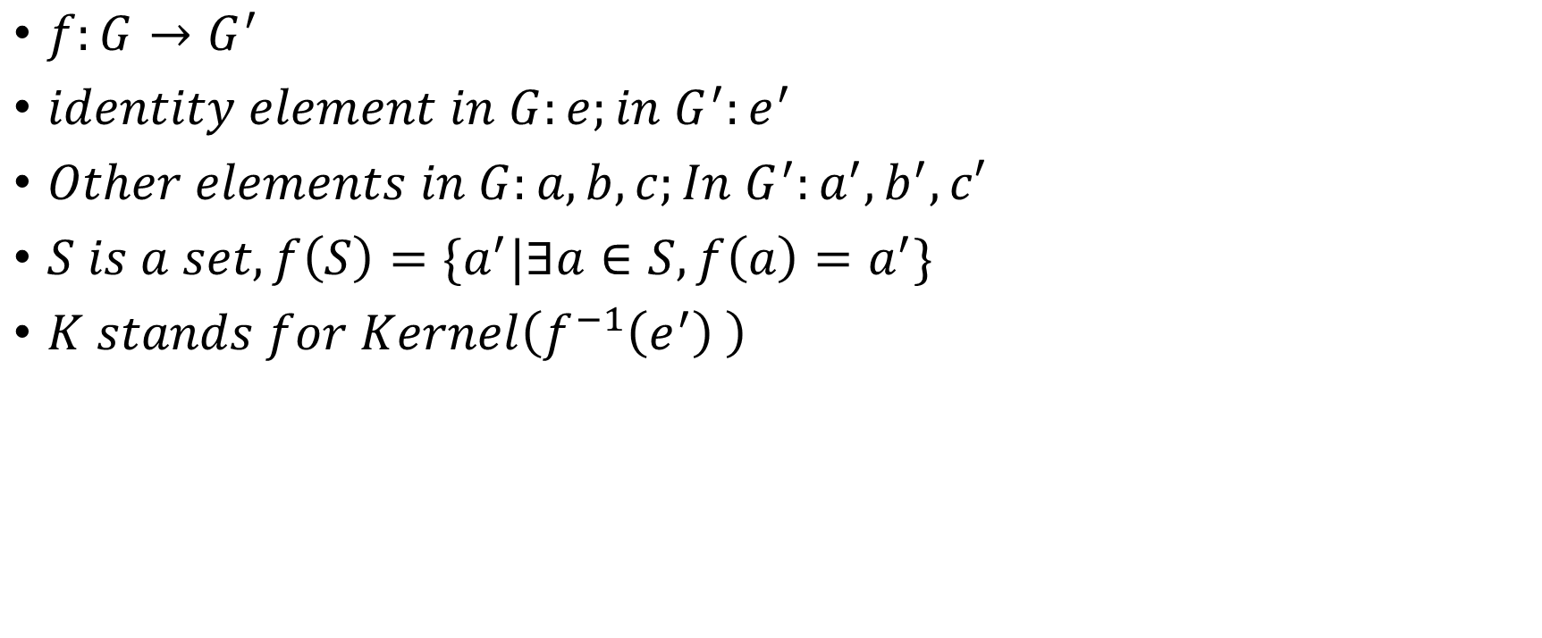
Symbols
$f:G→G^{′}$
$identity element in G:e;in G^{′}:e^{′}$
$Other elements in G:a,b,c;In G^{′}:a^{′},b^{′},c′$
$S is a set, f\left(S\right)=\{a^{′}|∃a∈S, f\left(a\right)=a^{′}\}$
$K stands for Kernel\left(f^{−1}\left(e^{′}\right) \right)$

Slide 5

Kernel和任意的G’中非单位元元素的逆像不相交
$Suppose K∩f^{−1}\left(a^{′}\right)=b$
$∵b∈K,f\left(b\right)=e^{′}$
$∵b∈f^{−1}\left(a^{′}\right), f\left(b\right)=a^{′}$
But f is well-defined
Contradicts

Slide 6
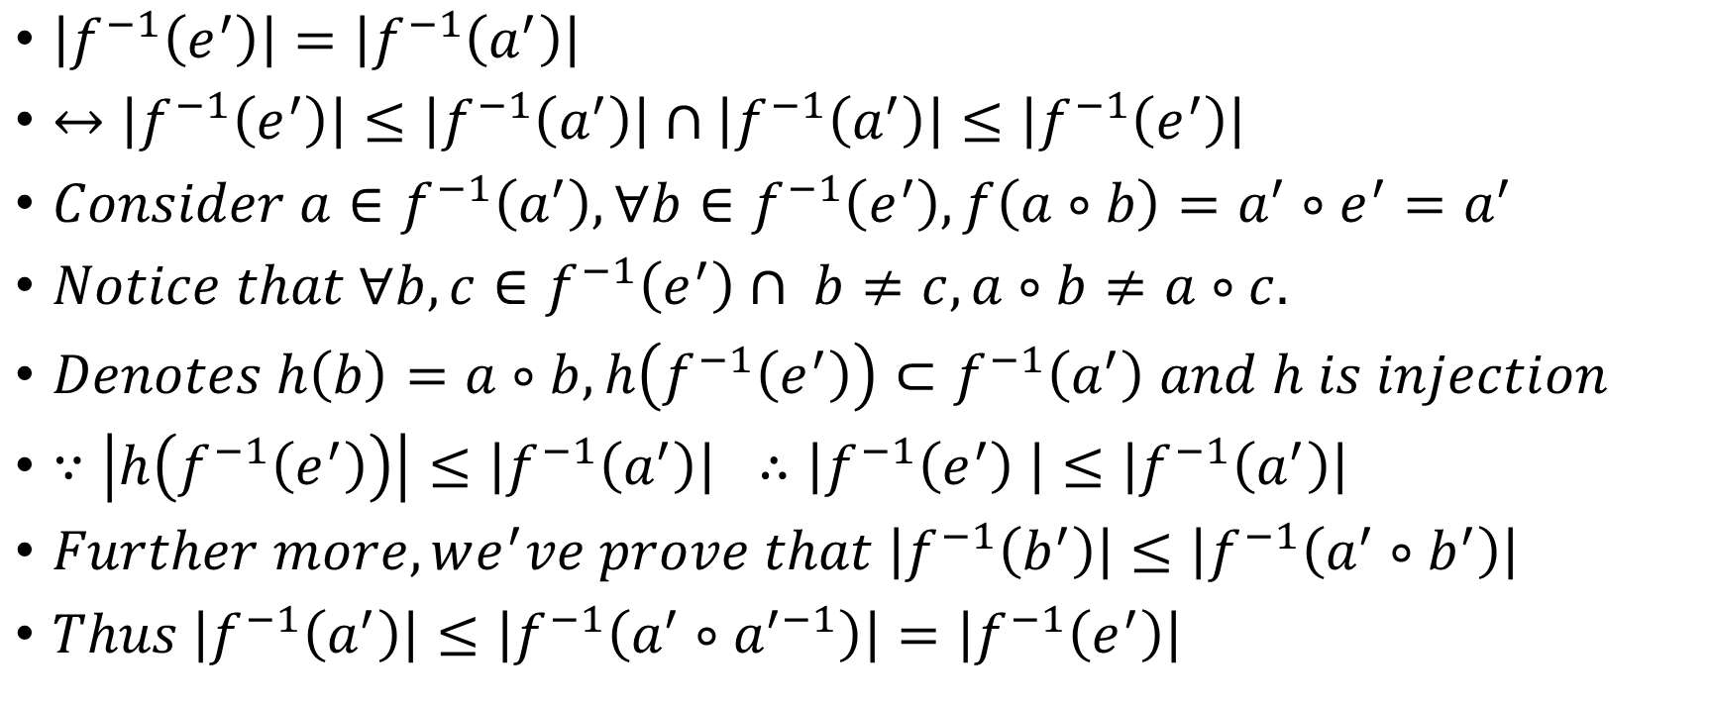
Kernel和任意的G’中非单位元元素的逆像同势
$\left|f^{−1}\left(e^{′}\right)\right|=\left|f^{−1}\left(a^{′}\right)\right|$
$↔\left|f^{−1}\left(e^{′}\right)\right|≤\left|f^{−1}\left(a^{′}\right)\right|∩\left|f^{−1}\left(a^{′}\right)\right|≤\left|f^{−1}\left(e^{′}\right)\right|$
$Consider a∈f^{−1}\left(a^{′}\right), ∀b∈f^{−1}\left(e^{′}\right), f\left(a∘b\right)=a^{′}∘e^{′}=a^{′}$
$Notice that ∀b,c∈f^{−1}\left(e^{′}\right)∩ b≠c, a∘b≠a∘c.$
$Denotes h\left(b\right)=a∘b, h\left(f^{−1}\left(e^{′}\right)\right)⊂f^{−1}\left(a^{′}\right) and h is injection$
$∵\left|h\left(f^{−1}\left(e^{′}\right)\right)\right|≤\left|f^{−1}\left(a^{′}\right)\right| ∴\left|f^{−1}\left(e^{′}\right) \right|≤\left|f^{−1}\left(a^{′}\right)\right|$
$Further more, we^{′}ve prove that \left|f^{−1}\left(b^{′}\right)\right|≤\left|f^{−1}\left(a^{′}∘b^{′}\right)\right|$
$Thus \left|f^{−1}\left(a^{′}\right)\right|≤\left|f^{−1}\left(a^{′}∘a^{′−1}\right)\right|=\left|f^{−1}\left(e^{′}\right)\right|$

Slide 7
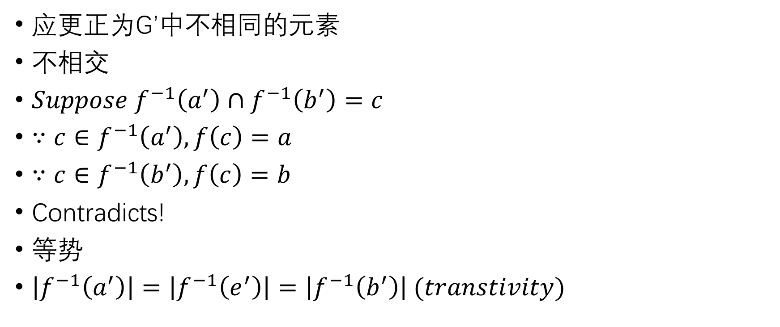
任意的G’中元素的逆像不相交且同势
应更正为G’中不相同的元素
$不相交$
$Suppose f^{−1}\left(a^{′}\right)∩f^{−1}\left(b^{′}\right)=c$
$∵c∈f^{−1}\left(a^{′}\right), f\left(c\right)=a$
$∵c∈f^{−1}\left(b^{′}\right), f\left(c\right)=b$
Contradicts!
$等势$
$\left|f^{−1}\left(a^{′}\right)\right|=\left|f^{−1}\left(e^{′}\right)\right|=\left|f^{−1}\left(b^{′}\right)\right| (transtivity)$

Slide 8

任意的G’中元素的逆像必定是kernel的某个陪集
$Suppose a∈f^{−1}\left(a^{′}\right)$
$a∘f^{−1}\left(e^{′}\right)⊂f^{−1}\left(a^{′}\right)$
$Since \left|a∘f^{−1}\left(e^{′}\right)\right|=\left|f^{−1}\left(e^{′}\right)\right|=\left|f^{−1}\left(a^{′}\right)\right|$
$Thus a∘f^{−1}\left(e^{′}\right)=f^{−1}\left(a^{′}\right)$

Slide 9
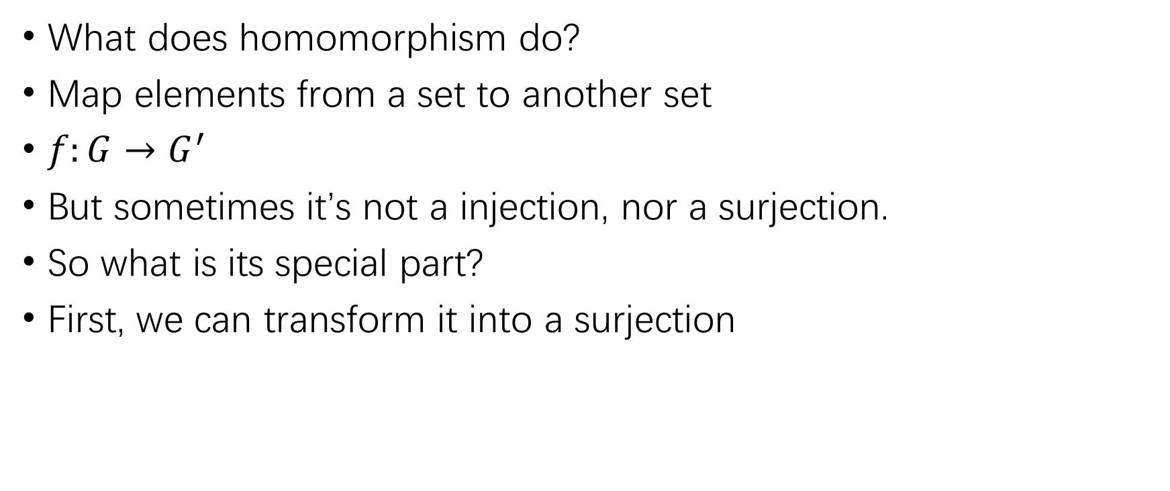
Another comprehension
What does homomorphism do?
Map elements from a set to another set
$f:G→G^{′}$
But sometimes it’s not a injection, nor a surjection.
So what is its special part?
First, we can transform it into a surjection

Slide 10
Another comprehension
What does homomorphism do?
Map elements from a set to another set
$f:G→G^{′}$
But sometimes it’s not a injection, nor a surjection.
So what is its special part?
First, we can transform it into a surjection

Slide 11
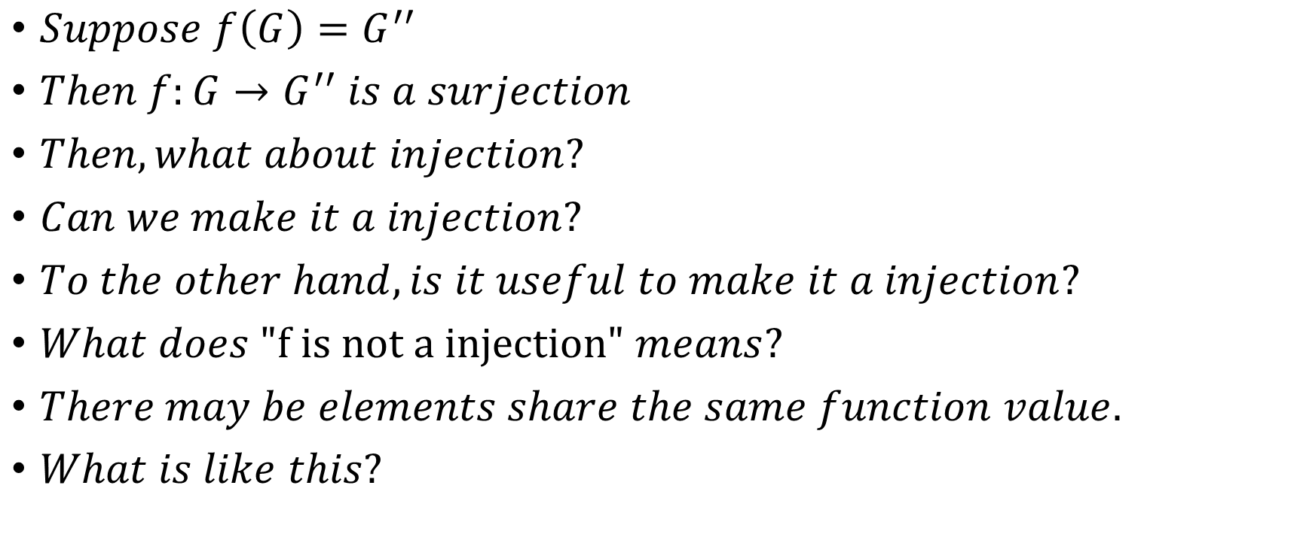
Another comprehension
$Suppose f\left(G\right)=G^{′′}$
$Then f:G→G^{′′} is a surjection$
$Then, what about injection?$
$Can we make it a injection?$
$To the other hand, is it useful to make it a injection?$
$What does \text{"}\text{f} \text{is} \text{not} \text{a} \text{injection}\text{"} means?$
$There may be elements share the same function value.$
$What is like this?$

Slide 12

Another comprehension
$many elements with shared \text{"}\text{mark}\text{"} −− equivalence class!$
$So if we consider f as a function that transform an element in$
$G into its equivalence class?$
$Especially, congruence class!$

Slide 13

Another comprehension
$Review the propositions$
Kernel和任意的G’中非单位元元素的逆像不相交
Kernel和任意的G’中非单位元元素的逆像同势
任意的G’中元素的逆像不相交且同势
任意的G’中元素的逆像必定是kernel的某个陪集

Slide 14
Thanks!

