Slide 1
SCOPE: Scalable Composite Optimization for Learning on Spark
Shen-Yi Zhao, Ru Xiang, Ying-Hao Shi, Peng Gao and Wu-Jun Li
National Key Laboratory for Novel Software Technology
Department of Computer Science and Technology, Nanjing University, China

Slide 2


Introduction
SGD
SVRG
PSO
DSO
SPARK
Notes:
很多机器学习模型都可以被归为解决这样的优化问题，不同的模型有不同的f_i
w是参数
最众所周知的就是SGD即随机梯度下降，大家都学过local search，一样的，每次挑一个或一些
但是sgd方差过大，收敛不稳定，因此有了svrg，作了一些改进，达到线性收敛
这些都属于随机优化so
大数据时代，就出现多核多线程的pso，集群分布式的dso
本算法搭载分布式平台spark，是一个同步的基于mapreduce的平台，hadoop

Slide 3
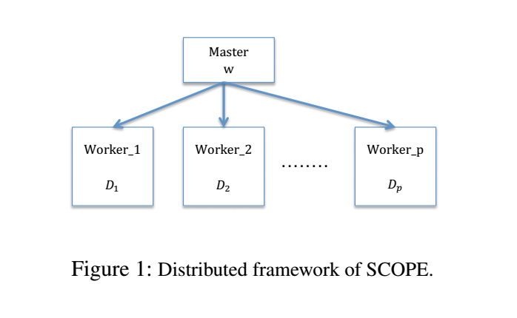
Framework

Slide 4
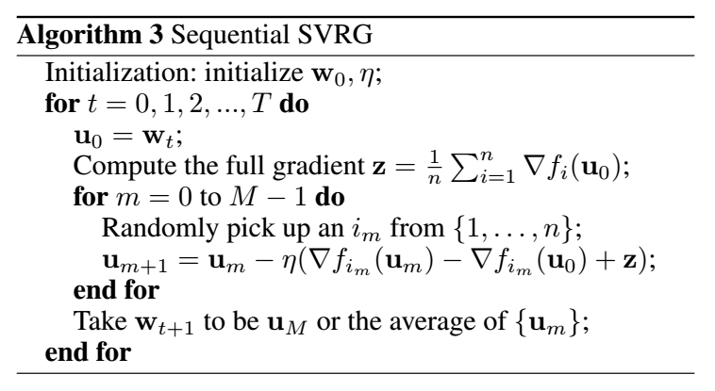
SVRG

Slide 5
Data and Parameter
Dataset is distributively stored on Workers
W is stored on the Master

Slide 6
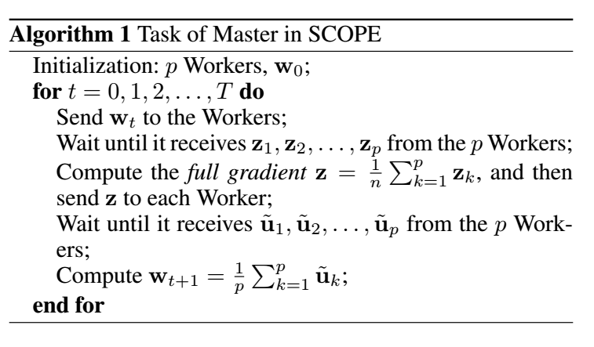

Slide 7
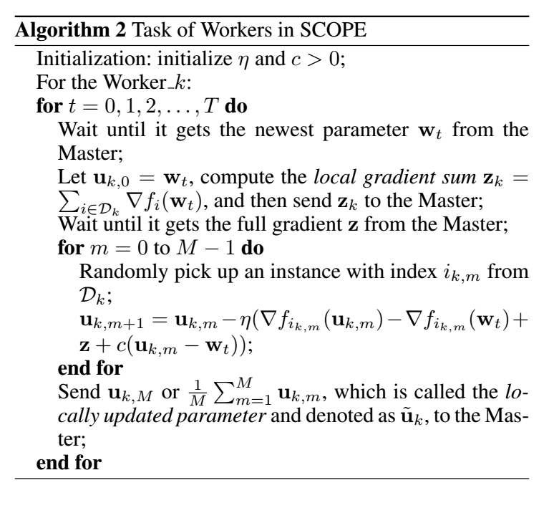

Slide 8

Analysis
Worker only use native data
The update rule in Master
The update rule for $u_{k,m+1}$

Slide 9
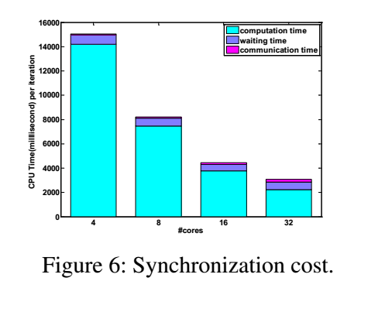
Communication Cost

Slide 10
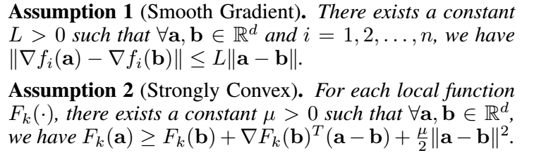

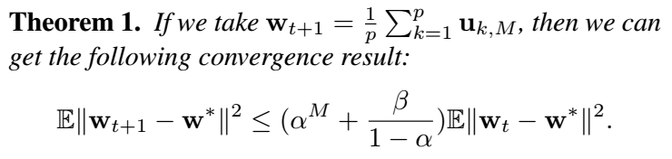
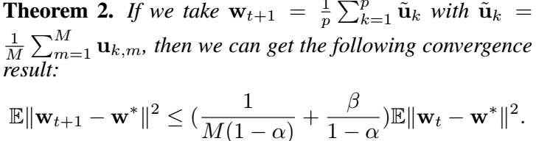
Convergence

Slide 11
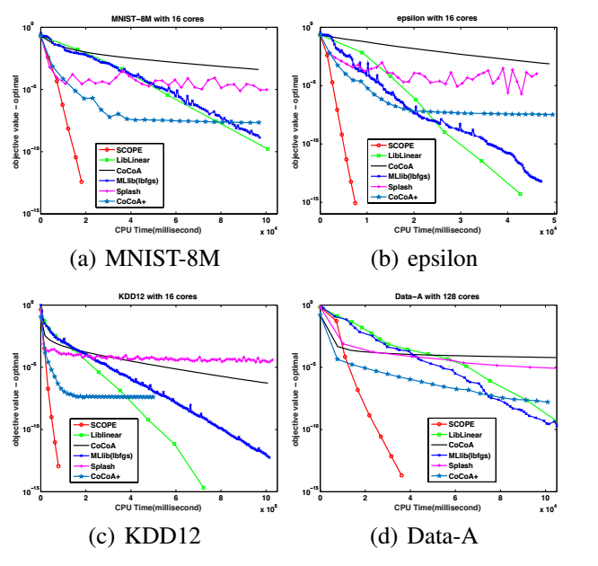
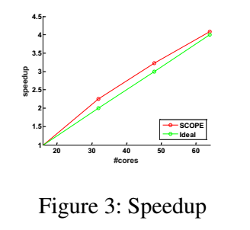
Experiment
a Spark cluster of 33 machines (nodes) connected by 10GB Ethernet
12 Intel Xeon E5-2620 cores with 64GB memory

Slide 12
谢谢！

