Slide 1
Searching an unsorted array
4/28/2018 何润雨（171240009）
Notes:
查找一个无序数组

Slide 2
原题回顾

Slide 3

5-2 Searching an unsorted array
This problem examines three algorithms for searching for a value $x$ in an unsorted array $A$ consisting of $n$ elements.
Notes:
本题讲分析3个算法
有的地方问的是多少次，有的地方问的是running time
Running time取决于多少次的时候统一采用执行次数分析

Slide 4
RANDOM-SEARCH

Slide 5
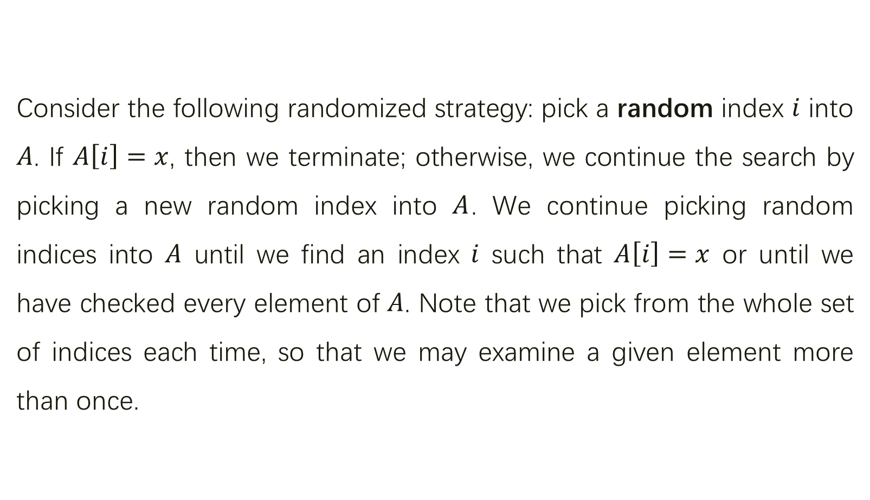
Consider the following randomized strategy: pick a random index $i$ into $A$. If $A\left[i\right]=x$, then we terminate; otherwise, we continue the search by picking a new random index into $A$. We continue picking random indices into $A$ until we find an index $i$ such that $A\left[i\right]=x$ or until we have checked every element of $A$. Note that we pick from the whole set of indices each time, so that we may examine a given element more than once.
Notes:
简单暴力
（开销大）

Slide 6
a.
Write pseudocode for a procedure RANDOM-SEARCH to implement the strategy above. Be sure that your algorithm terminates when all indices into A have been picked.
Notes:
注意当所有下标都被挑选过时需要终止。

Slide 7

RANDOM-SEARCH($x, A, n$):
$v = ∅$
while $\left|v\right|≠ n$
$i$ = RANDOM$(1, n)$
if $A[i] = x$
return $i$
else
$v = v   i$
return null
Notes:
比较抽象的伪代码，实现方案不局限于数组

Slide 8

RANDOM-SEARCH($x, A, n$):
$a\left[1 .. n\right]←0$
$count←0$
while (count < n)
$i←rand\left(1,n\right)$
if $a\left[i\right]=0$
if $A\left[i\right]=x$
return i
else
$a\left[i\right]=1$
$count←count+1$
return null
Notes:
（稍作改动）

Slide 9
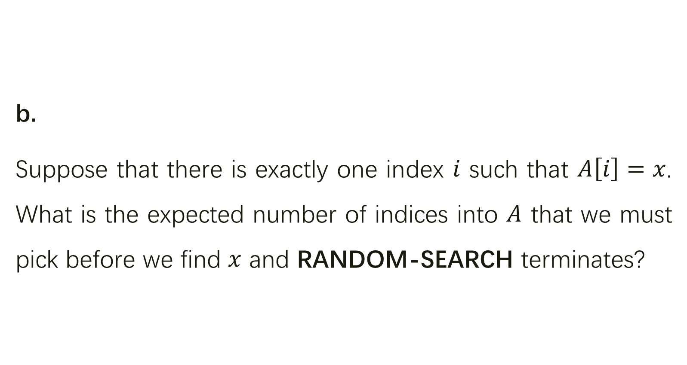
b.
Suppose that there is exactly one index $i$ such that $A\left[i\right]=x$. What is the expected number of indices into $A$ that we must pick before we find $x$ and RANDOM-SEARCH terminates?
Notes:
注意当所有下标都被挑选过时需要终止。

Slide 10
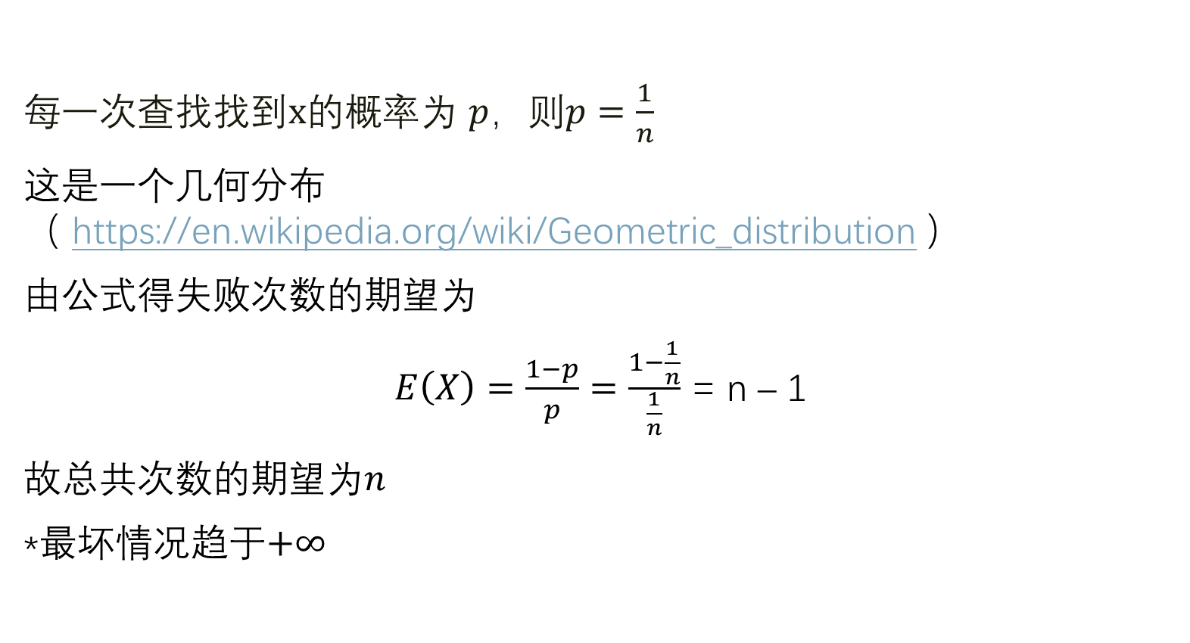
每一次查找找到$x$的概率为 $p$，则$p=\frac{1}{n}$
这是一个几何分布（ https://en.wikipedia.org/wiki/Geometric_distribution ）
由公式得失败次数的期望为
$E\left(X\right)=\frac{1−p}{p}=\frac{1−\frac{1}{n}}{\frac{1}{n}}$ = n – 1
故总共次数的期望为$n$
*最坏情况趋于$+∞$
Notes:
查k次都失败了，第k+1次成功 → 几何分布
查过了也还是要耗费一次操作

Slide 11
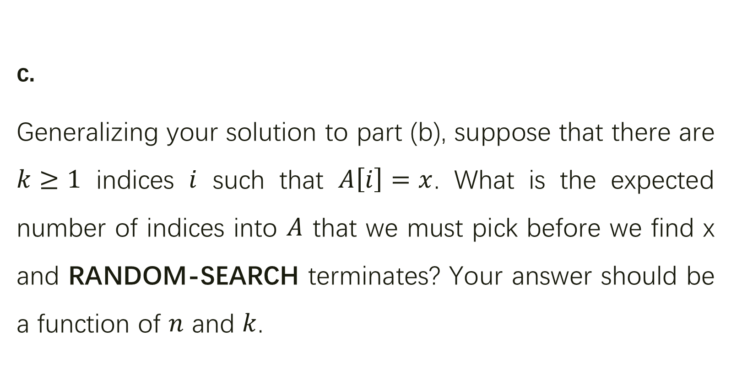
c.
Generalizing your solution to part (b), suppose that there are $k≥1$ indices $i$ such that $A\left[i\right]=x$. What is the expected number of indices into $A$ that we must pick before we find x and RANDOM-SEARCH terminates? Your answer should be a function of $n$ and $k$.
Notes:
恰好k个为x

Slide 12

每一次查找找到$x$的概率为 $p$，则$p=\frac{k}{n}$，
这是一个几何分布
由公式得失败次数的期望为
$$E\left(X\right)=\frac{1−p}{p}=\frac{1−\frac{k}{n}}{\frac{k}{n}}=\frac{n−k}{k}$$
故总共次数的期望为$\frac{n}{k}$
Notes:
几何分布

Slide 13
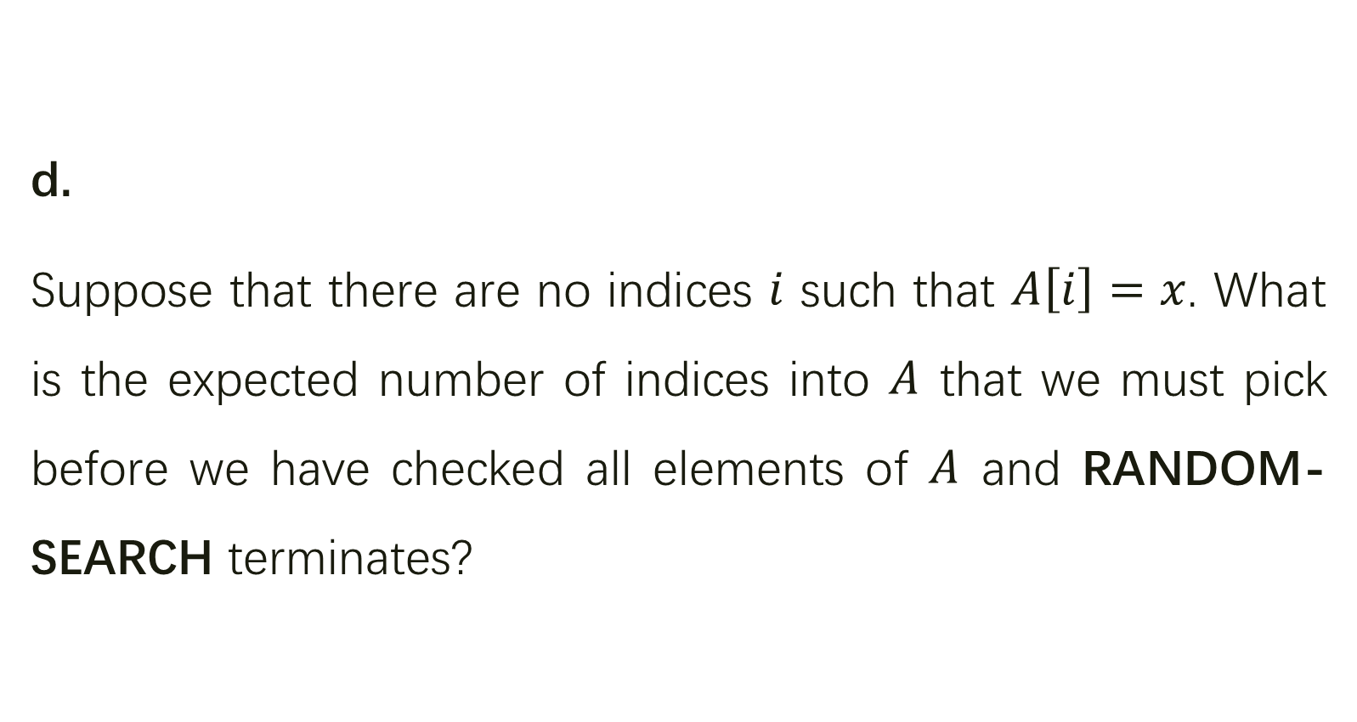
d.
Suppose that there are no indices $i$ such that $A\left[i\right]=x$. What is the expected number of indices into $A$ that we must pick before we have checked all elements of $A$ and RANDOM-SEARCH terminates?
Notes:
恰好一个为x

Slide 14

参见《算法导论》P134 5.4.2 balls and bins 第三类问题
由书上公式可得
$$E\left[n\right]=n(\ln{n}+O\left(1\right))$$
Notes:
Balls and bins

Slide 15
DETERMINISTIC-SEARCH
Notes:
确定的算法

Slide 16
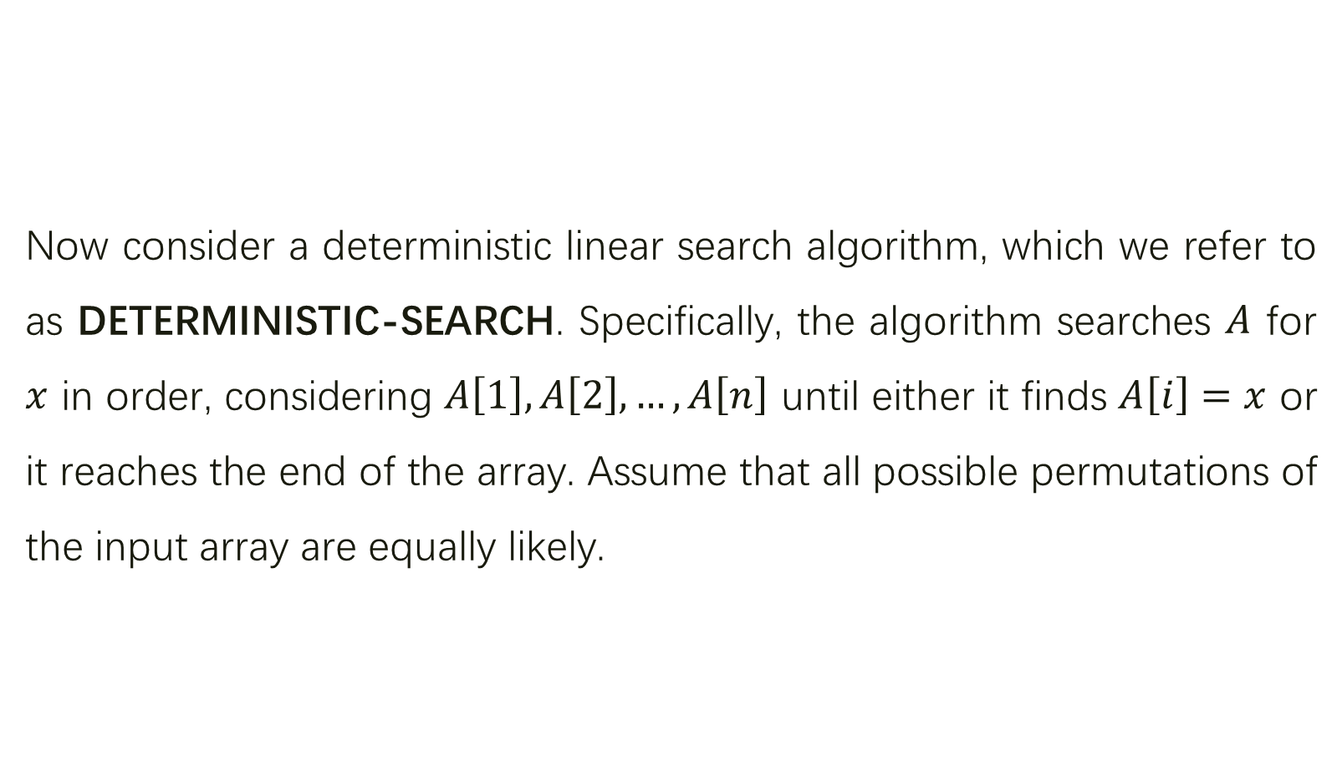
Now consider a deterministic linear search algorithm, which we refer to as DETERMINISTIC-SEARCH. Specifically, the algorithm searches $A$ for $x$ in order, considering $A\left[1\right],A\left[2\right],…,A\left[n\right]$ until either it finds $A\left[i\right]=x$ or it reaches the end of the array. Assume that all possible permutations of the input array are equally likely.

Slide 17
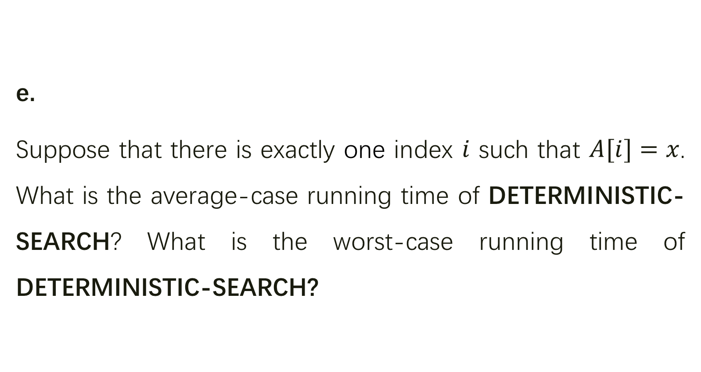
e.
Suppose that there is exactly one index $i$ such that $A[i]=x$. What is the average-case running time of DETERMINISTIC-SEARCH? What is the worst-case running time of DETERMINISTIC-SEARCH?

Slide 18
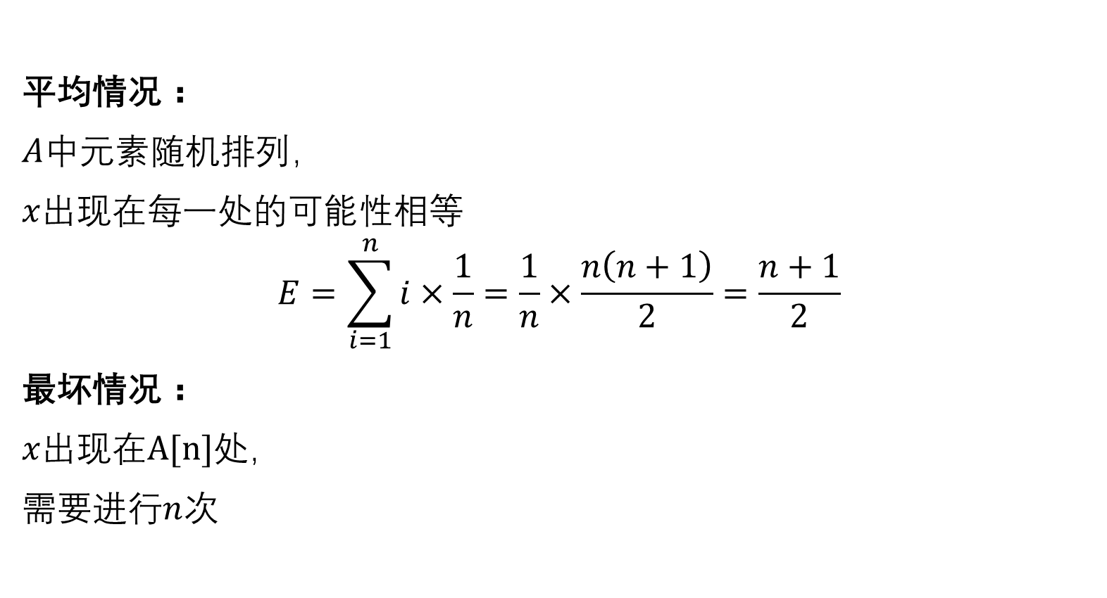
平均情况：
$A$中元素随机排列，
$x$出现在每一处的可能性相等
$$E=\sum_{i=1}^{n}{i×\frac{1}{n}=\frac{1}{n}×\frac{n\left(n+1\right)}{2}=\frac{n+1}{2}}$$
最坏情况：
$x$出现在$A[n]$处，
需要进行$n$次
Notes:
运行时间本质上由操作次数决定，故此处用pick的次数来分析运行时间
X在每一处出现的可能性相等

Slide 19
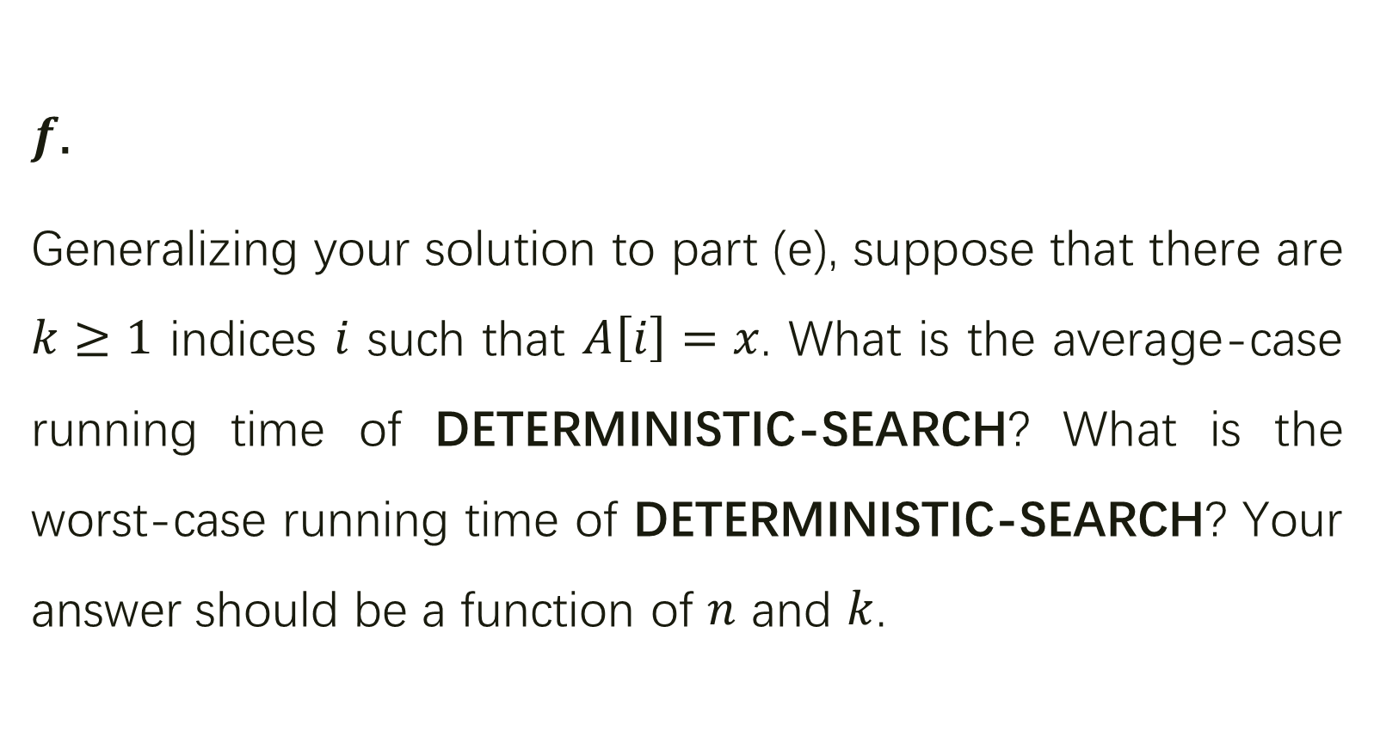
$f$.
Generalizing your solution to part (e), suppose that there are $k≥1$ indices $i$ such that $A\left[i\right]=x$. What is the average-case running time of DETERMINISTIC-SEARCH? What is the worst-case running time of DETERMINISTIC-SEARCH? Your answer should be a function of $n$ and $k$.

Slide 20

最坏情况：
$x$出现在$A\left[n−k+1\right],A\left[n−k+2\right]…A[n]$ ，
需要进行$n−k+1$次

Slide 21
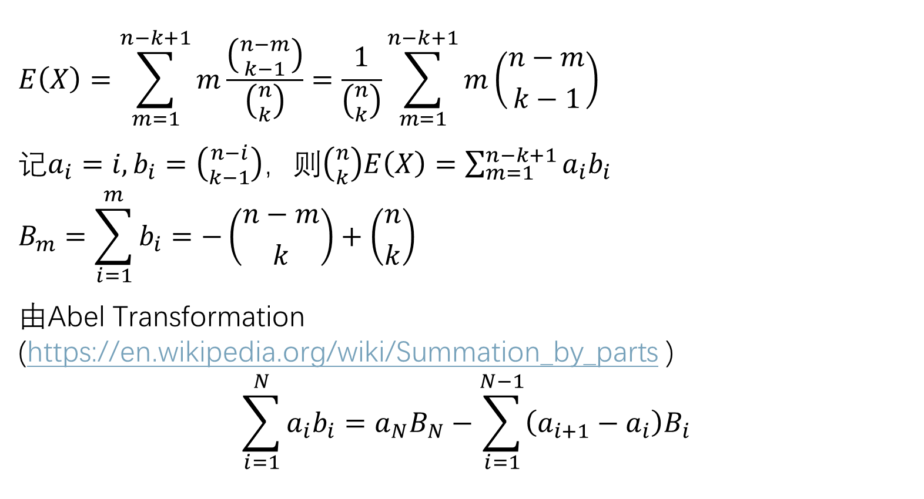
$$E\left(X\right)=\sum_{m=1}^{n−k+1}{m\frac{\left({n−m \atop k−1}\right)}{\left({n \atop k}\right)}}=\frac{1}{\left({n \atop k}\right)}\sum_{m=1}^{n−k+1}{m\left({n−m \atop k−1}\right)}$$
记$a_{i}=i, b_{i}=\left({n−i \atop k−1}\right)$，则$\left({n \atop k}\right)E\left(X\right)=\sum_{m=1}^{n−k+1}{a_{i}b_{i}}$
$$B_{m}=\sum_{i=1}^{m}{b_{i}}=−\left({n−m \atop k}\right)+\left({n \atop k}\right)$$
由Abel Transformation (https://en.wikipedia.org/wiki/Summation_by_parts )
$$\sum_{i=1}^{N}{a_{i}b_{i}}=a_{N}B_{N}−\sum_{i=1}^{N−1}{\left(a_{i+1}−a_{i}\right)B_{i}}$$
Notes:
总情况数即n项中选k项是x
操作m次就是第m项是x，后n-m项中选k-1项是x

Slide 22
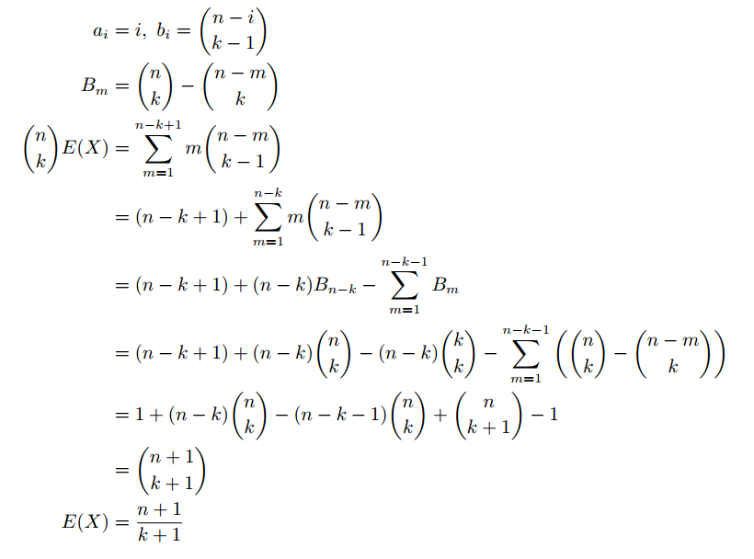

Slide 23
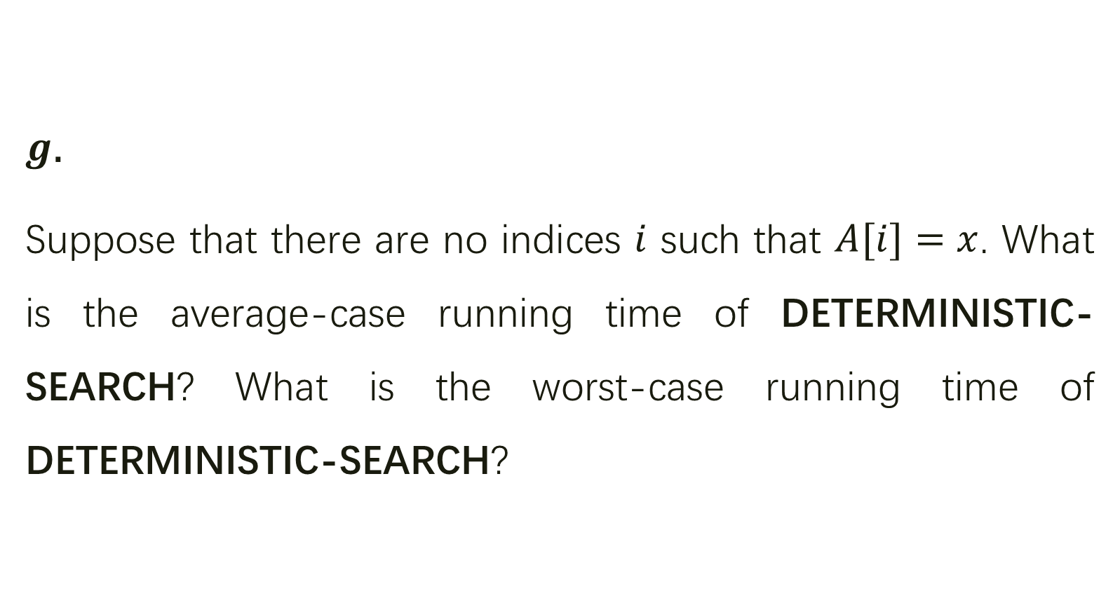
$g$.
Suppose that there are no indices $i$ such that $A[i]=x$. What is the average-case running time of DETERMINISTIC-SEARCH? What is the worst-case running time of DETERMINISTIC-SEARCH?

Slide 24

$A$中不含有$x$，所以终止的时候一定是查询到了$A[n]$
平均情况：
$n$
最坏情况：
$n$

Slide 25
SCRAMBLE-SEARCH
Notes:
随机与确定结合

Slide 26
Finally, consider a randomized algorithm SCRAMBLE-SEARCH that works by first randomly permuting the input array and then running the deterministic linear search given above on the resulting permuting array.

Slide 27
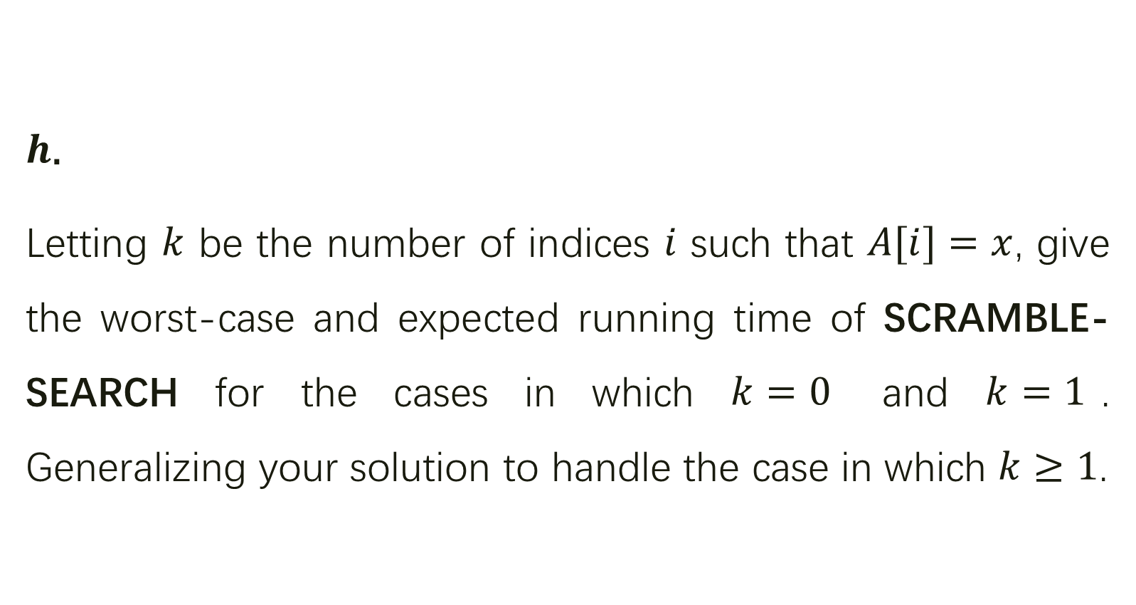
$h$.
Letting $k$ be the number of indices $i$ such that $A[i]=x$, give the worst-case and expected running time of SCRAMBLE-SEARCH for the cases in which $k=0$ and $k=1$. Generalizing your solution to handle the case in which $k≥1$.

Slide 28
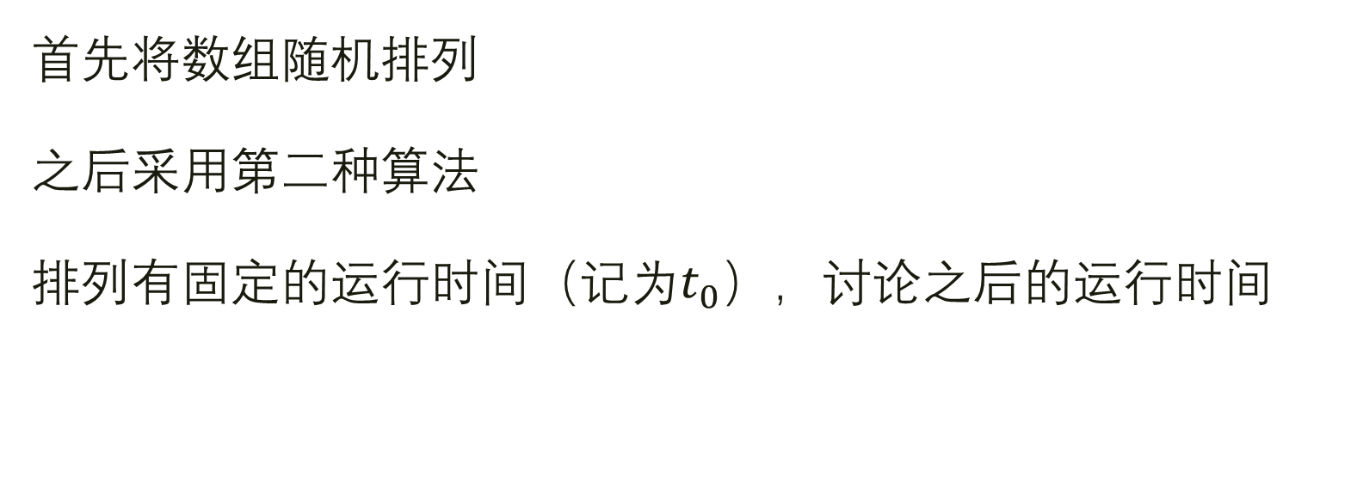
分析
首先将数组随机排列
之后采用第二种算法
排列有固定的运行时间（记为$t_{0}$），讨论之后的运行时间
Notes:
将数组随机排列，避免每次都出现最坏的情况

Slide 29

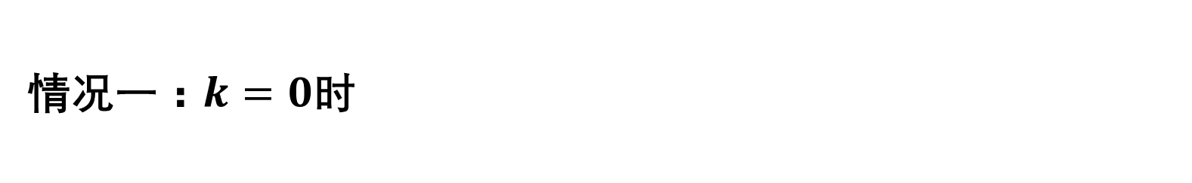
情况一：$k=0$时
不可能因为$A\left[i\right]=x$而停止，一定是到了$A[n]$停止
平均情况：
$n$
最坏情况：
$n$

Slide 30
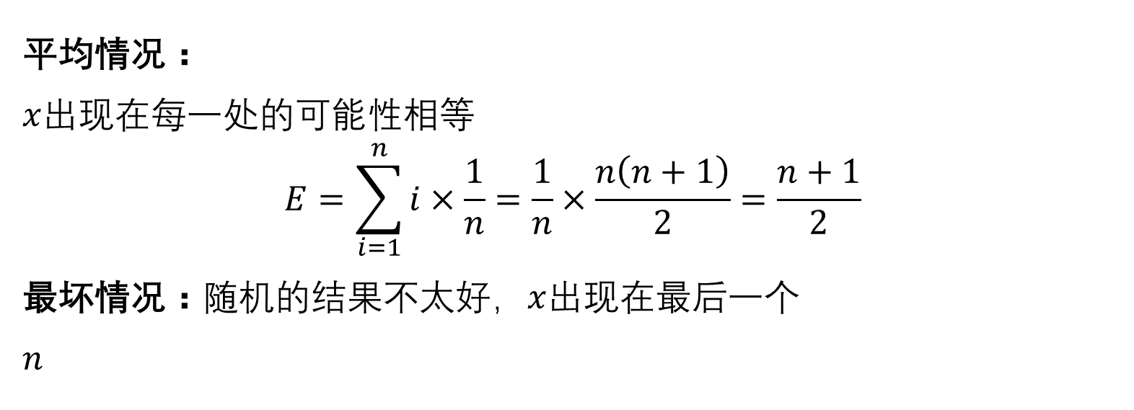
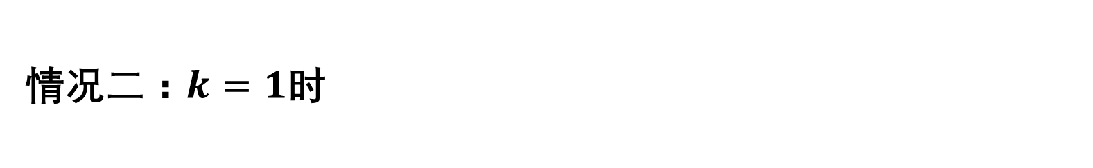
情况二：$k=1$时
平均情况：
$x$出现在每一处的可能性相等
$$E=\sum_{i=1}^{n}{i×\frac{1}{n}=\frac{1}{n}×\frac{n\left(n+1\right)}{2}=\frac{n+1}{2}}$$
最坏情况：随机的结果不太好，$x$出现在最后一个
$n$

Slide 31
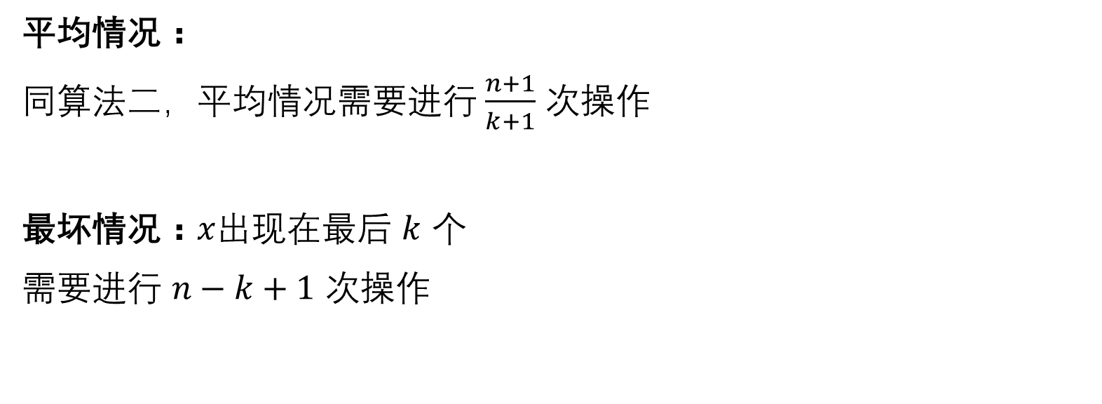
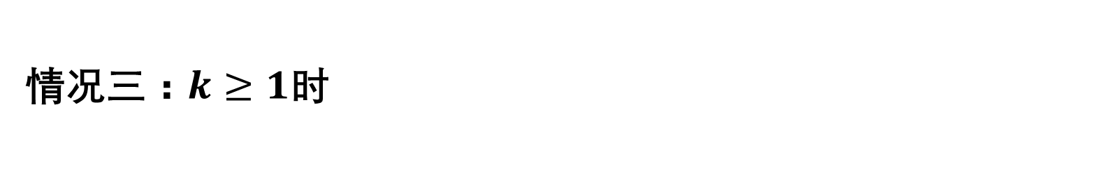
情况三：$k≥1$时
平均情况：
同算法二，平均情况需要进行 $\frac{n+1}{k+1}$ 次操作
最坏情况：$x$出现在最后 $k$ 个
需要进行 $n−k+1$ 次操作

Slide 32
COMPARE

Slide 33

$i$.
Which of the three searching algorithms would you use? Explain your answer.

Slide 34
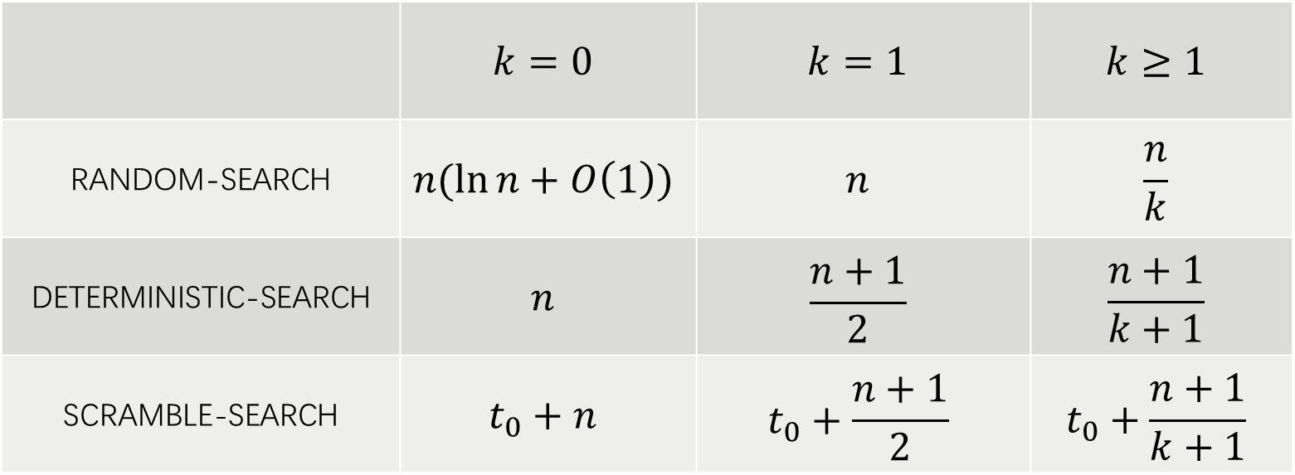
比较平均需要的时间
 | $$k=0$$ | $$k=1$$ | $$k≥1$$
RANDOM-SEARCH | $$n(\ln{n}+O\left(1\right))$$ | $$n$$ | $$\frac{n}{k}$$
DETERMINISTIC-SEARCH | $$n$$ | $$\frac{n+1}{2}$$ | $$\frac{n+1}{k+1}$$
SCRAMBLE-SEARCH | $$t_{0}+n$$ | $$t_{0}+\frac{n+1}{2}$$ | $$t_{0}+\frac{n+1}{k+1}$$
Notes:
平均时间来看，第二种算法最优

Slide 35
所以，第二种算法是最好的
吗？

Slide 36
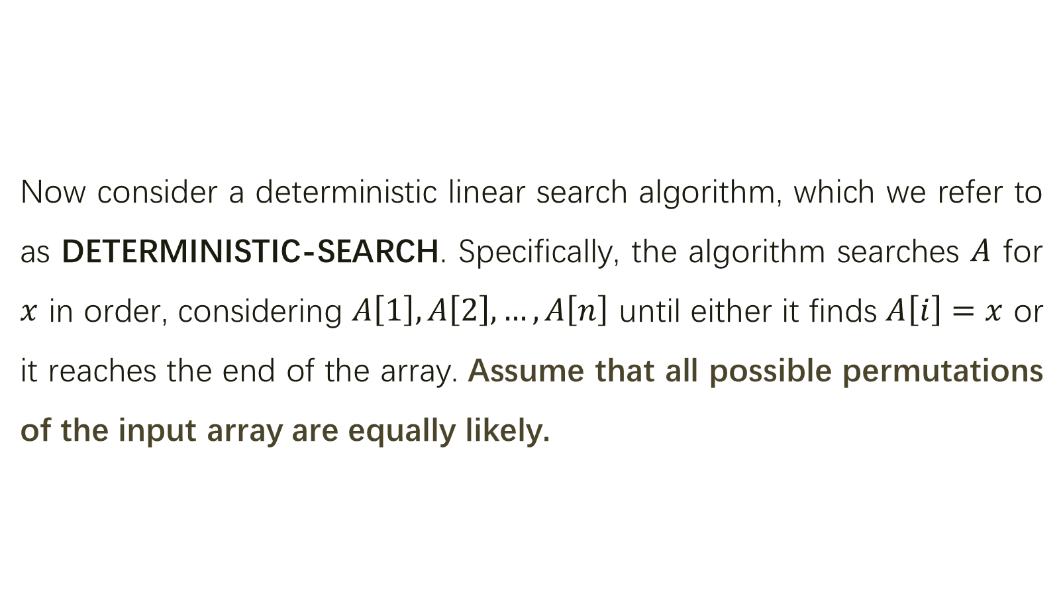
Now consider a deterministic linear search algorithm, which we refer to as DETERMINISTIC-SEARCH. Specifically, the algorithm searches $A$ for $x$ in order, considering $A\left[1\right],A\left[2\right],…,A\left[n\right]$ until either it finds $A\left[i\right]=x$ or it reaches the end of the array. Assume that all possible permutations of the input array are equally likely.
Notes:
如果没有这一假定，实际运用当中要考虑第二种最坏情况与平均情况的差、随机排列的开销。

Slide 37
谢谢大家！

