Slide 1
Stochastic Optimization for Kernel PCA
Lijun Zhang
Tianbao Yang
Jinfeng Yi
Rong Jin
Zhi-Hua Zhou
AAAI’ 16

Slide 2
Outline
Introduction
Motivation
Related Work
Algorithm
Reformulation of Kernel PCA
Optimization by Stochastic Proximal Gradient Descent
Analysis
Experiments
Conclusions

Slide 3
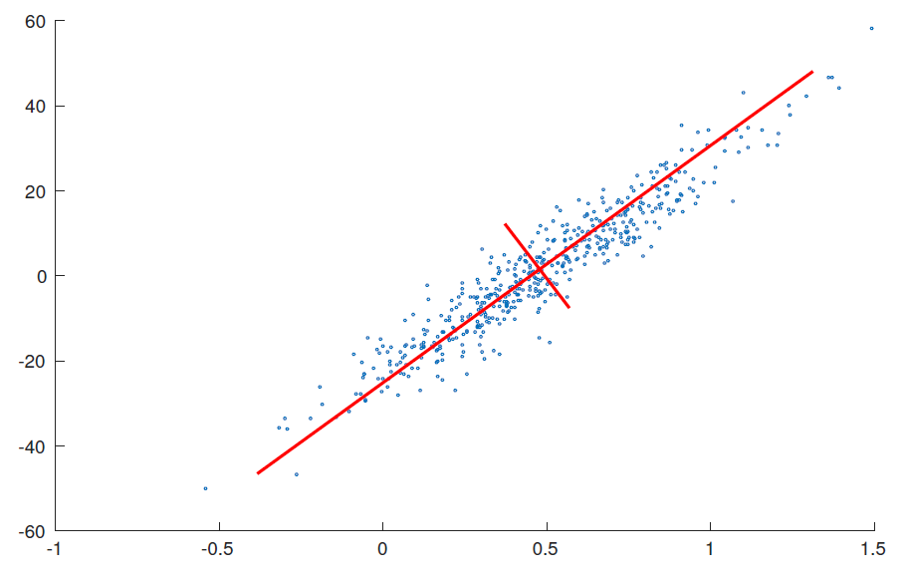

Principal Component Analysis
Maximize the variance after projection
$\max_{v}{v^{⊤}Cov\left(X\right)v} s.t. v^{⊤}v=1$

Slide 4
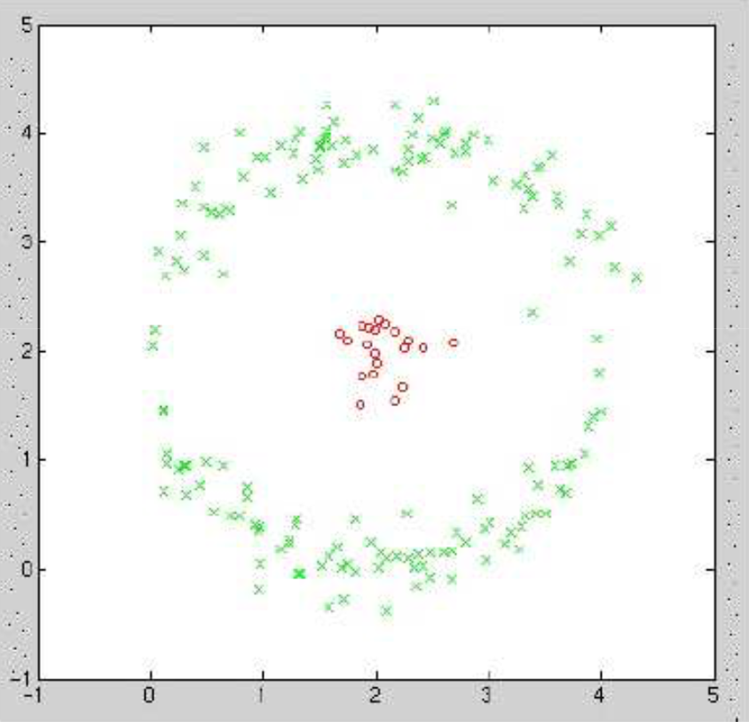
Kernel PCA
Classes linearly inseparable in the input space

Slide 5
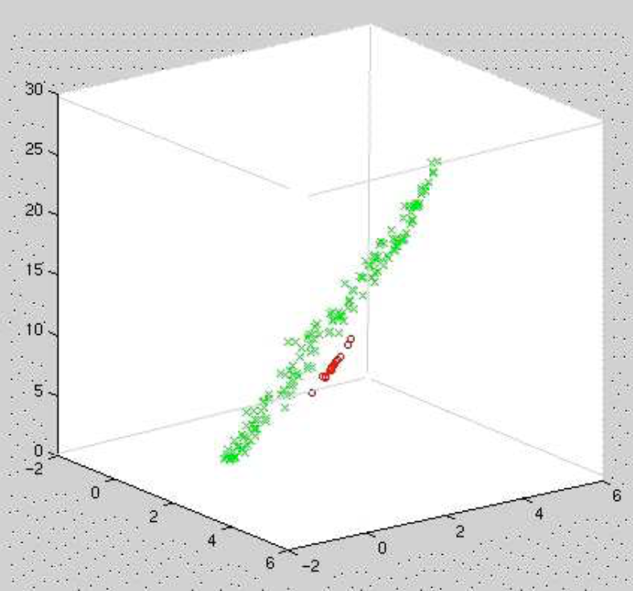

Kernel PCA
High-Dimensional Mapping (Linear separable)
$Φ: ℝ^{d}→ ℝ^{D}$

Slide 6
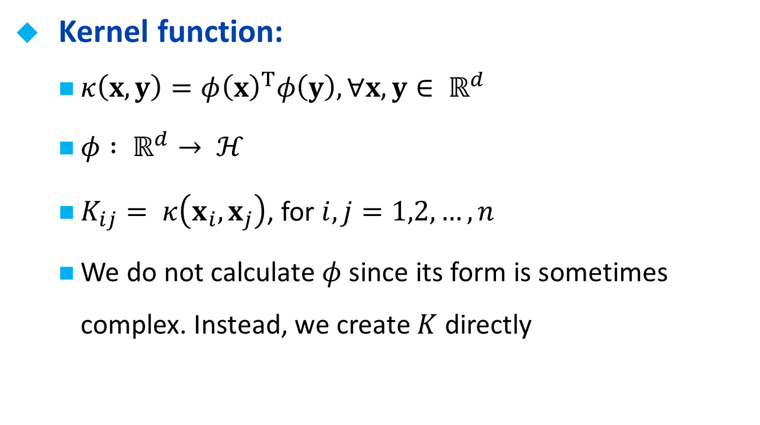
Kernel function
Kernel function:
$κ\left(x,y\right)=φ{\left(x\right)}^{T}φ\left(y\right), ∀x,y∈ ℝ^{d}$
$φ : ℝ^{d}→ ℋ$
$K_{ij}= κ\left(x_{i},x_{j}\right)$, for $i,j=1,2,…,n$
We do not calculate $φ$ since its form is sometimes complex. Instead, we create $K$ directly

Slide 7
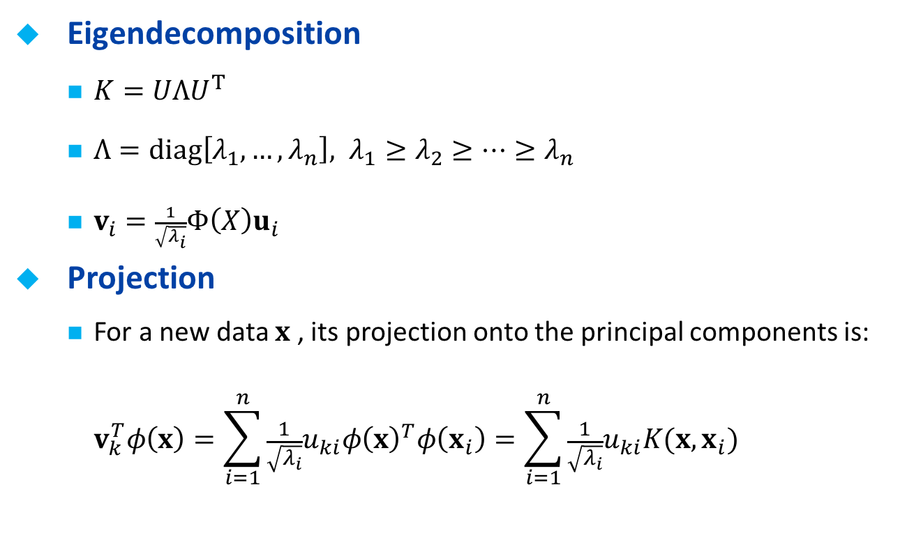
Kernel PCA
Eigendecomposition
$K=UΛU^{T}$
$Λ=diag\left[λ_{1},…,λ_{n}\right], λ_{1}≥λ_{2}≥⋯≥λ_{n}$
$v_{i}=\frac{1}{\sqrt{λ_{i}}}Φ\left(X\right)u_{i}$
Projection
For a new data $x$ , its projection onto the principal components is: $v_{k}^{T}φ\left(x\right)=\sum_{i=1}^{n}{{\frac{1}{\sqrt{λ_{i}}}u}_{ki}φ{\left(x\right)}^{T}φ\left(x_{i}\right)=\sum_{i=1}^{n}{{\frac{1}{\sqrt{λ_{i}}}u}_{ki}K(x,x_{i})}}$

Slide 8
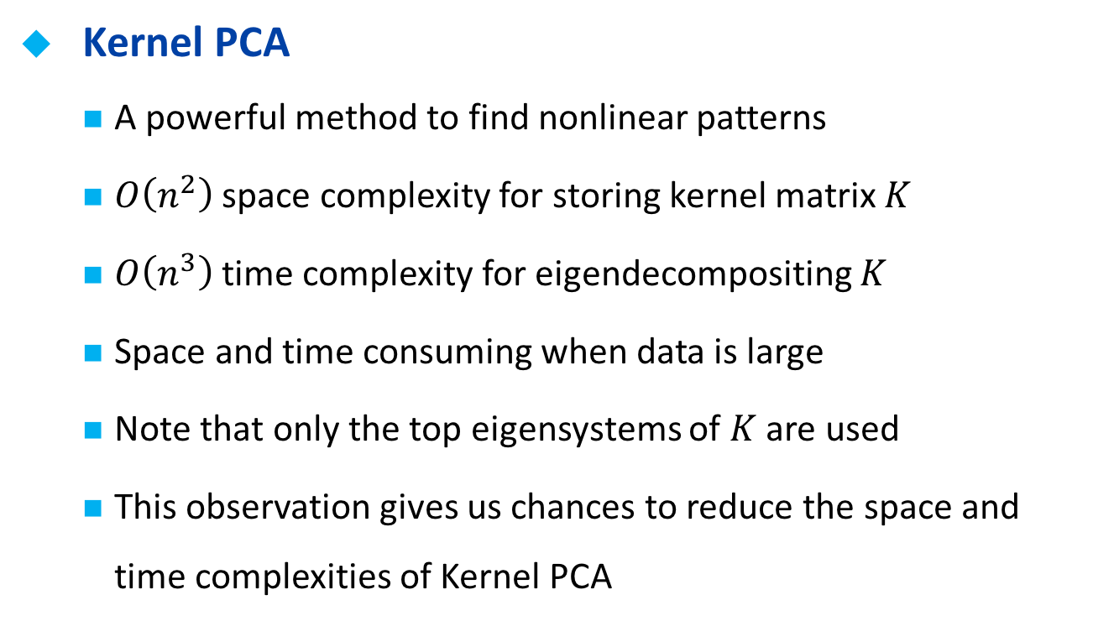
Motivation
Kernel PCA
A powerful method to find nonlinear patterns
$O\left(n^{2}\right)$ space complexity for storing kernel matrix $K$
$O\left(n^{3}\right)$ time complexity for eigendecompositing $K$
Space and time consuming when data is large
Note that only the top eigensystems of $K$ are used
This observation gives us chances to reduce the space and time complexities of Kernel PCA

Slide 9
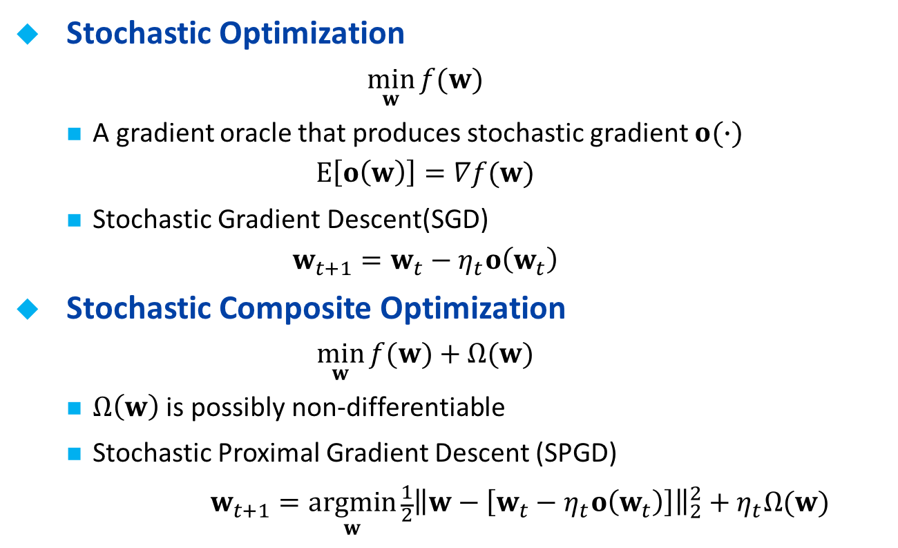
Stochastic Optimization
Stochastic Optimization
$$\min_{w}{f(w)}$$
A gradient oracle that produces stochastic gradient $o(∙)$
$$E\left[o\left(w\right)\right]=∇f(w)$$
Stochastic Gradient Descent(SGD)
$$w_{t+1}=w_{t}−η_{t}o\left(w_{t}\right)$$
Stochastic Composite Optimization
$$\min_{w}{f(w)}+Ω(w)$$
$Ω\left(w\right)$ is possibly non-differentiable
Stochastic Proximal Gradient Descent (SPGD)
$$w_{t+1}=\underset{w}{argmin}{{\frac{1}{2}\left\|w−\left[w_{t}−η_{t}o\left(w_{t}\right)\right]\right\|}_{2}^{2}+η_{t}Ω(w) }$$

Slide 10
Outline
Introduction
Motivation
Related Work
Algorithm
Reformulation of Kernel PCA
Optimization by Stochastic Proximal Gradient Descent
Analysis
Experiments
Conclusions

Slide 11


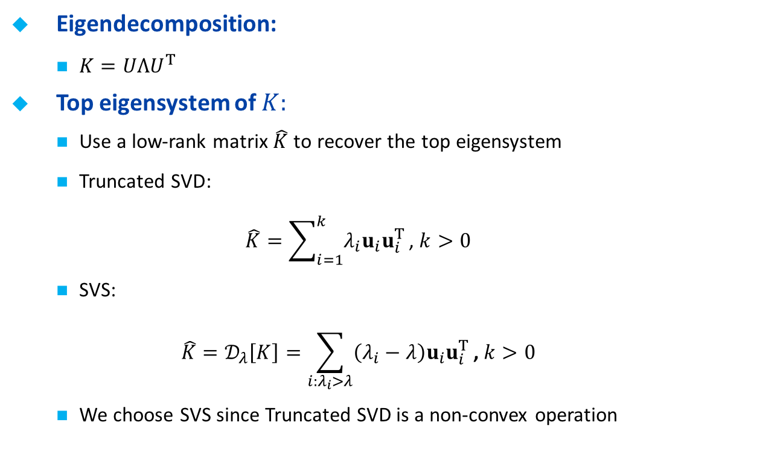
Reformulation
Eigendecomposition:
$K=UΛU^{T}$
Top eigensystem of $K:$
Use a low-rank matrix $\hat{K}$ to recover the top eigensystem
Truncated SVD: $\hat{K}=\sum_{i=1}^{k}{λ_{i}u_{i}u_{i}^{T}}\text{,} k>0$
SVS: $\hat{K}=𝒟_{λ}\left[K\right]=\sum_{i:λ_{i}>λ}{\left(λ_{i}−λ\right)u_{i}u_{i}^{T}}\text{,} k>0$
We choose SVS since Truncated SVD is a non-convex operation
Notes:
SVD非凸

Slide 12
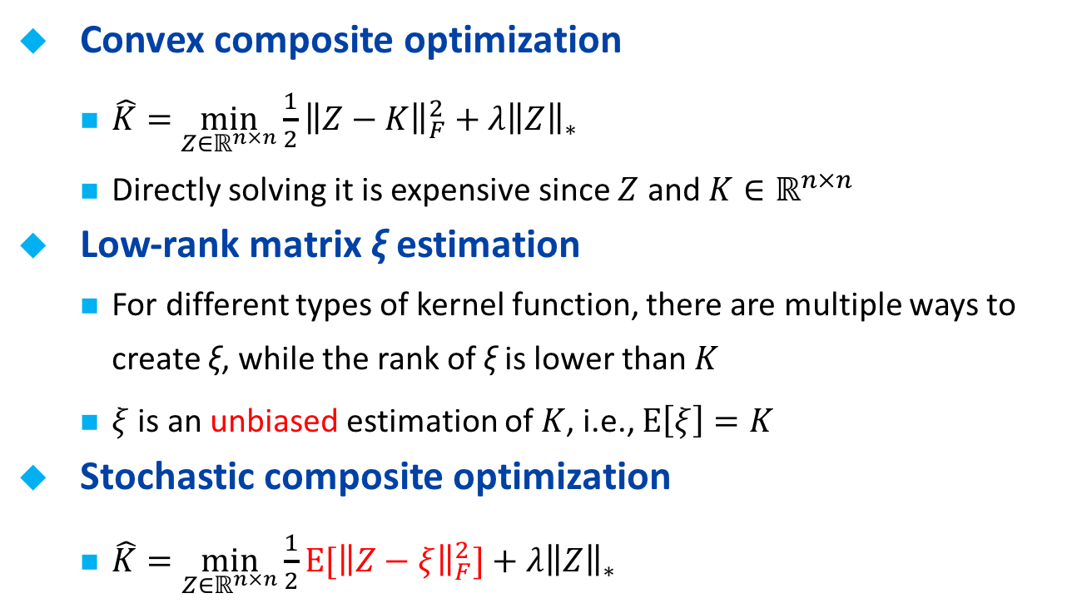
Reformulation
Convex composite optimization
$\hat{K}=$ $\min_{Z∈ℝ^{n×n}}{\frac{1}{2}{\left\|Z−K\right\|}_{F}^{2}+λ{\left\|Z\right\|}_{∗}}$
Directly solving it is expensive since $Z$ and $K∈ℝ^{n×n}$
Low-rank matrix ξ estimation
For different types of kernel function, there are multiple ways to create ξ, while the rank of ξ is lower than $K$
$ξ$ is an unbiased estimation of $K$, i.e., $E\left[ξ\right]=K$
Stochastic composite optimization
$\hat{K}=\min_{Z∈ℝ^{n×n}}{\frac{1}{2}{E[\left\|Z−ξ\right\|}_{F}^{2}]+λ{\left\|Z\right\|}_{∗}}$

Slide 13
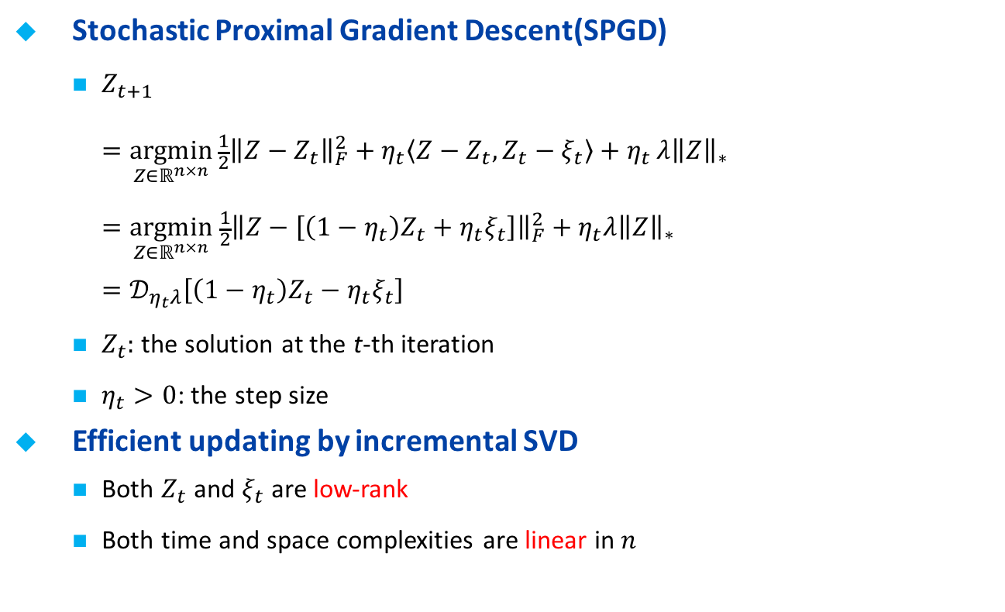
Algorithm
Stochastic Proximal Gradient Descent(SPGD)
$Z_{t+1}$ $=\underset{Z∈ℝ^{n×n}}{argmin}{\frac{1}{2}{\left\|Z−Z_{t}\right\|}_{F}^{2}+η_{t}\left\langle Z−Z_{t},Z_{t}−ξ_{t}\right\rangle +η_{t}}λ{\left\|Z\right\|}_{∗}$ $=\underset{Z∈ℝ^{n×n}}{argmin} \frac{1}{2}{\left\|Z−\left[\left(1−η_{t}\right)Z_{t}+η_{t}ξ_{t}\right]\right\|}_{F}^{2}+η_{t}λ{\left\|Z\right\|}_{∗}$ $=𝒟_{η_{t}λ}\left[\left(1−η_{t}\right)Z_{t}−η_{t}ξ_{t}\right]$
$Z_{t}:$ the solution at the t-th iteration
$η_{t}>0$: the step size
Efficient updating by incremental SVD
Both $Z_{t}$ and $ξ_{t}$ are low-rank
Both time and space complexities are linear in $n$

Slide 14
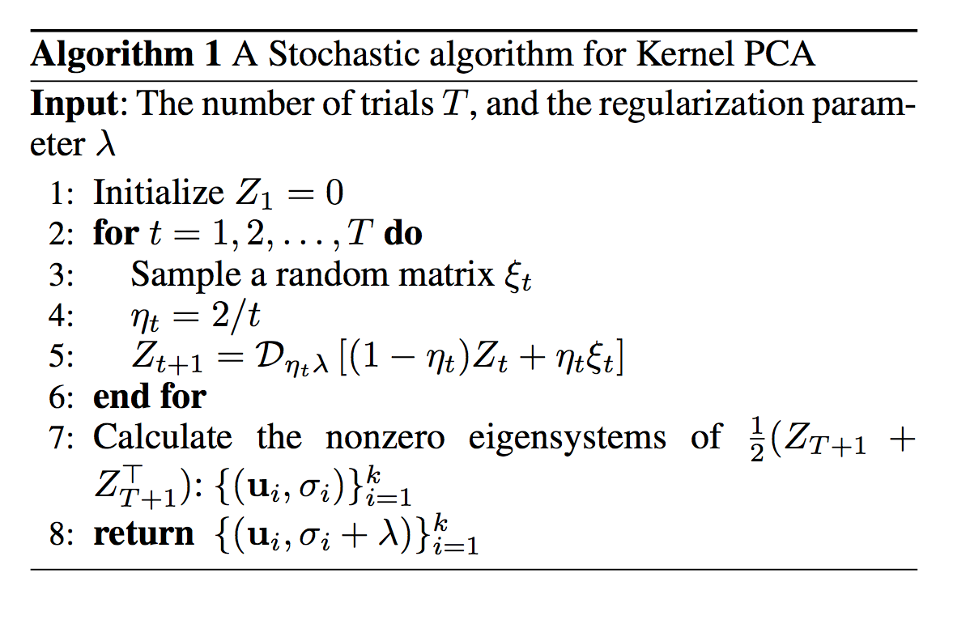
Algorithm

Slide 15
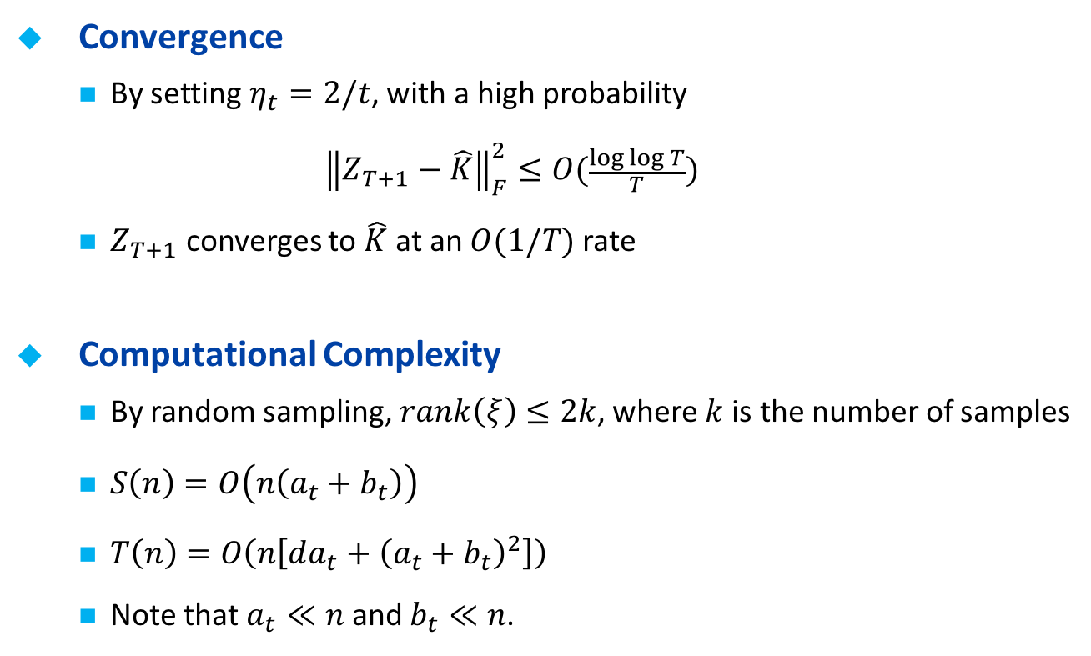
Analysis
Convergence
By setting $η_{t}=2/t$, with a high probability
$${\left\|Z_{T+1}−\hat{K}\right\|}_{F}^{2}≤O(\frac{log log T}{T})$$
$Z_{T+1}$ converges to $\hat{K}$ at an $O(1/T)$ rate
Computational Complexity
By random sampling, $rank\left(ξ\right)≤2k$, where $k$ is the number of samples
$S\left(n\right)=O\left(n\left(a_{t}+b_{t}\right)\right)$
$T\left(n\right)=O\left(n\left[da_{t}+{\left(a_{t}+b_{t}\right)}^{2}\right]\right)$
Note that $a_{t}≪n$ and $b_{t}≪n$.

Slide 16
Outline
Introduction
Motivation
Related Work
Algorithm
Reformulation of Kernel PCA
Optimization by Stochastic Proximal Gradient Descent
Analysis
Experiments
Conclusions

Slide 17
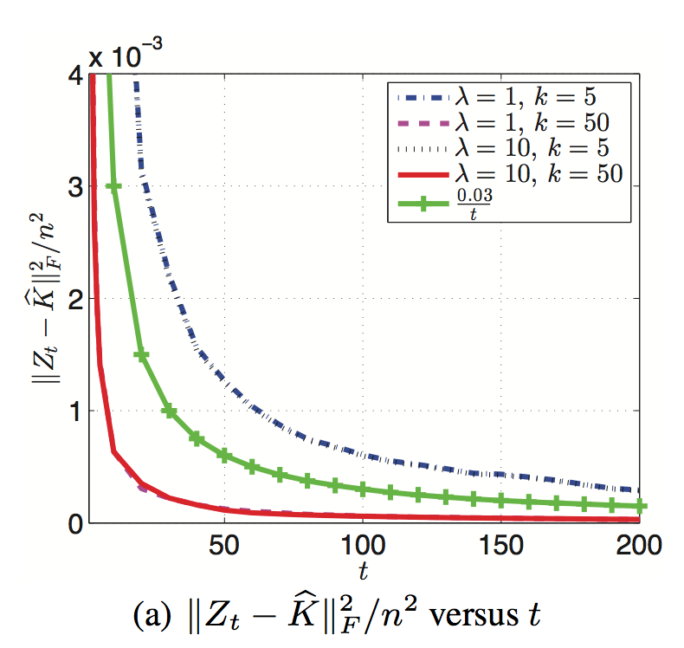
Experiments

Slide 18
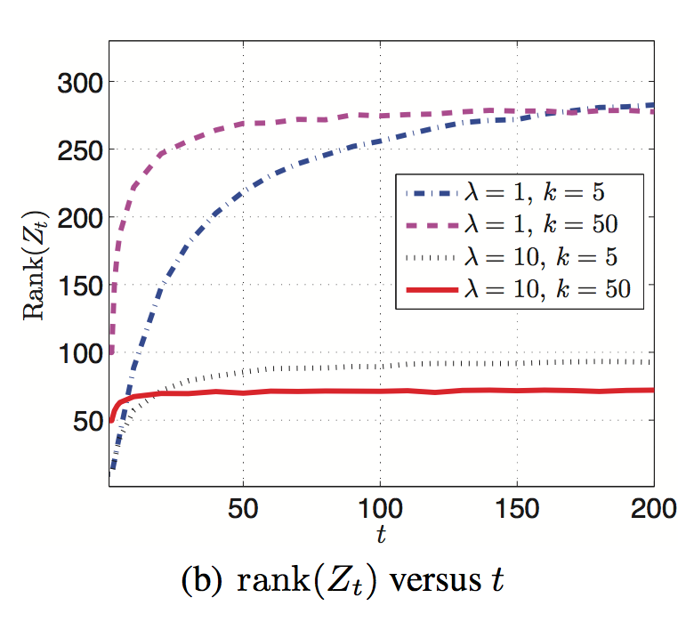
Experiments

Slide 19
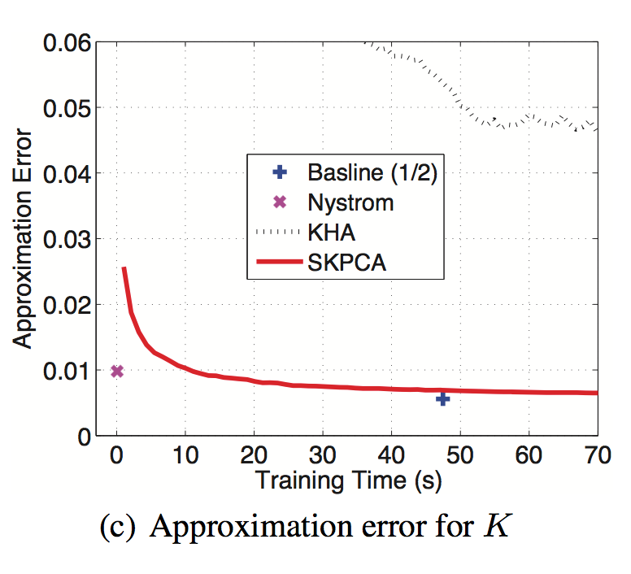
Experiments

Slide 20
Outline
Introduction
Motivation
Related Work
Algorithm
Reformulation of Kernel PCA
Optimization by Stochastic Proximal Gradient Descent
Analysis
Experiments
Conclusions

Slide 21
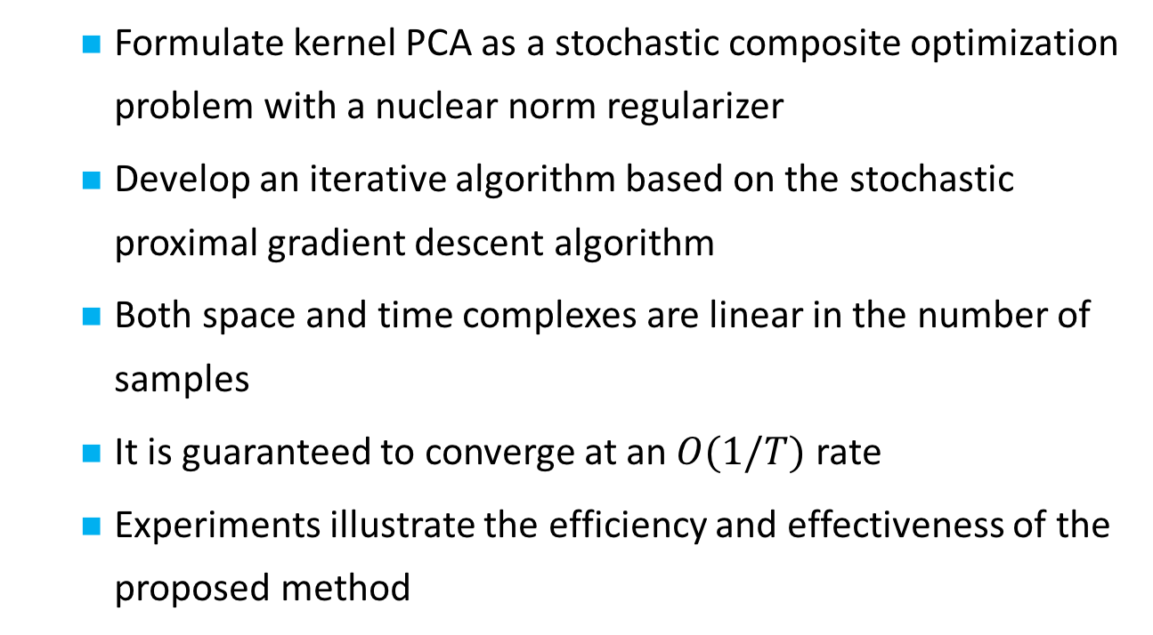
Conclusion
Formulate kernel PCA as a stochastic composite optimization problem with a nuclear norm regularizer
Develop an iterative algorithm based on the stochastic proximal gradient descent algorithm
Both space and time complexes are linear in the number of samples
It is guaranteed to converge at an $O(1/T)$ rate
Experiments illustrate the efficiency and effectiveness of the proposed method

Slide 22
Thank you!

