Slide 1
Functions
Lecture 5

Slide 2
Functions
A function is a block of code with a name.
We execute the code by calling the function.
A function may take zero or more arguments and (usually) yields a result.
int fact (int v) {
int ret = 1;
while (v > 1) ret *= v--;
return ret;
}

Slide 3
Parameters 形式参数 & arguments 实际参数
parameter
argument
int fact (int v) {
int ret = 1;
while (v > 1) ret *= v--;
return ret;
}
int main ( ) {
int a = 6;
cout << fact(a) << endl;
cout << fact(7) << endl;
return 0;
}

Slide 4
Calling a function
Initializes the function’s parameters from the corresponding arguments.
Transfers control to the function.
Execution of the calling function is suspended and execution of the called function begins.

Slide 5
Function declaration
A function declaration is like a function definition expect that a declaration has no function body (replaced by a semicolon).

Slide 6
Function declaration
// declaration of fact( )
int fact (int v);
int fact (int v) {
int ret = 1;
while (v > 1) ret *= v--;
return ret;
}
int main ( ) {
cout << fact(7) << endl;
return 0;
}
int fact (int v) {
int ret = 1;
while (v > 1) ret *= v--;
return ret;
}
int main ( ) {
cout << fact(7) << endl;
return 0;
}
Ok.
Ok.

Slide 7
Separate compilation
#ifndef FACT_H_
#define FACT_H_
int fact (int v);
#endif
Fact.h
#include <iostream>
#include “Fact.h”
using namespace std;
int main ( ) {
cout << fact(7) << endl;
return 0;
}
int fact (int v) {
int ret = 1;
while (v > 1) ret *= v--;
return ret;
}
Fact.cpp
Main.cpp

Slide 8
Write a makefile to compile multiple source files.
all: run_fact
run_fact: Fact.o Main.o
g++ Fact.o Main.o -o run_fact
Fact.o: Fact.cpp
g++ -O3 -Wall -c Fact.cpp -o Fact.o
Main.o: Main.cpp
g++ -O3 -Wall -c Main.cpp -o Main.o
clean:
rm -f *.o
makefile

Slide 9
Write a makefile to compile multiple source files.
$ make all
g++ -O3 -Wall -c Fact.cpp -o Fact.o
g++ -O3 -Wall -c Main.cpp -o Main.o
g++ Fact.o Main.o -o run_fact
$ ./run_fact
5040
$ make clean
rm -f *.o
Tested on macOS High Sierra ver. 10.13.6 with 3.1 GHz Intel Core i7 [Oct 24, 2018]

Slide 10
Argument passing
The function’s parameters are initialized from the corresponding arguments.
Parameter initialization works the same way as variable initialization.
1. Passing by value
n (int)
int v = n;
ret (int)
r (int)
int fact(int v);
int r = fact(n);
fact

Slide 11
Argument passing
What if the argument is a large, complex data object?
Copying the entire graph. Very time-consuming.
int diameter(Graph g);
Graph gr;
int d = diameter(gr);
gr (Graph)
Graph g(gr);
ret (int)
d (int)
diameter

Slide 12
Argument passing
Pointer parameters / arguments
gr (Graph)
int diameter(Graph *g);
Graph gr;
Graph *p = &gr;
int d = diameter(p);
Graph *g = p;
ret (int)
d (int)
p (Graph*)
diameter

Slide 13
Argument passing
回忆：数组名 / 指向数组首元素的指针
Passing an array
数组长度
double average(int *arr, int n);
int a[ ] = {0, 1, 1, 2, 3, 5, 8, 13, 21};
double v1 = average(a, 9);
int b[ ] = {0, 1, 2, 3, 4, 5, 6};
double v2 = average(b, 7);

Slide 14
Argument passing
2. Passing by reference
形式参数被初始化为实际参数的别名。
int diameter(const Graph &g);
gr (Graph)
ret (int)
d (int)
Graph gr;
int d = diameter(gr);
const Graph &g = gr;
diameter

Slide 15
Argument passing
Reference parameters that are not changed inside a function should be references to const.
int diameter(const Graph &g);
以下函数声明暗示着Graph对象g会在函数中被改变，尽管在实际实现时g完全可以保持不变。
int diameter(Graph &g);

Slide 16
Return types
Most types can be used as the return type of a function.
In particular, the return type can be void, which means that the function does not return a value.
The return value is used to initialize a temporary at the call site, and that temporary is the result of the function call.
int fact(int v);
int diameter(const Graph &g);
void append(vector<int> &vec, int n);

Slide 17
Return types
MyInt getMyInt(int n) {
MyInt obj(n);
return obj;
};
What if the return type is complex?
struct MyInt {
int n;
MyInt(int v): n(v) { }
MyInt(const MyInt &obj): n(obj.n) {
cout << “copy.\n”;
}
};
int main( ) {
MyInt obj = getMyInt(4);
cout << obj.n << endl;
return 0;
};

Slide 18
Return types
MyInt getMyObject(int n) {
MyInt obj(n);
return obj;
};
What if the return type is complex?
$ g++ -c Main.cpp -o Main.o
$ g++ Main.o -o rvo
$ ./rvo
4
int main( ) {
MyInt obj = getMyInt(4);
cout << obj.n << endl;
return 0;
};
Tested on macOS High Sierra ver. 10.13.6 with GCC ver. 4.2.1 [Oct 24, 2018]

Slide 19
Return types
MyInt getMyInt(int n) {
MyInt obj(n);
return obj;
};
What if the return type is complex?
1st copy
$ g++ -c Main.cpp -o Main.o -fno-elide-constructors
$ g++ Main.o -o rvo
$ ./rvo
copy.
copy.
4
2nd copy
int main( ) {
MyInt obj = getMyInt(4);
cout << obj.n << endl;
return 0;
};
Tested on macOS High Sierra ver. 10.13.6 with GCC ver. 4.2.1 [Oct 24, 2018]

Slide 20
Copy elision & RVO return value optimization
Copy elision是旨在省略不必要的对象复制的一种编译器优化技术。
Return value optimization（RVO）是一种编译器优化技术，它旨在省略用于保存函数返回值的临时对象。
MyInt* getMyInt(int n, MyInt *_r) {
MyInt obj(n);
*_r = obj;
return _r;
};
MyInt getMyInt(int n) {
MyInt obj(n);
return obj;
};
compiler

Slide 21
Return types
建议不要过度依赖编译器优化。
使用非常量引用参数来接收函数的实际计算结果；保留函数返回值用于指示函数的执行过程中是否存在异常。
int getMyInt(int n, MyInt &obj);

Slide 22
Return types
int& add(int &a, int b) {
a += b;
return a;
}
int main( ) {
int a = 3;
add(a, 4) += 5;
cout << a;
return 0;
}
可以返回指针或引用。

Slide 23
Return types
不可以返回指向局部变量的指针或绑定局部变量的引用。
int& func(int n) {
int a = 5;
int &r = a;
r += n;
return r;
}
warning: reference to stack memory associated with local variable 'a' returned
cout << func(4);
-350296528
Tested on macOS High Sierra ver. 10.13.6 with GCC ver. 4.2.1 [Oct 24, 2018]

Slide 24
Throwing exceptions
int fact (int v) throw (int) {
if (v < 0) throw -1;
if (v > 12) throw 1;
int ret = 1;
while (v > 1) ret *= v--;
return ret;
}
int main ( ) {
try {
cout << fact(20) << endl;
} catch (int e) {
if (e == -1) cout << “error type 1.\n”;
else if (e == 1) cout << “error type 2.\n”;
else cout << “unknown error.\n”;
}
return 0;
}
error type 2.

Slide 25
Exceptions vs error code
C++有包括抛出异常、捕获异常在内的一整套异常处理机制。
这套机制不太好用。
利用函数返回值返回错误代码是常用做法。

Slide 26
Overloaded functions
Functions that have the same name but different parameter lists and that appear in the same scope are overloaded.
void print (const char *cp);
void print (const int *beg, const int *end);
void print (const int ia[ ], size_t size);

Slide 27
Function matching
int ia[7] = {0, 1, 1, 2, 3, 5, 8};
void print (const char *cp);
void print (const int *beg, const int *end);
void print (const int ia[ ], size_t size);
print (ia, 5);
print (ia, ia + 4);
print (“Hello”);

Slide 28
Overloading and const parameters
int func (int n);
int func (const int n);
// error: redefinition of ‘func’
实际上第二个函数的const没什么意义

Slide 29
Overloading and const parameters
int func (int &n) {
cout << "func1.\n";
n *= 2;
return n;
}
int func (const int &n) {
cout << "func2.\n";
return n;
}
int main() {
int a = 4;
const int b = 6;
cout << func(a) << endl;
cout << func(b) << endl;
return 0;
}
func1.
8
func2.
6
按照constness做精确匹配
Tested on macOS High Sierra ver. 10.13.6 with GCC ver. 4.2.1 [Oct 24, 2018]

Slide 30
Overloading and const parameters
int main() {
int a = 4;
const int b = 6;
cout << func(a) << endl;
cout << func(b) << endl;
return 0;
}
func2.
4
func2.
6
int func (const int &n) {
cout << "func2.\n";
return n;
}
对变量a做了const conversion，然后再匹配
Tested on macOS High Sierra ver. 10.13.6 with GCC ver. 4.2.1 [Oct 24, 2018]

Slide 31
Overloading and const parameters
int main() {
int a = 4;
const int b = 6;
cout << func(a) << endl;
cout << func(b) << endl;
return 0;
}
int func (int &n) {
cout << "func1.\n";
n *= 2;
return n;
}
error: no matching function for call to ‘func’
Tested on macOS High Sierra ver. 10.13.6 with GCC ver. 4.2.1 [Oct 24, 2018]

Slide 32
Pointers to functions
写一个函数，根据用户指定的比较方法对二维空间中的点进行排序。
bool x_less (const Point &a, const Point &b);
bool y_less (const Point &a, const Point &b);
void mySort (
vector<Point> &points,
bool (*p) (const Point &, const Point &)
) {
// 用(*p)(a, b)来比较两个点a和b
}

Slide 33
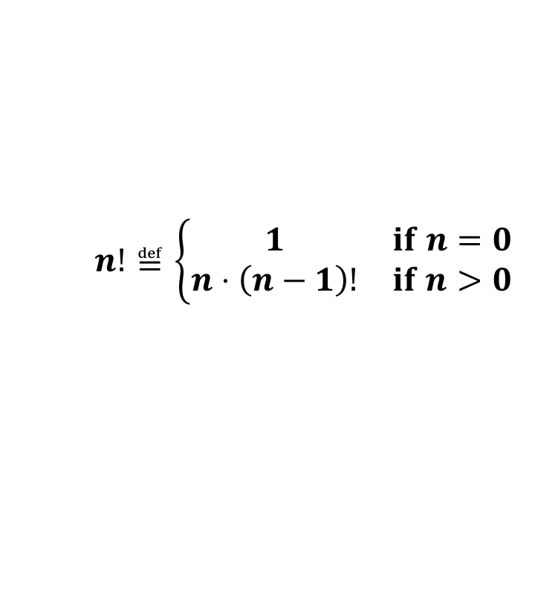

Recursion
A function that calls itself, either directly or indirectly, is a recursive function.
int fact (int n) {
if (n == 0) return 1;
return n * fact(n-1);
}
$$n!≝n⋅\left(n−1\right)⋅\left(n−2\right)⋅⋯⋅2⋅1$$
$$n!≝\left\{\begin{matrix}1 & if n=0 \\ n⋅\left(n−1\right)! & if n>0\end{matrix}\right.$$
必须有终止条件判断，否则会无限递归。

Slide 34
Function comment block
作为programmer，当我们使用一个已有function的时候，我们不希望关心它的实现细节。
作为programmer，当我们使用一个已有function的时候，我们需要了解它的实现细节。

Slide 35
Function comment block
/**
* Computes the factorial of a given number.
* Input: integer n
* Requirement: n >= 0 and n <= 12
* Output: n!
* Algorithm: recursion.
*/
int fact (int n);

Slide 36
Function comment block
/**
* Sorts a vector of points based on a user-specified comparator.
* Input: points, a vector of points;
* p, a pointer to a comparator function
* Output: points, sorted according to the specified comparator
* Complexity: O(nlogn), where n is the number of points
*/
void mySort (vector<Point> &points, bool (*p)(const Point&, const Point&));

Slide 37
Next lecture
C++ Primer, Chapter 7

