Slide 1
Searching an Unsorted Array CLRS Exercise 5.2, Page 143
Xu Zhiming

Slide 2
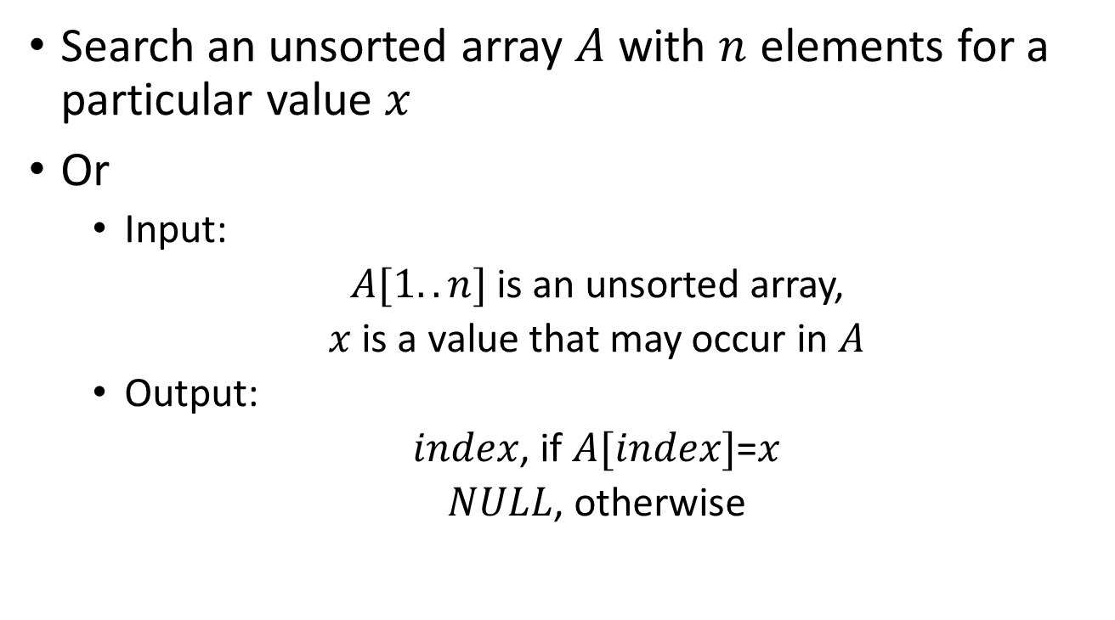
Description
Search an unsorted array $A$ with $n$ elements for a particular value $x$
Or
Input:
$A[1..n]$ is an unsorted array,
$x$ is a value that may occur in $A$
Output:
$index$, if $A[index]$=$x$
$NULL$, otherwise

Slide 3
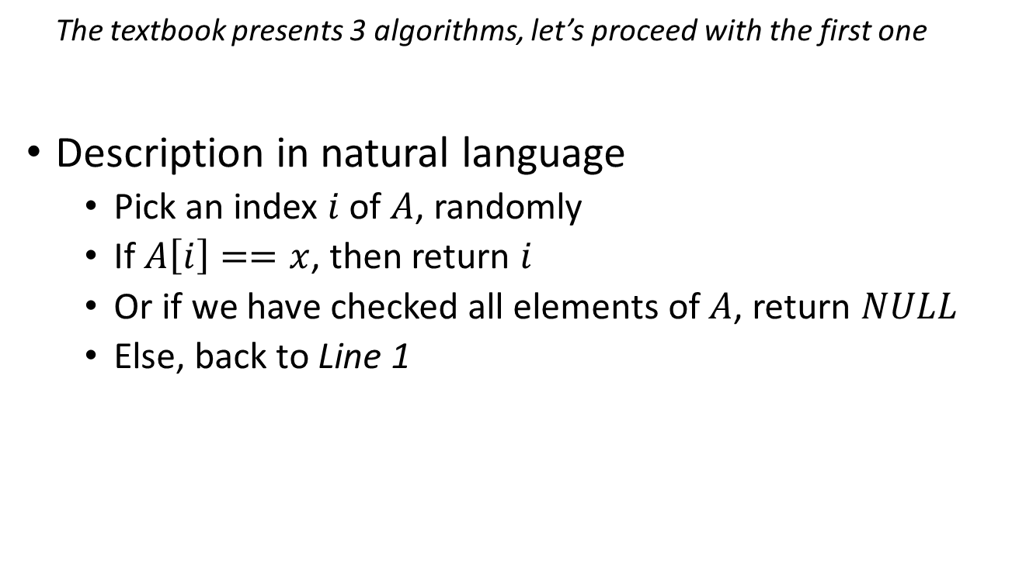
Algorithms: RANDOM-SEARCH
The textbook presents 3 algorithms, let’s proceed with the first one
Description in natural language
Pick an index $i$ of $A$, randomly
If $A\left[i\right]==x$, then return $i$
Or if we have checked all elements of $A$, return $NULL$
Else, back to Line 1

Slide 4
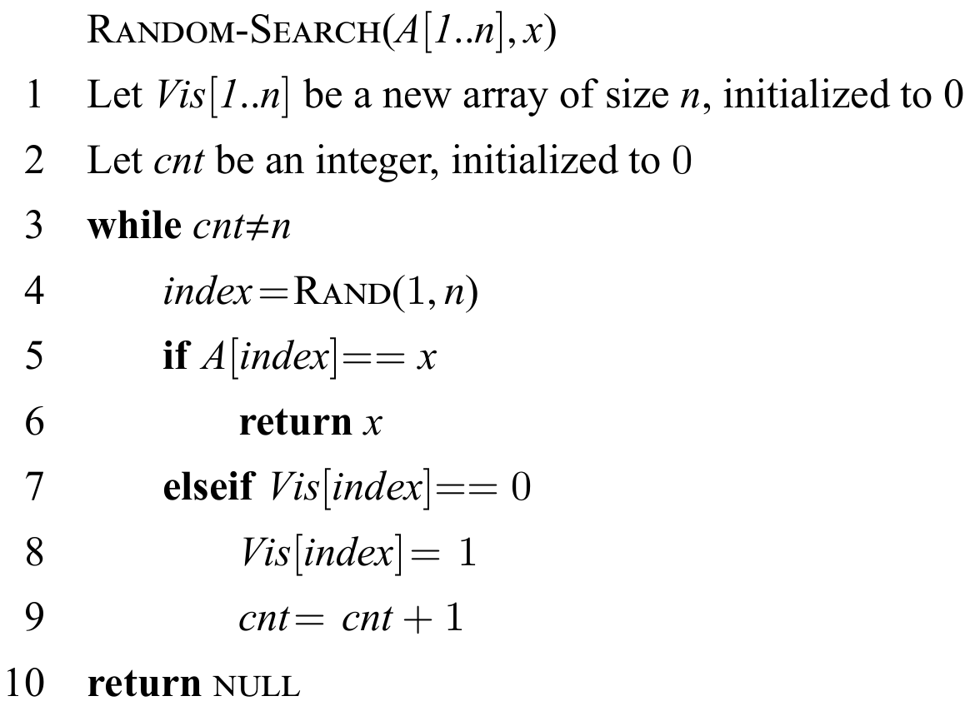
Algorithms: Random Search
Pseudocode (a)

Slide 5
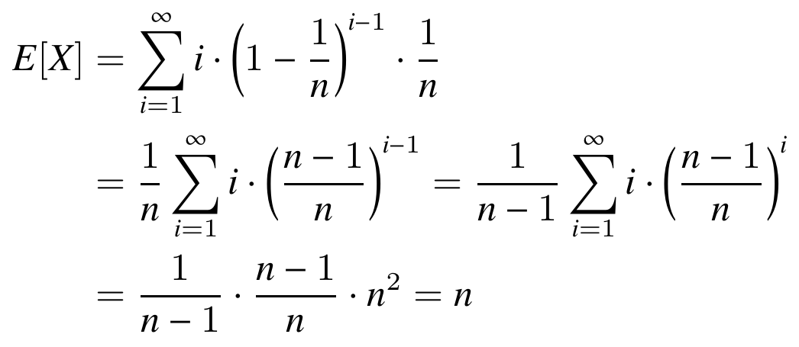
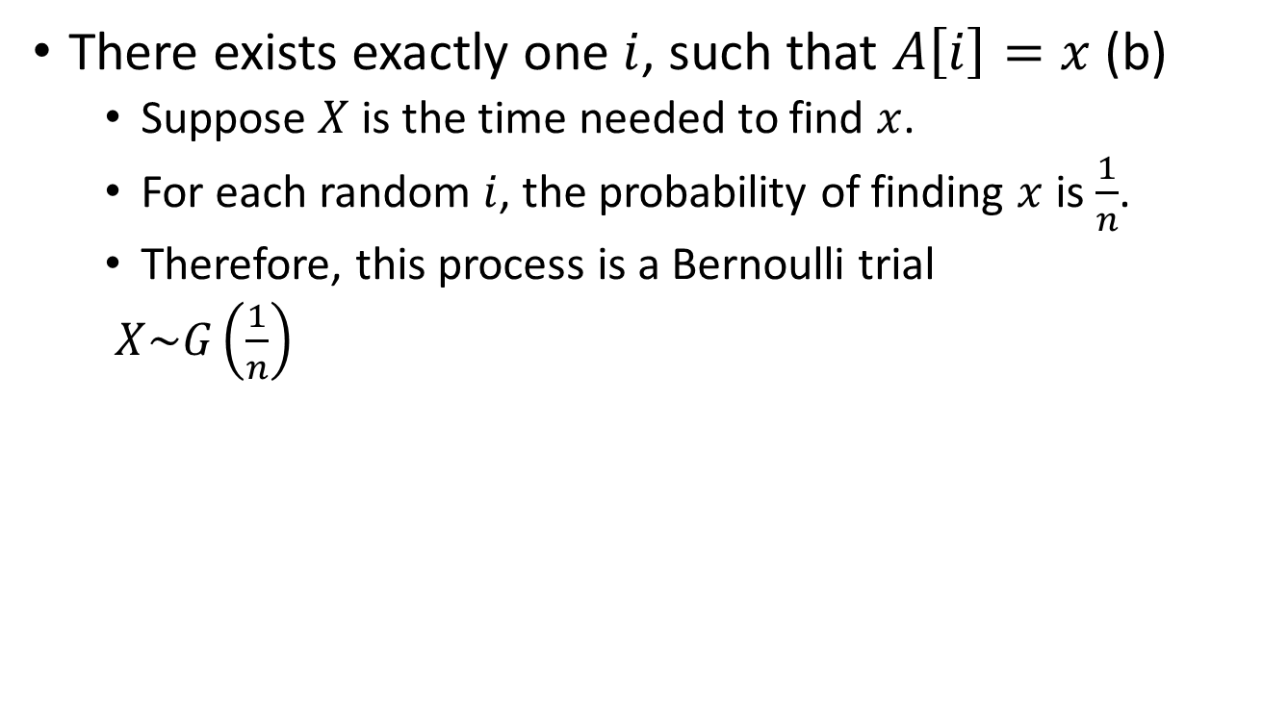
Analysis
There exists exactly one $i$, such that $A\left[i\right]=x$ (b)
Suppose $X$ is the time needed to find $x$.
For each random $i$, the probability of finding $x$ is $\frac{1}{n}$.
Therefore, this process is a Bernoulli trial
$X\sim G\left(\frac{1}{n}\right)$

Slide 6
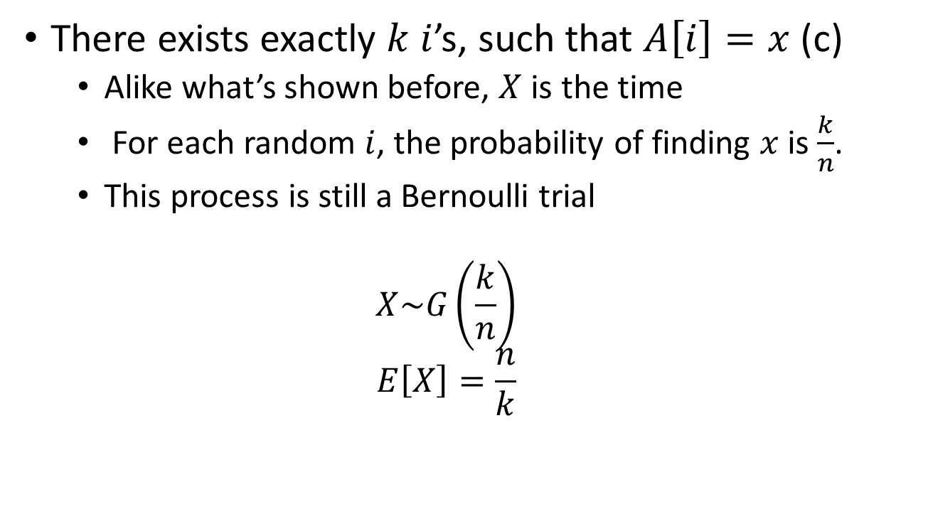
Analysis
There exists exactly $k$ $i$’s, such that $A\left[i\right]=x$ (c)
Alike what’s shown before, $X$ is the time
For each random $i$, the probability of finding $x$ is $\frac{k}{n}$.
This process is still a Bernoulli trial
$$X\sim G\left(\frac{k}{n}\right)$$
$$E\left[X\right]=\frac{n}{k}$$

Slide 7
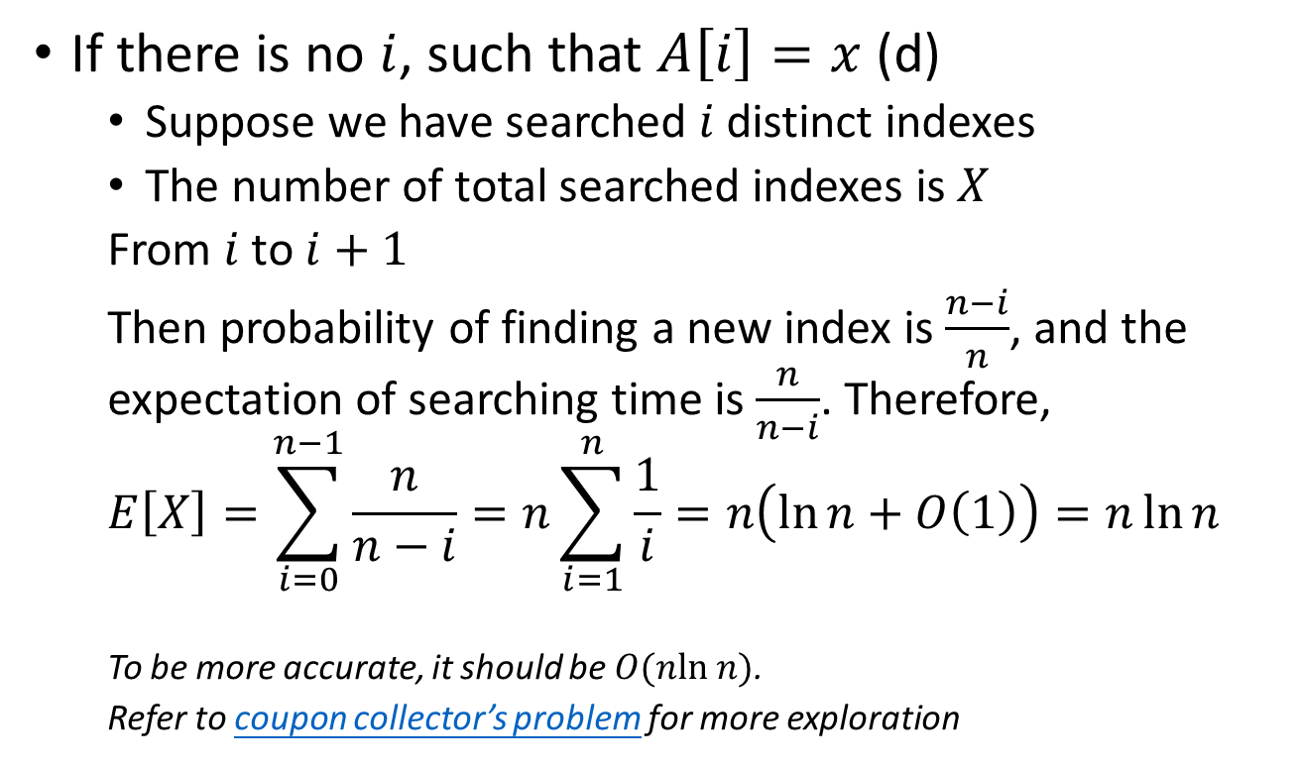
Analysis
If there is no $i$, such that $A\left[i\right]=x$ (d)
Suppose we have searched $i$ distinct indexes
The number of total searched indexes is $X$
From $i$ to $i+1$
Then probability of finding a new index is $\frac{n−i}{n}$, and the expectation of searching time is $\frac{n}{n−i}$. Therefore,
$$E\left[X\right]=\sum_{i=0}^{n−1}{\frac{n}{n−i}=n\sum_{i=1}^{n}{\frac{1}{i}}=n\left(\ln{n}+O\left(1\right)\right)}=n\ln{n}$$
To be more accurate, it should be $O(nln n)$.
Refer to coupon collector’s problem for more exploration

Slide 8
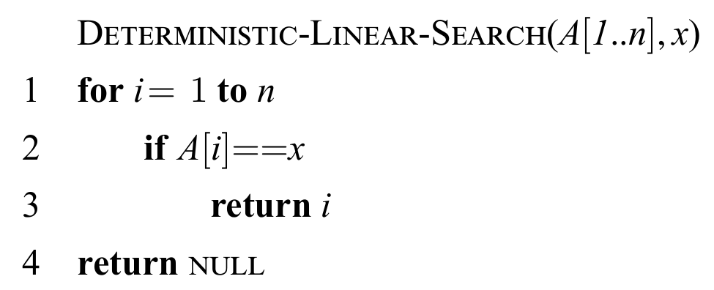

Algorithm: Deterministic linear search
Description in natural language
Search $A$ in order, i.e., $A\left[1\right],A\left[2\right],…$, until
$A\left[index\right]=x$, or
End of $A$
Pseudocode

Slide 9
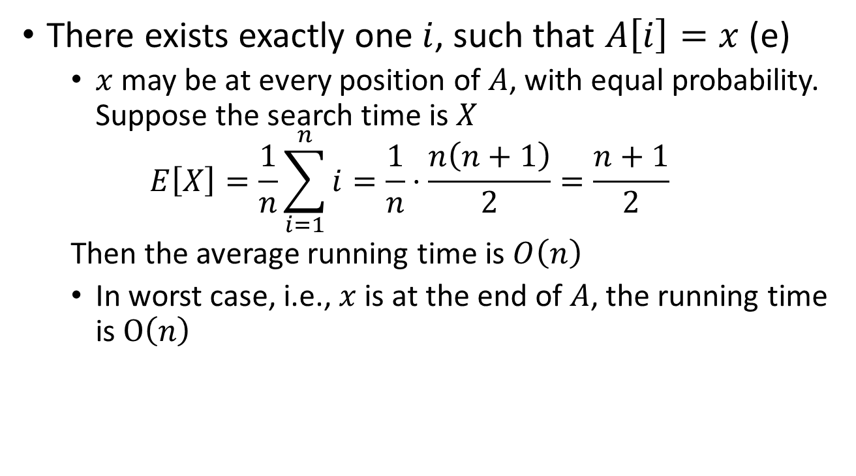
Analysis
There exists exactly one $i$, such that $A\left[i\right]=x$ (e)
$x$ may be at every position of $A$, with equal probability. Suppose the search time is $X$
$$E\left[X\right]=\frac{1}{n}\sum_{i=1}^{n}{i}=\frac{1}{n}⋅\frac{n\left(n+1\right)}{2}=\frac{n+1}{2}$$
Then the average running time is $O\left(n\right)$
In worst case, i.e., $x$ is at the end of $A$, the running time is $O\left(n\right)$

Slide 10
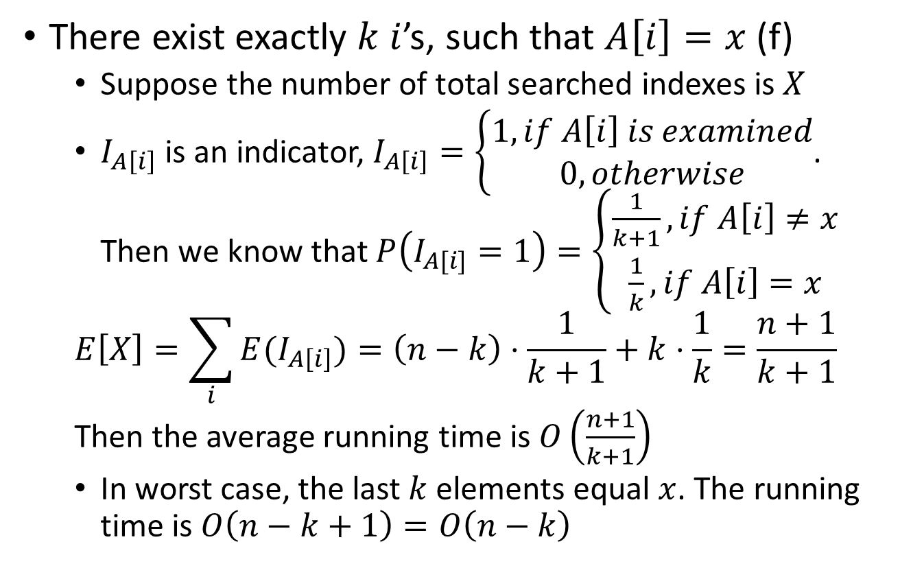
Analysis
There exist exactly $k$ $i$’s, such that $A\left[i\right]=x$ (f)
Suppose the number of total searched indexes is $X$
$I_{A\left[i\right]}$ is an indicator, $I_{A\left[i\right]}=\left\{\begin{aligned}1,if A\left[i\right] is examined \\ 0,otherwise\end{aligned}\right.$. Then we know that $P\left(I_{A[i]}=1\right)=\left\{\begin{aligned}\frac{1}{k+1},if A\left[i\right]≠x \\ \frac{1}{k},if A\left[i\right]=x\end{aligned}\right.$
$$E\left[X\right]=\sum_{i}{E(I_{A\left[i\right]})}=\left(n−k\right)⋅\frac{1}{k+1}+k⋅\frac{1}{k}=\frac{n+1}{k+1}$$
Then the average running time is $O\left(\frac{n+1}{k+1}\right)$
In worst case, the last $k$ elements equal $x$. The running time is $O\left(n−k+1\right)=O\left(n−k\right)$

Slide 11

Analysis
There is no $i$, such that $A\left[i\right]=x$ (g)
Obviously, the average and worst running times are both $O\left(n\right)$, i.e., we need to check all elements of $A$

Slide 12
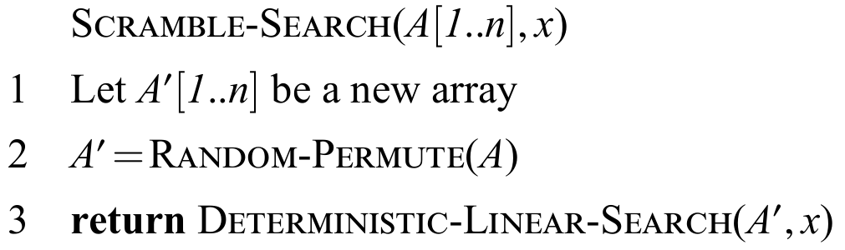

Algorithm: Scramble Search
Description in natural language
Randomly permute $A$, which yields $A′$
Do Deterministic Search on $A′$
Pseudocode

Slide 13
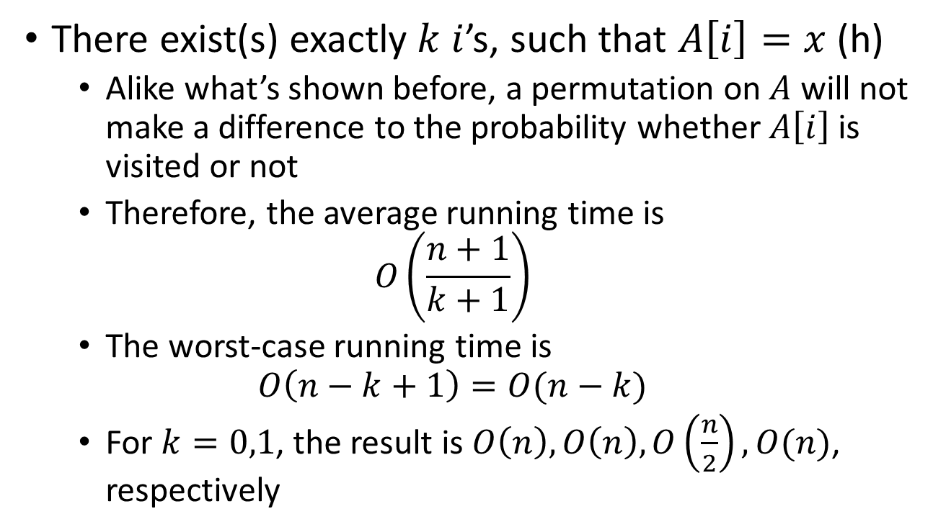
Analysis
There exist(s) exactly $k$ $i$’s, such that $A\left[i\right]=x$ (h)
Alike what’s shown before, a permutation on $A$ will not make a difference to the probability whether $A\left[i\right]$ is visited or not
Therefore, the average running time is
$$O\left(\frac{n+1}{k+1}\right)$$
The worst-case running time is
$$O\left(n−k+1\right)=O(n−k)$$
For $k=0,1$, the result is $O\left(n\right),O\left(n\right),O\left(\frac{n}{2}\right),O(n)$, respectively

Slide 14
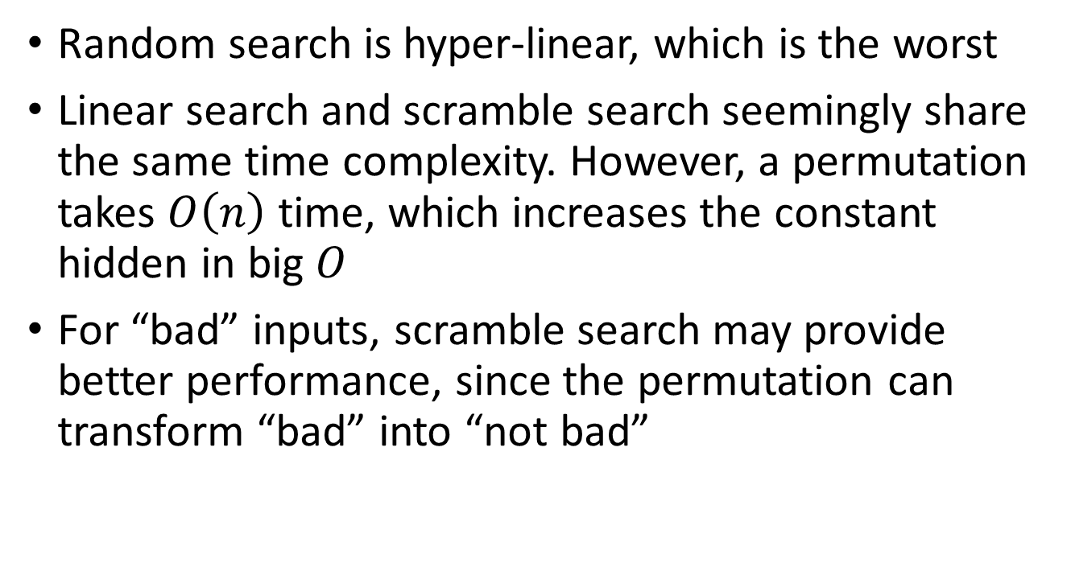
Which is the best of three?
Random search is hyper-linear, which is the worst
Linear search and scramble search seemingly share the same time complexity. However, a permutation takes $O\left(n\right)$ time, which increases the constant hidden in big $O$
For “bad” inputs, scramble search may provide better performance, since the permutation can transform “bad” into “not bad”

Slide 15
Thanks for listening
Q & A

