Slide 1
Deep Forest: Towards an Alternative to Deep Neural Networks
Zhi-Hua Zhou and Ji Feng
LAMDA GROUP
Nanjing University,China
Presented by Qi-Zhi Cai

Slide 2
About this work
Proposed an new decision tree ensemble method (gcForest)
Compare it with Deep Neural Network and get highly competitive performance
Proposed another perspective of Deep Learning

Slide 3
Outline
Introduction
gcForest Model
Cascade Forest Structure
Multi-Grained Scanning
Comparison with Deep Neural Network
Experiments
Conclution

Slide 4
Outline
Introduction
gcForest Model
Cascade Forest Structure
Multi-Grained Scanning
Comparison with Deep Neural Network
Experiments
Conclution

Slide 5
Why Forest?
Large Model Capacity
Fewer hyper-parameters
Friendly for Parallel Computing

Slide 6
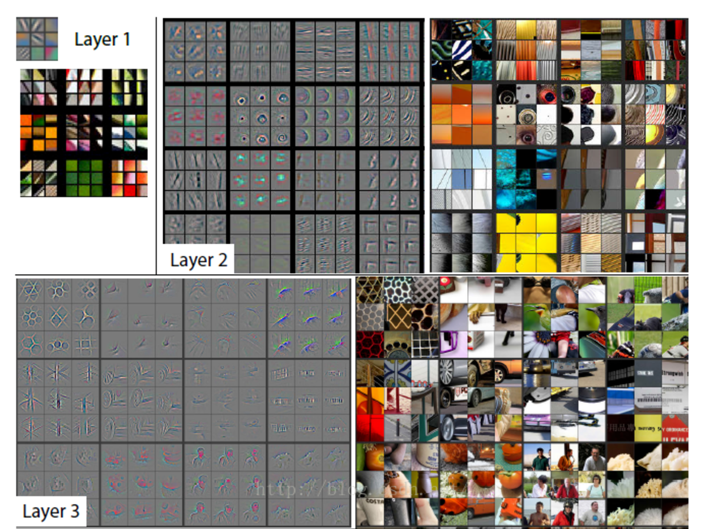
Representation Learning
Distributed Representation

Slide 7
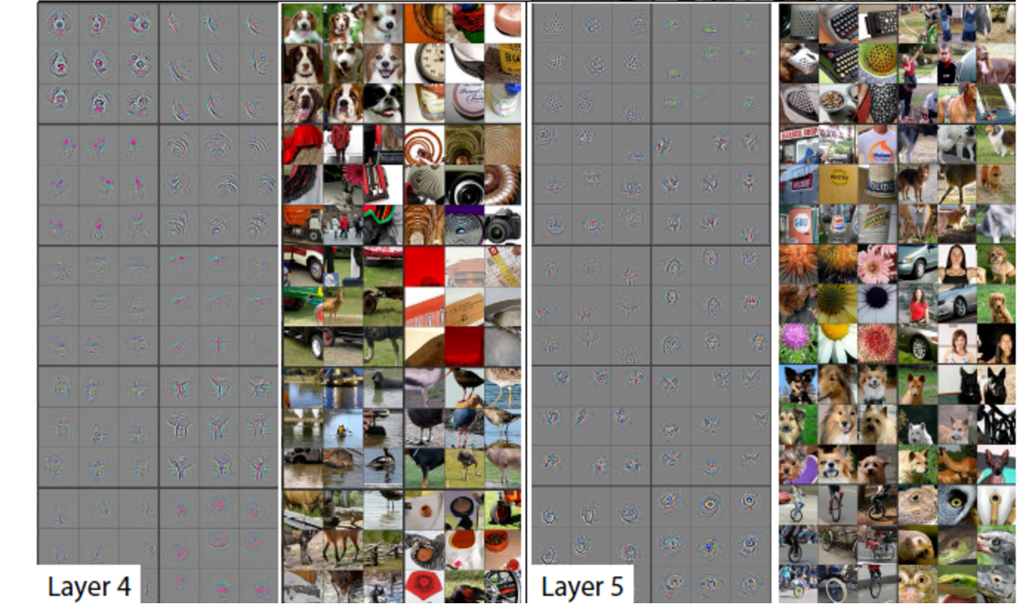
Representation Learning

Slide 8
Outline
Introduction
gcForest Model
Cascade Forest Structure
Multi-Grained Scanning
Comparison with Deep Neural Network
Experiments
Conclution

Slide 9
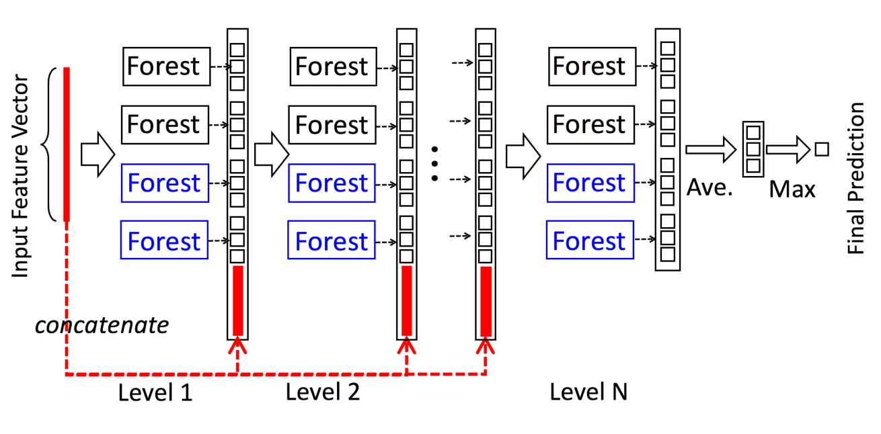
Cascade Forest Structure
Diversity vs Accucracy
Use prior probability as a supervisor
Use raw feature every layer to avoid divergence

Slide 10
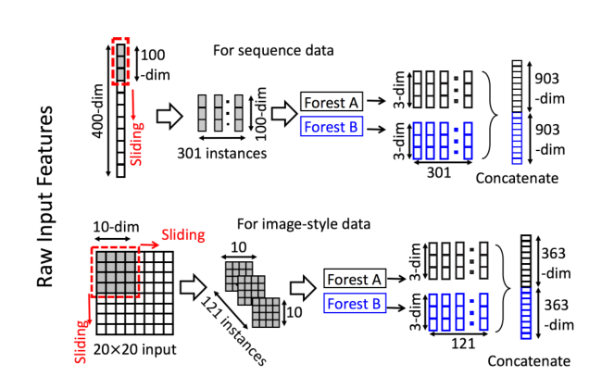
Multi-Grained Scanning

Slide 11
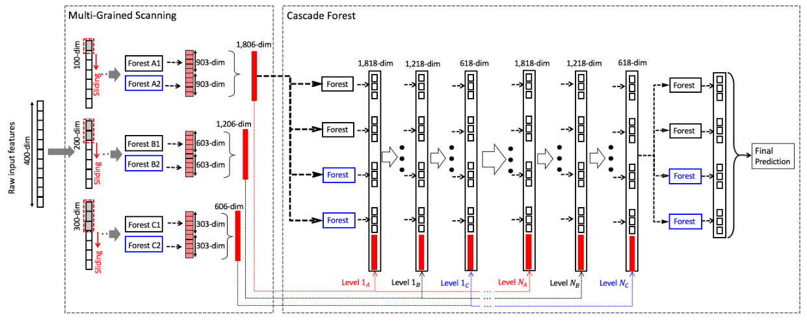
gcForest Model

Slide 12
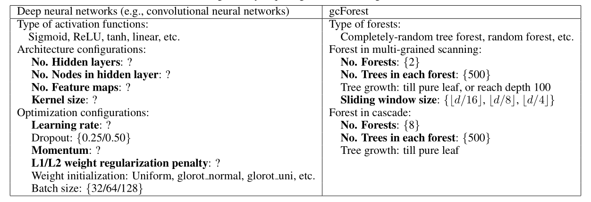
Comparison with DNN

Slide 13
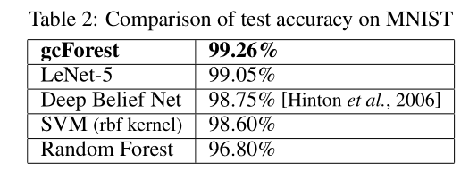
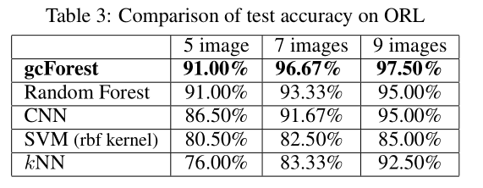
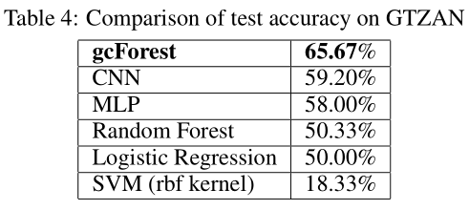
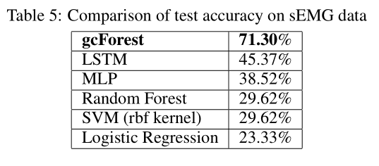
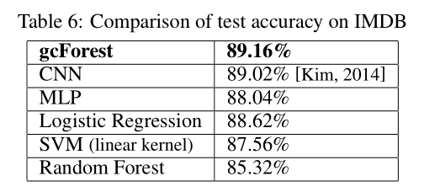
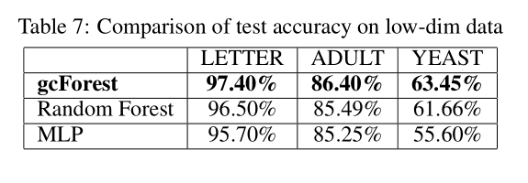
Experiments

Slide 14
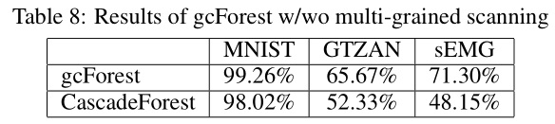
Influence of Multi-Grained Scannings

Slide 15
More in Experement

Slide 16
Conclusion
We proposed the gcForset model
Fewer hyperparameter
Competitive performance compare to DNN
Work well on different kinds of jobs

