Slide 1
4-9问题的形式化描述

Slide 2









1
2
3
4
Encode:
00=‘0’, 01=‘1’,10=‘#’
Multiple choices：
$$\left[\begin{matrix}0 \\ 0 \\ \begin{aligned}1 \\ 1\end{aligned}\end{matrix}\begin{matrix}1 \\ 0 \\ \begin{aligned}0 \\ 0\end{aligned}\end{matrix}\begin{matrix}0 \\ 1 \\ \begin{aligned}0 \\ 0\end{aligned}\end{matrix}\begin{matrix}0 \\ 1 \\ \begin{aligned}0 \\ 0\end{aligned}\end{matrix}\right]$$
$$0100 0011 1000 1000$$
$$0100\#0011\#1000\#1000$$
$$0011 1000 0100 0100$$
$$00010000100000010110010000001001000000$$
$$0000 1101 0110 0000$$
$$…$$
$$4\#0100\#0011\#1000\#1000$$
$$100\#0100\#0011\#1000\#1000$$
$$0100001000010000100000010110010000001001000000$$
$$\left[\begin{matrix}0 \\ 0 \\ \begin{aligned}-1 \\ -2\end{aligned}\end{matrix}\begin{matrix}4 \\ 0 \\ \begin{aligned}0 \\ 0\end{aligned}\end{matrix}\begin{matrix}0 \\ 2 \\ \begin{aligned}0 \\ 0\end{aligned}\end{matrix}\begin{matrix}0 \\ 1 \\ \begin{aligned}0 \\ 0\end{aligned}\end{matrix}\right]$$
$$4\#0400\#0021\#-1000\#-2000$$
$$？$$
$$4\#0\#4\#0\#0\#0\#0\#2\#1\#−1\#0\#0\#0\#−2\#0\#0\#0$$
❶：11=‘-’
❷：在所有权重前添加一位符号位，00=‘0’正，01=‘1’负
如果是稀疏矩阵呢？
进一步压缩$：4\#0\#4\#\#0\#0\#2\#1\#\#−1\#\#−2\#\#$

Slide 3
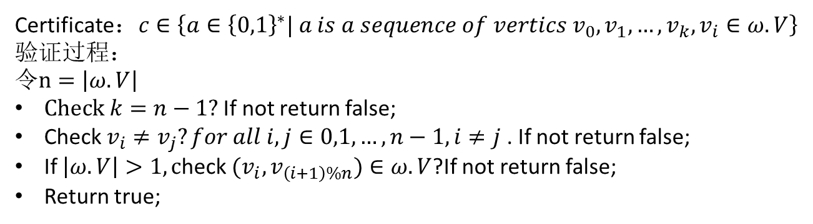
此时（在一定程度上）可以不用纠结于如何编码！而直接关注与问题本身！
Certificate：$c∈\left\{a∈{\left\{0,1\right\}}^{∗}| a is a sequence of vertics v_{0},v_{1},…,v_{k},v_{i}∈ω.V\right\}$
验证过程：
$令n=\left|ω.V\right|$
$Check$ $k=n−1?$ If not return false;
Check $v_{i}≠v_{j}?for all i,j∈0,1,…,n−1,i≠j$ . If not return false;
If $\left|ω.V\right|>1, c$heck ${(v}_{i},v_{\left(i+1\right)\%n})∈ω.V$?If not return false;
Return true;

Slide 4
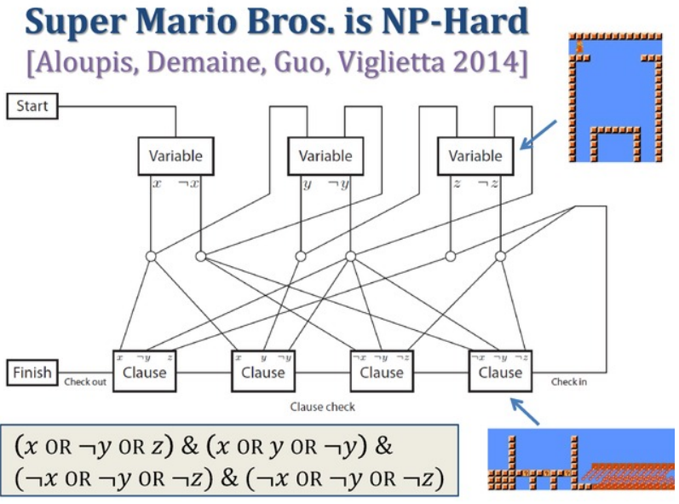
Source:
http://courses.csail.mit.edu/6.890/fall14/scribe/lec4.pdf

Slide 5
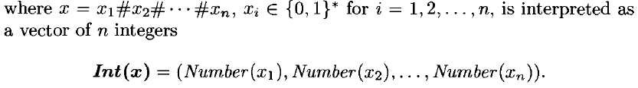
Pseudo-polynomial time
In computational complexity theory, a numeric algorithm runs in pseudo-polynomial time if its running time is polynomial in the numeric value of the input, but is exponential in the length of the input – the number of bits required to represent it.
Integer-valued Problems：algorithmic problems whose inputs can be viewed as a collection of integers. In what follows we fix the coding of inputs to words over {0, 1, #},
|x|:the length of the input
Max numeric value

Slide 6
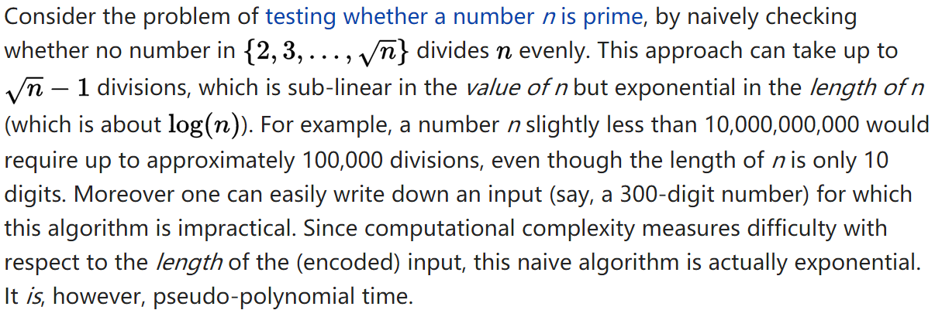
Pseudo-polynomial time
https://en.wikipedia.org/wiki/Pseudo-polynomial_time

Slide 7
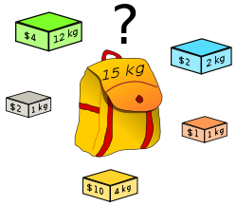
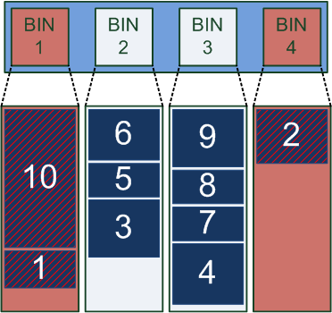
Pseudo-polynomial time
An NP-complete problem with known pseudo-polynomial time algorithms is called weakly NP-complete.
0-1 Knapsack problem is weakly NP-complete
can be solved by a dynamic programming algorithm
An NP-complete problem is called strongly NP-complete if it is proven that it cannot be solved by a pseudo-polynomial time algorithm unless P=NP.
bin packing is strongly NP-complete
https://en.wikipedia.org/wiki/Pseudo-polynomial_time
https://en.wikipedia.org/wiki/Weak_NP-completeness
https://en.wikipedia.org/wiki/Strong_NP-completeness

