Slide 1
Open-Category Classification by Adversarial Sample Generation
Yang Yu, Wei-Yang Qu, Nan Li, and Zimin Guo
汇报人：刘驭壬

Slide 2
Outline
Introduction
Open-Category Classification
Background
Related Problems
Adversarial Learning
Derivative-free Optimization
Proposed Method
ASG Framework
Experiments
Conclusion

Slide 3
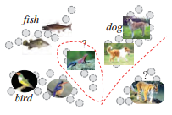
Open-Category Classification
An example
Open-Category Classification
there are novel classes that none of their instances are observed during the training phase, but in the test phase their instances could be encountered

Slide 4
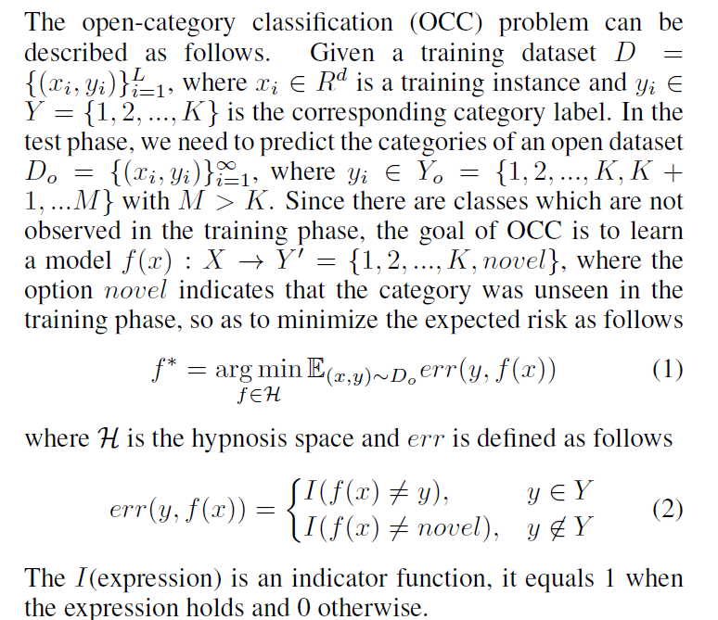
Open-Category Classification

Slide 5
Related Problems
Incremental Learning
New classes are assumed to appear incremental in the training set
Learning with Rejection Option
Classifier reject to recognize an instance if its confidence is low
Outlier Detection
Apply to OCC problem by treating unseen class instances as outliers
Zero-Shot Learning
commonly assume that a high-level attribute set is available for all classes including the unseen one

Slide 6
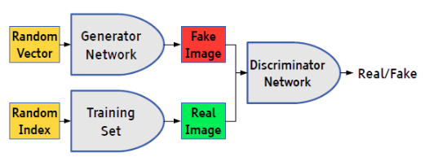
Adversarial Learning
Adversarial Learning model
Discriminative Model: Try to discriminate the origin data and generated data
Generative Model: Learns to generate instances that can fool the discriminative model as a non-generated instance
Generative Adversarial Nets(GAN)
result in a model that is consistent
with the original data distribution

Slide 7
Derivative-free Optimization
A derivative-free optimization method consider an optimization formalized as:
Instead of calculating gradients of , samples solutions and learns from their feedbacks for finding better solutions
Some Derivative-free Methods
genetic algorithms, most are heuristic methods
Bayesian optimization methods
Optimistic optimization methods
Model-based optimization(i.e. RACOS)

Slide 8

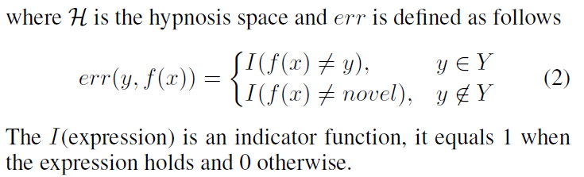
ASG Framework
Minimize:
Consideration:
No instances of class novel
Instances considered to belong to the seen class
Instances considered to belong to the unseen class
Generate instances of class novel
Generate positive and negative instances of class seen

Slide 9

Generate negative instances of class seen
Generate negative instances of class seen
Goal: optimize a point in the instance space to be close to the seen class instances, but cannot be recognized as an seen class instance by the discriminator
Optimize:

Slide 10



Generate negative instances of class seen
Optimize:
Regular term
Limit the distance of points belongs to and
The distance of points in should not be too small
Minimize:

Slide 11
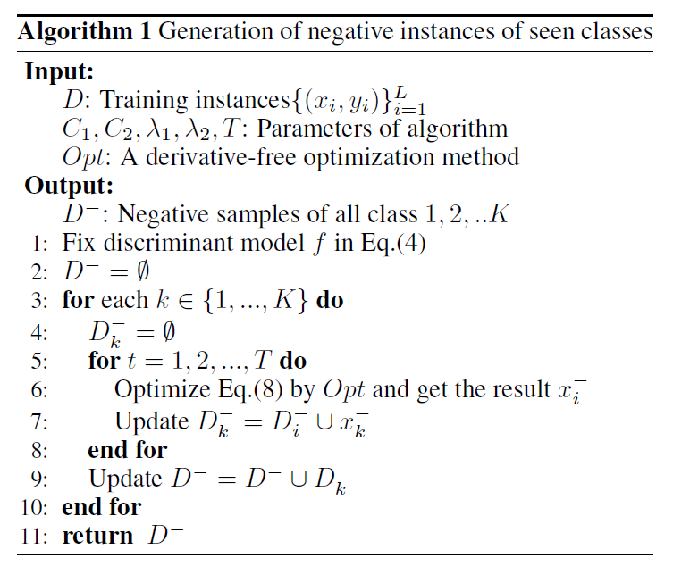
Generate negative instances of class seen
Algorithm
T is the numbers to be sampled in practice
Eq.(8):

Slide 12



Generate positive instances of class seen
Optimize:
Regular term
The distance of points in should not be too small
Minimize:
Algorithm: just replace Eq.(8) with Eq.(11) in Algorithm.1

Slide 13
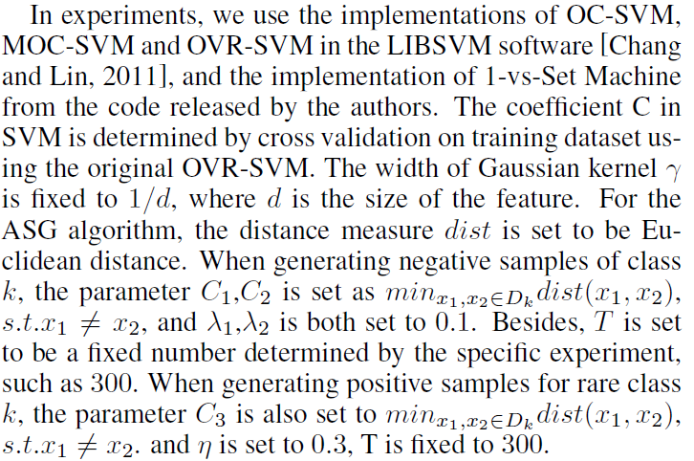
Experiments
Discriminant model: RBF-SVM
Compared methods: OC-SVM, MOC-SVM, 1-vs-Set Machine, OVR-SVM

Slide 14
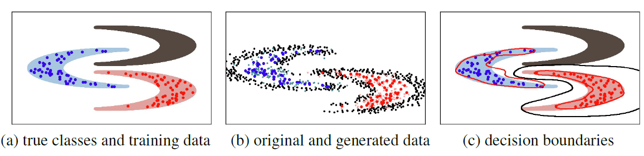
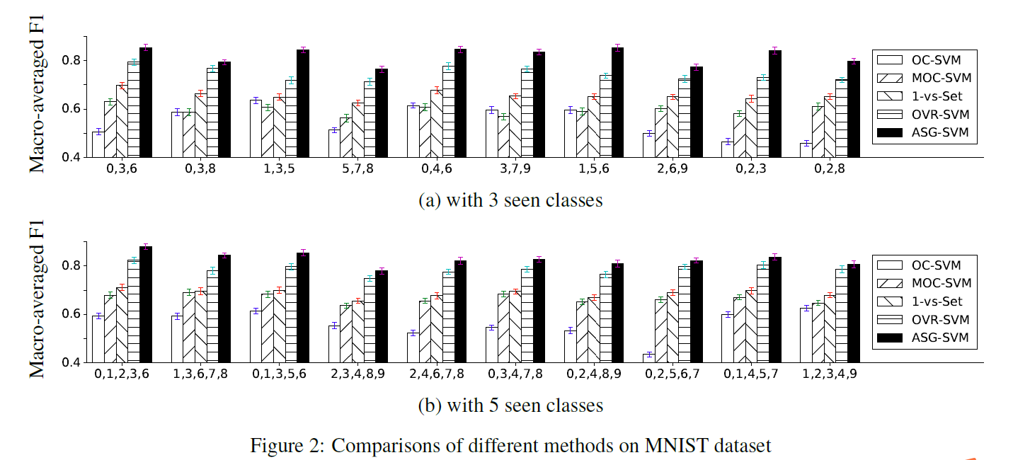
Experiment Results
Results on 3 moon:
Results on MNIST:

Slide 15
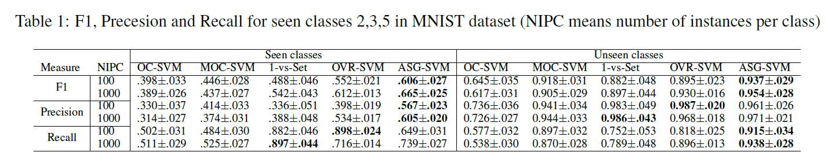
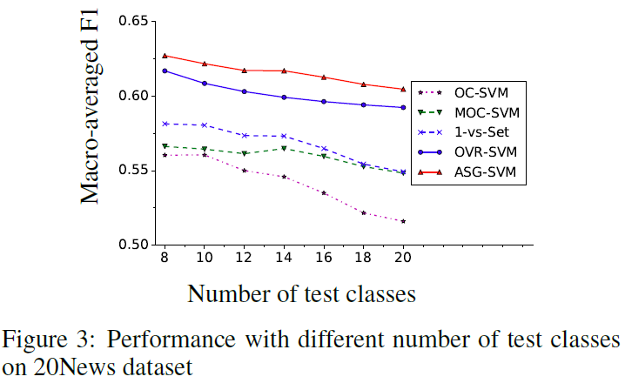
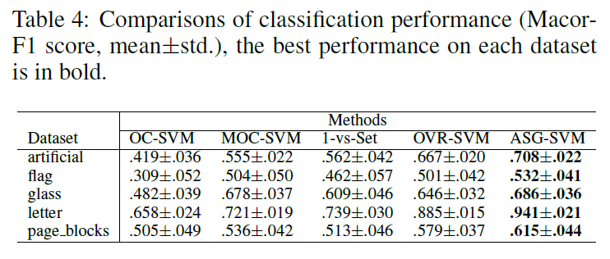
Experiment Results
Results on MNIST:
Results on the 20 News Group:
Results on the 5 small datasets:

Slide 16
Conclusion
Open-category classification problem is a practical problem when a system needs to predict the data in open environments
propose to address the problem by adversarial data generation
Experiments on several datasets show the effectiveness of the proposed method

Slide 17
Thanks！

