Slide 1
Monty Hall Problem
171860624 毕秋宇
2018-4-28

Slide 2
Introduction

Slide 3
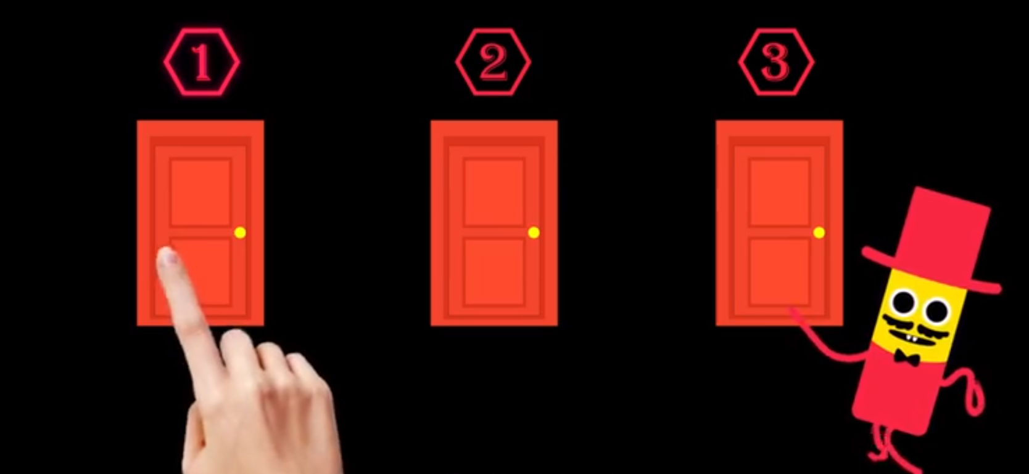
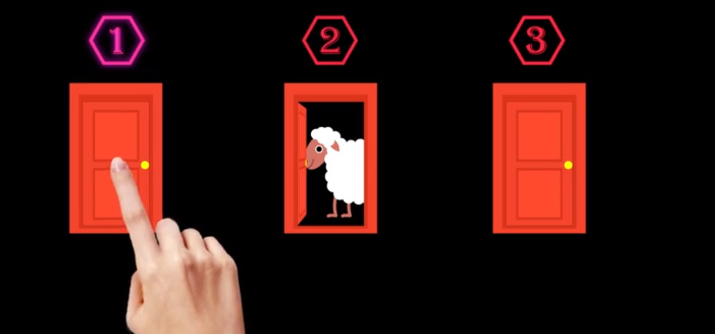
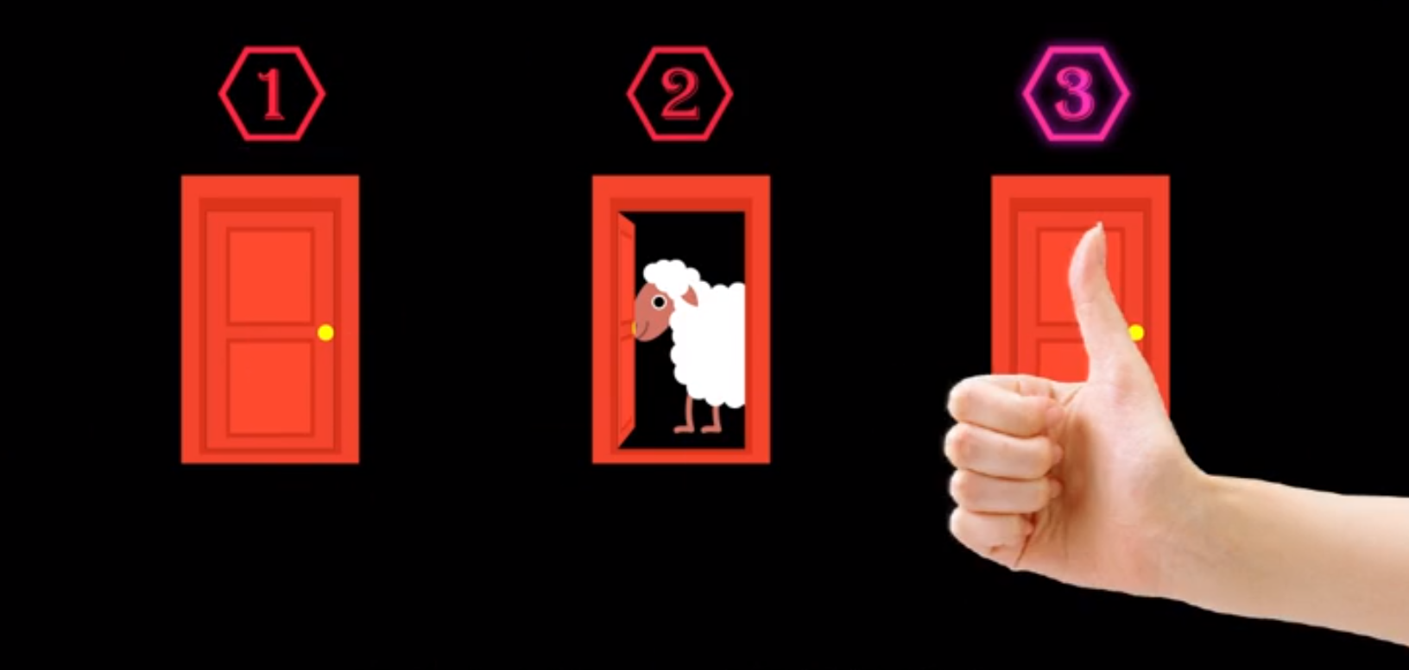
Introduction

Slide 4
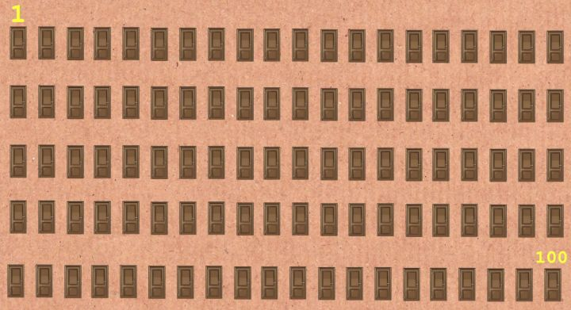
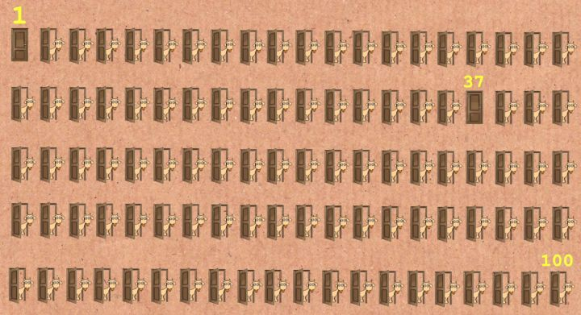
Solution 1: An easier condition

Slide 5
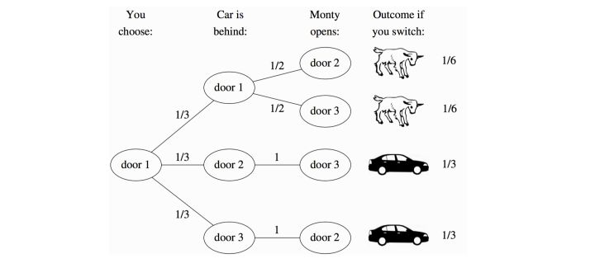
Solution 2: Probability tree

Slide 6
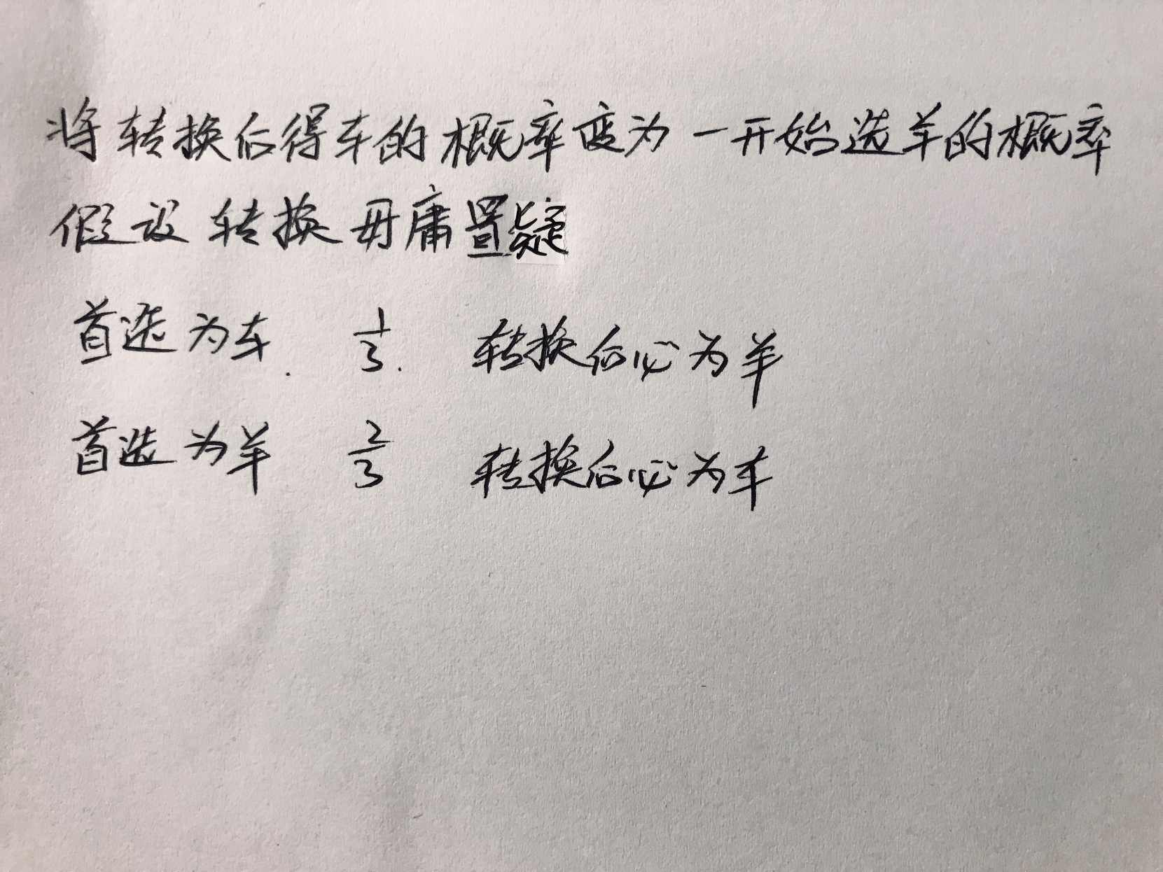
Solution 3: Focus on the first choice

Slide 7
A video
没想到你是这样的主持人……

Slide 8
Thanks

