Slide 1
Arrays, Vectors & Strings
Lecture 3

Slide 2
Built-in arrays 数组
int a[5] = {1, 2, 4, 8, 16};
a
1 | 2 | 4 | 8 | 16
An array is a container of unnamed objects of a single type that we access by position.
Container
Unnamed objects
Single type
Access by position
int b = a[2];
a[3]=7;

Slide 3
Built-in arrays
Definition / initialization
int a[5] = {1, 2, 4, 8, 16};
int b[5] = {1, 2, 4};
// ok. equivalent to int b[5] = {1, 2, 4, 0, 0};
int c[ ] = {1, 2, 4, 8, 16};
// ok. equivalent to int c[5] = {1, 2, 4, 8, 16};
const size_t N = 5;
int d[N] = {1, 2, 4, 8, 16};

Slide 4
Built-in arrays
You CAN NOT do the following.
int a[4] = {1, 2, 4, 8, 16};
// error: excess elements in array initializer
int b[5] = {1, 2, 4, 8, 16};
int c[5] = b;
// error: array initializer must be an initializer list

Slide 5
Built-in arrays
Array names are converted to (constant) pointers.
a
1 | 2 | 4 | 8 | 16
int a[5] = {1, 2, 4, 8, 16};
a
int *p = a;
// ok.
1 | 2 | 4 | 8 | 16
const int *q = a;
// ok.
int b = 3;
a = &b;
// error: array type ‘int [5]’ is not assignable.

Slide 6
Built-in arrays
Array names are converted to (constant) pointers.
a
1 | 2 | 4 | 8 | 16
a
int a[5] = {1, 2, 4, 8, 16};
1 | 2 | 4 | 8 | 16
int b = *a;
// ok. equivalent to int b = a[0];
int c = *(a + 3);
// ok. equivalent to int c = a[3]; pointer arithmetic

Slide 7
Built-in arrays
Array names are converted to (constant) pointers.
a
1 | 2 | 4 | 8 | 16
a
int a[5] = {1, 2, 4, 8, 16};
1 | 2 | 4 | 8 | 16
int **p = &a;
int (*q)[5] = &a;
cout << **q << endl;
cout << *(*q + 4) << endl;
// error: 不能用int (*)[5]初始化int **
// ok.
// ok. the result is 1.
// ok. the result is 16.

Slide 8
Array index out of bounds
int a[5] = {1, 2, 4, 8, 16};
cout << a[5];
// warning: array index 5 is past the end of the array
cout << *(a + 5);
// problematic, but will be accepted by the compiler
All warnings should be treated as errors.

Slide 9
Bounds checking
const size_t N = 5;
int a[N] = {1, 2, 4, 8, 16};
size_t j = 0;
// … some other code
if (j >= 0 && j < N) {
// do something with element a[j]
}
else {
// report an index-out-of-bound error
}
size_t j = 0;
// … some other code
assert (j >= 0 && j < N);
// do something with element a[j]

Slide 10
Bounds checking
Think:
What is the benefit of bounds checking?
What is the cost of bounds checking?
Should we enforce bounds checking when designing a programming language?

Slide 11
vector
// an empty vector
vector<int> a;
vector<int> b(10);
// a vector with ten 0s
vector<int> c(10, 1);
// a vector with ten 1s
vector<int> d{1, 2, 4, 8, 16};
// supported by C++11
g++ -c some_file.cpp -o some_file.o -std=c++11
int arr[5] = {1, 2, 4, 8, 16};
vector<int> v(begin(arr), end(arr));

Slide 12
push_back
1 / 1
2 / 2
3 / 4
4 / 4
5 / 8
6 / 8
7 / 8
8 / 8
9 / 16
10 / 16
11 / 16
12 / 16
13 / 16
14 / 16
15 / 16
16 / 16
17 / 32
18 / 32
vector<int> v;
for (int i = 0; i != 18; ++i) {
v.push_back(i);
cout << v.size( ) << “ / “ << v.capacity( ) << endl;
}
1 | 2 | 3 | 4 | 5
size = 5, capacity = 8
Tested on macOS High Sierra ver. 10.13.6 with 3.1 GHz Intel Core i7 [Oct 12, 2018]

Slide 13
at vs. operator [ ]
vector<int> v{1, 2, 4, 8, 16};
v[7] = 9;
cout << v[7] << endl;
v.at(7) = 9;
cout << v.at(7) << endl;
No bounds checking.
Undefined behavior.
Bounds checking.
Throw a runtime out_of_range exception.

Slide 14
Iterators
迭代器
vector<int> v{1, 2, 4, 8, 16};
指向v的第一个元素
相等判断，而非大小判断
vector<int>::iterator it = v.begin( );
for ( ; it != v.end( ); ++it) cout << *it << ” ”;
指向v的最后一个元素的下一个位置
Dereference，取指向位置的值
迭代器向后移动一个位置

Slide 15
Iterators
begin( )
end( )
1 | 2 | 3 | 4 | 5
Think:
Why left-closed, right-open?
Why do we use != instead of < or <=?

Slide 16
Iterators
begin(arr) / end(arr)
int arr[ ] = {1, 2, 4, 8, 16};
vector<int> v(begin(arr), end(arr));
array arr
iterator
Overload
vector<int>::iterator it;
for ( it = begin(v); it != end(v); ++it ) {
// do something
}
vector v
iterator
begin(v) / end(v)
实际调用v.begin( )和v.end( )
重载：在同一个可见域中为不同的函数赋予同样的名字。

Slide 17
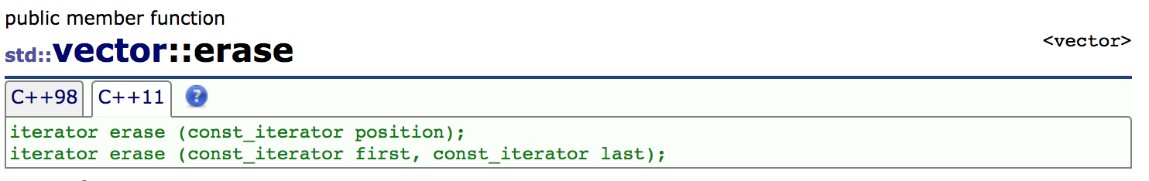
erase
C++ Reference http://www.cplusplus.com/reference/vector/vector/erase/
函数声明
删除一个迭代器指向的位置上的值
删除两个迭代器之间的所有值（左闭右开）
返回一个新的迭代器，指向最后一个被删除值的下一个位置（可能是end）。
vector上原有的迭代器，在position/first之前的继续有效，在position/first及其后的失效。

Slide 18
erase
vector<int> v{1, 2, 4, 8, 16, 32, 64, 128, 256};
vector<int>::const_iterator it = v.begin( ) + 3;
v.erase(it);
cout << *it;
// ok. erase 8. return value ignored.
1, 2, 4, 16, 32, 64, 128, 256
// dangerous: iterator invalidated. (undefined behavior)
it = v.erase(v.begin() + 1, v.begin() + 4);
cout << *it;
// ok. erase 2, 4, 16. it points to 32.
// ok. print 32.
1, 32, 64, 128, 256

Slide 19
erase
vector<int> v{1, 2, 4, 8, 16, 32, 64, 128, 256};
vector<int>::const_iterator it = v.begin( ) + 3;
v.erase(it);
cout << *it;
// ok. erase 8. return value ignored.
// dangerous: iterator invalidated. (undefined behavior)
16
未定义行为：C++标准未明确规定，因此相应情况的具体处理取决于各个编译器的具体实现。
正确的程序不应当依赖未定义行为。
学习过程中应注意区分哪些行为是C++标准、哪些行为是编译器扩展。
Tested on macOS High Sierra ver. 10.13.6 with 3.1 GHz Intel Core i7 [Oct 12, 2018]

Slide 20
erase
如果删除的不是最后一个元素，那么erase需要移动被删除位置后的所有数据来填充因为删除而产生的“空位”。

Slide 21
Strings
null character
Null-terminated string
“Hello, World!”
H | e | l | l | o | , |  | W | o | r | l | d | ! | \0
char s1[14] = {'H’, 'e’, 'l’, 'l’, 'o’, ',’, ' ‘, 'W’, 'o’, 'r’, 'l’, 'd’, '!’, '\0'};
Hello, World!
cout << s1 << endl;
char s2[ ] = {'H’, 'e’, 'l’, 'l’, 'o’, ',’, ' ‘, 'W’, 'o’, 'r’, 'l’, 'd’, '!’, '\0'};
Hello, World!
cout << s2 << endl;
char s3[ ] = “Hello, World!”;
Hello, World!
cout << s3 << endl;
14
cout << sizeof(s3) / sizeof(char) << endl;

Slide 22
Strings
null character
Null-terminated string
“Hello, World!”
H | e | l | l | o | , |  | W | o | r | l | d | ! | \0
const char *s4= “Hello, World!”;
cout << s4 << endl;
Hello, World!
char *s5= “Hello, World!”;
// warning: ISO C++11 does not allow conversion from
string literal to ‘char *’
cout << s5 << endl;
Tested on macOS High Sierra ver. 10.13.6 with 3.1 GHz Intel Core i7 [Oct 12, 2018]

Slide 23
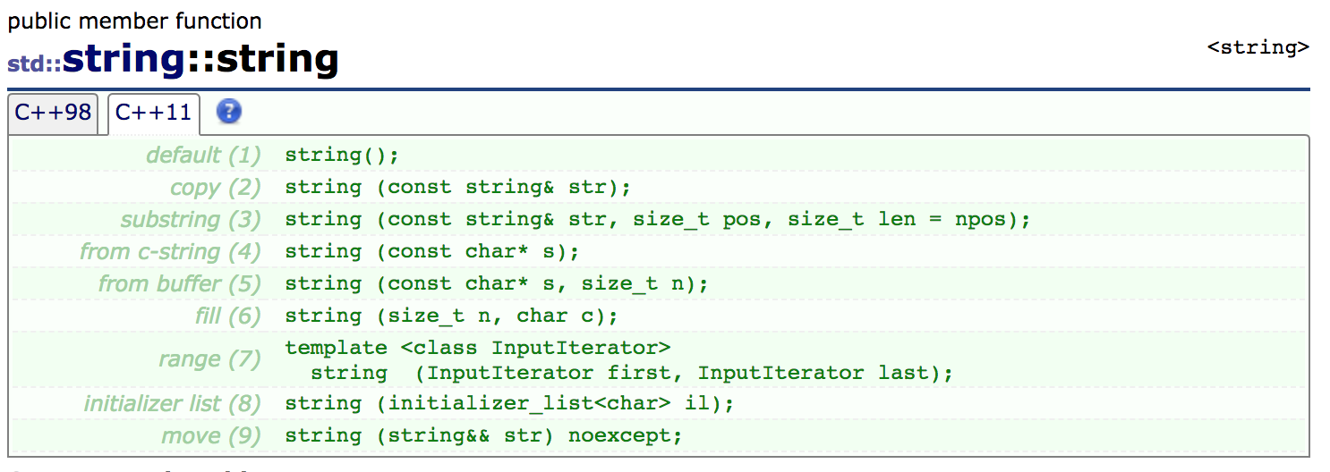
string
string: a variable-length sequence of characters

Slide 24
string
string s1;
// empty string
string s2(“Hello, World!”);
// Hello, World!
string s3(s2);
// Hello, World!
string s4(s2.begin( ), s2.begin( ) + 5);
// Hello
left-closed, right-open

Slide 25
string
string s1(“Hello”);
cout << s1.length( ) << endl;
string s2(“World”);
cout << (s1 == s2) << endl;
string s3 = s1 + “, “ + s2 + “!”;
cout << s3 << endl;
string s4 = s3.substr(7, 10);
cout << s4 << endl;
5
// equivalent to s1.size( )
0
// string comparison (matching)
// string concatenation
Hello, World!
// substring. 10 characters starting from s3[7].
World!

Slide 26
string operations
push_back( )
insert( ) & erase( )
empty( ) & clear( )
at( ) & operator [ ]
data( ) & c_str( )
begin( ) & end( )
find( )
添加字符到串尾，有与vector类似的capacity增长策略
插入、删除，有与vector类似的迭代器失效问题
判断是否为空 / 清空（并不实际释放内存）
元素操作，at有自动的bounds checking，而[ ]没有
获取C-style的字符串char *（两个函数等价）
迭代器，分别指向首字符和尾字符的下一个位置
查找（字符或子串）

Slide 27
Next lecture
C++ Primer, Chapters 4 & 5

