Slide 1
计算机问题求解 – 论题3-13 - 最大流算法
2018年12月4日

Slide 2
Lucky Puck Company’s Trucking Problem
Lucky公司生产冰球，其工厂在温哥华，仓库在温尼泊。公司委托物流公司运输。物流公司经营固定线路网，可能经过多个中间城市。分配给Lucky公司的任意两个城市间的最大运输量是固定的。如果Lucky公司是按运输量确定生产量，它如何计划它每天最大产量？
问题1：
如何建立解决这个问题的模型？
Notes:
公司只关心每天最多可以生产多少,每天温尼泊能收到多少?

Slide 3
问题2:运输方案有多种,最优方案是什么?
图中的方案是最优的吗?

Slide 4
问题3：
如果工厂与仓库都不止一个，该怎么办？

Slide 5
A Model of Oil Supply
supplying capacity
17
cosuming capacity
17
16
18
a
f
g
12
20
20
17
12
10
e
15
30
S
c
h
D
20
7
20
60
20
Vertices:
a, b: refineries
g, h, i: markets
others: relays
b
d
i
13
30
17
pipeline, with max capacity/week

Slide 7
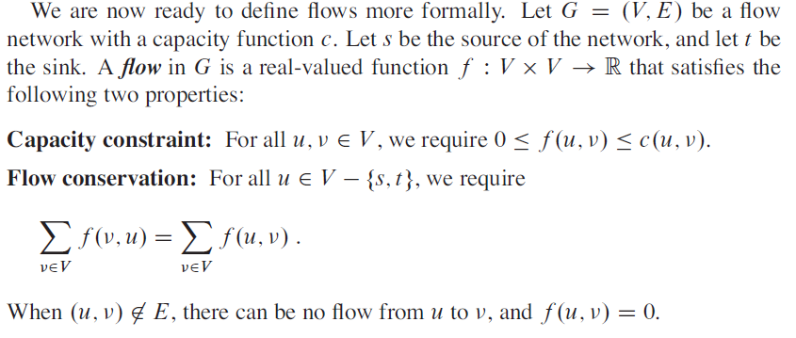
严格的数学模型
Notes:
容量限制
流量守恒：除了源节点和汇节点，所有节点流入和流出的都抵消。

Slide 8
问题4:
什么叫一个flow的“value”?
什么是最大流问题?
Notes:
|f| = 从源节点流出的总流量 - 流入源节点的流量（一般为0）
最大流：给定G、s、t，希望找到值最大的一个流。

Slide 9
How to get the maximum flow?
5
4
5
6
7
1
2
6
4
5
2
3
5

Slide 10
How to get the maximum flow?
2/5
4
5
2/6
2/7
1
2
6
4
5
2
3
5
Notes:
在现有网络中，找到一条增广路径，然后将其提升到最大值。

Slide 11
Path1 in N
2/6
2/5
2/7
1
4
5
6
Properly oriented
Value of flow increased by 3
5/6
5/5
5/7
1
4
5
6

Slide 12
How to get the maximum flow?
5/5
4
5
5/6
5/7
1
2
6
4
5
2
3
5

Slide 13
Path2 in N
4,0
5,0
5,0
1
2
3
6
Properly oriented
Value of flow increased by 4
4,4
5,4
5,4
1
2
3
6

Slide 14
How to get the maximum flow?
5/5
4
5
5/6
5/7
1
2
6
4/4
4/5
2
3
4/5
No other path?

Slide 15
Path3 in N
5/6
0/2
4/5
1
4
3
6
Properly oriented
Value of flow increased by 1
6/6
1/2
5/5
1
4
3
6

Slide 16
No other path!
5/5
4
5
6/6
5/7
1
1/2
6
4/4
5/5
2
3
4/5
Find all the path and increase its flow value to the max!

Slide 17
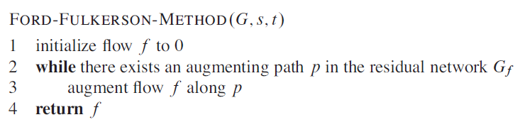
找到所有的augmenting path是方法的关键所在!

Slide 18
再看这个流网络中的流f：
5/5
4
5
5/6
5/7
1
2
当前流f下的残存运力C_{f}
6
4/4
4/5
2
3
4/5
0
1
4
5
4
5
2
1
2
1
2
6
1
2
6
0
1
1
2
3
2
3
1
1
当前流f下的残存网络G_{f}

Slide 19
借助残存运力/网络概念，再看上述寻找过程
5
3
6
4
5
7
4
4
5
5
1
4
5
2
1
2
6
1
2
6
1
2
6
4
2
5
4
2
5
4
2
5
3
3
3
5
5
5
4
5
2
1
4
5
2
Over？
1
1
6
1
2
6
2
2
1
3
3
1
1

Slide 20
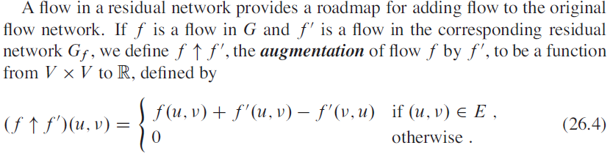
5
3
6
4
5
7
4
4
5
5
1
4
5
2
1
2
6
1
2
6
1
2
6
4
2
5
4
2
5
4
2
5
3
3
3
5
5
5
Notes:
f‘对f的增广

Slide 21
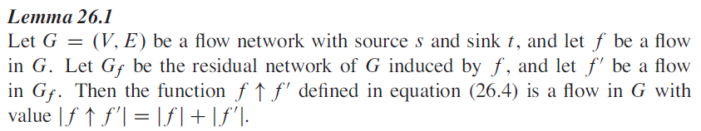

证明要点：
1，证明函数是一个流：符合流的两个特性
2，证明

Slide 22
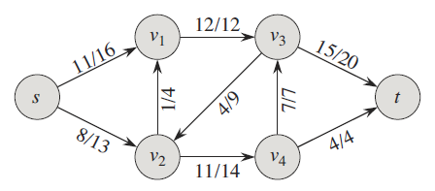
我们找到的方法一定正确吗？
问题出在什么地方？
这种决策在增广流过程中能保证不出现吗？
这是最大的流了吗？
我们有办法还是在“残存”模型中“纠正”这个错误吗？
12/12
11/16
19/20
No！
0/9
1/4
7/7
12/13
11/14
4/4

Slide 23
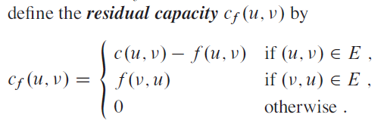
residual capacity
问题5：我们为什么要如此定义residual capacity?

Slide 24
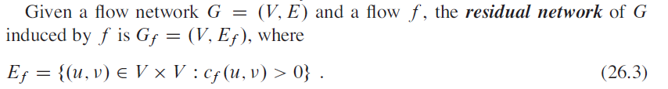
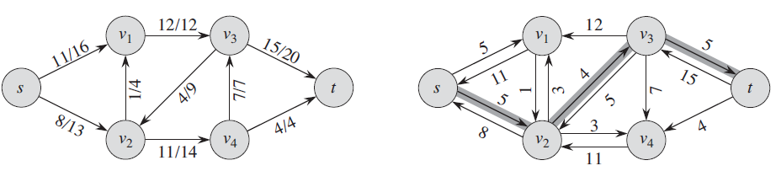
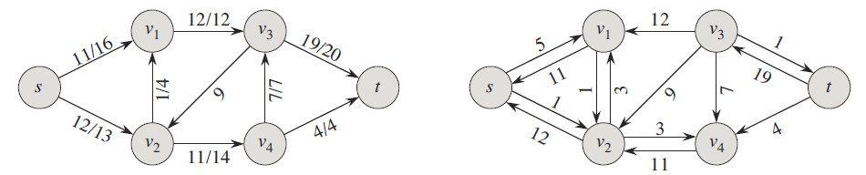
Residual Network
残存网络中找不到源到目的地的路径，所有增广路确定全部找到？

Slide 25
Notes:
增广结果是G的一个新的流，更大的流；

Slide 26
证明要点：
1，证明函数是一个流：符合流的两个特性
2，证明

Slide 27
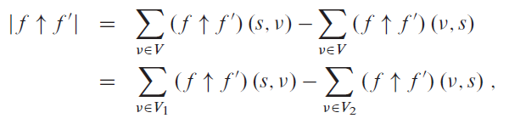
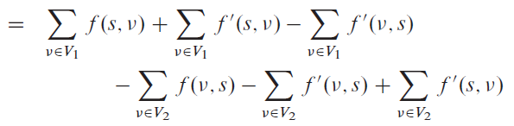
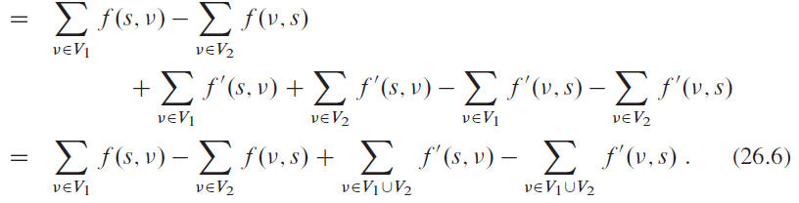
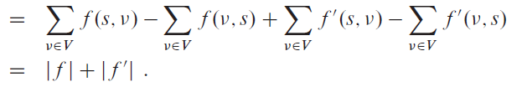
S
V2
V1
T

Slide 28
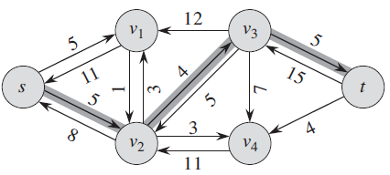
增广路径
问题7：如果在residual network中发现了一条s,t路径，
是否一定可以将流网络中的流进行扩大？
问题8：If not，是否意味着最大流已经出现？
Notes:
能否找到？
残余能力是否一定大于0？
最小的残余能力是否一定可以被利用？

Slide 29
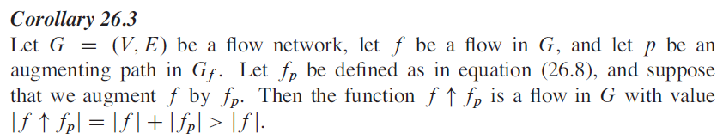
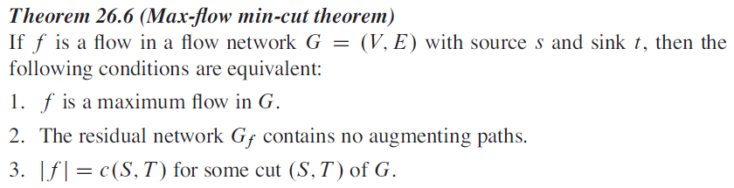
答案是肯定的：

Slide 30
问题10：任意的流值，都不会超过任意的割容量?
5
4
5
6
7
1
2
6
4
5
2
3
5

Slide 31
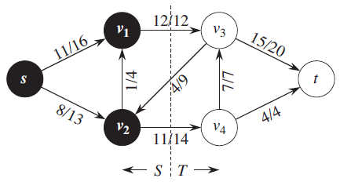

流网络的割
问题9：任何一个割的净流量是否一定等于f的值？

Slide 32
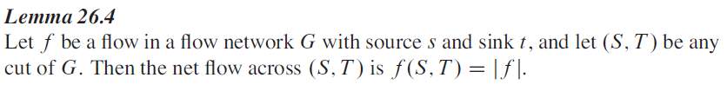

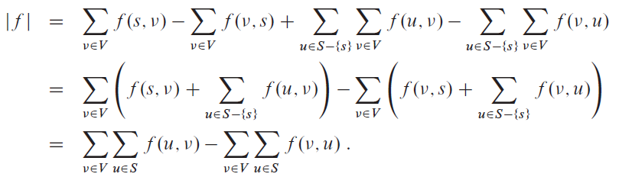
Yes：
流量守恒
证明：
Notes:
所有由S中节点发出的流的和 减去 所有进入S中节点的流的和
其中，S中节点发给S中其它节点的流和 等于 S中节点收到的S中其它节点发出的流和
因此才有书中证明结束前第二个刮号内的值是0.

Slide 33
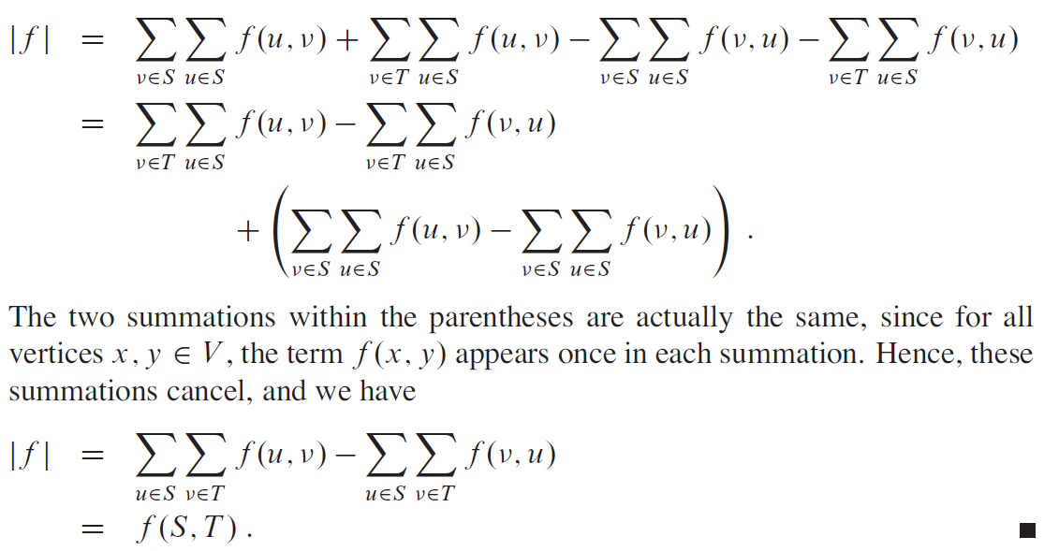
f(x,y)重复出现，结果为0
S和T是V的划分

Slide 34
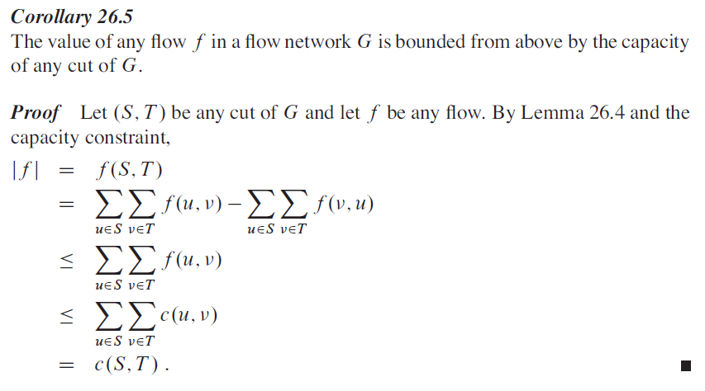
Notes:
任意割的净流量一定小于割容量

Slide 35
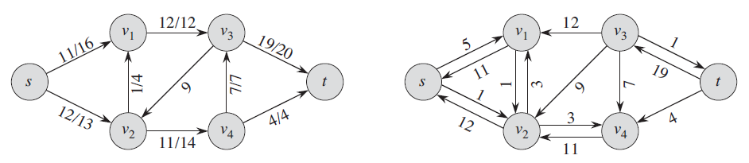
证明要点：找不到增广路径时，残存网络必定将网络进行了切割，这个切割的容量恰好就是这个流的值
T
T
S
S

Slide 36
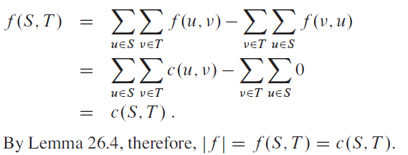
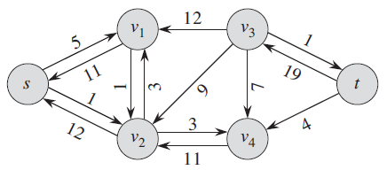
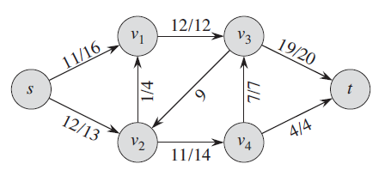

Slide 37
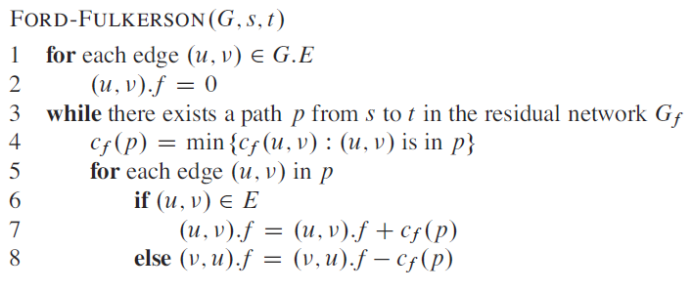
如何设计该方法的实现算法？
算法的正确性已经证明，但其效率取决于s-t路径的探知

Slide 38
General Scenario:
Labeling Algorithm (Ford & Fulkson)
Residual capacity:
e_{i,j}=C_{i,j}-F_{i,j}
e_{i,j}=F_{j,i} if F_{j,i}>0
e_{4,5}
3
5
4
e_{4,5}
e_{4,1}
e_{6,5}
4
e_{5,6}
e_{1,4}
2
e_{5,2}
2
e_{2,4}
4
1
e_{4,2}
e_{2,5}
6
e_{3,6}
3
5
e_{6,3}
e_{2,1}
e_{2,3}
3
2
3
e_{3,2}
edges in N
C_{i,j} is the capacity of edge (i,j)
F_{i,j} is the flow on edge (i,j)
edges in s(N), but not in N

Slide 39


Labeling Algorithm (Ford & Fulkson)
Initialization: set all flow to 0
N₁, all nodes connected to the source by an edge with positive residual capacity
Step 1: (1) Identify N1
(2) Label nodes in N1 as follows
residual capacity of (1,j)
[4,1]
3
e_{1,4}= 4 e_{4,1}= 0
4
5
[E_{j}, 1]
4
4
1
2
6
2
5
Denoting node 1
e_{1,2}= 5 e_{2,1}= 0
3
2
3
3
[5,1]

Slide 40
Labeling Algorithm (Ford & Fulkson)
N₂(j), all unlabelled nodes connected to node j by an edge with positive residual capacity
Step 2: (1) Identify N₂(j), based on the node j, with the smallest number, in N₁
(2) Label nodes in N2(j) as follows
Also N₂(4), in this case
min{E_{j}, residual capacity of (j,k)}
[4,1]
e_{4,5}= 3 e_{5,4}= 0
[2,2]
[E_{k}, j]
5
e_{1,4}= 4 e_{4,1}= 0
4
3
4
Denoting node j
4
1
2
e_{2,5}= 2 e_{5,2}= 0
6
2
(3) Do as above for all j
in N₁, and let
5
e_{1,2}= 5 e_{2,1}= 0
3
2
3
3
e_{2,3}= 3 e_{3,2}= 0
[3,2]
[5,1]
j

Slide 41
Labeling Algorithm (Ford & Fulkson)
Step 3: Continue as in step 2, forming N₃, N₄, N₅, ..., until:
(i) the sink has been labeled,
and the total flow is the
maximum flow (step 4)
or
N₃, the sink has been labeled
[4,1]
e_{4,5}= 3 e_{5,4}= 0
[2,2]
e_{1,4}= 4 e_{4,1}= 0
4
5
3
4
[3,3]
(ii) the sink has not been
labeled, but no other
nodes can be labeled
according to the rules
(note: the source is not labeled)
4
1
2
e_{2,5}= 2 e_{5,2}= 0
6
2
5
3
e_{1,2}= 5 e_{2,1}= 0
e_{3,6}= 3 e_{6,3}= 0
2
3
3
e_{2,3}= 3 e_{3,2}= 0
[3,2]
[5,1]
j

Slide 42
Situation after one full cycle:
[4,1]
[2,2]
4
5
[3,3]
The label of sink is [E_{n}, m] (here, [3,3]), where E_{n} is the amount of extra flow that can be made to reach the sink through a path π, and the path can be traced backward by node m
1
6
5
3
e_{1,2}= 5 e_{2,1}= 0
e_{3,6}= 3 e_{6,3}= 0
2
3
3
e_{2,3}= 3 e_{3,2}= 0
[3,2]
[5,1]
[4,1]
[2,2]
e_{i,j}, e_{j,i} are changed accordingly
and then return to step 1
4
5
[3,3]
1
2
6
5
3
e_{1,2}= 2 e_{2,1}= 3
e_{3,6}= 0 e_{6,3}= 3
2
3
3
e_{2,3}= 0 e_{3,2}= 3
[3,2]
[5,1]

Slide 43

Applying Labeling Algorithm
e_{4,5}= 3 e_{5,4}= 0
e_{1,4}= 4 e_{4,1}= 0
4
5
e_{3,6}= 4 e_{6,3}= 0
3
4
4
2
1
2
e_{2,5}= 2 e_{5,2}= 0
6
5
3
After the first cycle
e_{1,2}= 5 e_{2,1}= 0
e_{3,6}= 3 e_{6,3}= 0
2
3
3
e_{2,3}= 3 e_{3,2}= 0
[4,1]
e_{4,5}= 3 e_{5,4}= 0
[2,2]
At the beginning, setting all flow to 0
e_{1,4}= 4 e_{4,1}= 0
4
5
e_{3,6}= 4 e_{6,3}= 0
3
4
4
2
1
2
e_{2,5}= 2 e_{5,2}= 0
6
5
3
[3,3]
e_{1,2}= 5 e_{2,1}= 0
e_{3,6}= 3 e_{6,3}= 0
2
3
3
e_{2,3}= 3 e_{3,2}= 0
[5,1]
[3,2]

Slide 44
Applying Labeling Algorithm
e_{4,5}= 3 e_{5,4}= 0
After the first cycle
e_{1,4}= 4 e_{4,1}= 0
4
5
e_{3,6}= 4 e_{6,3}= 0
3
4
4
2
1
2
e_{2,5}= 2 e_{5,2}= 0
6
5
3
After the second cycle
e_{1,2}= 2 e_{2,1}= 3
e_{3,6}= 0 e_{6,3}= 3
2
3
3
e_{2,3}= 0 e_{3,2}= 3
[4,1]
e_{4,5}= 3 e_{5,4}= 0
[2,2]
e_{1,4}= 4 e_{4,1}= 0
4
5
e_{3,6}= 4 e_{6,3}= 0
3
4
4
2
We increased the flow of this path by 3
1
2
e_{2,5}= 2 e_{5,2}= 0
6
5
3
[2,5]
e_{1,2}= 2 e_{2,1}= 3
e_{3,6}= 0 e_{6,3}= 3
2
3
3
e_{2,3}= 0 e_{3,2}= 3
[2,1]
×

Slide 45
Applying Labeling Algorithm
e_{4,5}= 3 e_{5,4}= 0
We increased the flow of this path by 2
e_{1,4}= 4 e_{4,1}= 0
4
5
e_{3,6}= 2 e_{6,3}= 2
3
4
4
2
1
2
e_{2,5}= 0 e_{5,2}= 2
6
5
3
e_{1,2}= 0 e_{2,1}= 5
e_{3,6}= 0 e_{6,3}= 3
After the third cycle
2
3
3
e_{2,3}= 0 e_{3,2}= 3
[4,1]
e_{4,5}= 3 e_{5,4}= 0
[3,4]
After the second cycle
e_{1,4}= 4 e_{4,1}= 0
4
5
3
e_{3,6}= 2 e_{6,3}= 2
4
4
2
1
2
e_{2,5}= 0 e_{5,2}= 2
6
5
3
[2,5]
e_{1,2}= 0 e_{2,1}= 5
e_{3,6}= 0 e_{6,3}= 3
2
3
3
e_{2,3}= 0 e_{3,2}= 3
[2,5]
×

Slide 46
Applying Labeling Algorithm
We increased the flow of this path by 2
e_{4,5}= 1 e_{5,4}= 2
e_{1,4}= 2 e_{4,1}= 2
4
5
e_{5,6}= 0 e_{6,5}= 4
3
e_{2,5}= 2 e_{5,2}= 0
4
4
After the fourth cycle
The sink has not been labeled, so the final result reached
1
2
e_{2,5}= 0 e_{5,2}= 2
6
2
5
3
e_{1,2}= 0 e_{2,1}= 5
e_{3,6}= 0 e_{6,3}= 3
2
3
3
e_{2,3}= 0 e_{3,2}= 3
[2,1]
e_{4,5}= 1 e_{5,4}= 2
[1,4]
After the third cycle
e_{1,4}= 2 e_{4,1}= 2
4
5
3,2
e_{3,6}= 0 e_{6,3}= 4
4,2
e_{2,5}= 2 e_{5,2}= 0
2,2
4,4
1
2,0
e_{2,5}= 0 e_{5,2}= 2
6
5,5
×
e_{1,2}= 0 e_{2,1}= 5
3,3
3,3
e_{3,6}= 0 e_{6,3}= 3
2
e_{2,3}= 0 e_{3,2}= 3
3
[1,5]
×

Slide 47

Correctness of Labeling Algorithm
Any path π in N from the source to the sink begins with a node in M₁ and ends with a node in M₂.
Let K consists of all edges in N that connect a node in M₁ with a node in M₂. So, there must be a edge (i,j), with i is the last node in π that belongs to M₁, and j in M₂. So, (i,j) is in K, and K is a cut.
For all such (i,j), the final flow produced by the algorithm must result in (i,j) carrying its full capacity, otherwise, the positive excess capacity will cause j labeled, contradiction.
Algorithm stops at Step 4
[2,1]
[1,4]
e_{4,5}= 1
4
5
e_{1,4}= 2
3,2
e_{3,6}= 0
4,2
e_{2,5}= 2
2,2
4,4
1
2,0
e_{2,5}= 0
6
5,5
×
e_{1,2}= 0
3,3
3,3
e_{3,6}= 0
2
e_{2,3}= 0
3
[1,5]
×
M₂
M₁
edges in K

Slide 48
Chatty tenants and the cloud network sharing problem [NSDI'13]
Preliminaries
Multi-tenant Datacenters: Public/Private cloud datacenters
Tenants: users renting virtual machines
Requirements for network sharing [FairCloud, SIGCOMM’12]
Req. 1: Min Bandwidth Guarantee
Tenants want predictable performance/cost
Req. 2: High Utilization
Utilize sparse resource as much as possible
Req. 3: Proportionality
Not all flows are equal; some pay more

Slide 49
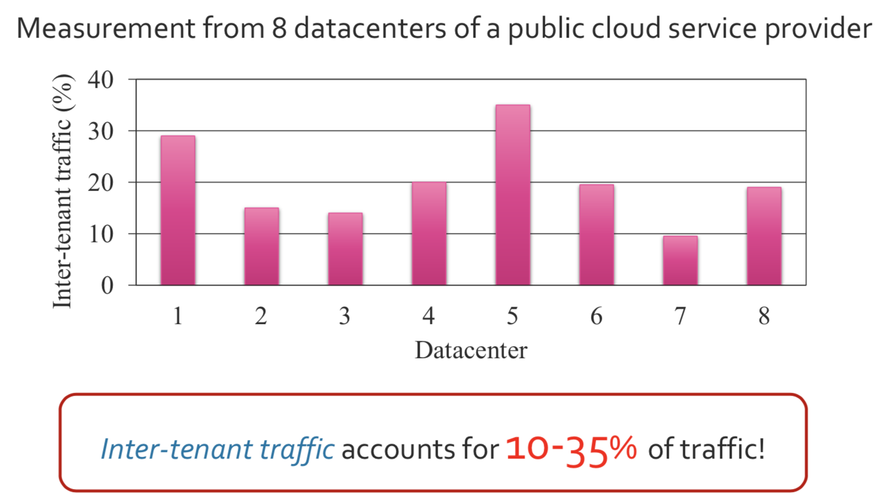
Prevalent of inter-tenant traffic
Inter-tenant traffic leads to richer communication pattern and makes minimum bandwidth guarantee harder!
When new tenants arrive, how to deploy their VMs to ensure their Min Bandwidth Guarantee and each physical link is not over-used?
A max-flow approach

Slide 50
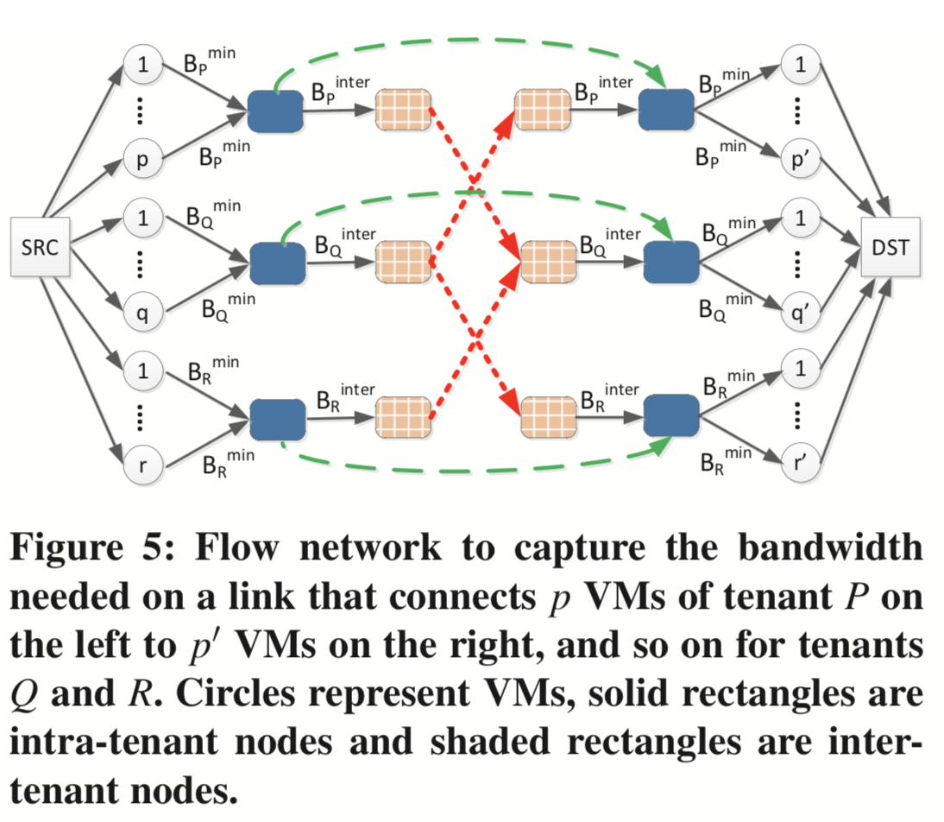
B_{p}^{min} : min bandwidth guarantee for each VM of tenant p.
B_{p}^{inter} : min bandwidth guarantee between tenant p and all the other tenants.
All dashed edges in the right figure have infinity capacities.
Applying a max-flow algorithm to the right figure can examine whether the total traffic (the max-flow value) exceeds the capacity of the physical link.

Slide 51

工作分配问题
问题表述
一个机构有m个工作位置,有n个申请者。每个申请者适合位置中的一部分。
是否有可能给每个申请者安排合适的位置？
如果不能，最多可以安排多少人？
怎么安排？

Slide 52
Matching
s₁
b₁
s₁
b₁
G上的最大匹配
s₂
b₂
s₂
b₂
s₃
b₃
s₃
b₃
s₄
b₄
s₄
b₄
s₅
b₅
s₅
b₅
图G

Slide 53
用网络流来解两步图最大匹配问题
s₁
b₁
s₂
b₂
x
s₃
b₃
y
s₄
b₄
Labeling algorithm for max flow is used in the network to compute the matching
s₅
b₅
with each capacity set to 1

Slide 54
Hall’s Marriage Theorem
Let R be a relation from A to B. Then there exists a complete matching M if and only if for each X⊆A, |X|≤|R(X)|

Slide 55
Open topics:
1,写出标号算法。用标号法求解以下流网络的最大流
3
6
5
7
7
7
1
3
4
3
2
4
6
5
6
2,利用最大流算法，证明hall定理

Slide 56
课外作业
TC Ex.26.1: 1, 2, 6, 7
TC Ex.26.2: 2, 6, 8, 10, 12, 13
TC Ex.26.3: 3
TC Prob.26: 1, 2

Slide 57
Hall’s Marriage Theorem
Let R be a relation from A to B. Then there exists a complete matching M if and only if for each X⊆A, |X|≤|R(X)|
Proof:
⇒ Obviously
⇐ |A| = n
add supersource and supersink, if max flow value is |A|, then we get it.
If min cut has value |A|, we get it.

Slide 58
Hall’s Marriage Theorem
Suppose K is a minimal cut.
We can consider all edges in K as in three sets:
S₁: those begin at supersource; |s1|=m
S₂: those correspond to pairs in R;
S₃: those end at supersink.
s1
x
y
s2
s3
A
B

Slide 59
Hall’s Marriage Theorem
Remove S1:
|A1| = m
s1
x
y
K is the min cut,
No edges in K
begin from A1
s2
s3
|A2| = n-m
B2 = R(A2)
|B2| >= |A2| = n-m
precondition
If m = n, s1=n, we get it
X通过A2集合元素至少和n-m个B2元素相连
Notes:
保留A1到B中的一条边并不会导致X和Y的连通。

Slide 60
Hall’s Marriage Theorem
Remove S2: suppose |S2| = r
|S1|=m
X至少和n-m
个B2元素相连
s1
x
y
s2
s3
if |S3|=0, |S2| = n-m, |K|= |S1|+|S2| = n
X is still connected to at least (n-m)-r elements of B
if |S3|>0
Notes:
S3如果还有边，X和Y就一定相连。

Slide 61
Hall’s Marriage Theorem
K is a min cut:
X is still connected to at least (n-m)-r elements of B
|S3| >= (n-m)-r
s1
x
y
s2
s3
|K| = |S1|+|S2|+|S3| >= m + r+ n-m-r = n

Slide 62
Proof of Hall’s Theorem:
|K| >= n, So, the following greens is one of the min cut.
So , the following reds is one of the complete matching
x
y

