Slide 1
Lexicographical order VS canonical order
凌弘毅 151220060

Slide 2
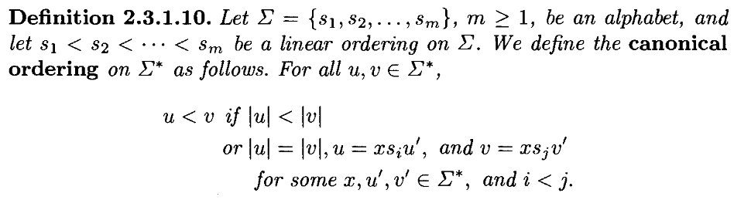
这个序和字典序的区别在哪里？
问题：如何利用这个形式体系来定义字典序？

Slide 3
Lexicographical order
Consider a finite set A, often called alphabet, which is totally ordered. The lexicographic order is a total order on the sequences of elements of A, often called words on A, which is defined as follows.
Given two different sequences of the same length, a₁a₂...a_{k} and b₁b₂...b_{k}, the first one is smaller than the second one for the lexicographical order, if a_{i}<b_{i} (for the order of A), for the first i where a_{i} and b_{i} differ.
To compare sequences of different lengths, the shorter sequence is usually padded at the end with enough "blanks"

Slide 4
Difference
当两个word的长度相同的时候, Lexicographical order 和 canonical order 是一样的。
当两个word长度不同的时候, 判断方式不一样。

Slide 5
example
Apple , zoo
Lexicographical order：apple < zoo
canonical order : zoo < apple

Slide 6
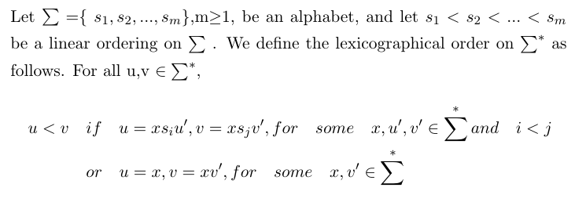
Definition for Lexicographical order

Slide 7
Thank you

