Slide 1
Brooks’ theorem
171870691 张廷昊

Slide 2
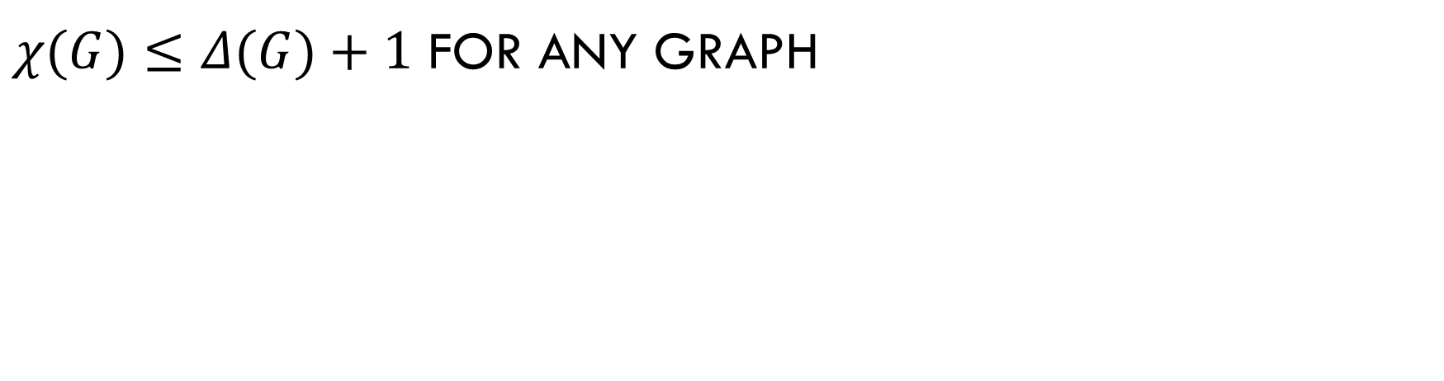
$χ(G)≤Δ(G)+1$ for any graph

Slide 3
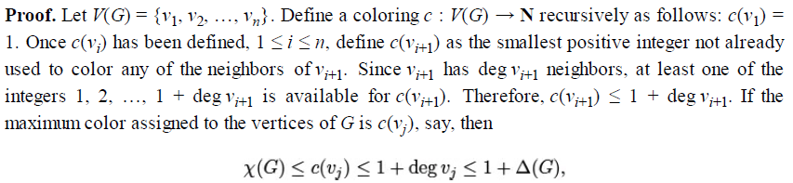

Slide 4

Assumption
$$Δ\left(G\right)≥3$$
Method
Induction

Slide 5

Induction ON $Δ .$
$For each Δ$, Induction on N
Inductive hypothesis
For all $Δ^{′}<Δ$ , theorem holds

Slide 6
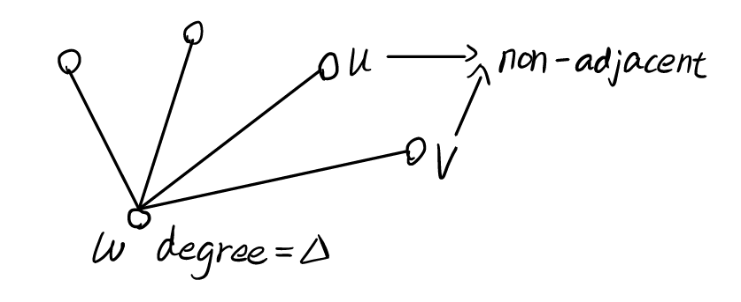

Induction on N
Basic step $n=Δ+1$
Same color for two NON-ADJACNED vertices

Slide 7
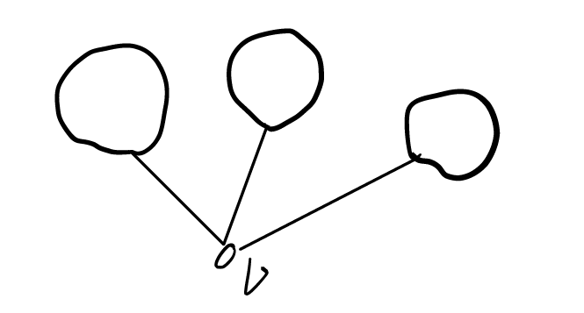

For $n≥Δ+2$
Case 1
There is a vertex$v$ such that$G−v$ is disconnected.

Slide 8
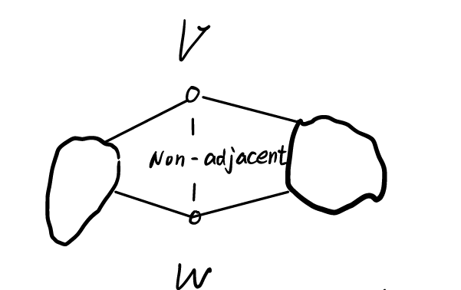
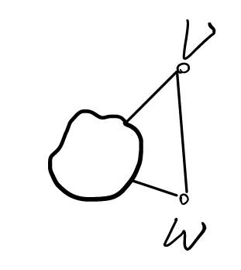
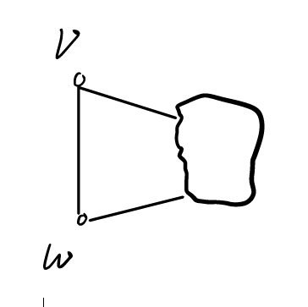

For $n≥Δ+2$
Case 2
$G−v$ is connected for all$v$, but there are two non-adjacent vertices $v$and $w$
such that $G−v−w$ is disconnected.
G1
G2

Slide 9
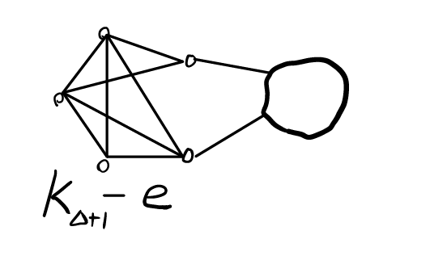
Special condition

Slide 10
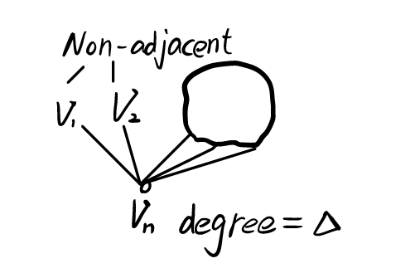

For $n≥Δ+2$
Case 3
$G−v−w$ is connected for every pair of non-adjacent vertices$v$and$w$.

Slide 11
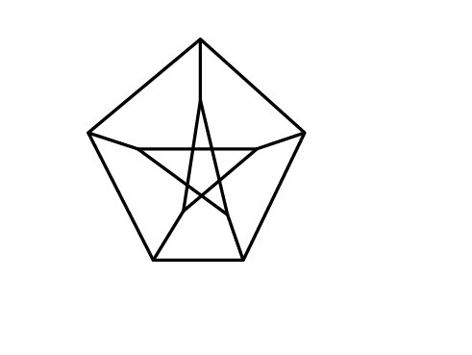

PETERSON GRAPH
$$χ(G)≤3$$

