Slide 1
Generation Function
张灵毓 171240524

Slide 2
CONTENTS
Solving the recurrence
1
Definition
4
Examples
2
3
Operations on generating functions

Slide 3

In mathematics, a generating function is a way of encoding an infinite sequence of numbers (a_{n}) by treating them as the coefficient of a power series.
对于一个无穷的序列(a_{n}) ，构造如下函数：
$G\left(Z\right)=a_{0}$ + $a_{1}z+a_{2}z^{2}+…=\sum_{k=0}^{∞}{a_{k}z^{k}}$
称函数G(z)是序列(a_{n})的生成函数.
生成函数有:
Ordinary generating functions, exponential generating functions, Lambert series, Bell series, and Dirichlet series
Definition

Slide 4


Ordinary generating function (OGF)
The ordinary generating function of a sequence a_{n} is
$$G\left(a_{n};x\right)=\sum_{n=0}^{∞}{a_{n}x^{n}}$$
Usually, we do not evaluate the generating function on any particular value, the numbers we want to count are the coefficients carried by the terms in the formal power series.
So why define such a function?
The true power of generating functions comes from the various algebraic operations that we can perform on these generating functions
点击编辑内容
单击此处编辑您要的内容，建议您在展示时采用微软雅黑字体，本模版所有图形线条及其相应素材均可自由编辑、改色、替换。更多使用说明和作品请详阅模版最末的使用手册。更多使用说明和作品请详阅模版最末的使用手册。更多使用说明和作品请详阅模版最末的使用手册。更多使用说明和作品请详阅模版最末的使用手册。
The ordinary generating function can be generalized to arrays with multiple indices
$$G\left(a_{m,n};x,y\right)=\sum_{m,n=0}^{∞}{a_{m,n}}x^{m}y^{n}$$

Slide 5
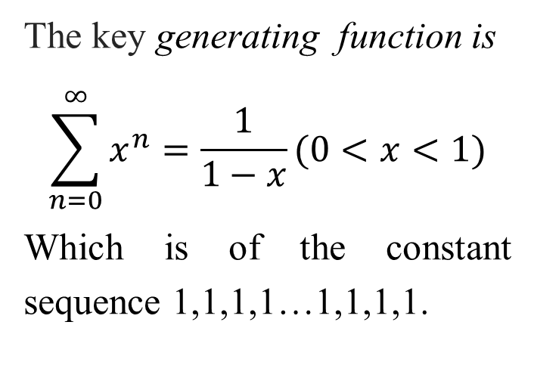
The key generating function is
$$\sum_{n=0}^{∞}{x^{n}=\frac{1}{1−x}(0<x<1)}$$
Which is of the constant sequence 1,1,1,1…1,1,1,1.
Examples

Slide 6
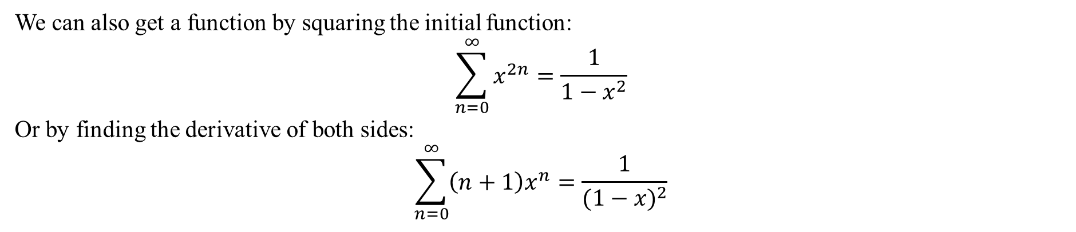
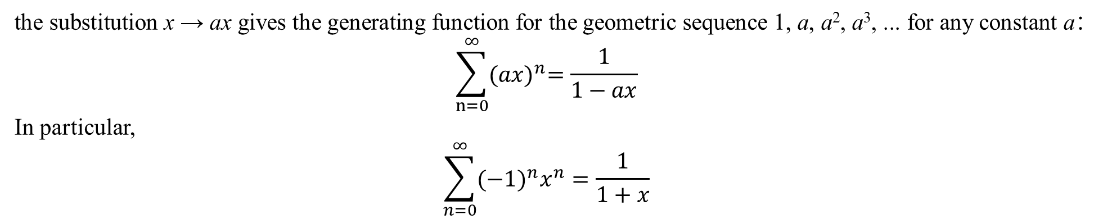
Derived Functions
the substitution x → ax gives the generating function for the geometric sequence 1, a, a², a³, ... for any constant a：
$$\sum_{n=0}^{∞}{{(ax)}^{n}=\frac{1}{1−ax}}$$
In particular,
$$\sum_{n=0}^{∞}{{(−1)}^{n}x^{n}}=\frac{1}{1+x}$$
We can also get a function by squaring the initial function:
$$\sum_{n=0}^{∞}{x^{2n}=\frac{1}{1−x^{2}}}$$
Or by finding the derivative of both sides:
$$\sum_{n=0}^{∞}{\left(n+1\right)x^{n}=\frac{1}{{(1−x)}^{2}}}$$

Slide 7
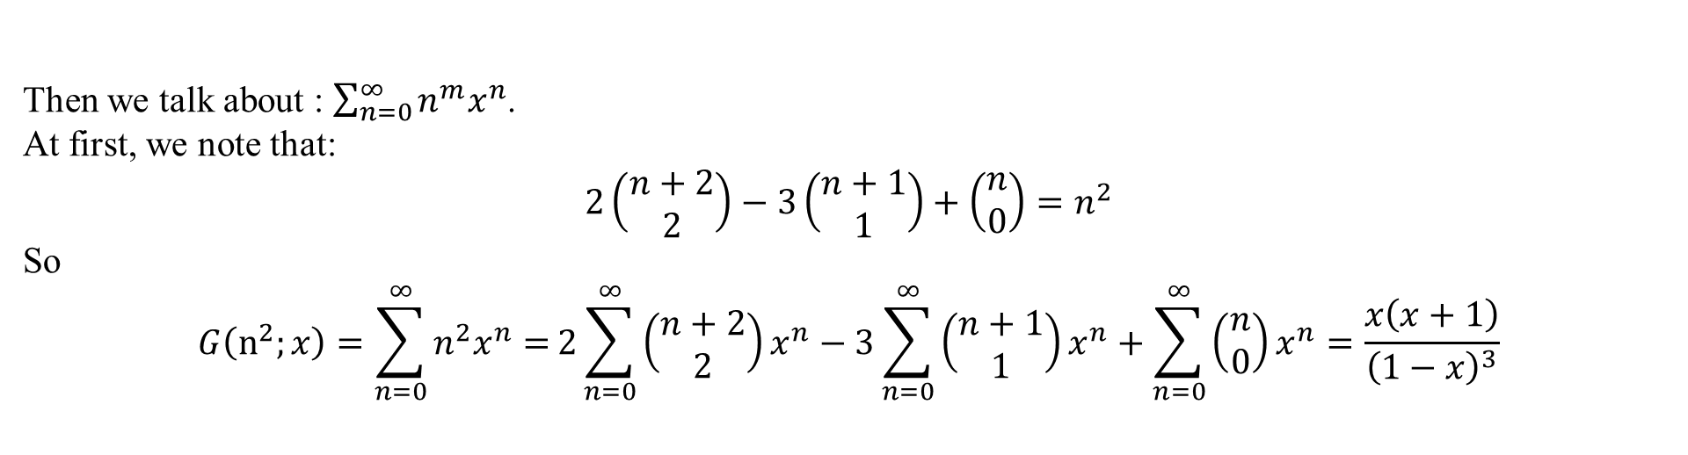
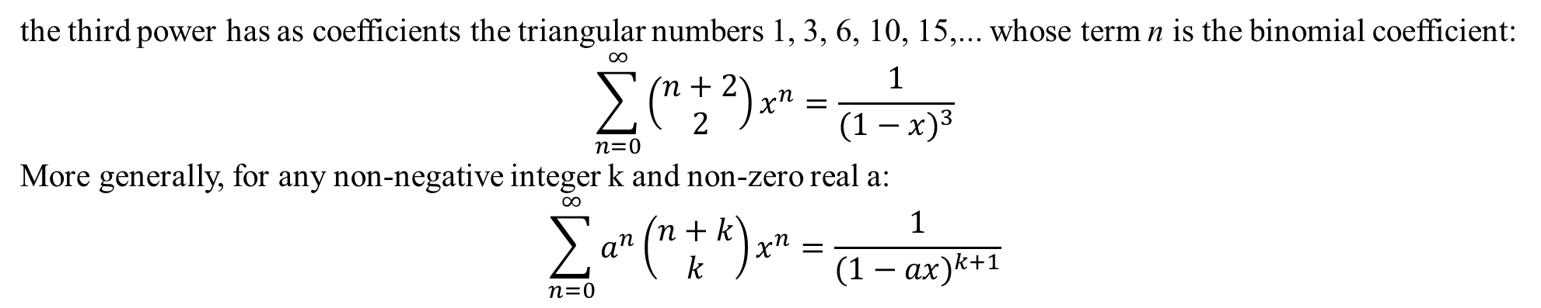
Derived Functions
the third power has as coefficients the triangular numbers 1, 3, 6, 10, 15,... whose term n is the binomial coefficient:
$$\sum_{n=0}^{∞}{\left(\begin{matrix}n+2 \\ 2\end{matrix}\right)x^{n}=\frac{1}{{(1−x)}^{3}}}$$
More generally, for any non-negative integer k and non-zero real a:
$$\sum_{n=0}^{∞}{a^{n}\left(\begin{matrix}n+k \\ k\end{matrix}\right)x^{n}}=\frac{1}{{(1−ax)}^{k+1}}$$
02
Then we talk about : $\sum_{n=0}^{∞}{n^{m}x^{n}}$.
At first, we note that:
$$2\left(\begin{matrix}n+2 \\ 2\end{matrix}\right)−3\left(\begin{matrix}n+1 \\ 1\end{matrix}\right)+\left(\begin{matrix}n \\ 0\end{matrix}\right)=n^{2}$$
So
$$G\left(n^{2};x\right)=\sum_{n=0}^{∞}{n^{2}x^{n}=}2\sum_{n=0}^{∞}{\left(\begin{matrix}n+2 \\ 2\end{matrix}\right)x^{n}}−3\sum_{n=0}^{∞}{\left(\begin{matrix}n+1 \\ 1\end{matrix}\right)x^{n}}+\sum_{n=0}^{∞}{\left(\begin{matrix}n \\ 0\end{matrix}\right)x^{n}}=\frac{x\left(x+1\right)}{{\left(1−x\right)}^{3}}$$
单击此处编辑您要的内容，建议您在展示时采用微软雅黑字体，本模版所有图形线条及其相应素材均可自由编辑、改色、替换。

Slide 8

Derived Functions
By induction(for integer m>0):
$$n^{m}=\sum_{j=0}^{m}{\{\begin{matrix}m \\ j\end{matrix}\}\frac{n!}{\left(n−j\right)!}}$$
And $\{\begin{matrix}m \\ j\end{matrix}\}$ is Stirling numbers of the second kind. Which means the number of partitions of an n-element set into k classes.(we have done this problem in hw3)
And we also know:
$$\sum_{n≥0}{\frac{n!}{\left(n−j\right)!}z^{n}}=j!\frac{z^{j}}{{(1−z)}^{j+1}}$$
$$\sum_{i=0}^{k}{(\begin{matrix}k \\ i\end{matrix})\frac{{(−1)}^{k−i}}{{(1−z)}^{i+1}}}=\frac{z^{k}}{{(1−z)}^{k+1}}$$
Therefore(可以用数学知识推导出来…orz).
$$\sum_{n≥0}{n^{m}z^{n}}=\sum_{j=0}^{m}{\{\begin{matrix}m+1 \\ j+1\end{matrix}\}\frac{{(−1)}^{m−j}j!}{{(1−z)}^{j+1}}}$$

Slide 9
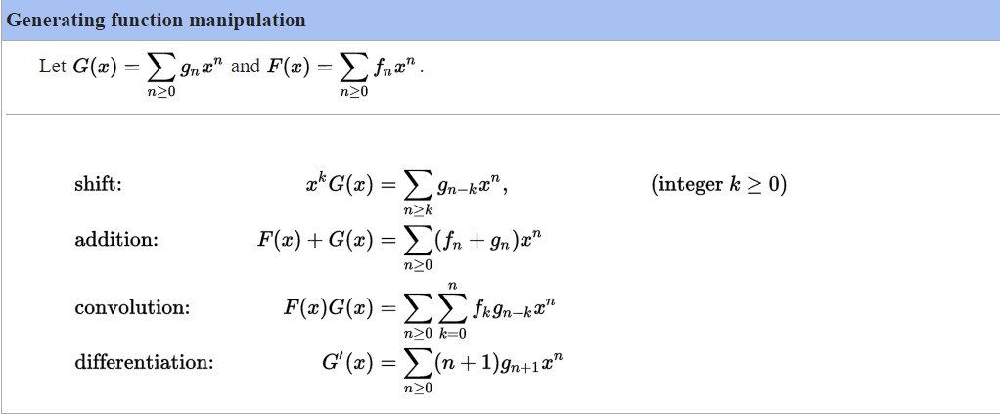
Operations on generating functions

Slide 10


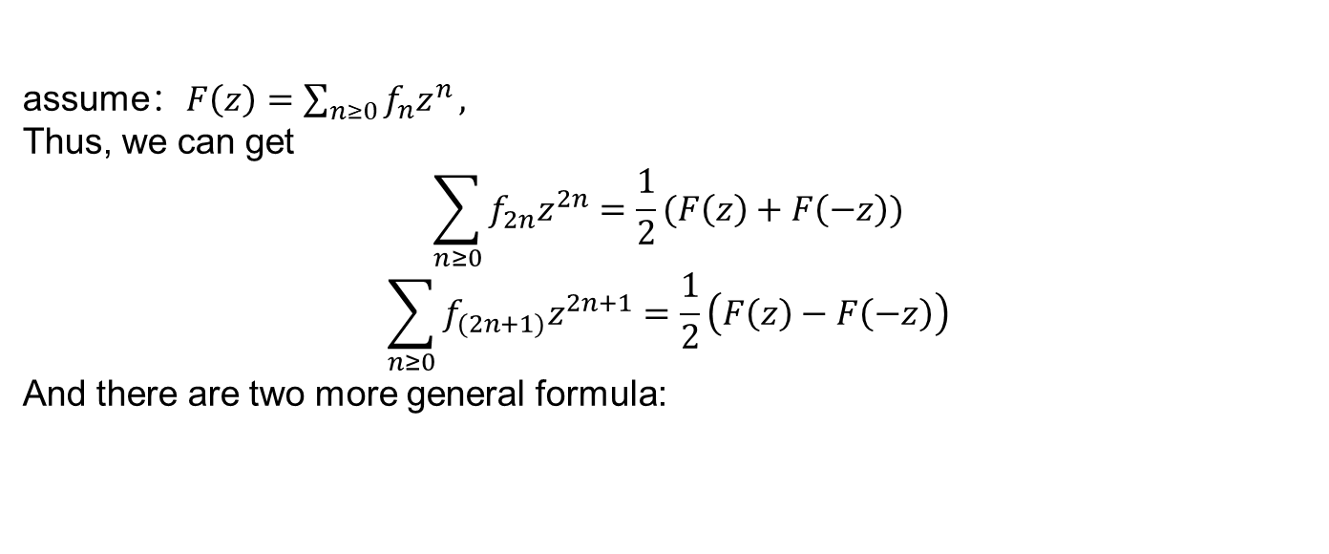
Enumerating arithmetic progressions of sequences
assume：$F\left(z\right)=\sum_{n≥0}{f_{n}z^{n}},$
Thus, we can get
$$\sum_{n≥0}{f_{2n}z^{2n}}=\frac{1}{2}(F\left(z\right)+F\left(−z\right))$$
$$\sum_{n≥0}{f_{(2n+1)}z^{2n+1}}=\frac{1}{2}\left(F\left(z\right)−F\left(−z\right)\right)$$
And there are two more general formula:

Slide 11
Show solving Hanoi
Steps:
①define generation function G(x) according to recurrence.
②use mathematic method to build equation and get G(x).
③expand the G(x) and find the results.
Solving the recurrence

Slide 12

Hanoi
Assume that h(n) is the times of moving plates
$$h\left(1\right)=1$$
$$h\left(2\right)=2h\left(1\right)+1$$
$$h\left(3\right)=2h\left(2\right)+1$$
Therefore
$$h\left(n\right)=\left\{\begin{aligned}2h\left(n−1\right)+1 n>1 \\ 1 n=1\end{aligned}\right.$$
Define
$$G\left(x\right)=\sum_{k=1}^{∞}{{h\left(k\right)x}^{k}}(x<1)$$
Then
$$G\left(x\right)−2xG\left(x\right)=h\left(1\right)x+h\left(2\right)x^{2}+…−2h\left(1\right)x^{2}−2h\left(2\right)x^{3}−…$$
Thus
$$\left(1−2x\right)G\left(x\right)=x+x^{2}+x^{3}+…=\frac{x}{1−x}$$
$$G\left(x\right)=\frac{x}{(1−x)(1−2x)}=\frac{1}{1−2x}−\frac{1}{1−x}=\sum_{n=0}^{∞}{{\left(2x\right)}^{n}}−\sum_{n=0}^{∞}{x^{n}}=\sum_{n=0}^{∞}{{\left(2^{n}−1\right)x}^{n}}$$
So
$$h\left(n\right)=2^{n}−1$$
标题一
标题一
标题一

Slide 13
致谢

