Slide 1
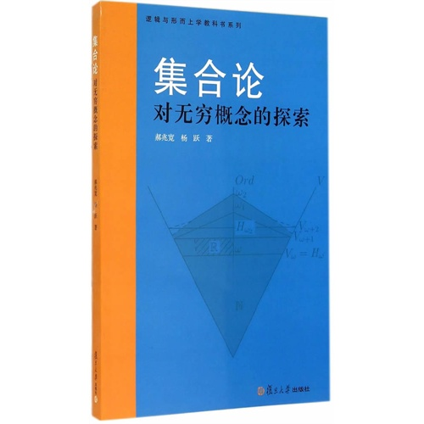
选择公理及其等价性命题 Axiom of choice and the Equivalents
——从入门到放弃

Slide 2
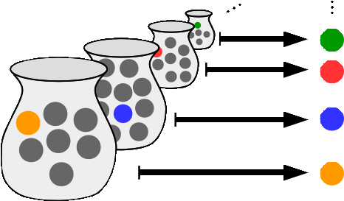
For any set X of nonempty sets, there exists a choice function f defined on X，such that for all Y ∈ X one has f(Y) ∈ Y。
对于任何一个由非空集合构成的集合X，存在一个定义在X上的选择函数，这个函数将一个集合映射到这个集合的一个元素上。
对于每一个非空的集合，我们一定可以从中选择一个元素

Slide 3
对于确定元素的集合，可以用ZF公理集合论推导出选择公理。
选择公理主要应用于无穷个不确定集合，不知道每个集合中具体的元素时，选择公理指出此时仍然可以对元素进行提取。
for any (even infinite) collection of pairs of shoes, one can pick out the left shoe from each pair to obtain an appropriate selection, but for an infinite collection of pairs of socks (assumed to have no distinguishing features), such a selection can be obtained only by invoking the axiom of choice.

Slide 4
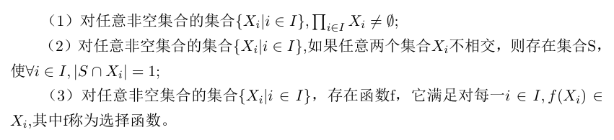
选择公理的三种表示方法：

Slide 5
良序公理
良序集：每一个非空子集都有最小元（严格小于其他所有元素）
良序公理：每一个集合都可以通过定义一个序的关系，成为一个良序集。
*此公理与选择公理等价

Slide 6

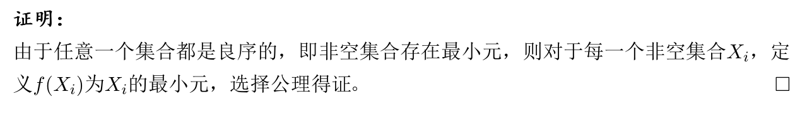

不会！
http://www.mn.uio.no/math/tjenester/kunnskap/kompendier/acwozl.pdf

Slide 7
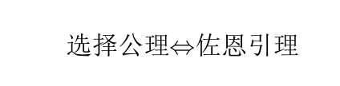
佐恩引理
偏序集的链：偏序集的一个全序子集。
佐恩引理：如果偏序集X的每个链都有上界，则X有极大元。
*此定理也与选择公理等价！
http://www.mn.uio.no/math/tjenester/kunnskap/kompendier/acwozl.pdf

Slide 8
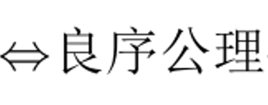

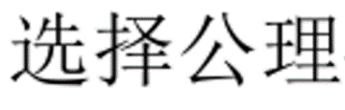

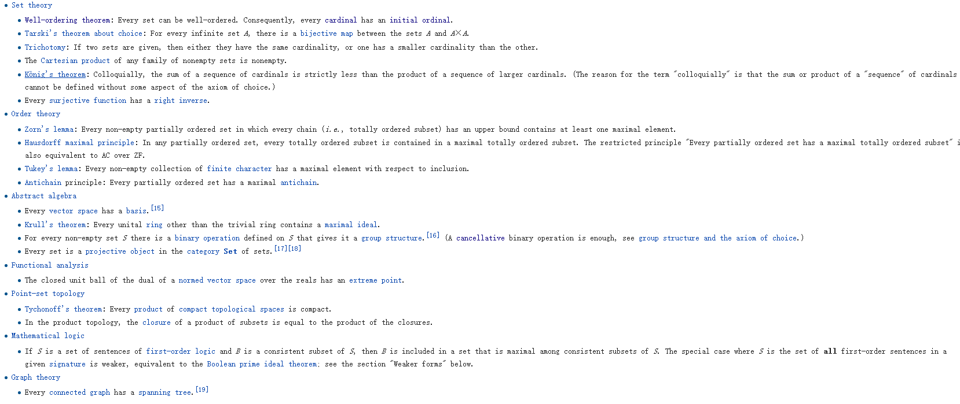

Slide 9
在有限集合的范畴里，选择公理可以完全由ZF推出。涉及到无穷概念时，没有选择公理很多结论都无法得到。
Not every situation requires the axiom of choice. For finite sets X, the axiom of choice follows from the other axioms of set theory. In that case it is equivalent to saying that if we have several (a finite number of) boxes, each containing at least one item, then we can choose exactly one item from each box. Clearly we can do this: We start at the first box, choose an item; go to the second box, choose an item; and so on. The number of boxes is finite, so eventually our choice procedure comes to an end. The result is an explicit choice function: a function that takes the first box to the first element we chose, the second box to the second element we chose, and so on. (A formal proof for all finite sets would use the principle of mathematical induction to prove "for every natural number k, every family of k nonempty sets has a choice function.") This method cannot, however, be used to show that every countable family of nonempty sets has a choice function, as is asserted by the axiom of countable choice. If the method is applied to an infinite sequence (X_{i} : i∈ω) of nonempty sets, a function is obtained at each finite stage, but there is no stage at which a choice function for the entire family is constructed, and no "limiting" choice function can be constructed, in general, in ZF without the axiom of choice.

Slide 10
ZF体系中，一个集合是无限的当且仅当每一个自然数都可以找到这个集合的一个子集和他等势。在ZFC中，只需他拥有一个可数的无穷子集。
ZF体系中，一个集合是无限的当且仅当他的幂集的幂集有一个和自己等势的真子集。在ZFC中，只需其自身拥有一个和自己等势的真子集。
A set is infinite if and only if for every natural number the set has a subset whose cardinality is that natural number.If the axiom of choice holds, then a set is infinite if and only if it includes a countable infinite subset.
In ZF, a set is infinite if and only if the powerset of its powerset is a Dedekind-infinite set, having a proper subset equivalent to itself.^{[1]} If the axiom of choice is also true, infinite sets are precisely the Dedekind-infinite sets.

Slide 11

Criticism to axiom of choice
选择公理从来只能说明“存在”，却无法构造，也可以说选择函数是没有定义的。
选择公理会推导出荒谬的结论，比如巴拿赫-塔斯基悖论
但不可否认选择公理确实能推导出很多有用的结论，解决很多问题。
Can a ball be decomposed into a finite number of point sets and reassembled into two balls identical to the original?

Slide 12
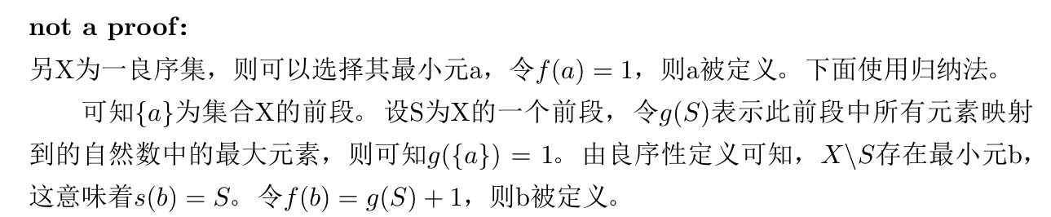

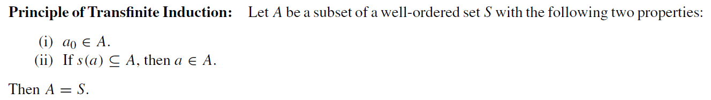
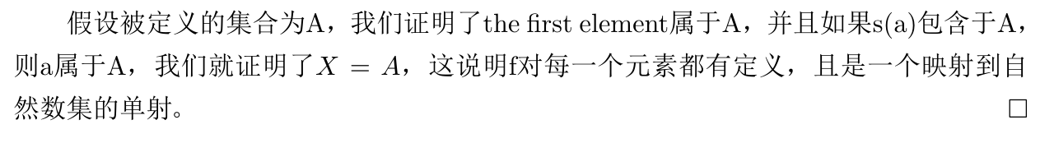
是不是所有良序集都是可数集？

Slide 13
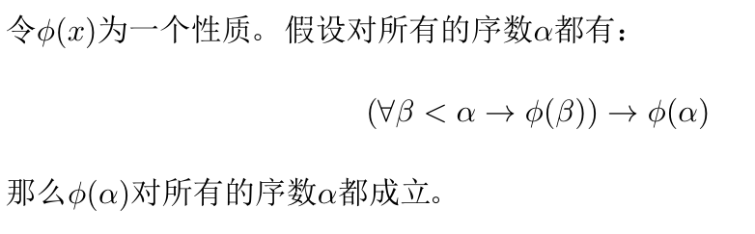
超穷归纳原理：
不同于普通归纳定义在自然数集上面，超穷归纳定义在序数上面。
上面的证明用了超穷归纳，所以对自然数的映射不成立。

Slide 14
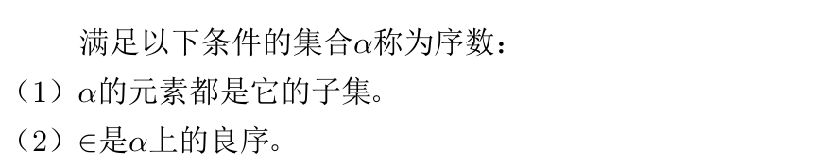

序数
序数有有穷序数和无穷序数之分
自然数恰好就是有穷序数

